Slide 2
Faculty Presenter

Slide 3
Faculty Disclosures

Slide 4
Learning Objectives

Slide 5
FPIES Epidemiology

Slide 6
Food Protein-Induced Enterocolitis Syndrome

Slide 7
Natural History: Prevalence and Food Triggers

Slide 8
Common Food Triggers

Slide 9
FPIES Clinical Phenotypes

Slide 10
Chronic vs Acute Presentation: Determined by frequency and dose of the ingested food

Slide 11
FPIES Phenotypes (continued)

Slide 12
Natural History: Resolution

Slide 13
Diagnosing FPIES

Slide 15
Acute FPIES diagnostic criteria

Slide 16
Diagnostic criteria for patients with possible chronic FPIES

Slide 17
FPIES Differential Diagnosis

Slide 18
Distinguishing FPIES, FPIAP, and FPE

Slide 19
Diagnostic Strategies

Slide 20
Oral Food Challenge: What Clinicians Need to Know

Slide 21
Oral Food Challenge (continued)

Slide 22
Acute and Long-Term Management

Slide 23
Case Study 1—Diagnosing FPIES

Slide 24
What are the signs and symptoms upon presentation that will help to diagnose this patient?

Slide 25
Case Study 1—Explanation

Slide 27
Treatment Strategies & Management

Slide 28
Acute Management

Slide 29
Case Study 2—Selecting foods for introduction

Slide 30
What is the next step to help the parents provide the necessary nutritional requirements for this young infant?

Slide 31
Case Study 2—Explanation

Slide 32
Case Study 2—Explanation (continued)

Slide 33
Long-term Management of FPIES

Slide 34
Long-term Nutritional Management

Slide 35
Nutritional Daily Management

Slide 36
Management While Breastfeeding

Slide 37
Selecting Safe Nutritional Alternatives

Slide 38
Selecting Safe Nutritional Alternatives

Slide 39
Peanut FPIES

Slide 40
Case Study 3— Timing of Reintroduction of Offending Food

Slide 41
When is the optimal time to reintroduce the food that has triggered FPIES?

Slide 42
Case Study 3—Explanation

Slide 43
New Areas of Research in FPIES

Slide 44
Immune Mechanisms of FPIES

Slide 45
FPIES in Adults!

Slide 46
Characteristics in Children vs Adults

Slide 47
Unmet Needs-I

Slide 48
Unmet Needs-II

Slide 49
Federal-Funded Research Is Lacking

Slide 50
Key Takeaways

Slide 51
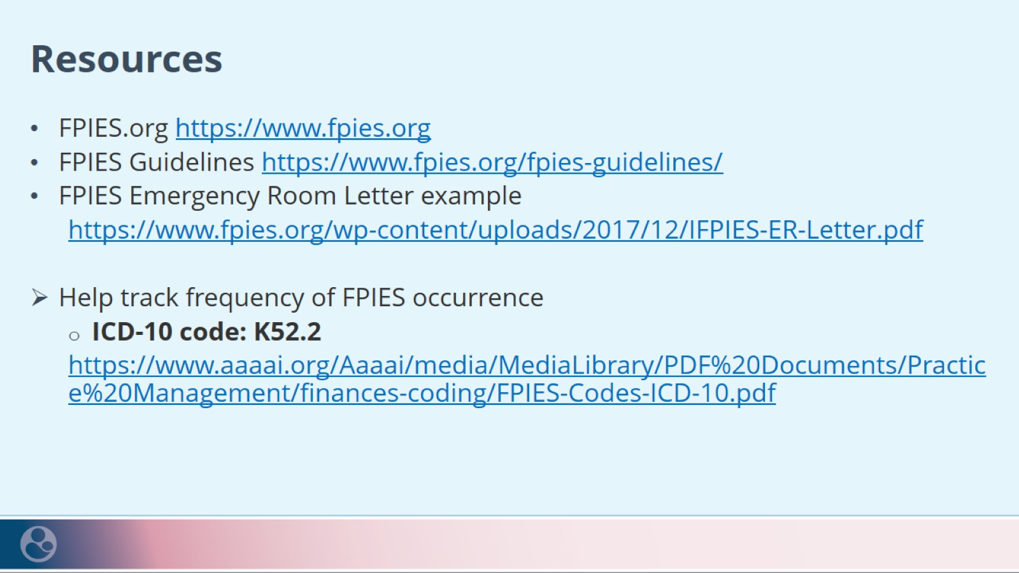
Resources

