Slide 2
Disclosures:
Role | Sponsors
Research funds to Yale (principal investigator) | Ferring Pharmaceuticals Mallinckrodt Pharmaceuticals Pfizer Pharmaceuticals Prolacta Bioscience Grant from Beth Israel Deaconess Medical Center with funds originating from Mead Johnson Grant from Weill Cornell with in-kind product from Mead Johnson
Consulting | Baxter
Role | Sponsors
Research funds to Yale (principal investigator) | Allen Foundation Hauptmann Fund National Institutes of Health
Consulting | Vermont Oxford Network
Volunteer | HMBANA Executive Board Mother’s Milk Bank of the Northeast
Authorship | Nutritional Care of the Preterm Infant published by Karger with book distribution by Mead Johnson; UpToDate
Attendee | Conferences with indirect, less often direct, formula company and other industry sponsors
Controversial research | Pediatrician interaction with formula industry; detailing the cost of breastfeeding

Slide 3

Goals of nutrition post-hospital discharge
Neurodevelopment

Slide 4

Goals of nutrition post-hospital discharge
Neurodevelopment
Growth

Slide 5
Goals of nutrition post-hospital discharge
Neurodevelopment
Growth
Health

Slide 6
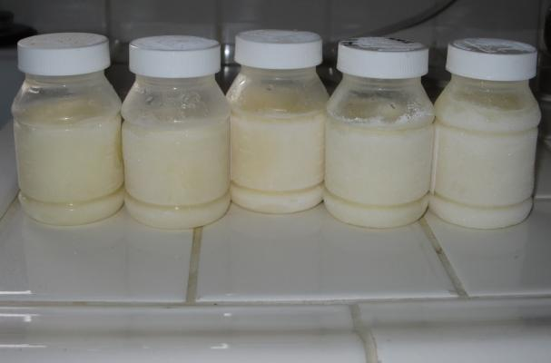
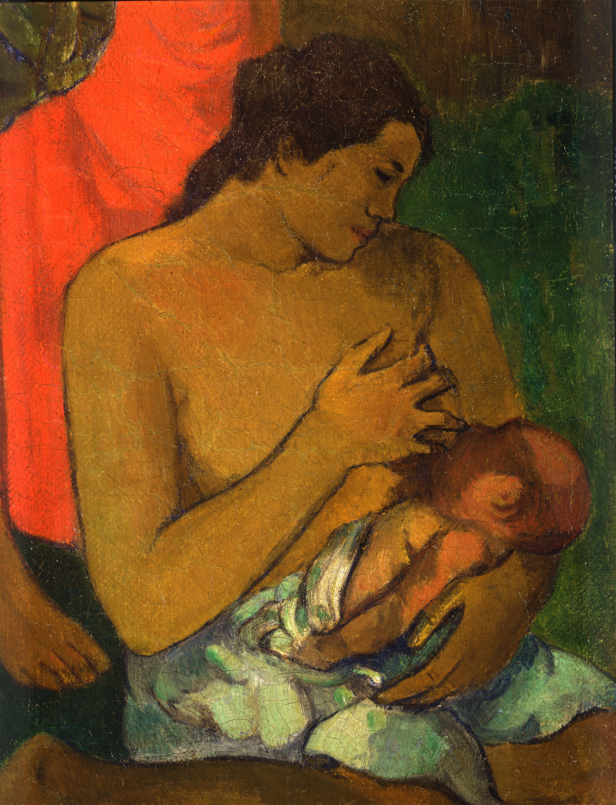
Goals of nutrition post-hospital discharge
Maximize proportion
and duration of
maternal milk feeds
Achieve family’s
feeding goal
Keep it simple

Slide 7

Enriched Formula Studies
Post-discharge formula (enriched formula, transitional formula) versus standard term formula
Preterm formula versus standard term formula
Aggett P et al 2006

Slide 8
Neurodevelopment: Enriched post-discharge formula not associated with better outcomes
Postdischarge formula compared with standard term formula after hospital discharge
Preterm formula compared with standard term formula after hospital discharge
Young et al 2016

Slide 9
Neurodevelopment: no benefit of enriched maternal milk
Study | Population | Intervention | Outcomes reaching statistically significance
O’Connor et al 2008 | 39 ≥80% mother’s milk and 750-1800 g at birth infants | Protein 0.8g/kg Calories 10-15/kg Fortified with HMF 50% of feeds for 12 weeks | Intervention infants at 4-6 months: Greater visual development Intervention infants at 18 months: No difference in Bayley II scale
Zachariassen et al 2011 | 320 infants born 24-32 weeks PMA receiving breastmilk at discharge | Protein 1.37 g/day Calories 17/day For 4 months | At 12 months: Not studied
De Cunha et al 2016 | 53 exclusively breastfed VLBW infants | Protein 0.5g/day Calories 20/day For 4-6 months | At 12 months: No difference in Bayley III scale No difference in developmental delay
Nutrient concentrations from Arslanoglu et al 2019

Slide 10
Is Human Milk Intake Associated with Preterm Infant Neurodevelopment?

Slide 11
Mother’s Milk and Preterm Infant Neurodevelopment
Study | Population | Human Milk Dose | Age at evaluation | Outcome
Vohr et al 2007 (n=773) | ELBW | Breast milk for hospitalization | 30 months | For every 10 ml/kg/day increase in breast milk, MDI increased by 0.59, PDI by 0.56, and total behavior percentile score by 0.99 by BSID-II
Tanaka et al 2009 (n=18) | VLBW | More than 80% breast milk feeds in first month | 5 years | Breastfed group had significantly higher sequential processing on KABC, Day-Night Test, KRISP, Motor Planning Test scores
Rozé et al 2012 (n=1462) | Born 22-32 weeks PMA EPIPAGE Cohort | Breastfeeding at time of discharge | 5 years | Breastfeeding at discharge associated with a 35% lower risk for suboptimal neurodevelopment by KABC
Belfort et al 2016 (n= 180) | Born < 30 weeks/ <1250 g | First 28 days with >50% breast milk | 7 years | Predominant breast milk feeding in first 28 days significantly associated with better IQ by WASI, mathematics by WRAT, working memory, and motor function tests by MABC
Horwood et al 2001 (n= 280) | VLBW | Duration of breast milk feeding | 7-8 years | Increasing duration of breast milk feeding significantly associated with increased verbal & performance IQ by WISC-R. Breastfed for ≥ 8 mos adjusted mean verbal IQ 6 points higher than those with no breast milk.
Elgin et al 2003 (n= 130) | LBW | >30% breast milk in neonatal ward | 11 years | Lack of breast milk associated with a significant mean reduction in IQ by WISC-R but this was no longer significant when adjusted for parental education
Johnson et al 2011 (n=307) | Born <26 weeks PMA | Received breast milk in NICU | 11 years | Breast milk in NICU significantly associated with higher reading scores
Isaacs et al 2010 (n=50) | Born ≤ 30 weeks PMA | % maternal milk for hospitalization | Adolescence | Milk dose significantly associated with Verbal IQ (specifically in boys), performance IQ and full-scale IQ in boys only by WISC-III and WAIS-III
MDI: Mental Development Index; PDI: Psychomotor Development Index; BSID-II: Bayley Scales of Infant Development Second Edition; WISC-R: Revised Wechsler Intelligence Scale for Children; KRISP: Kansas Reflection Impulsivity Scale for Preschoolers; KABC: Kaufman Assessment Battery for Children; WISC-III: Wechsler Intelligence Scale for Children Third Edition; WAIS-III: Wechsler Adult Intelligence Scale Third Edition; WASI: Weachsler Abbreviated Scale of Intelligence; WRAT: Wide Range Achievement Test; MABC: Movement Assessment Battery for Children

Slide 12
Is a specific growth trajectory post-hospital discharge related to neurodevelopment?
We do not know.

Slide 13
Disease
Nutrition
Growth pattern phenotypes
Social determinants
POGO Study
Patterns of Growth and Outcomes
PIs: Sarah Taylor and Cami Martin
NIH R01HD106359
Body composition patterns
Neurodevelopment at 2-years corrected age
Very preterm infant
From birth to 1-year corrected age

Slide 14
Growth parameters are not consistently impacted by enriched formula
Teller et al 2016

Slide 15
Growth outcomes with post-discharge formula compared to term formula
Young et al 2016

Slide 16
Growth outcomes with preterm formula compared to term formula
Young et al 2016

Slide 17
Nutrient-Enrichment vs. No Enrichment of Mother’s Milk Post-Hospital Discharge
Study | Population | Intervention | Outcomes reaching statistically significance
O’Connor et al 2008 | 39 ≥80% mother’s milk and 750-1800 g at birth infants | Protein 0.8g/kg Calories 10-15/kg Fortified with HMF 50% of feeds for 12 weeks | Intervention infants at 12 months: Heavier by 1.2 kg Longer Infants born <1250 g at 12 months: Greater head circumference
Zachariassen et al 2011 | 320 infants born 24-32 weeks PMA receiving breastmilk at discharge | Protein 1.37 g/day Calories 17/day For 4 months | At 12 months: No difference in growth
De Cunha et al 2016 | 53 exclusively breastfed VLBW infants | Protein 0.5g/day Calories 20/day For 4-6 months | At 12 months: Not measured
Nutrient concentrations from Arslanoglu et al 2019

Slide 18
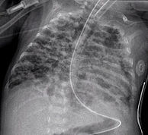
Health outcomes such as bone mineralization

Slide 19
Fetal Calcium and Phosphorus
80% is accrued in the 3rd trimester
  Peak accretion is 36-38 weeks
Starting at 26 weeks
  Calcium: 90-120 mg/kg/day (2.2-3 mmol/kg/day)
  Phosphorus: 60-75 mg/kg/day (1.9-2.4 mmol/kg/day)
  Magnesium: 3-5 mg/kg/day (0.12-0.2 mmol/kg/day)
Most bone deposition
  From 24 weeks to term

Slide 20
Enteral Mineral Availability for Bone Mineralization
Overall no difference with enriched formula
One study with higher bone mineral content with term formula
Solid line- standard term formula
Dashed line- post-discharge formula
Koo et al 2006; Litmanovitz et al 2004; Bishop et al 1993; De Curtis et al 2002; Atkinson et al 2004

Slide 21
Nutrient-Enrichment vs. No Enrichment of Mother’s Milk Post-Hospital Discharge
Study | Population | Intervention | Outcomes reaching statistically significance
O’Connor et al 2008 | 39 ≥80% mother’s milk and 750-1800 g at birth infants | Protein 0.8g/kg Calories 10-15/kg Fortified with HMF 50% of feeds for 12 weeks | Intervention infants at 12 months: Greater bone mineral content
Zachariassen et al 2011 | 320 infants born 24-32 weeks PMA receiving breastmilk at discharge | Protein 1.37 g/day Calories 17/day For 4 months | At 12 months: No measures
De Cunha et al 2016 | 53 exclusively breastfed VLBW infants | Protein 0.5g/day Calories 20/day For 4-6 months | At 12 months: No measures
Nutrient concentrations from Arslanoglu et al 2019

Slide 22

Health outcome risks for breastfeeding term infants
Ever Breastfeeding
11% ↓ Leukemia
12% ↓Asthma 5-18 years
33% ↓ Otitis media
29% ↓ Crohn’s disease
22% ↓ Ulcerative colitis
22% ↓ Childhood & adult obesity
33% ↓ Type 2 diabetes mellitus
64% ↓ Gastrointestinal infections
72% ↓ Lower respiratory infections
19% ↓ Infant mortality (U.S.)
51% ↓ Neonatal mortality
21% ↓ Postneonatal mortality
(to 38% ↓if >3 months)
>6 months exclusive breastfeeding
compared to <4 months exclusive
19% ↓Lower respiratory tract infection
30% ↓Severe or persistent diarrhea
AHRQ 2007 & AAP 2022

Slide 23
Upper respiratory infection symptom days in 39 infants born <2 kg
Blaymore Bier et al 2002

Slide 24
Post-Discharge Nutrition and Neurodevelopment, Growth, Outcomes Summary
Neurodevelopment
  Potentially maternal milk
  Potentially growth velocity but less evidence than growth velocity before term age
Growth
  Greater head circumference growth
    With preterm formula
    With 50% HMF for 3 months in infants born <1250g (small study)
  Greater weight and length gain with 50% human milk fortification for 3 months (small study)
Outcomes
  Decreased risk of infections, autoimmune disease, cancer, and mortality with breastfeeding (in term infants)
  Greater bone mineral content with 50% HMF for 3 months (small study)
  Less days of respiratory illness with intake of maternal milk (small study)

Slide 25
What should we do when we do not have much guidance from studies?
ESPGHAN 2006 “Feeding Preterm Infants After Hospital Discharge”
Monitor closely
Measure weight, length, head circumference to identify infants with poor growth
AGA infants should be breast-fed when possible
When formula-fed, feed regular infant formula
If SGA at discharge, supplement with human milk fortifier or enriched formula
  Until at least 40 weeks’
  Potentially until 52 weeks’
By 40-52 weeks postmenstrual age
Preterm infants without significant brain, lung, cardiac disease develop the ability to
“feed” to grow (at least calories).
  Titrates volume to obtain calories required to gain weight
Likely plays a role in the mixed results from post-discharge nutrition RCTs
ESPGHAN Committee on Nutrition et al. 2006

Slide 26
Nutritional Needs Beyond Maternal Milk
Outcomes | Nutrition
Bone mineralization at 12 months CA | 50% of feeds with HMF for 12 weeks post-discharge (O’Connor D et al 2008; Aimone A et al 2009) Otherwise, no evidence of required calcium/phosphorus post-hospital discharge Maintain normal serum value of phosphorus (> 5.6 mg/dL) and 25(OH)D (>30 ng/mL)
Growth | Difficult because post-NICU studies have compared feed type rather than specific nutrients. Feed to grow 25-35 g/day and then to maintain percentile line (do not lose trajectory) and maintain or improve proportion In-hospital growth relates to neurodevelopment
Neurodevelopment | Balance of milk nutrients/bioactives and growth trajectory
Iron stores | 3-5 mg/kg/day ferrous sulphate until iron-containing foods
Vitamin D stores (and potentially other vitamins) | At least 400 IU/day (and up to 1000 IU/day) Other vitamins need greater study

Slide 27
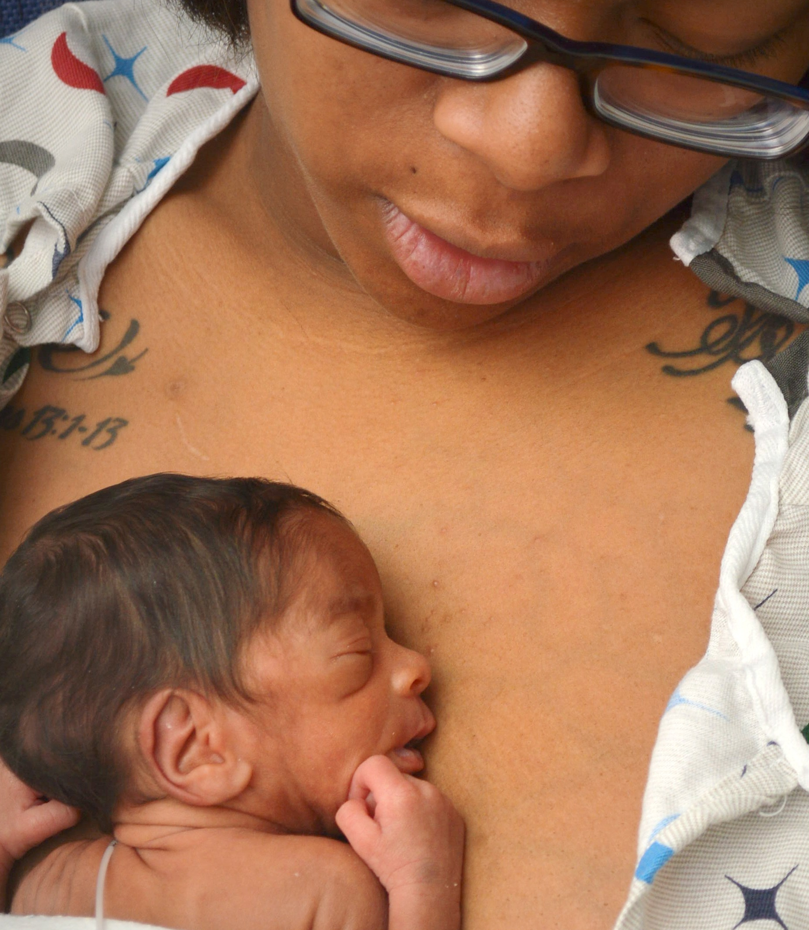
What is the parent’s feeding goal?

Slide 28

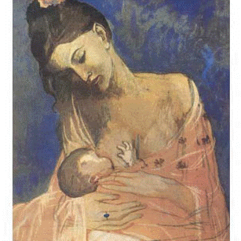
84% of US families initiate breastfeeding
Family’s Feeding Goal Before
Interrupted by Preterm Birth:
Can We Help Achieve?

Slide 29
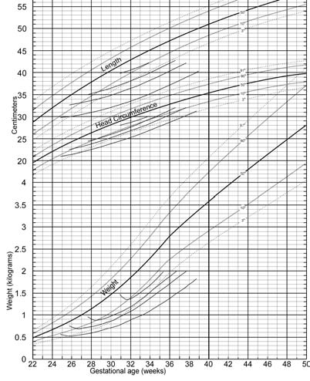
FAMILY’S FEEDING GOAL
Establish and sustain
maternal milk supply
Infant’s specific
nutritional needs
especially for brain growth
Maturation of infant oral ability

Slide 30

Clinical Application of Preterm Infant Discharge Nutrition Evidence
Know family’s feeding goal
Protect maternal milk intake
Monitor growth
Target positive growth trajectory “Feed to Grow” but need more information about body composition
Consider the infant’s other needs based on disease, growth pattern, and previous nutrition
Simplify when able (for parents and pediatricians)
  18% of parents mixing feeds incorrectly
(Zhang et al 2020)
Photo by Felicia LLC DBA Felicia Saunders Photography
https://www.feliciasaundersphotography.com

