Slide 2
Faculty
Brenda B. Poindexter, MD, MS
Chief, Division of Neonatology, Children’s Healthcare of Atlanta
Marcus Professor of Pediatrics, Emory University School of Medicine

Slide 3
Disclosure
Brenda Poindexter has documented no financial relationships to disclose or conflicts of interest (COIs) to resolve and has documented this presentation will not involve discussion of unapproved or off-label, experimental or investigational use.

Slide 4
Disclosure
Human Milk Fortifiers (bovine and human milk-based) are classified as exempt formulas by FDA.
Exempt infant formulas are “labeled for use by infants who have inborn errors of metabolism or low birth weight, or who otherwise have unusual medical or dietary problems” (21 CFR 107.3)

Slide 5
Benefits of Human Milk
Species-specific diet
Decreases infant mortality
Lower risk of NEC (and composite of NEC or death)
  Risk with formula feeding higher
  Less severe NEC with human milk
  Lower incidence of surgical NEC
Associated with decreased in-hospital morbidity including lower rates of late-onset sepsis, BPD, and severe ROP
Shorter hospital stay and lower incidence of rehospitalization than preterm formula

Slide 6
Non-Nutritive Components of Human Milk
Anti-infectious
Immunoglobulins
Lactoferrin
Lysozyme
Nucleotides
Defensins
Mucins
Oligosaccharides
Toll-like receptors
Cytokines
Trophic factors
Epidermal Growth Factor
Lactoferrin
Insulin-like Growth Factor
Hormones
Pituitary
Thyroid
Steroid
Cells
Neutrophils Macrophages
T-lymphocytes

Slide 7
Mean MDI and PDI scores at 18 and 30 months according to ANY maternal milk feeding in NICU
NICHD NRN RCT of parenteral glutamine supplementation
1400 ELBW infants with detailed daily nutritional data
75% received HM in hospital; only 30% received HM at discharge
Growth and neurodevelopmental outcomes assessed at 18 and 30 months corrected age
For each 10 mL/kg/d of maternal milk, MDI increased by 0.59 points and PDI increased by 0.56 points – impact at 18 months persisted at 30 months
Vohr, Poindexter, Pediatrics 2006 and 2007

Slide 8
Why Fortify?
Nearly impossible to meet metabolic demands and recommended nutritional intakes without fortifier
Higher intakes of protein, calcium and phosphorus to optimize growth with good bone mineralization
Although no definitive association between HMF and long-term neurodevelopmental outcomes, greater gains in growth in the NICU (both weight gain and linear growth) are related to better developmental outcomes
Brown, Cochrane Database Syst Rev 2020

Slide 9
Terms
MBM – maternal breast milk
DBM – donor breast milk
HMF – human milk fortifier
  HM-HMF – human milk-based HMF
  BM-HMF – bovine milk-based HMF
EHMD – exclusive human milk diet
PF – preterm formula

Slide 10
Fortifier Products
Multicomponent – provide range of nutrients, including protein (whey vs casein, intact vs hydrolyzed), fat, carbohydrates, vitamins, and minerals
  NB – different manufactures achieve same caloric density through varying distribution of macronutrients
Single Component – typically used in conjunction with multicomponent fortifiers to enhance delivery of individual nutrients
Milk source (bovine or human milk)
Formulation (powder or liquid)

Slide 11
Human Milk-Based HMFs
With DBM being preferred alternative to preterm formula when MBM is not available, the use of HM-HMF to promote an exclusive HM diet has been evaluated
HM-HMF is an expensive liquid product offered in a range of caloric preparations
Displaces a high proportion of MBM, especially at higher caloric densities (1:1 ratio for 100 kcal/100 mL)
Available at 22% of neonatal facilities in the US
Perrin, J Pediatr Gastroenterol Nutr 2018

Slide 12
Human Milk-Based HMFs
Proposed benefit of HM-HMF and an EHMD is extrapolated from the studies demonstrating the association between preterm formula and an increased incidence of NEC
Advantages of “exclusive” human milk diet has been suggested only in comparison to preterm formula or to supplementing maternal milk + formula and bovine fortifier
Only 1 RCT has compared EHMD to human milk + bovine HMF (OptiMoM) – none with primary outcome of NEC
Lucas, Lancet 1990
Quigley, Cochrane Database Syst Rev 2019
O’Connor, Am J Clin Nutr 2019

Slide 13
DoMINO and NRN MILK Trials
 | DoMINO (n=363) | MILK (n=483)
Study Population | 27 wks, 990 g BW | 26 wks, 840 g BW
Intervention | DBM or PF to supplement MBM | DBM or PF to supplement MBM
Primary Outcome – BSID III | No difference between groups | No difference between groups
NEC (Stage 2 or greater) | 1.7% (DBM) vs 6.6% (PF) | 4.2% (DBM) vs 9.0% (PF)
No infants in these trials received HM-HMF
O’Connor, JAMA 2016
Colaizy, PAS 2023

Slide 14
Exclusive Human Milk vs Preterm Formula in Extremely Preterm Infants
Randomized EP infants (27 wks, 980 g BW) whose mothers did not provide MBM (n=53) to EHMD or PF
Sample size based on primary outcome of days of parenteral nutrition
NEC (secondary outcome) occurred in 1 infant (3%) of EHMD group and in 5 (21%) of infants in PF group (p 0.08)
  NEC requiring surgery in 0 of EHMD and 4 of PF infants
*No comparison with DBM + bovine fortifier
Cristofalo, J Pediatr 2013

Slide 15
RCT of EHMD compared to MBM + Bovine HMF
Comparison of exclusive human milk diet with bovine milk-based HMF
Randomized 207 infants (BW 900 g; GA 27 wks)
  MBM + DBM + human HMF (started at 100 mL/kg/d)
  MBM + DBM + human HMF (started at 40 mL/kg/d)
  MBM + PF* + bovine HMF
  * true head-to-head comparison of the impact of bovine versus human milk-based HMF added to a base diet of human milk (either donor or maternal) is not possible in these trials
No difference in days on TPN, time with CVL, weight gain, length of stay, or combined outcome of late-onset sepsis or NEC
Sullivan, J Pediatr 2010

Slide 16
RCT of EHMD compared to MBM + Bovine HMF
Sullivan, J Pediatr 2010

Slide 17
Subgroup Analysis of Sullivan RCT
Secondary analysis focused on infants who only received 100% mother’s own milk base diet + fortification (n=114)
  no donor milk and no preterm formula exposure
 | EHMD (n=82) | MBM + bovine HMF (n=32) | p value
NEC (Stage 2 or greater) | 3/82 (3.7%) | 5/32 (15.6%) | 0.038
Surgical NEC | 1/82 (1.2%) | 3/32 (9.4%) | 0.066
Surgical NEC or death | 3/82 (3.7%) | 6/32 (18.8%) | 0.014
Death | 3/82 (3.7%) | 4/32 (12.5%) | 0.096
Lucas, Breastfeed Med 2020

Slide 18
OptiMoM Trial
Randomized 127 infants <1250 g (BW 880 g; GA 27 wks) to receive HM-HMF (n=64) or BM-HMF (n=63)
Base diet MBM or DM with fortification at 100 mL/kg/d
Primary outcome – percentage of infants with a feeding interruption for >12 hrs or a >50% reduction in feeding volume
No difference in feeding tolerance (primary outcome) or mortality and morbidity index (included death, late-onset sepsis, NEC, BPD, or severe ROP)
  Stage II or greater NEC 4.7% (HM-HMF) and 4.9% (BM-HMF)
O’Connor, Am J Clin Nutr 2019

Slide 19
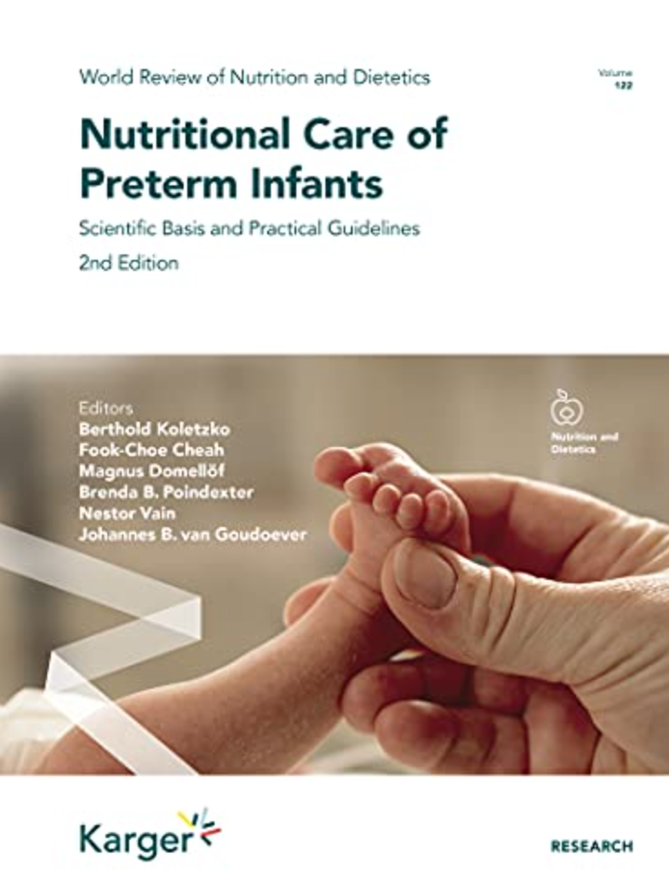
Summary of Evidence
“The use of bovine milk-based fortifiers is the current standard of care and represents an essential step towards covering nutrient needs”
“At this time there is no evidence to justify recommending a preferential use of HM-based fortifiers which are also far more expensive than bovine protein-based fortifiers”
Picaud, Nutritional Care of Preterm Infants 2021

Slide 20
HM-HMF—Impact on Preterm Infant Microbiome
HM-HMF has not been shown to have any impact on the preterm infant microbiome compared with BM-HMF
Microbial diversity influenced primarily by exposure to maternal breast milk
Kumbhare, Cell Rep Med 2022
Ford, Am J Clin Nutr 2019
Embleton, JAMA Netw Open 2023

Slide 21
Growth and HM-HMF
Length gain velocity significantly lower in exclusive HM group (0.84 ± 0.21 vs. 1.12 ± 0.28 cm/wk) than bovine formula (Cristofalo, J Pediatr 2013)
No difference in growth z-score trajectories between HM-HMF and BM-HMF in OptiMOM trial with HM-HMF group receiving higher caloric density (minimum 26 kcal/oz) (O’Connor, Am J Clin Nutr 2019)
Human milk-based cream product can also provide caloric enrichment (may worsen linear growth) (Hair, J Pediatr 2014)
Growth velocity lower in retrospective study of HM-HMF vs BM-HMF (no difference in NEC) (Eibensteiner, Nutrients 2019)

Slide 22
Special Considerations for Donor Human Milk
Compared to preterm MBM, nutritional profile of DBM is more similar to mature milk of mothers of term infants
Milk processing subjects donated milk to increase freeze-thaw cycles and additional handling that results in fat loss
Heat pasteurization reduce bioactivity and concentration of nonnutritive factors

Slide 23
Effects of Handling on Donor Milk
Step in Process | Fat g/dL | Protein g/dL
Raw | 2.17 ± 1.47 | 1.03 ± 0.39
Post-Pasteurization | 2.05 ± 1.46 | 0.99 ± 0.42
Thawed | 2.00 ± 1.45 | 0.97 ± 0.41
Fed by NG bolus | 1.88 ± 1.22 | 0.94 ± 0.38
Continuous infusion | 1.00 ± 0.99 | 0.89 ± 0.41
Viera, Early Human Development 2011

Slide 24
When to Fortify
Cochrane review (2020) evaluated 2 small RCTs with fortification at 20-40 mL/kg/d versus 100 mL/kg/d and found insufficient evidence to support early or late initiation
No studies to support the practice of slower incremental fortification by 1 to 2 kcal/oz versus fortifying directly to 24 kcal/oz
For donor milk, can add liquid protein immediately
Fortify at earliest practical time point
  If infant on maternal milk, that is at 25 ml per day, which limits wastage of maternal milk
Fu, Nutrients 2021

Slide 25
Conclusions
Human milk is the preferred nutrition source for preterm infants and should be fortified with a multicomponent fortifier to support short-term growth during the NICU course
At present, there is insufficient evidence to support the choice of human milk-based human milk fortifiers over bovine milk-based human milk fortifiers – either may be used, though long-term advantages are unclear

Slide 26
Conclusions
Additional fortification or modular agents may be necessary to attain optimal growth in high-risk infants (especially with use of pasteurized donor milk)
Additional studies for newer generation fortifier products are needed – possibly with partially or extensively hydrolyzed protein

