Slide 1
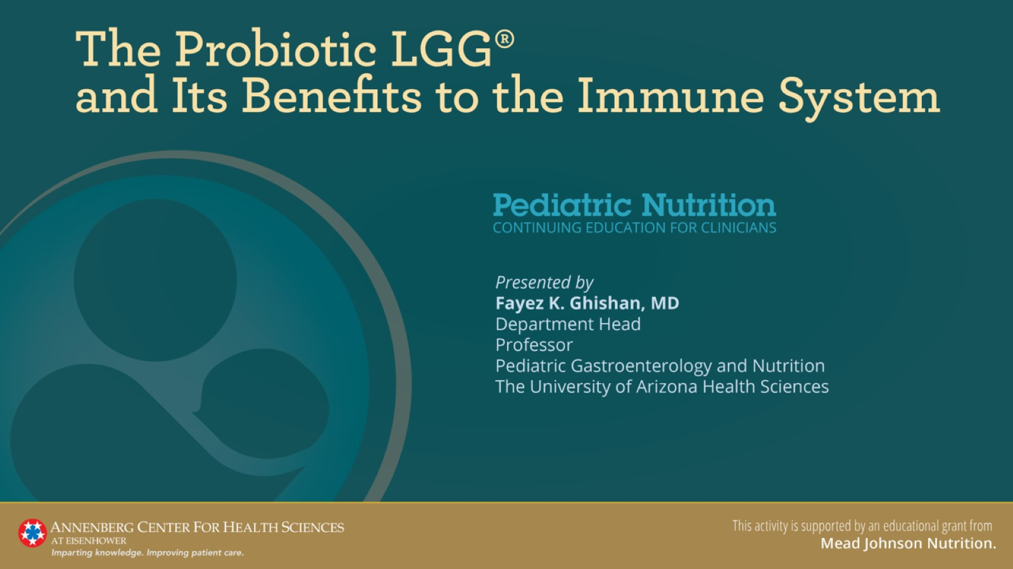

Slide 2
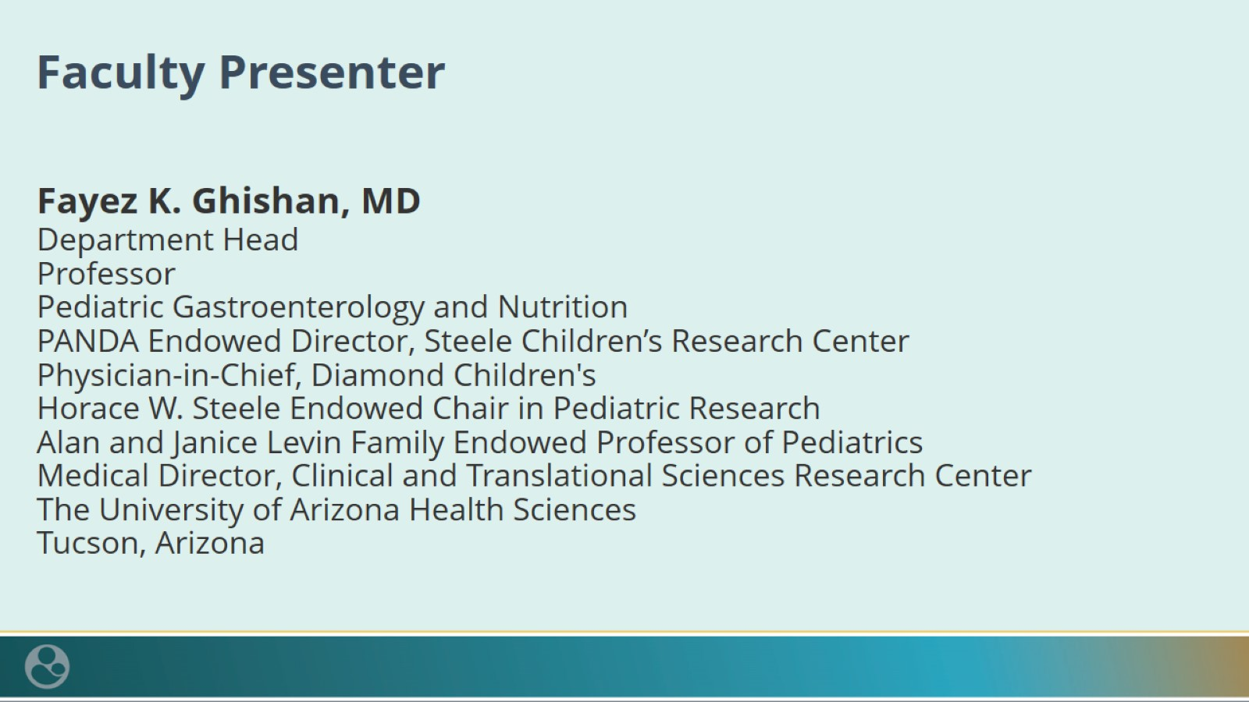
Faculty Presenter

Slide 3

Faculty Disclosures

Slide 4
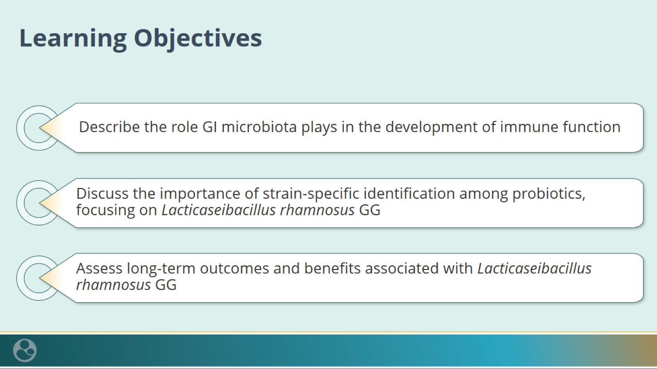
Learning Objectives

Slide 5
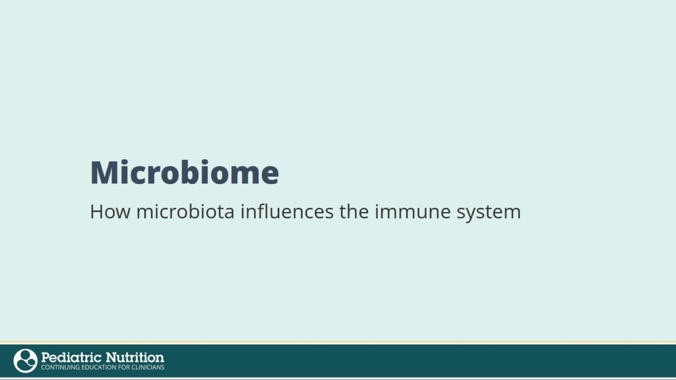
Microbiome

Slide 6
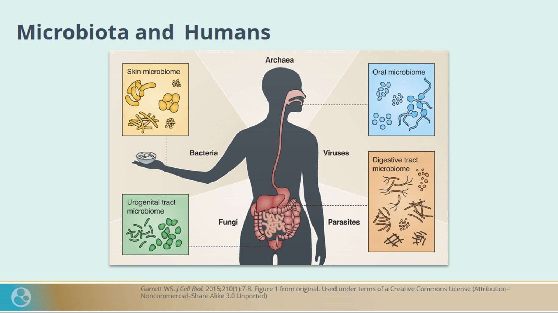
Microbiota and Humans

Slide 7
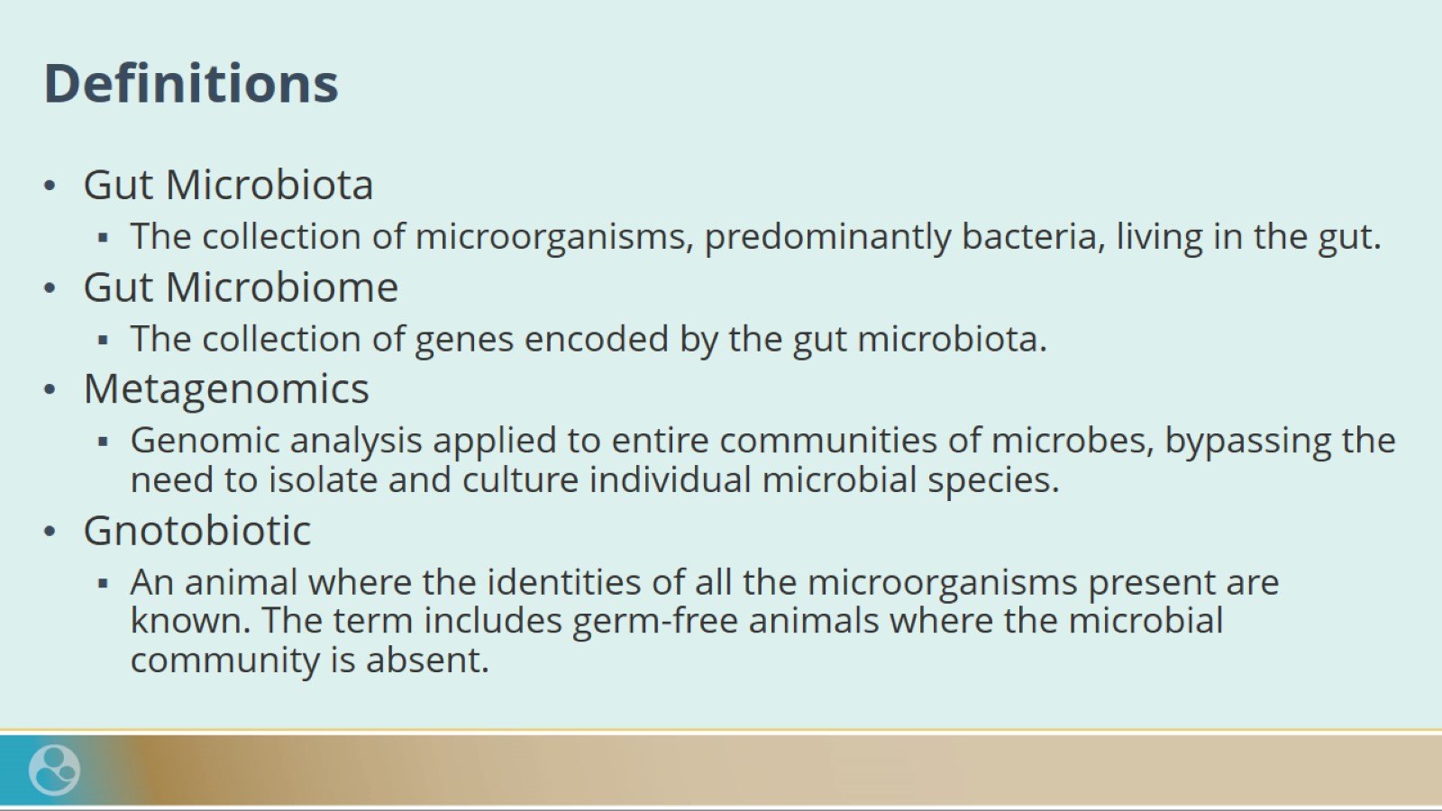
Definitions

Slide 8
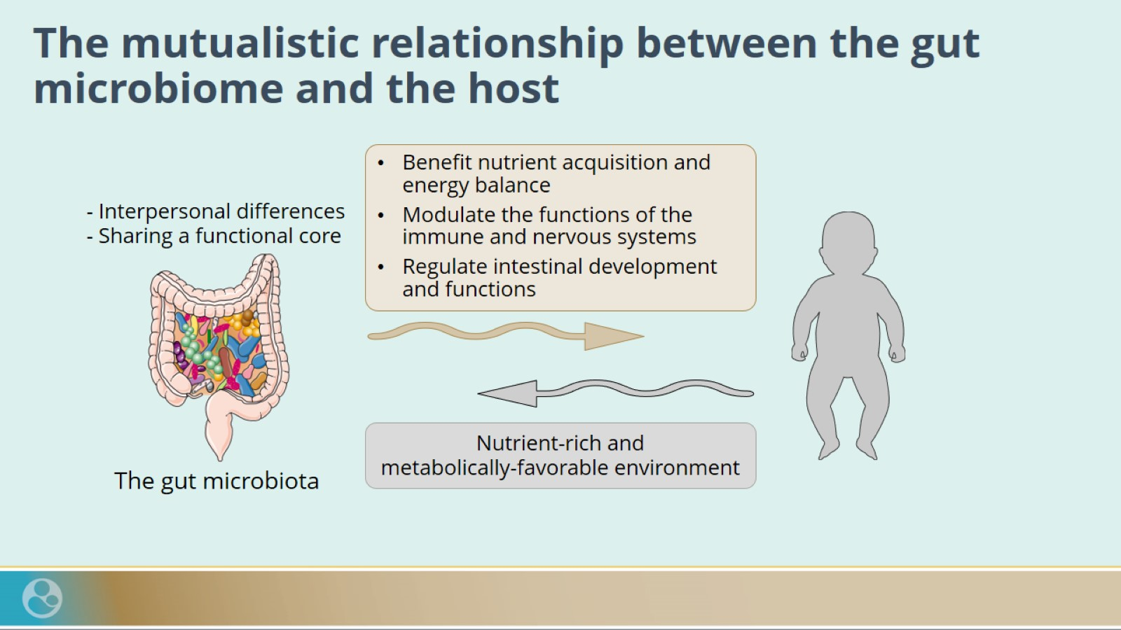
The mutualistic relationship between the gut microbiome and the host

Slide 9
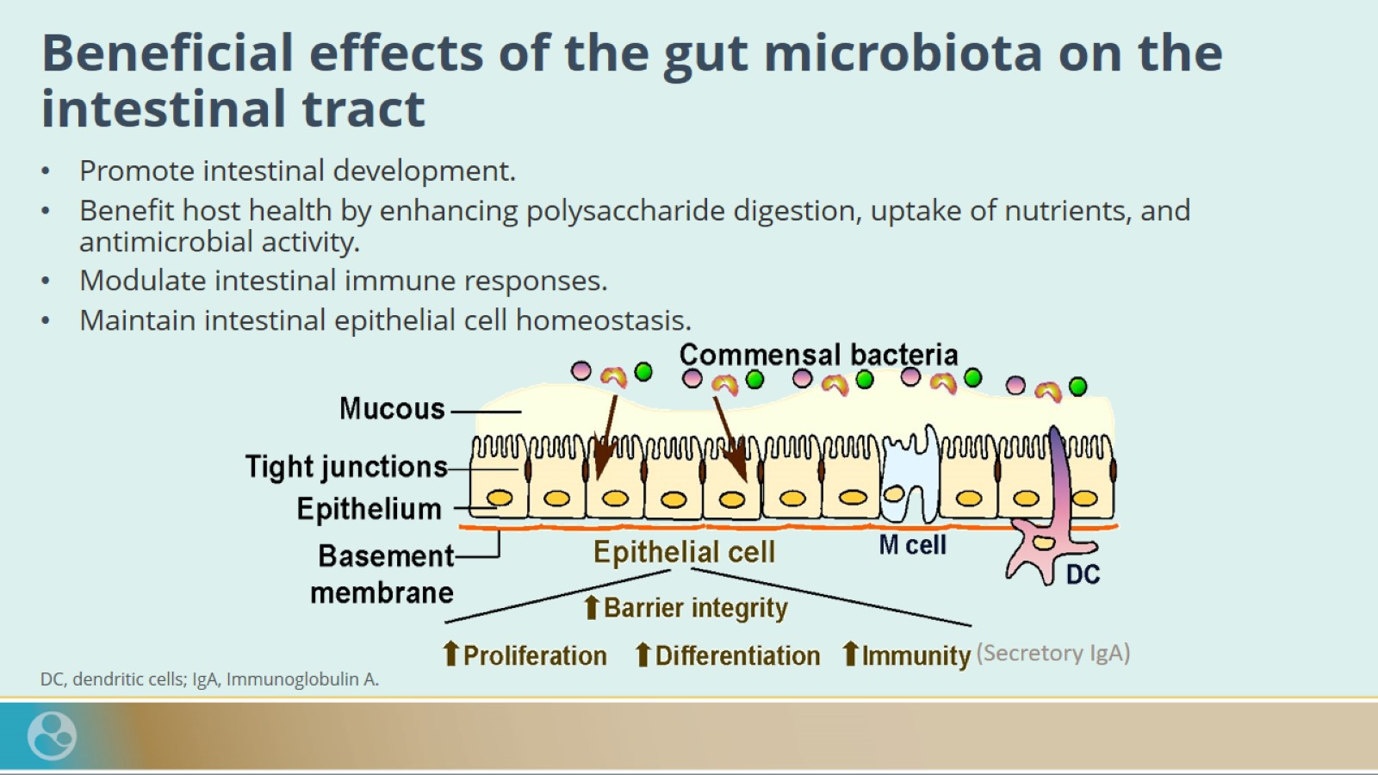
Beneficial effects of the gut microbiota on the intestinal tract

Slide 10
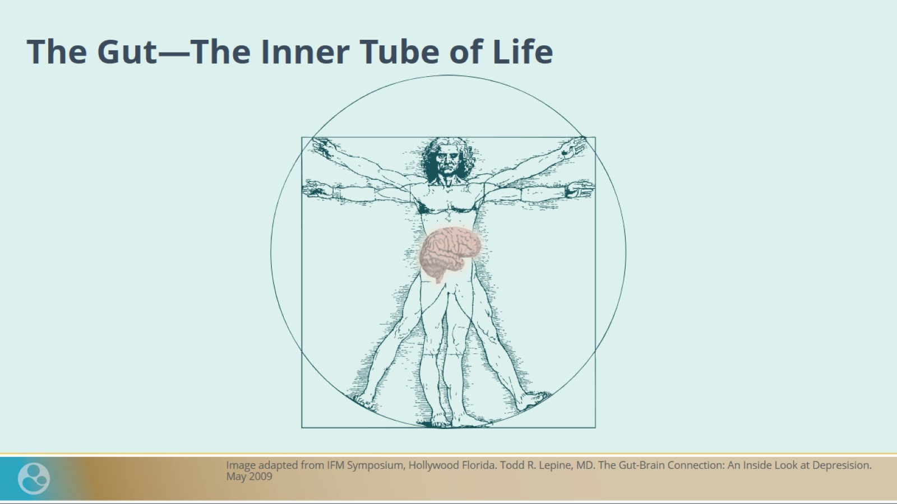
The Gut—The Inner Tube of Life

Slide 11
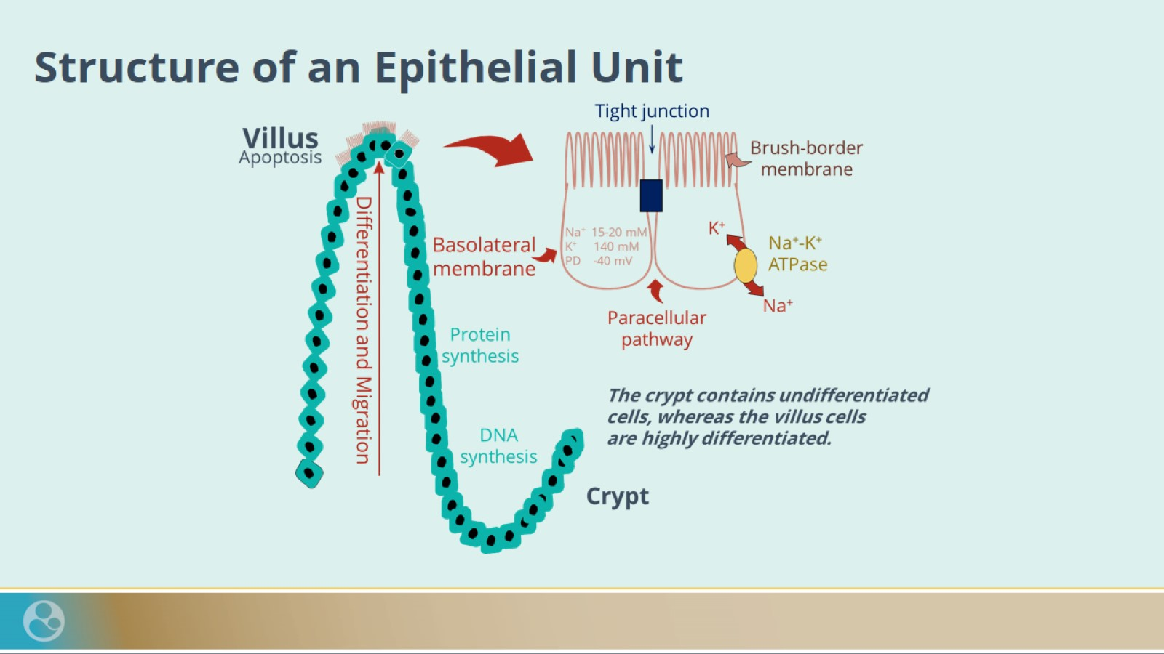
Structure of an Epithelial Unit

Slide 12
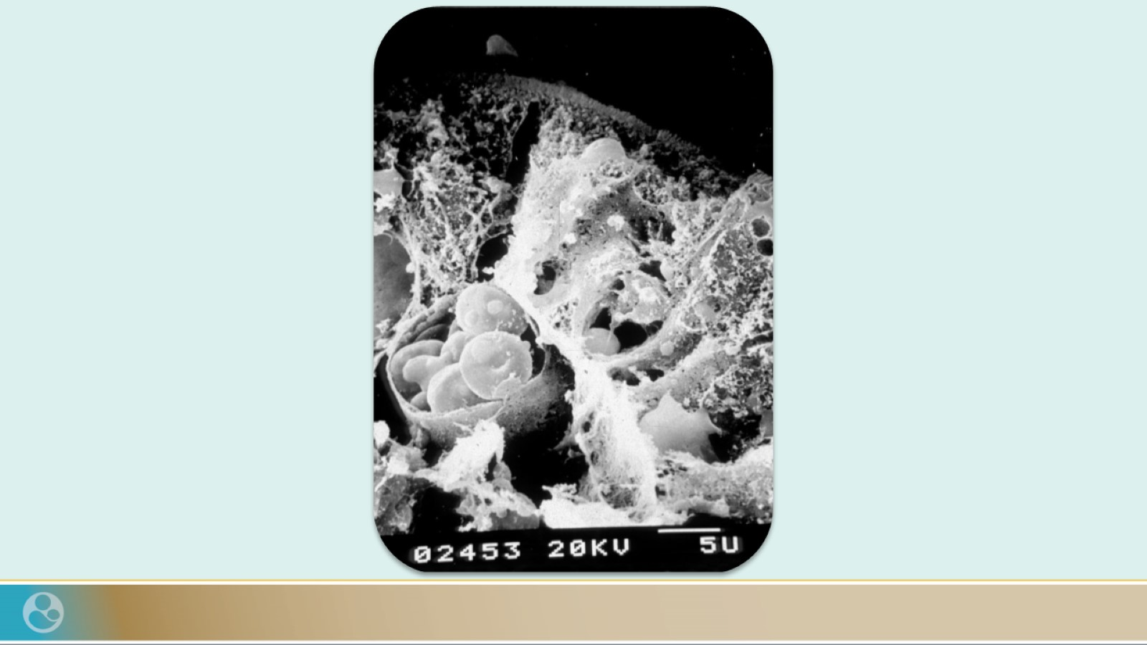

Slide 13
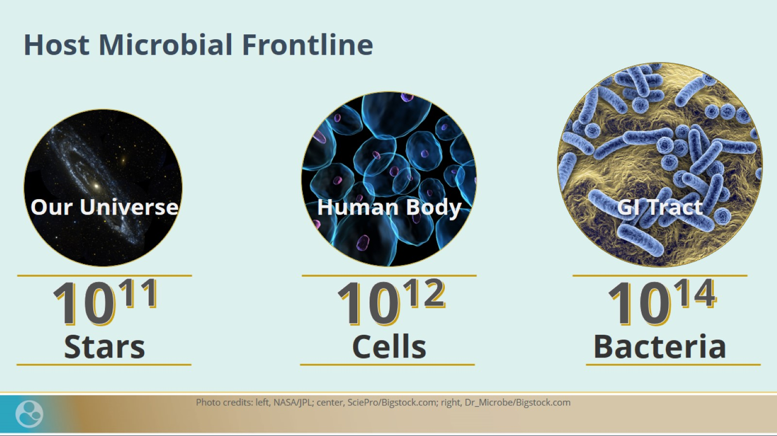
Host Microbial Frontline

Slide 14
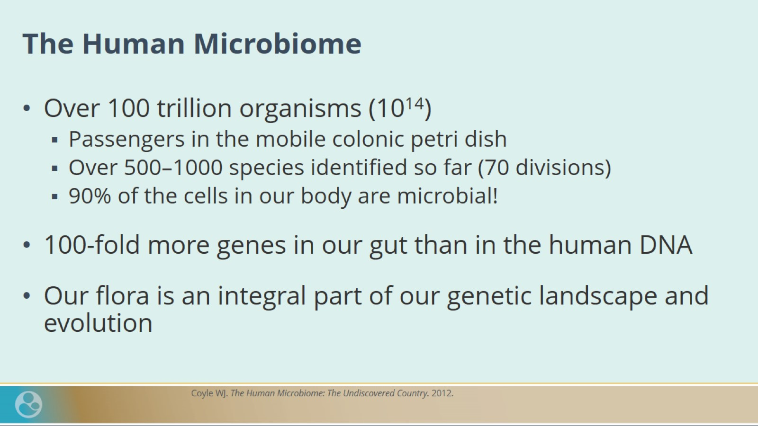
The Human Microbiome

Slide 15
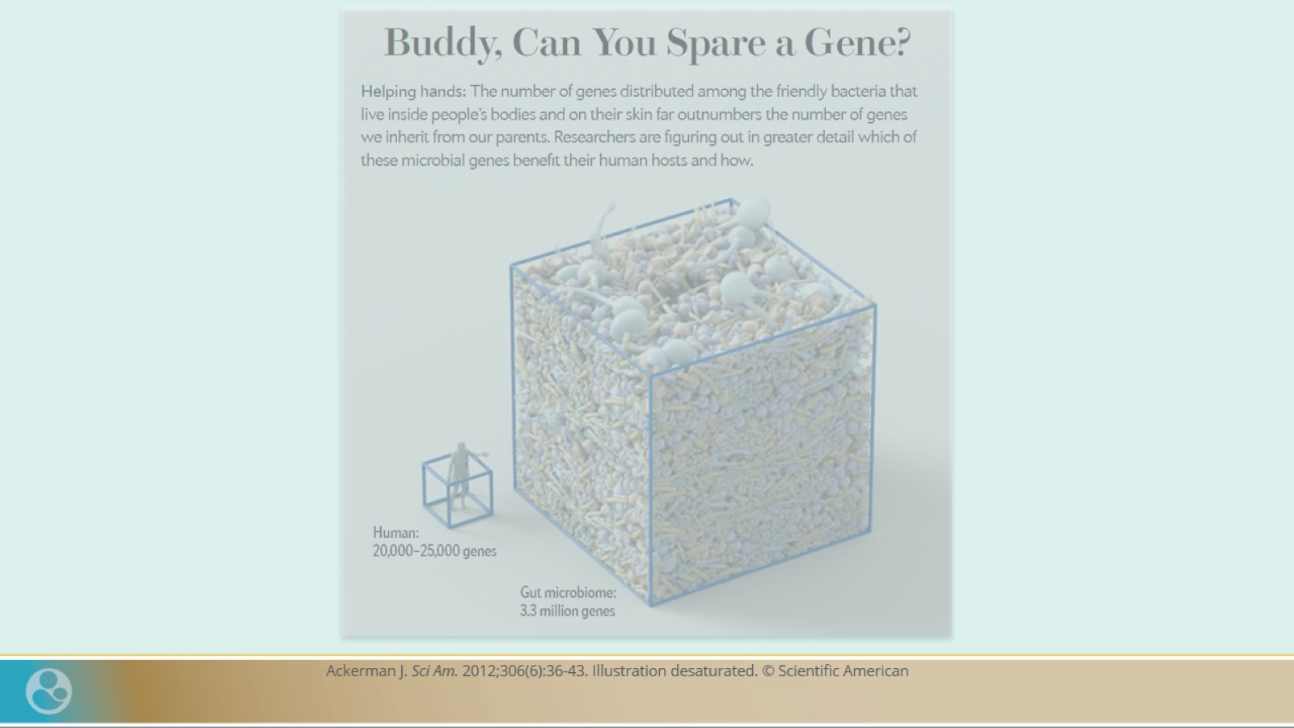

Slide 16
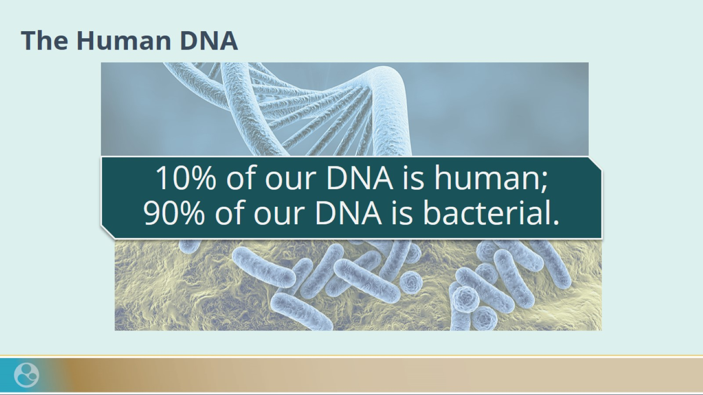
The Human DNA

Slide 17
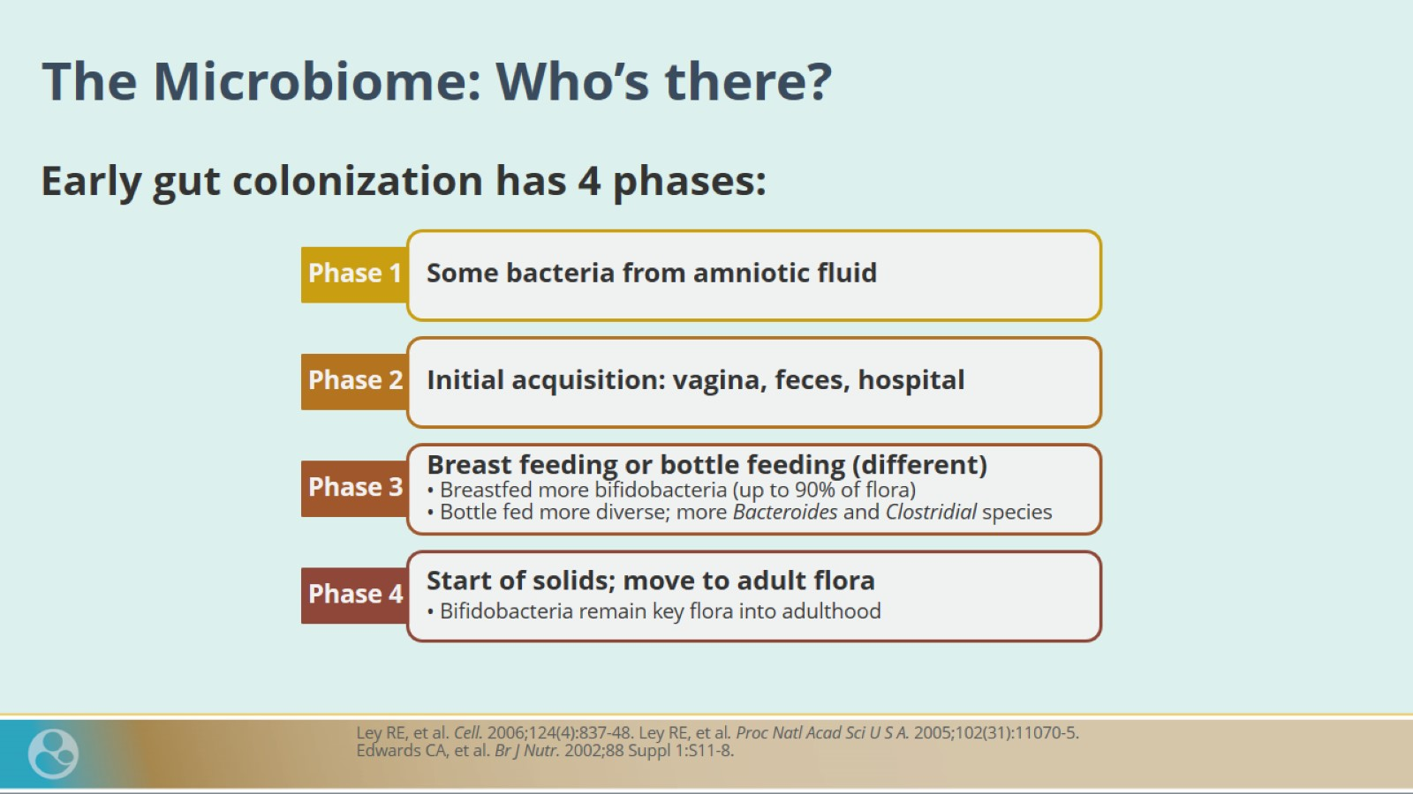
The Microbiome: Who’s there?

Slide 18
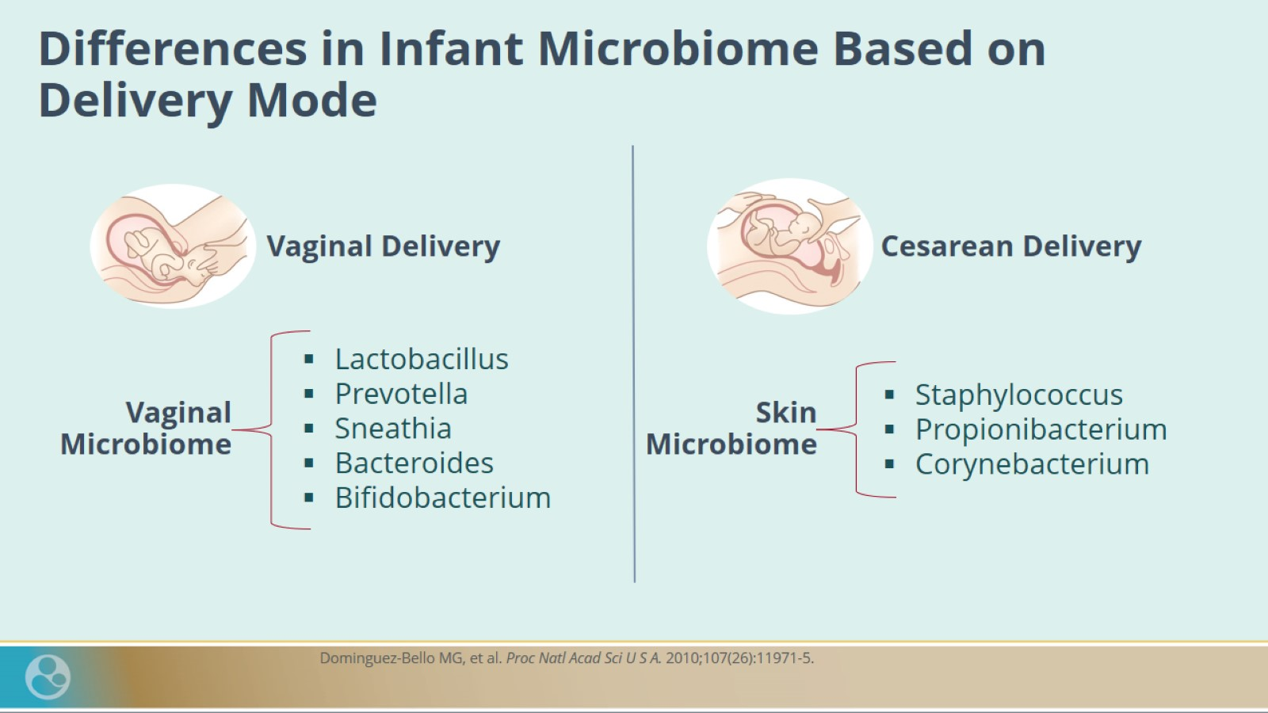
Differences in Infant Microbiome Based on Delivery Mode

Slide 19
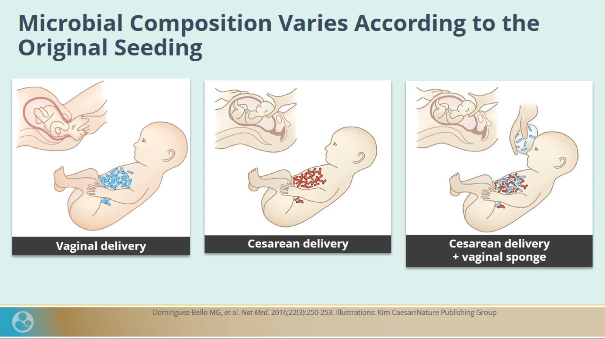
Microbial Composition Varies According to the Original Seeding

Slide 20
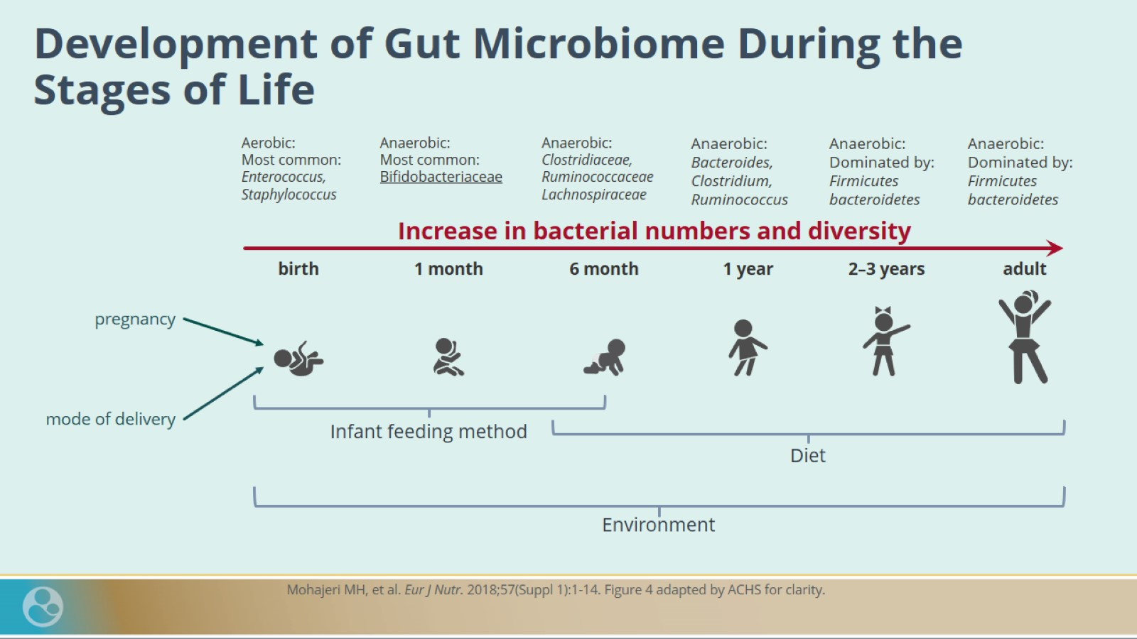
Development of Gut Microbiome During the Stages of Life

Slide 21
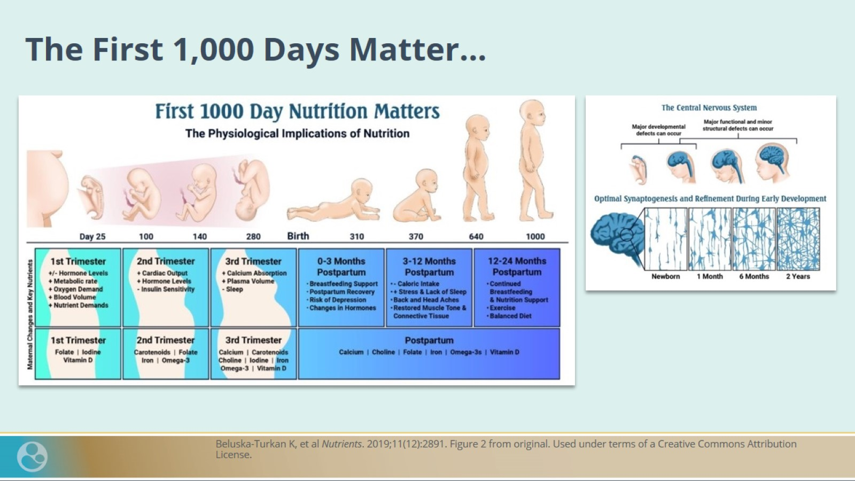
The First 1,000 Days Matter…

Slide 22

The Gut Microbiome is Like a Fingerprint

Slide 23
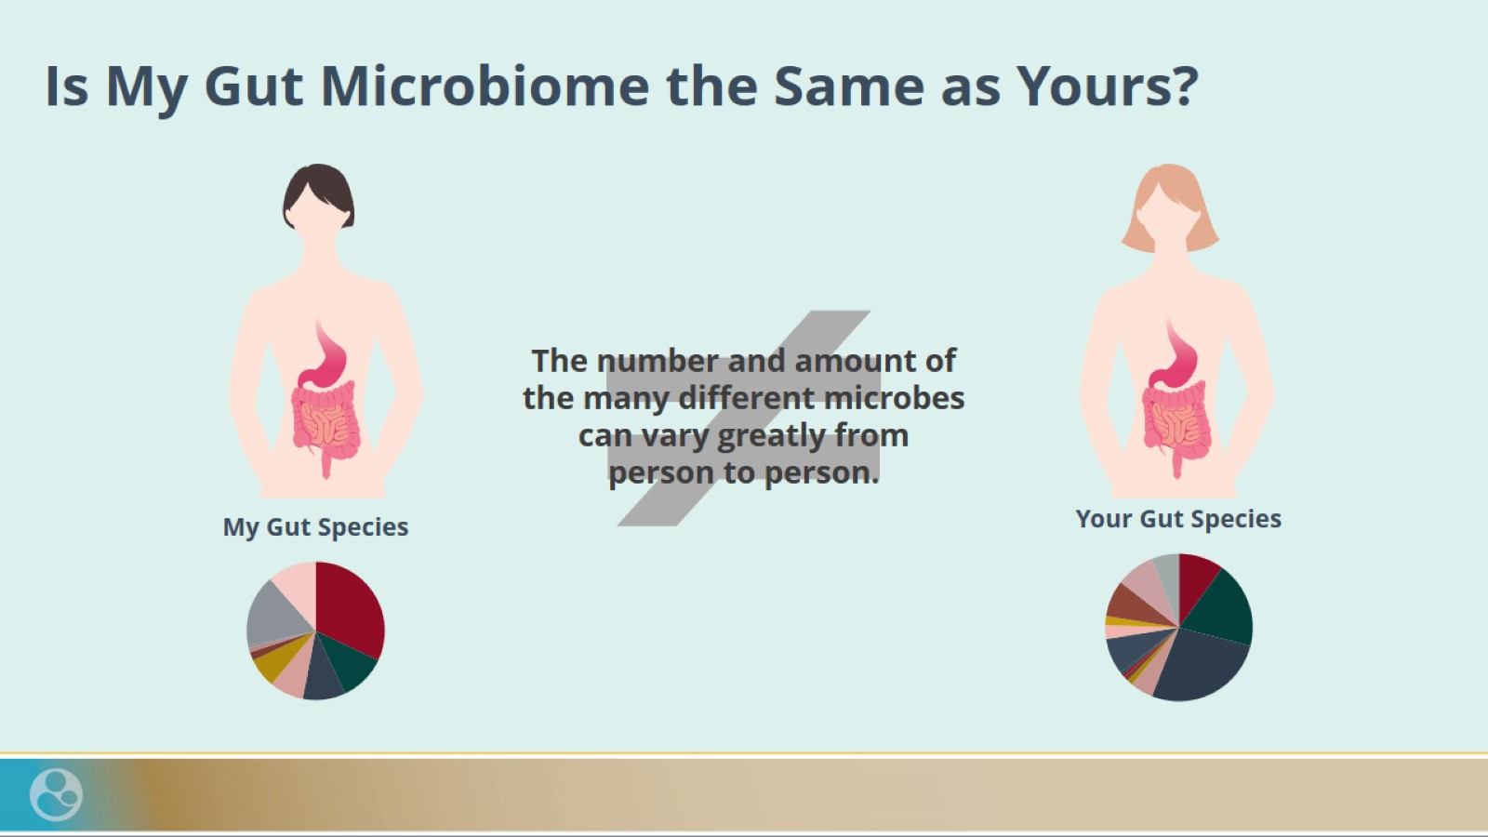
Is My Gut Microbiome the Same as Yours?

Slide 24
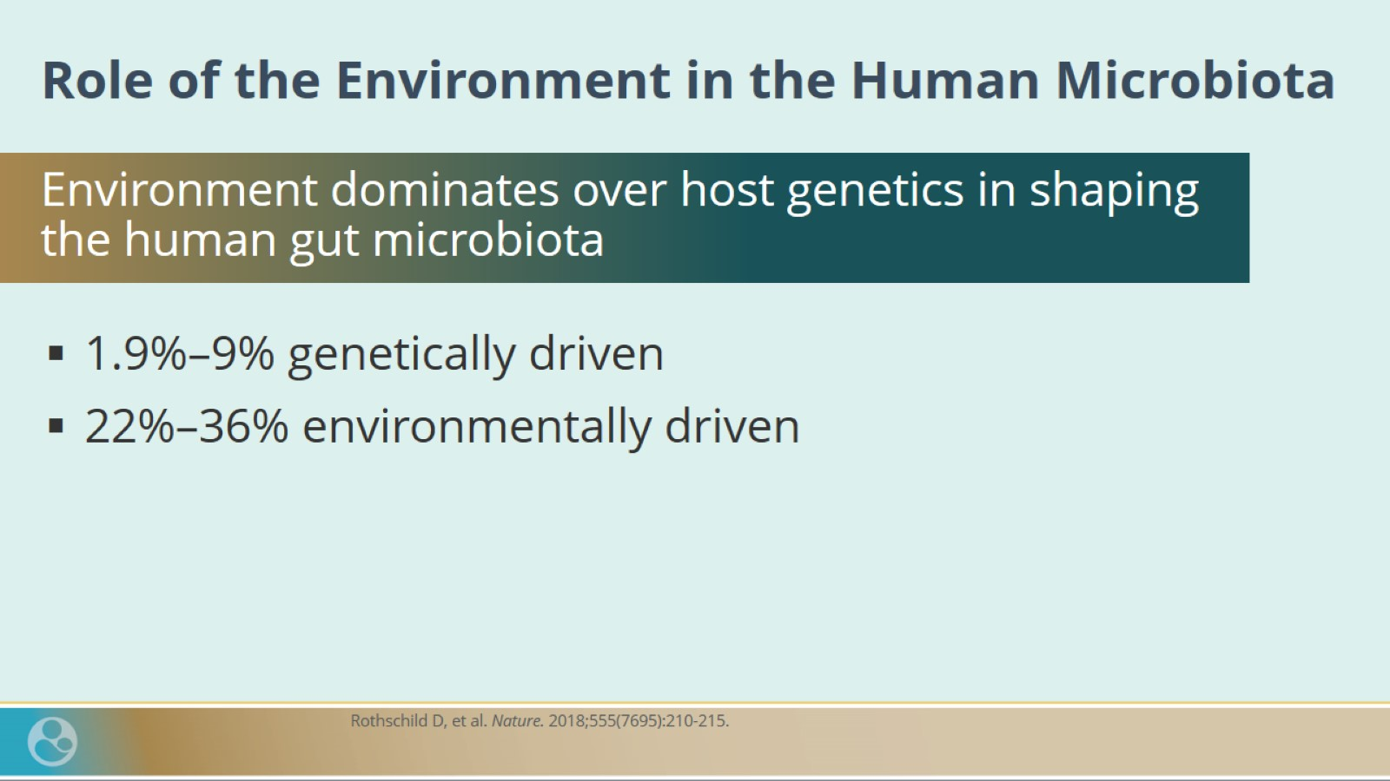
Role of the Environment in the Human Microbiota

Slide 25
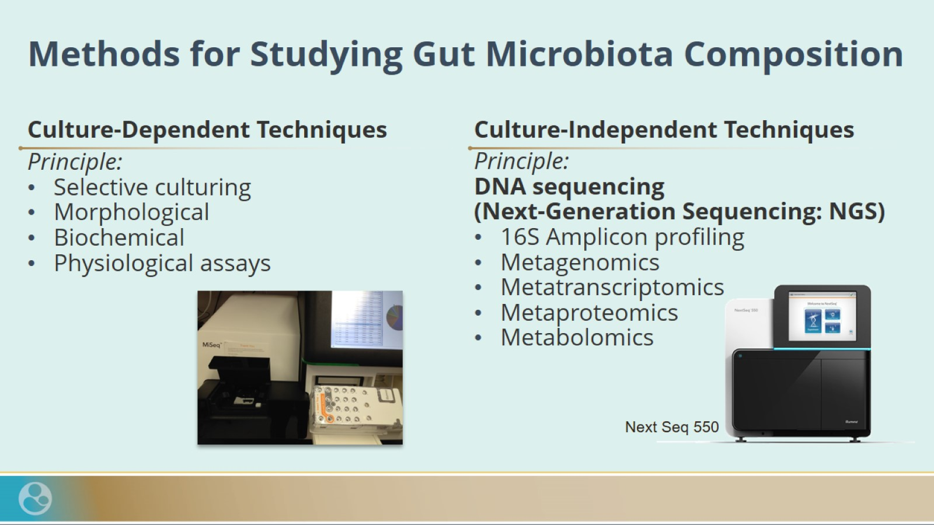
Methods for Studying Gut Microbiota Composition

Slide 26
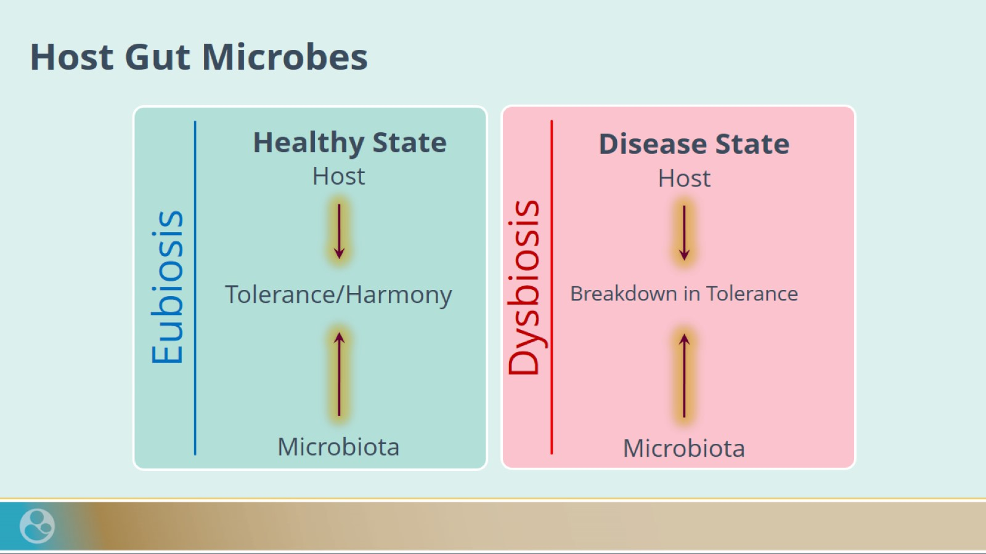
Host Gut Microbes

Slide 27
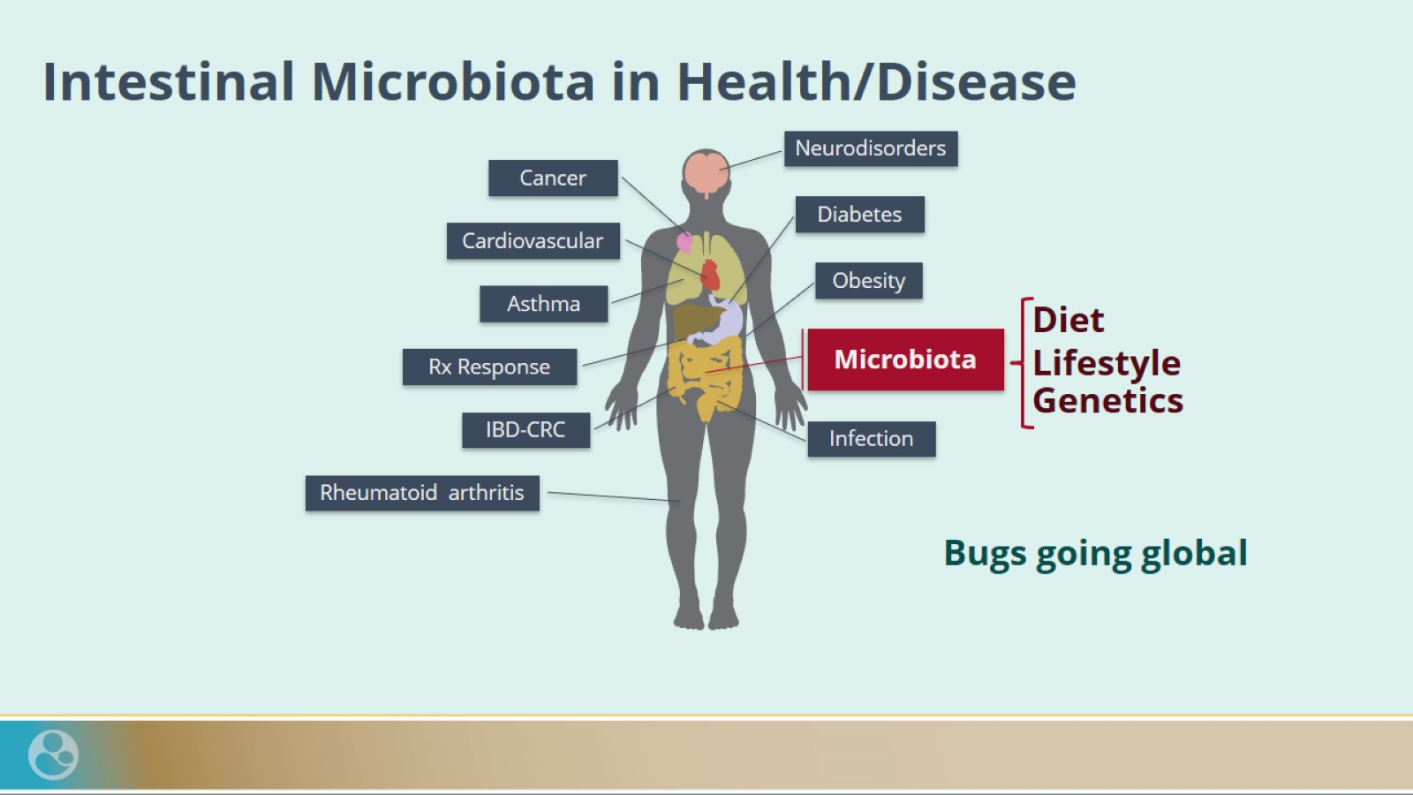
Intestinal Microbiota in Health/Disease

Slide 28
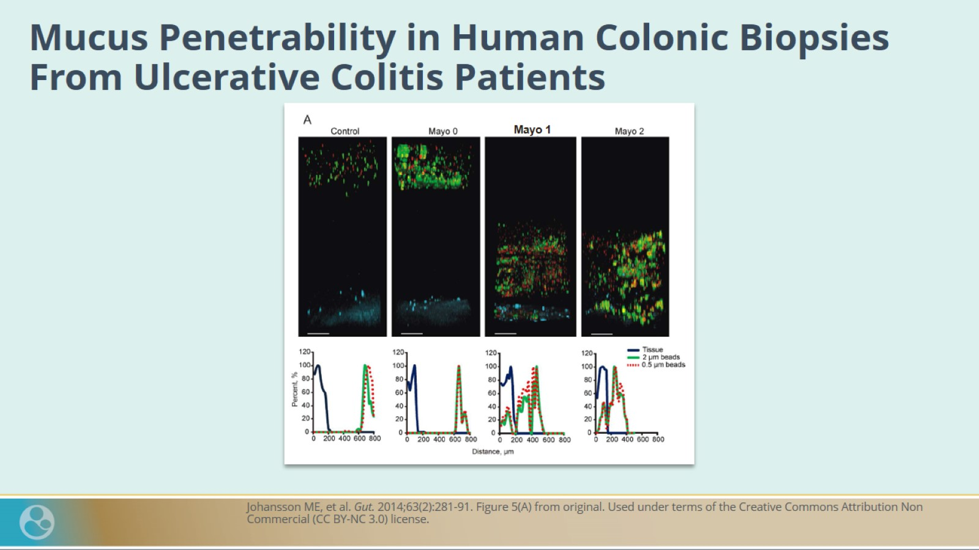
Mucus Penetrability in Human Colonic Biopsies From Ulcerative Colitis Patients

Slide 29
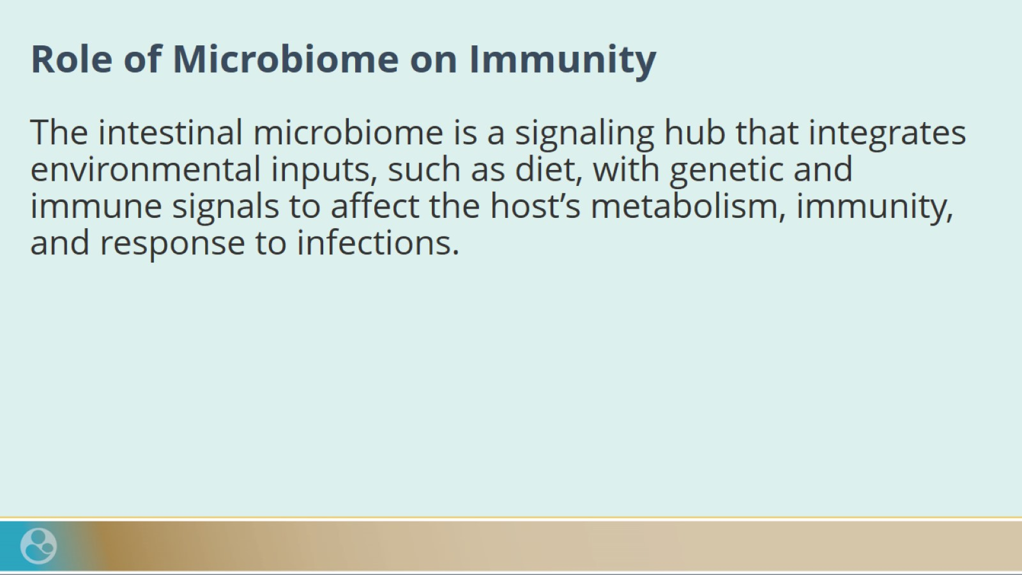
Role of Microbiome on Immunity

Slide 30
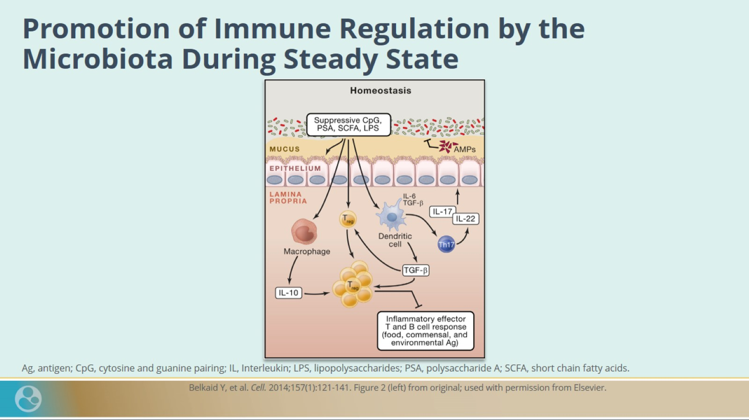
Promotion of Immune Regulation by the Microbiota During Steady State

Slide 31
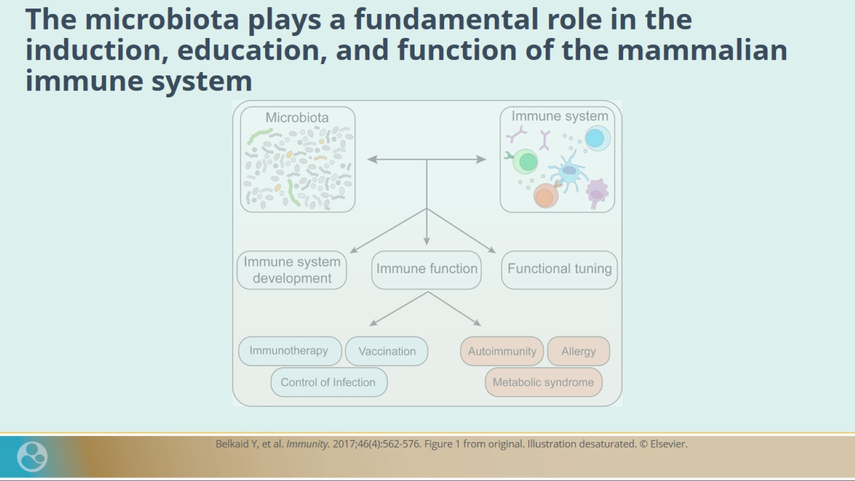
The microbiota plays a fundamental role in the induction, education, and function of the mammalian immune system

Slide 32
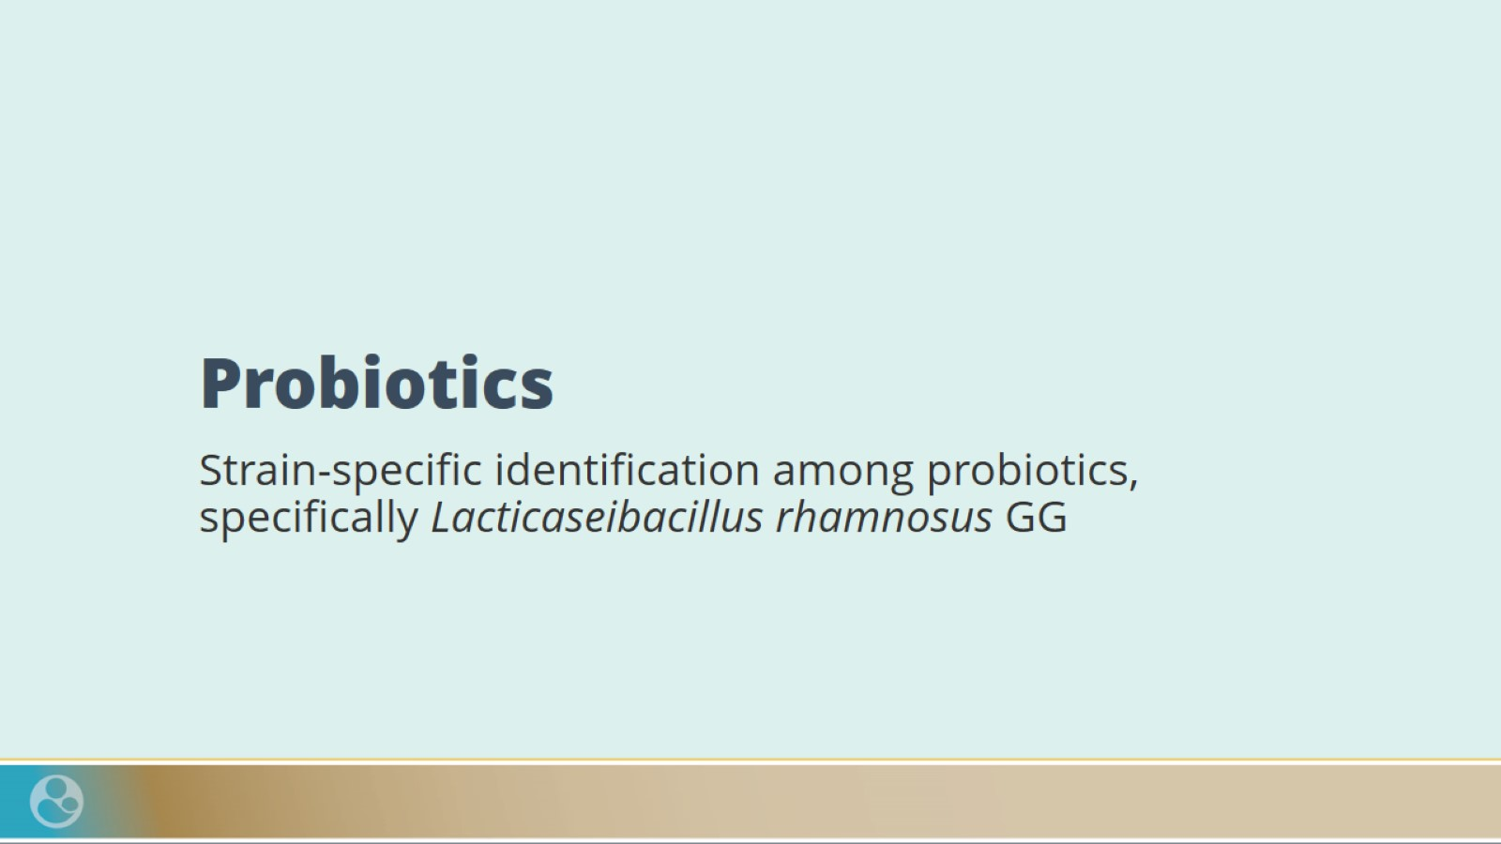
Probiotics

Slide 33
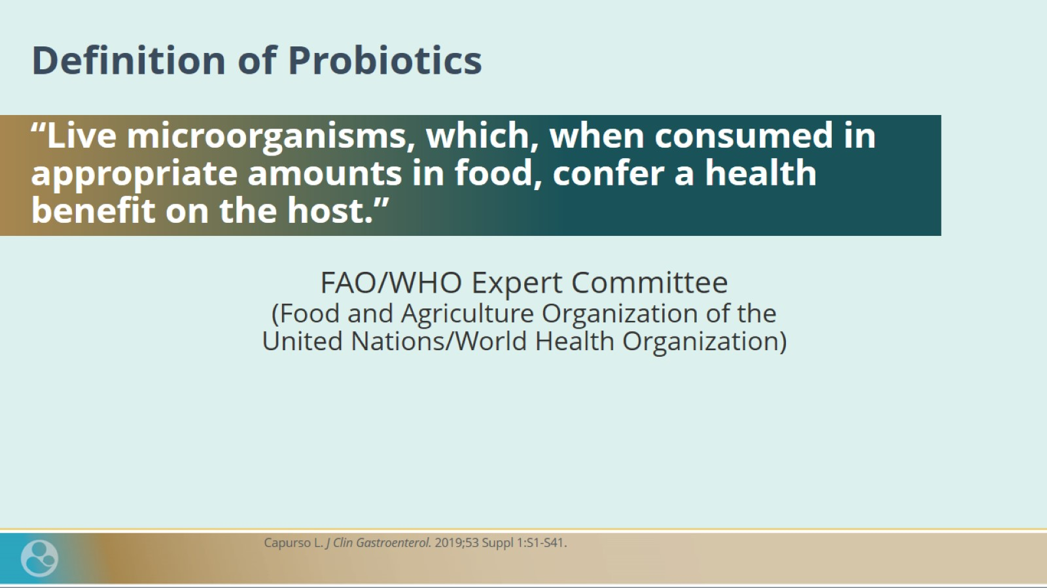
Definition of Probiotics

Slide 34
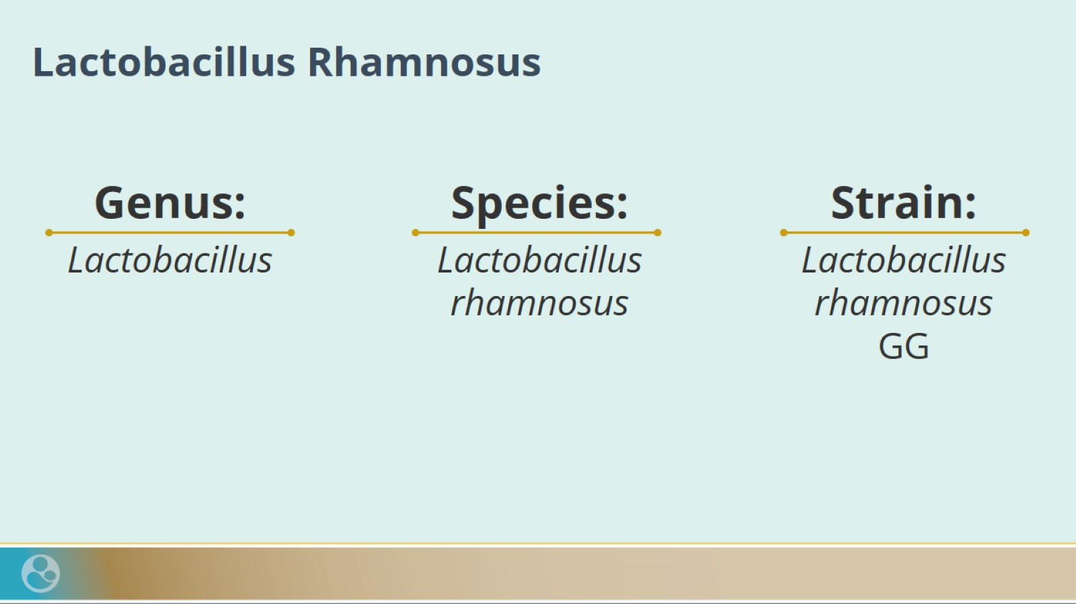
Lactobacillus Rhamnosus

Slide 35
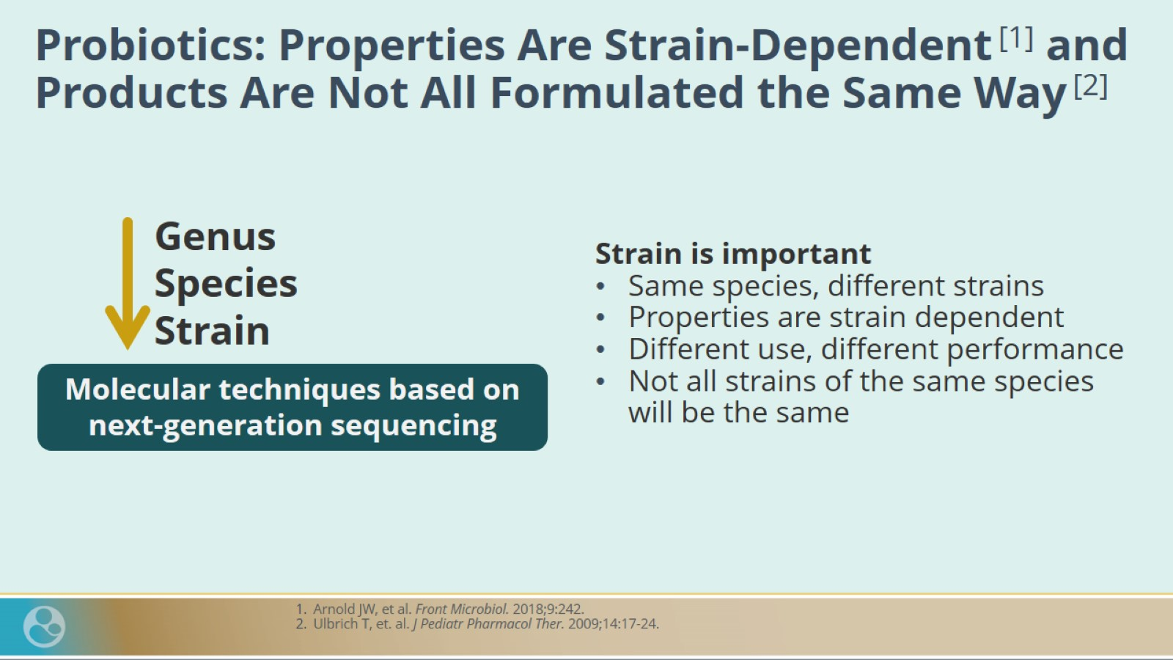
Probiotics: Properties Are Strain-Dependent ^{[1]} and Products Are Not All Formulated the Same Way ^{[2]}

Slide 36
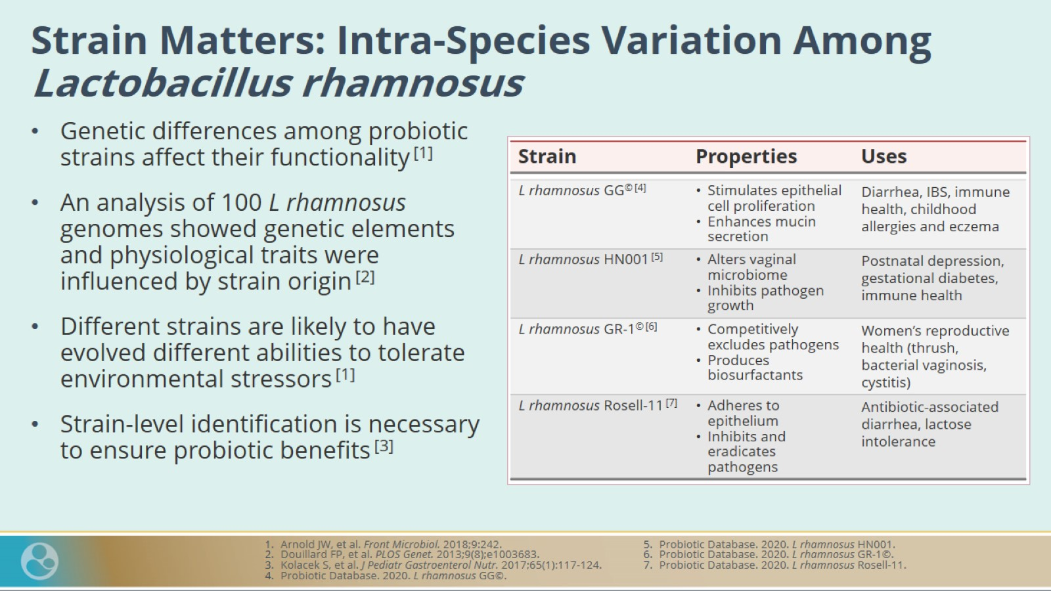
Strain Matters: Intra-Species Variation Among Lactobacillus rhamnosus

Slide 37
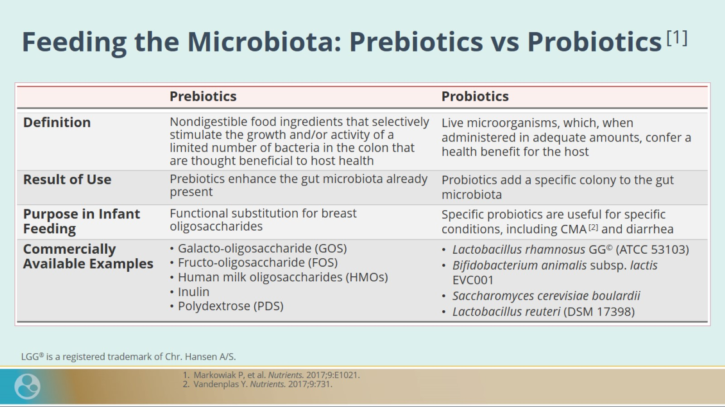
Feeding the Microbiota: Prebiotics vs Probiotics ^{[1]}

Slide 38
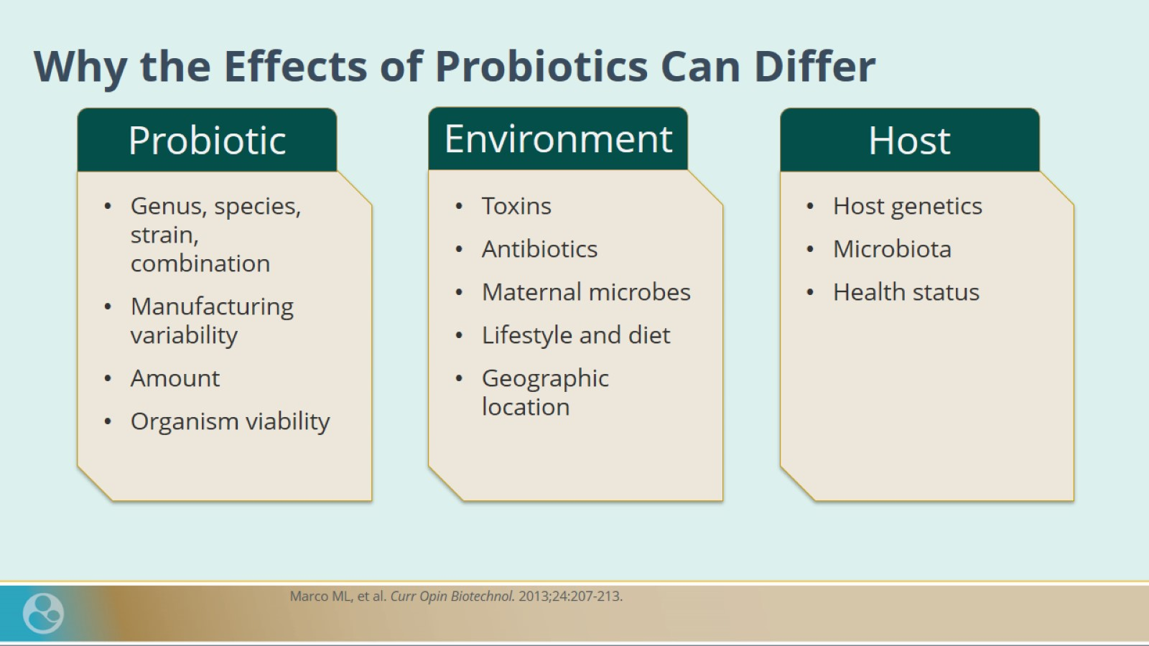
Why the Effects of Probiotics Can Differ

Slide 39
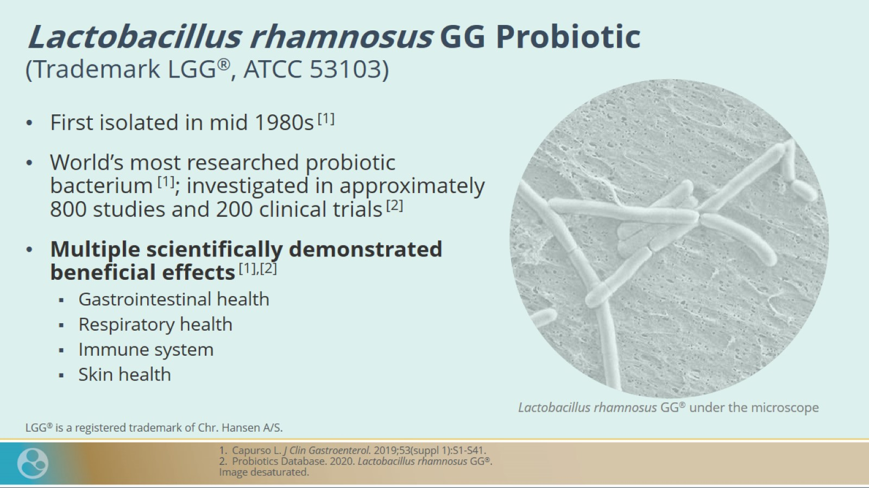
Lactobacillus rhamnosus GG Probiotic
(Trademark LGG®, ATCC 53103)

Slide 40
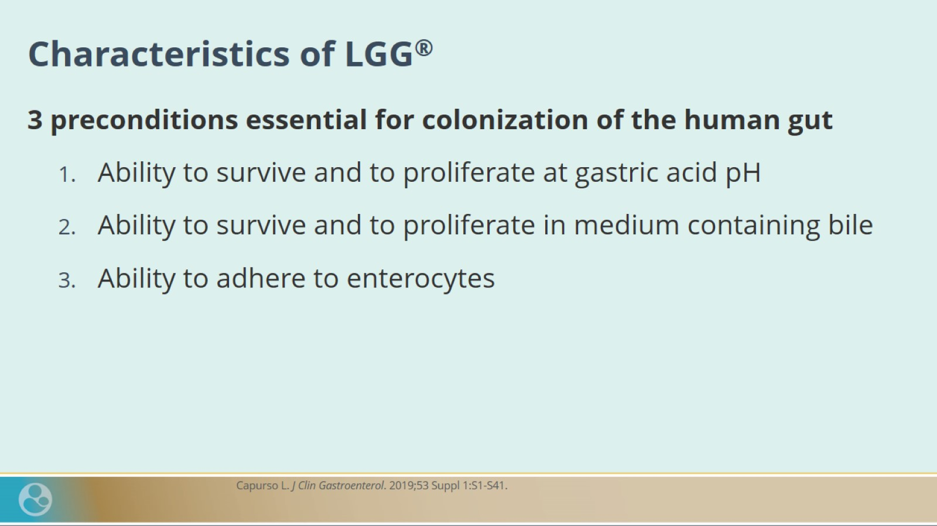
Characteristics of LGG®

Slide 41
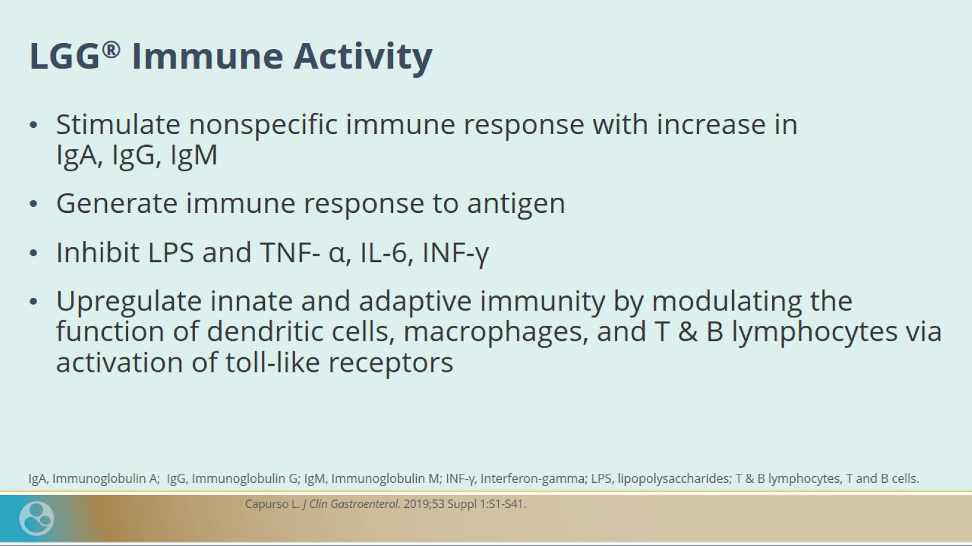
LGG® Immune Activity

Slide 42
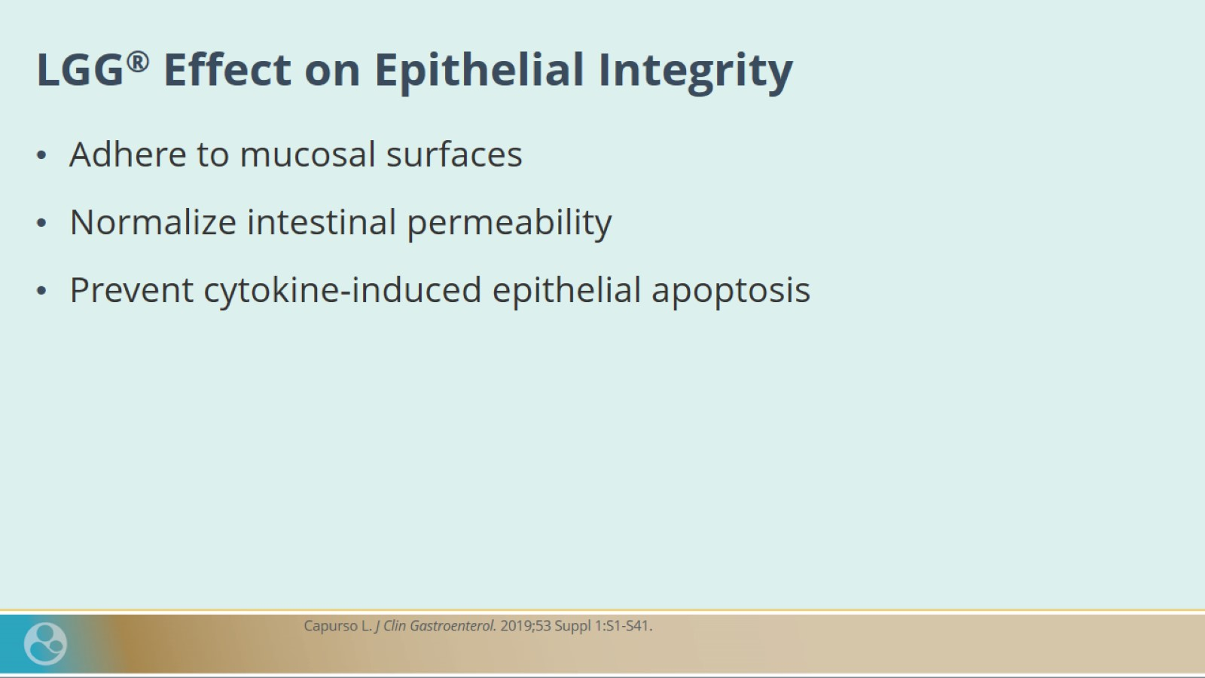
LGG® Effect on Epithelial Integrity

Slide 43
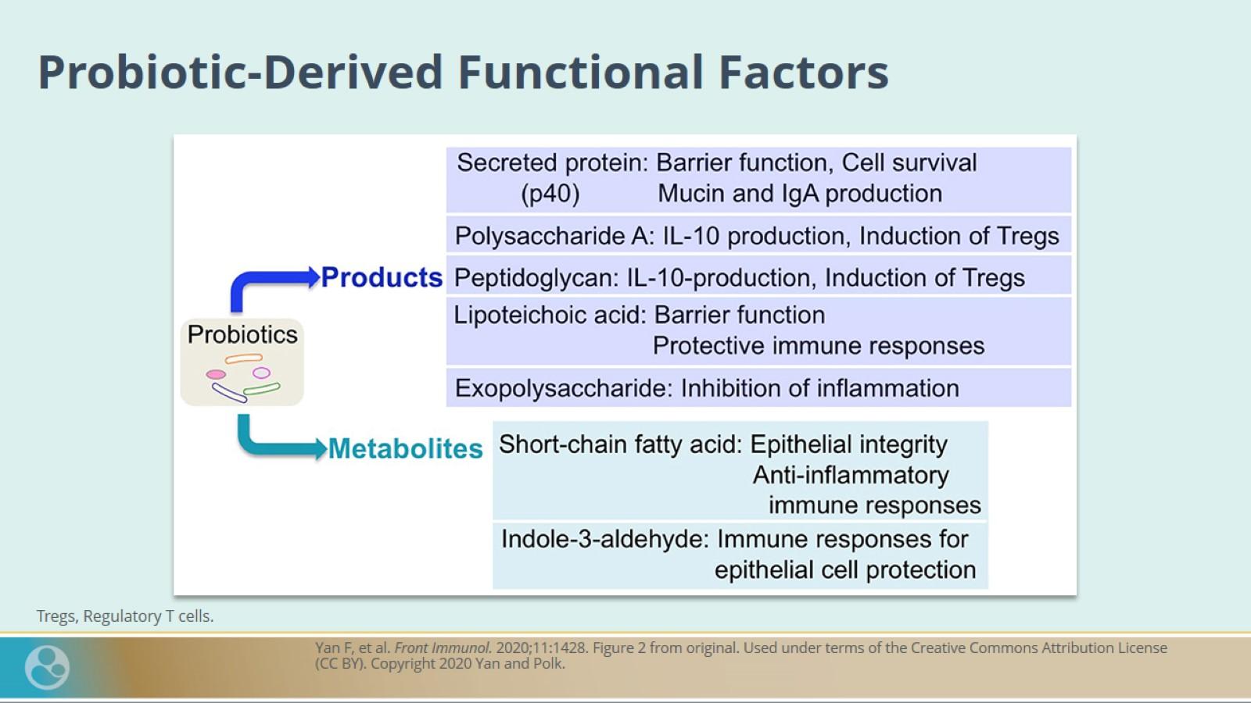
Probiotic-Derived Functional Factors

Slide 44
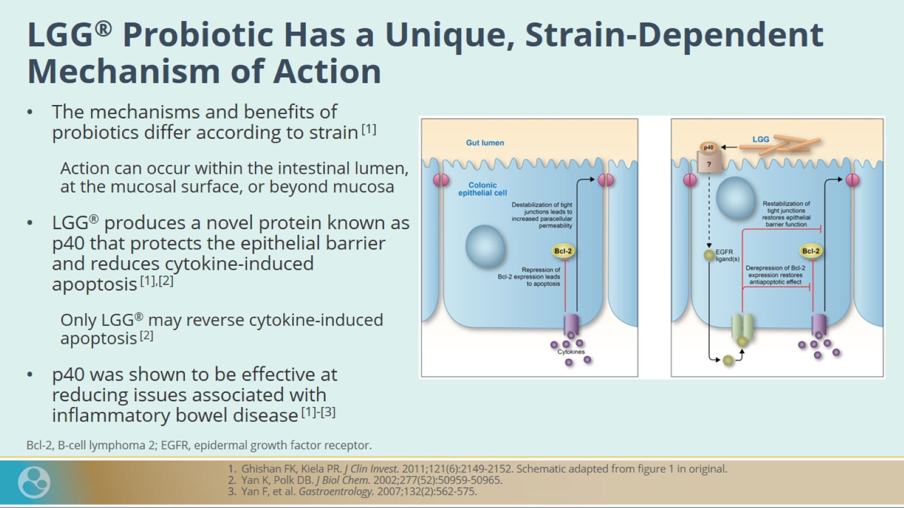
LGG® Probiotic Has a Unique, Strain-Dependent Mechanism of Action

Slide 45
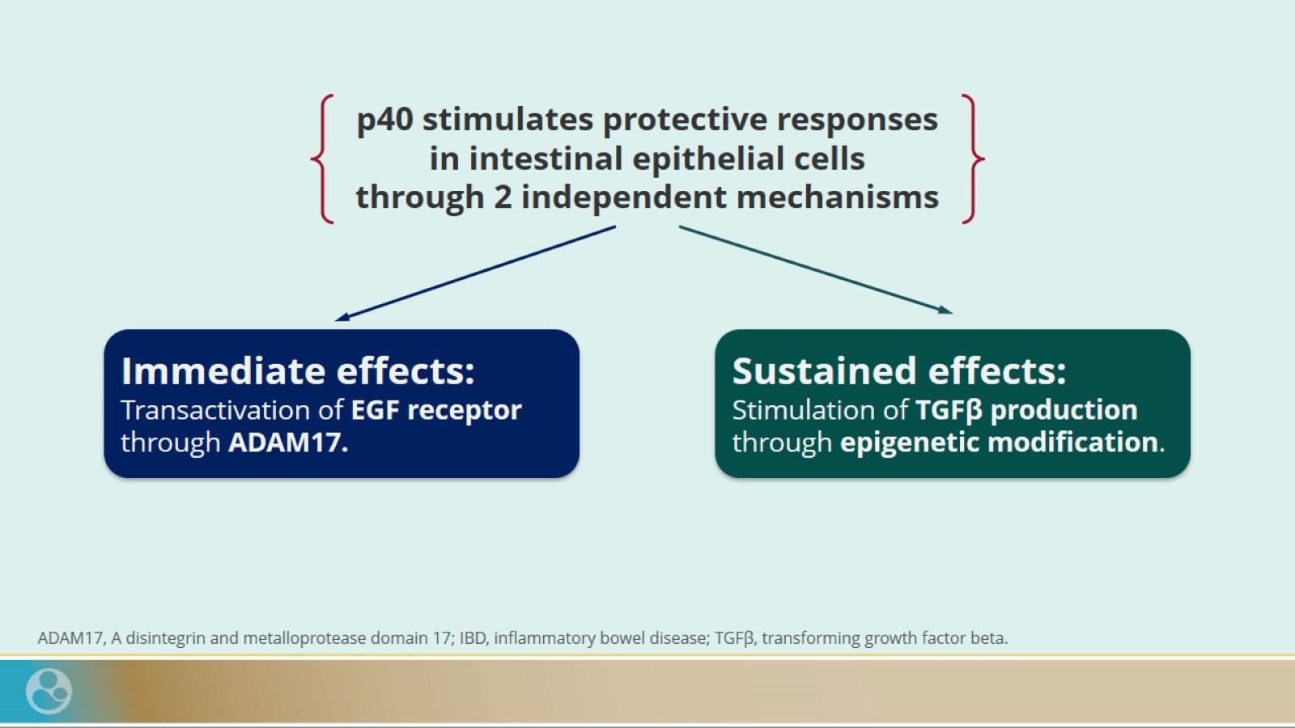

Slide 46
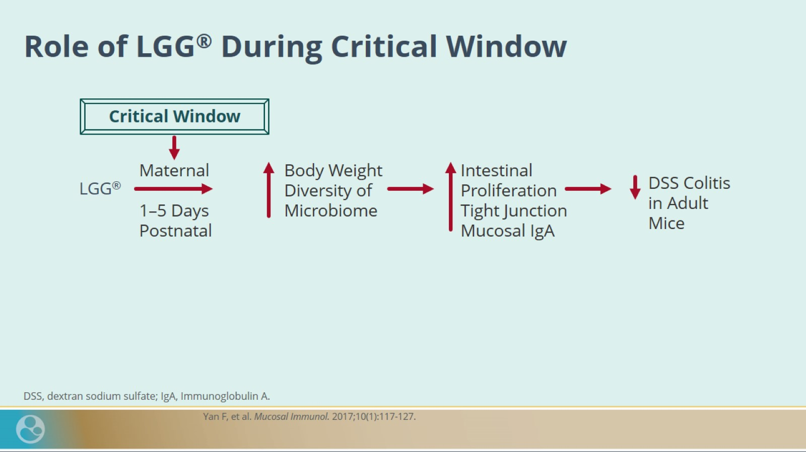
Role of LGG® During Critical Window

Slide 47
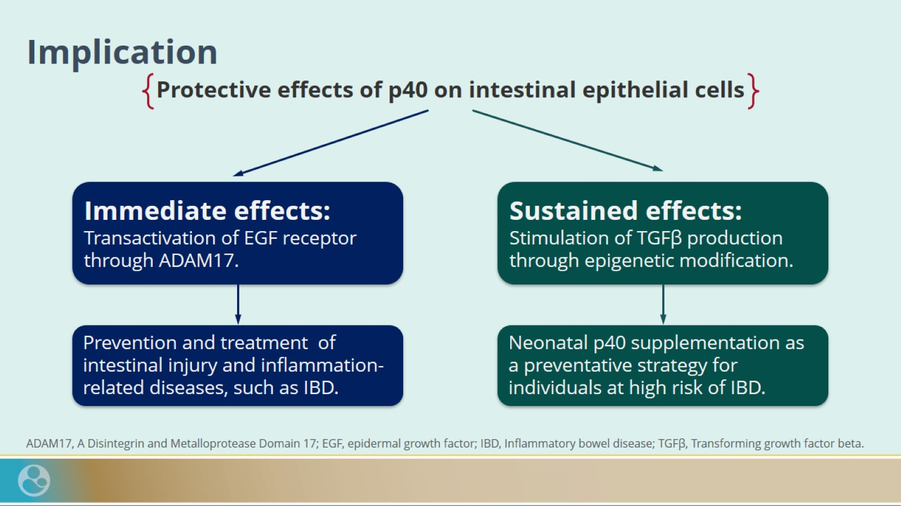
Implication

Slide 48
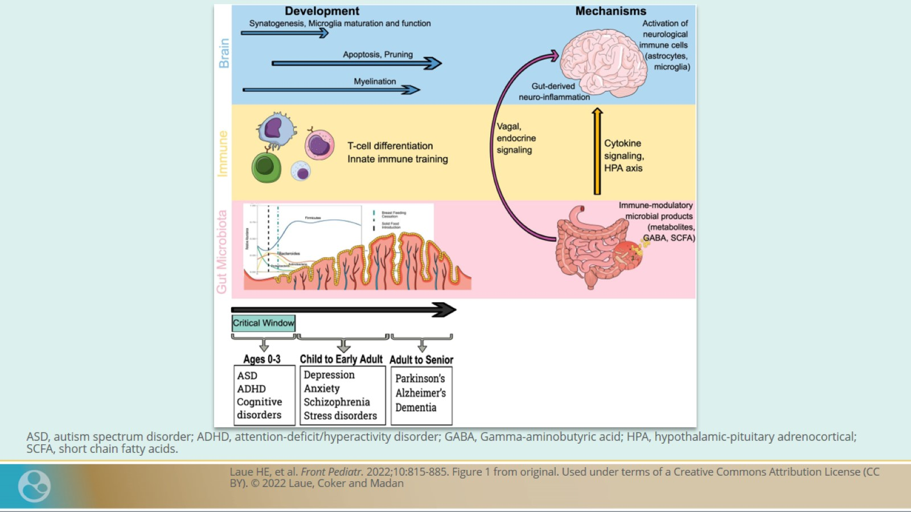

Slide 49
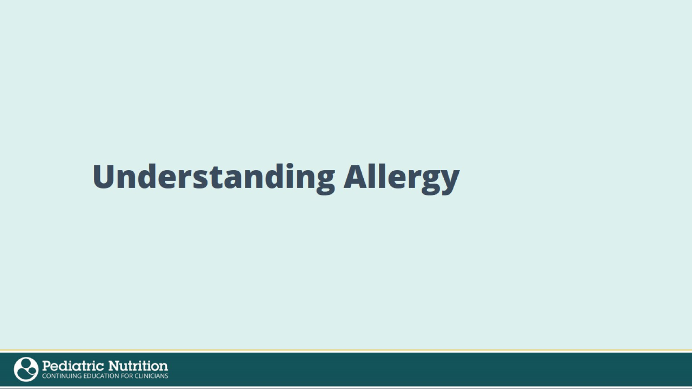
Understanding Allergy

Slide 50
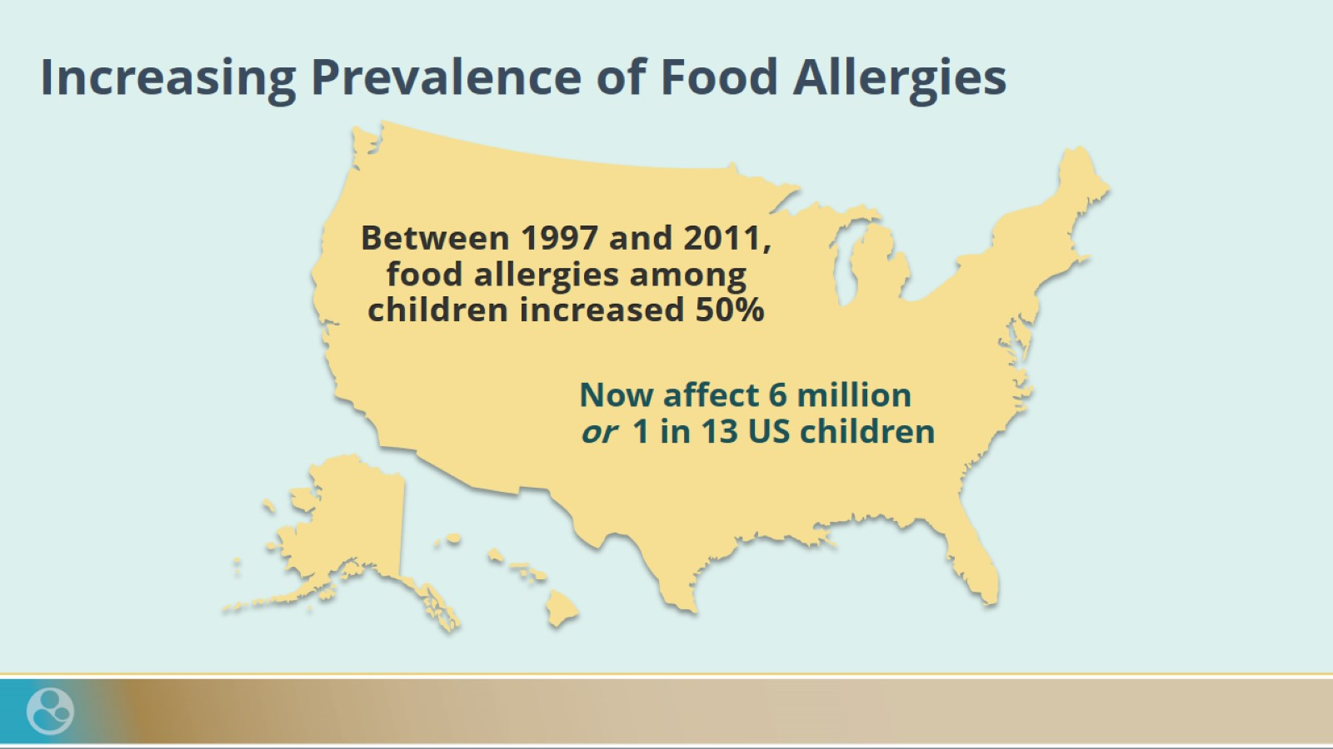
Increasing Prevalence of Food Allergies

Slide 51
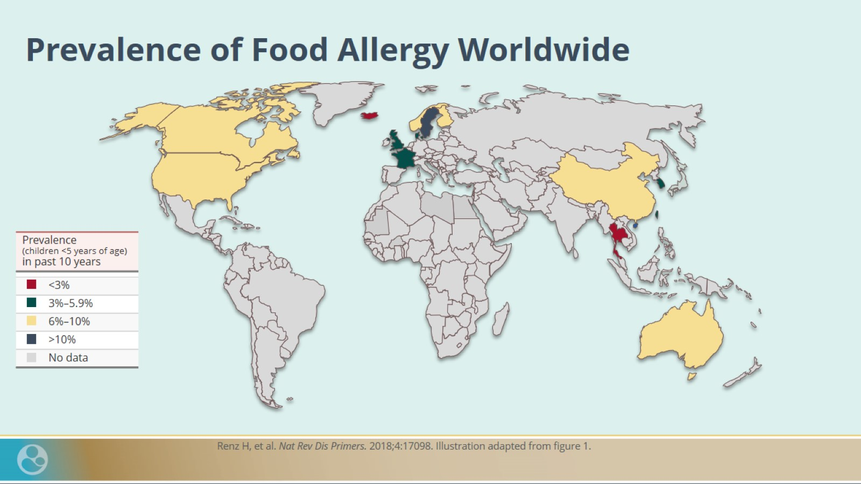
Prevalence of Food Allergy Worldwide

Slide 52
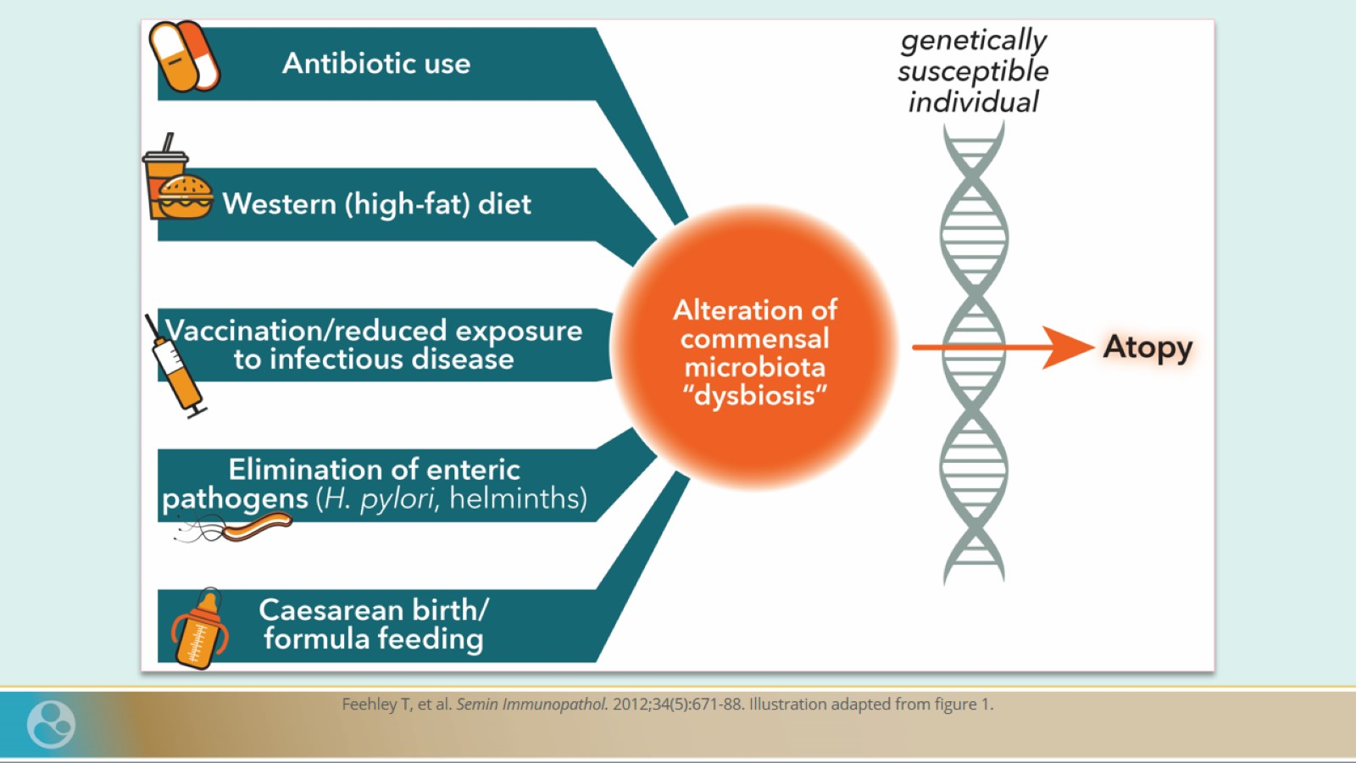

Slide 53

Effects of Probiotics in Atopic Disease Management ^{[1]–[4]}

Slide 54

Effects of Probiotics in Atopic Disease Management ^{[1]–[4]}

Slide 55

LGG® Probiotic Has Been Shown to Play a Role in Managing Atopic Eczema

Slide 56

LGG® Probiotic Has Been Shown to Play a Role in Managing Atopic Dermatitis

Slide 57

LGG® Probiotic Has Been Shown to Play a Role in Managing Infantile Colic

Slide 58

LGG® Probiotic Reduces Inflammation and Supports Gut Barrier Function in Infants With CMAC: Fecal Calprotectin Results

Slide 59

LGG® Probiotic Reduces the Occurrence of Hematochezia in Infants With CMAC: Occult Blood Stool Results

Slide 60

Summary

