Slide 2
Faculty Disclosures
Research Support: Regeneron, Allakos, Shire/Takeda, AstraZeneca, Adare/Ellodi, Danone
Consultant: Regeneron, Allakos, Adare/Ellodi, Shire/Takeda, AstraZeneca, Sanofi, Bristol Myers Squibb, Phathom, Recludix Pharma
All in the field of eosinophilic gastrointestinal diseases.

Slide 3
Learning Objectives
Recognize the clinical presentation of EoE in infants, toddlers, children and teenagers
Explore various dietary and medical management options for pediatric patients with EoE
Notes:
The lecture will be divided into 3 modules.

Slide 4
Module 1
Define EoE
Discuss etiology
Review immunopathogenesis

Slide 5
EoE: Definition
Chronic, immune/antigen-mediated esophageal disease is characterized by
Clinically: Symptoms related to esophageal dysfunction
Histologically: Esophageal eosinophil-predominant inflammation
Liacouras et al, J Allergy Clin Immunol 2011
Notes:
Reference:
Liacouras CA, Furuta GT, Hirano I, et al. Eosinophilic esophagitis: updated consensus recommendations for children and adults. J Allergy Clin Immunol. 2011;128(1):3-20.e6; quiz 21-2. doi: 10.1016/j.jaci.2011.02.040.

Slide 6
EoE: Causes
EoE triggers
Food allergens
Environmental allergens
Liacouras et al, J Allergy Clin Immunol 2011

Slide 7
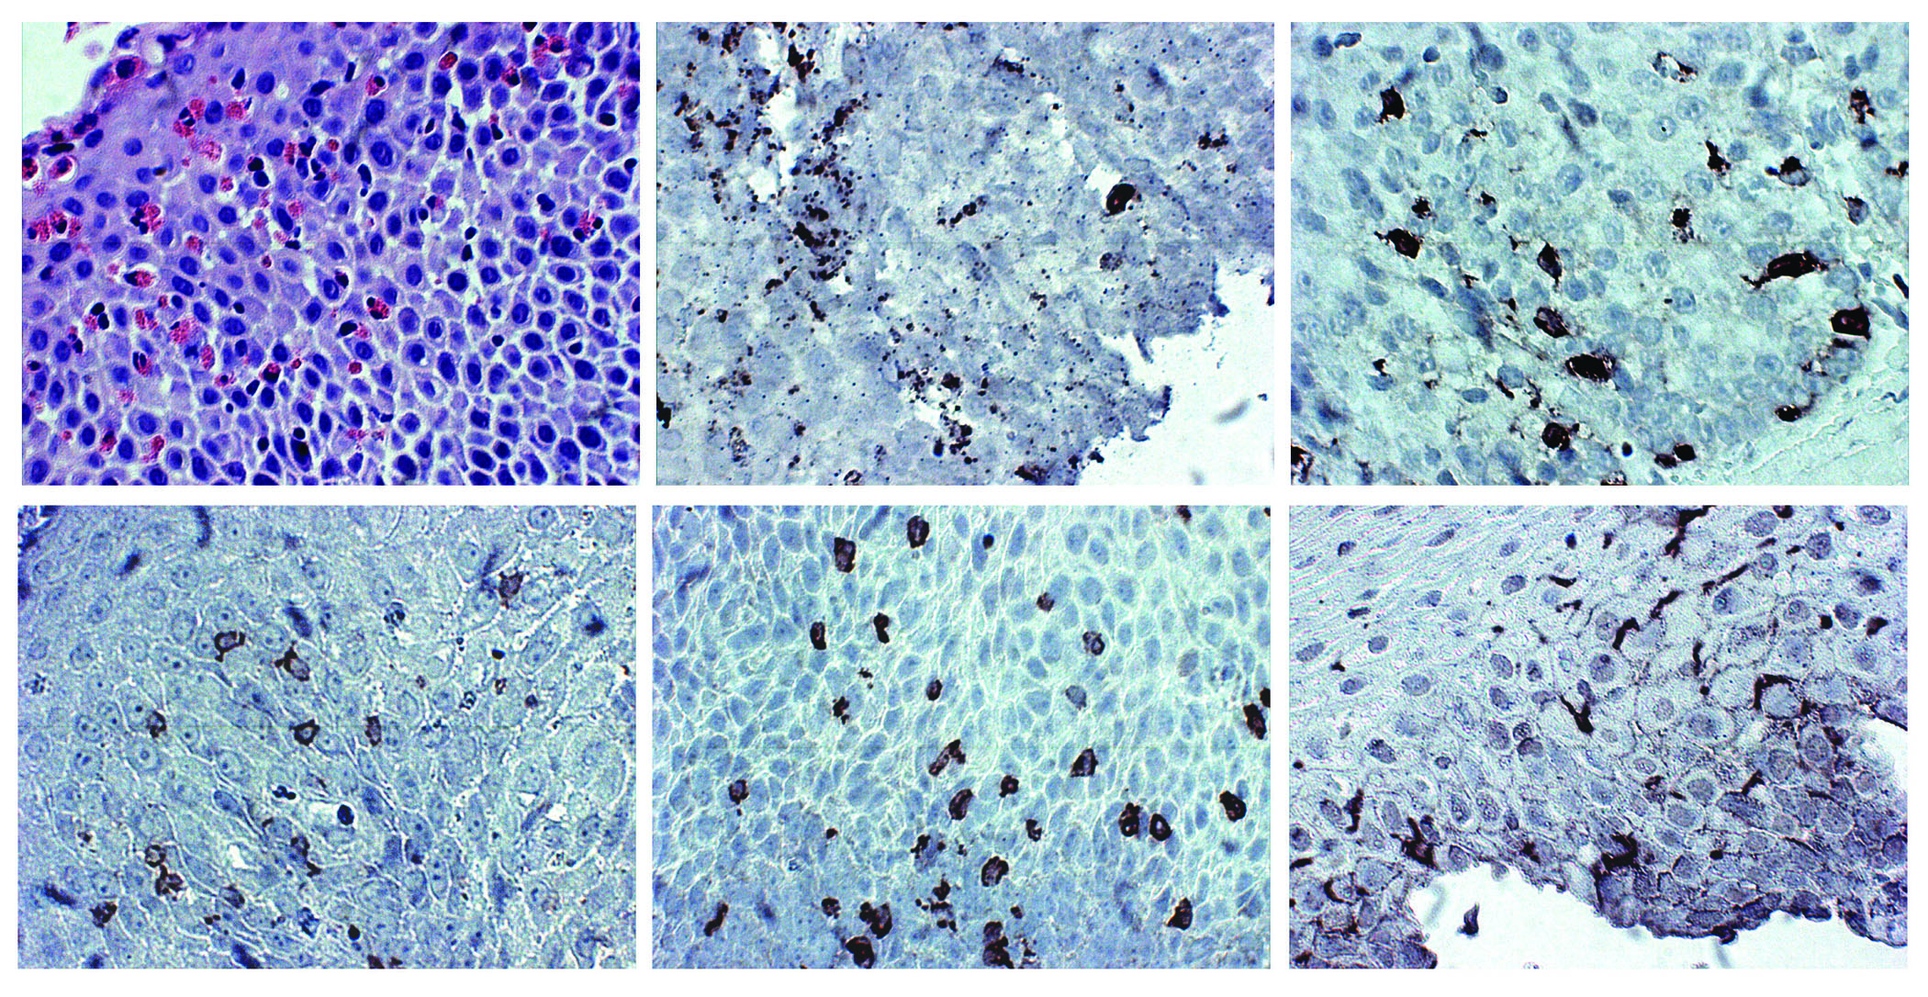
EoE: Allergic Histopathology
Allergen exposure → Allergic inflammatory response → Infiltration of the esophagus with eosinophils and other inflammatory cells
Eosinophils
Activated eosinophils
Mast cells
CD4 lymphocytes
CD8 lymphocytes
Dendritic cells
Chehade, Gastrointest Endosc Clin N Am 2008

Slide 8
EoE: Allergic Th2 Lymphocytes
Allergic Th2 milieu
IL-4
IL-13
IL-5
Cells x 10³/mm³
T lymphocytes
B lymphocytes
Lucendo et al, Am J Surg Pathol 2007
Blanchard et al, J Allergy Clin Immunol 2007
Notes:
References:
Blanchard C, Mingler MK, Vicario M, et al. IL-13 involvement in eosinophilic esophagitis: transcriptome analysis and reversibility with glucocorticoids. J Allergy Clin Immunol. 2007;120(6):1292-300.
Lucendo AJ, Navarro M, Comas C, et al. Immunophenotypic characterization and quantification of the epithelial inflammatory infiltrate in eosinophilic esophagitis through stereology: an analysis of the cellular mechanisms of the disease and the immunologic capacity of the esophagus. Am J Surg Pathol. 2007;31(4):598-606.

Slide 9
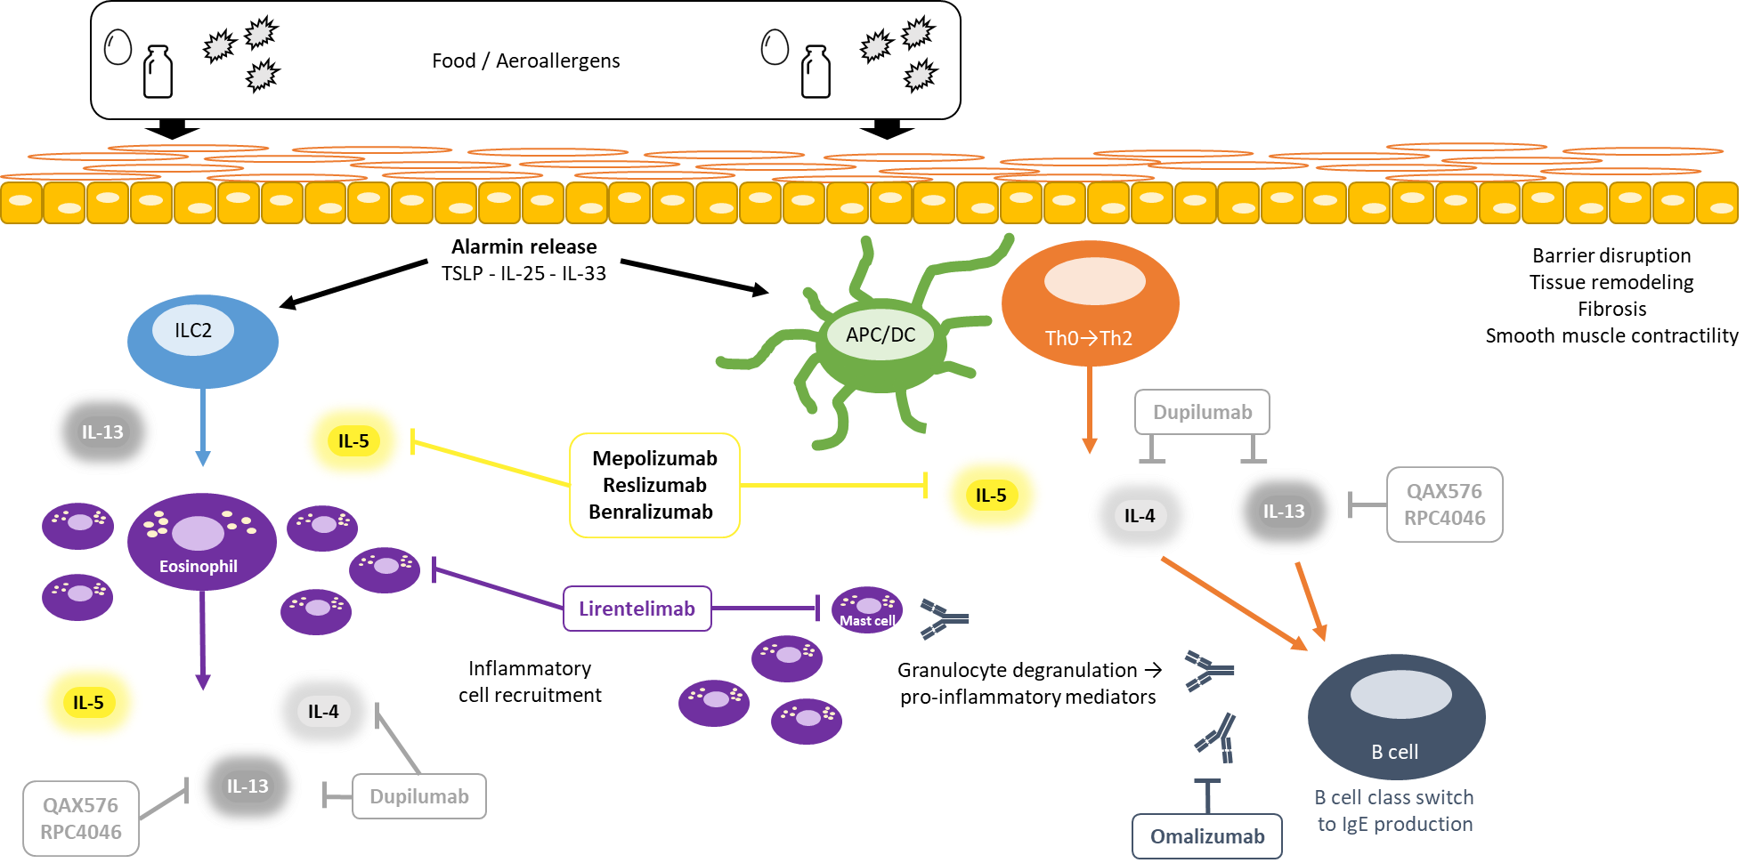
EoE: Immunopathogenesis
Bredenoord…Chehade…Jacob-Nara, Am J Gastroenterol 2022
Notes:
This cartoon summarizes what we just described in a simplified sequential manner. Food and environmental allergens trigger the esophageal epithelium to release alarmins, namely TSLP, IL-25 and IL-33, which then polarize downstream pathways toward an aberrant type 2 inflammatory response.
Type 2 cytokines, most notably IL-4, IL-5, and IL-13, and other proinflammatory mediators drive localized eosinophilia alongside the recruitment of inflammatory cells to the esophageal epithelium. IgE triggers granulocyte degranulation, releasing additional proinflammatory mediators, which promote a positive feedback loop. The resultant chronic inflammation ultimately leads to tissue remodeling and fibrosis.

Slide 10
Conclusion: Etiology and immunopathogenesis of EoE
EoE is a chronic disease.
It is triggered by food(s) and at times environmental allergens.
An allergic inflammatory process is dominant in a large number of patients with EoE.

Slide 11
Module 2
Demographics of EoE
How to diagnose EoE
EoE natural history, if untreated

Slide 12
EoE: Demographics
Age
Can occur at all ages
Gender
More common in males (M:F ratio ~3:1)
Comorbidities
More common in patients with food allergy
More common in patients with atopic diseases
Familial history
Family history of EoE
Family history of atopic diseases
Genetics and shared environment effects
Liacouras et al, J Allergy Clin Immunol 2011
Jensen et al, J Pediatr Gastroenerol Nutr 2013
Chehade et al, J Allergy Clin Immunol Pract 2018
Notes:
References:
Liacouras CA, Furuta GT, Hirano I, et al. Eosinophilic esophagitis: updated consensus recommendations for children and adults. J Allergy Clin Immunol. 2011;128(1):3-20.e6; quiz 21-2. doi: 10.1016/j.jaci.2011.02.040.
Jensen ET, Kappelman MD, Kim HP, Ringel-Kulka T, Dellon ES. Early life exposures as risk factors for pediatric eosinophilic esophagitis. J Pediatr Gastroenterol Nutr. 2013;57(1):67-71.
Chehade M, Jones SM, Pesek RD, et al. Phenotypic Characterization of Eosinophilic Esophagitis in a Large Multicenter Patient Population from the Consortium for Food Allergy Research. J Allergy Clin Immunol Pract. 2018;6(5):1534-1544.e5. doi: 10.1016/j.jaip.2018.05.038. Epub 2018 Aug 1.

Slide 13
EoE: Diagnosis

Slide 14
EoE: Symptoms Vary With Age
% patients
Chehade et al, J Pediatr Gastroenterol Nutr 2007
Gonsalves et al, Gastrointest Endosc 2006
Notes:
References:
Chehade M, Sampson HA, Morotti RA, Magid MS. Esophageal subepithelial fibrosis in children with eosinophilic esophagitis. J Pediatr Gastroenterol Nutr. 2007;45(3):319-28.
Gonsalves N, Policarpio-Nicolas M, Zhang Q, Rao MS, Hirano I. Histopathologic variability and endoscopic correlates in adults with eosinophilic esophagitis. Gastrointest Endosc. 2006;64(3):313-9.

Slide 15
EoE in young children: Feeding dysfunction
Oral motor dysfunction
Food refusal as a result of pain/discomfort → Disruption of normal development of oral motor skills → Immature oral motor skill set
Oral sensory dysfunction
Discomfort related to eating → Self-imposed lack of exposure to food →Gagging in response to a particular taste or texture
Discomfort related to eating → reduced motivation for oral exploration
→ Delayed oral sensory development
Young children with EoE can present with gagging with food and food refusal
Haas and Maune, Immunol Allergy Clin N Am 2009

Slide 16
EoE: Challenges in Clinical Presentation
Nonspecific gastrointestinal symptoms → look for:
Early satiety
Failure to thrive
Picky eating that is texture-specific
Personal or family history of food allergy
Personal or family history of atopy
History of allergic gastrointestinal symptoms in infancy
Subtle symptoms (due to feeding compensatory behaviors) → look for:
Taking too long to finish a meal
Prolonged chewing
Pocketing food in the mouth
Needing to drink with every bite of food
Cutting food into very small pieces
Lubricating tough/lumpy foods with condiments/dunking in liquids
Avoiding tough/lumpy foods altogether
Food refusal altogether

Slide 17
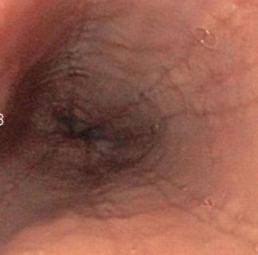
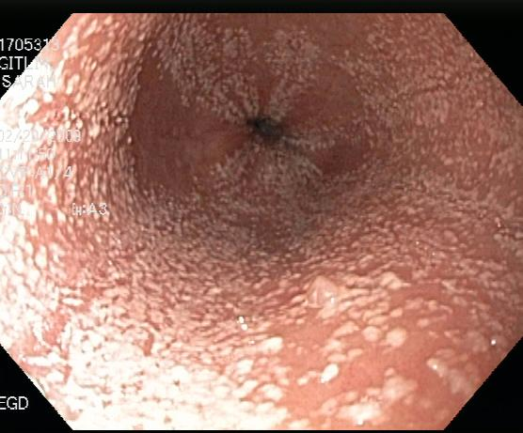
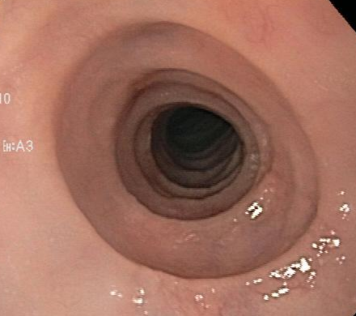
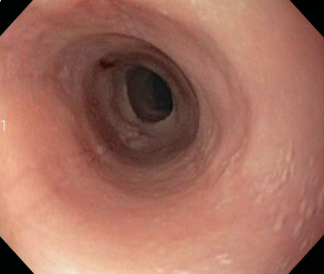
EoE: Endoscopic Diagnosis
Furrows
Plaques
Rings
Stricture

Slide 18
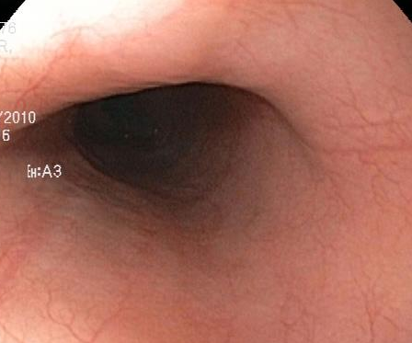
EoE: Endoscopic Diagnosis
normal
Endoscopy can be normal in up to 20% of patients
→ Biopsies important regardless of the endoscopic findings

Slide 19
EoE: Histological Diagnosis
Normal (0 eos/HPF)
EoE (≥15 eos/HPF)
PATCHY DISEASE
eos/HPF, eosinophils per high-power field

Slide 20
EoE: Histological Diagnosis
Eosinophil superficial layering and microabscesses
Eosinophilic degranulation

Slide 21
Most recent EoE Diagnostic Algorithm
Clinical presentation suggestive of EoE
Upper endoscopy with biopsies
Esophageal eosinophilia (≥15 eosinophils/HPF)
Evaluate for non-EoE disorders that cause or potentially contribute to esophageal eosinophilia
Eosinophilic esophagitis
Dellon et al, Gastroenterology 2018
Notes:
Reference:
Dellon ES, Liacouras CA, Molina-Infante J, et al. Updated International Consensus Diagnostic Criteria for Eosinophilic Esophagitis: Proceedings of the AGREE Conference. Gastroenterology. 2018;155(4):1022-1033.e10. doi: 10.1053/j.gastro.2018.07.009.

Slide 22
EoE: Natural History

Slide 23
EoE: Natural History
EoE is a chronic disease
EoE may progress: inflammation-predominant → fibrosis-predominant

Slide 24
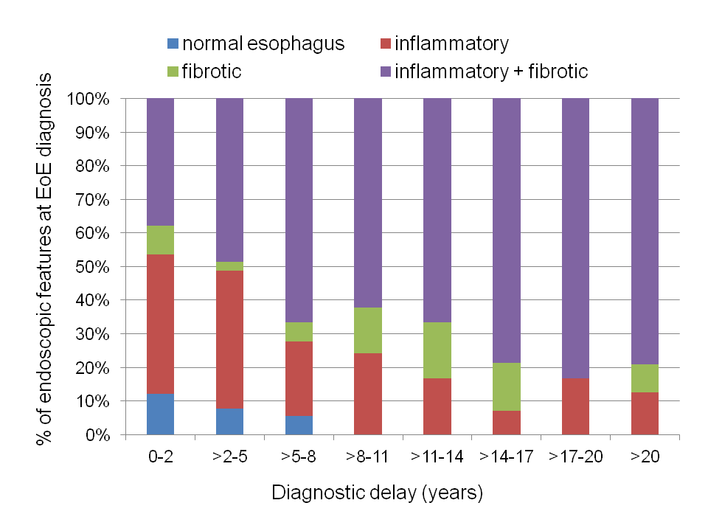
EoE: Course With Increasing Duration of Symptoms
Schoepfer et al, Gastroenterology 2013
Notes:
5/15/2023
24
Reference:
Schoepfer AM, Safroneeva E, Bussmann C, et al. Delay in diagnosis of eosinophilic esophagitis increases risk for stricture formation in a time-dependent manner. Gastroenterology. 2013;145(6):1230-6.e1-2. doi: 10.1053/j.gastro.2013.08.015.

Slide 25
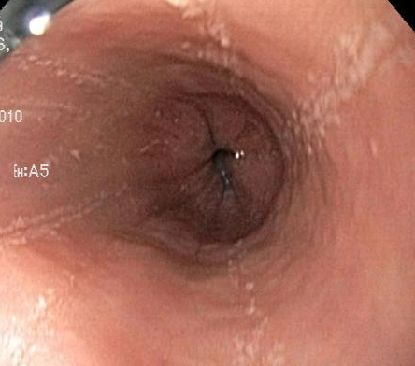
EoE: Inflammatory Phenotype
Furrows
Plaques
Plaques along furrows
Seen more often in early disease
Seen more often in children

Slide 26
EoE: Fibrostenotic Phenotype
Rings
Stricture
Seen more often in late disease
Seen more often in adults

Slide 27
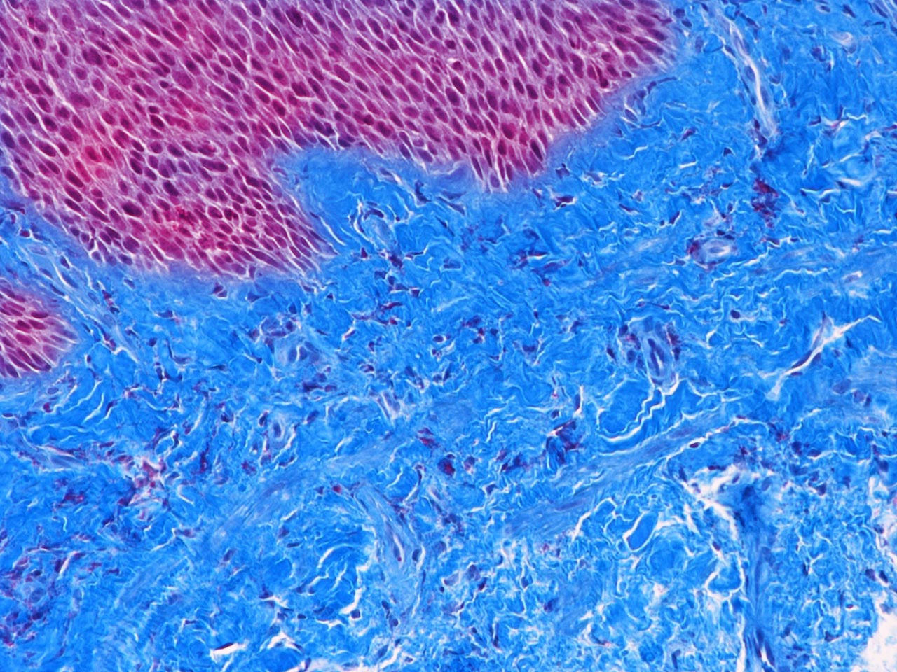
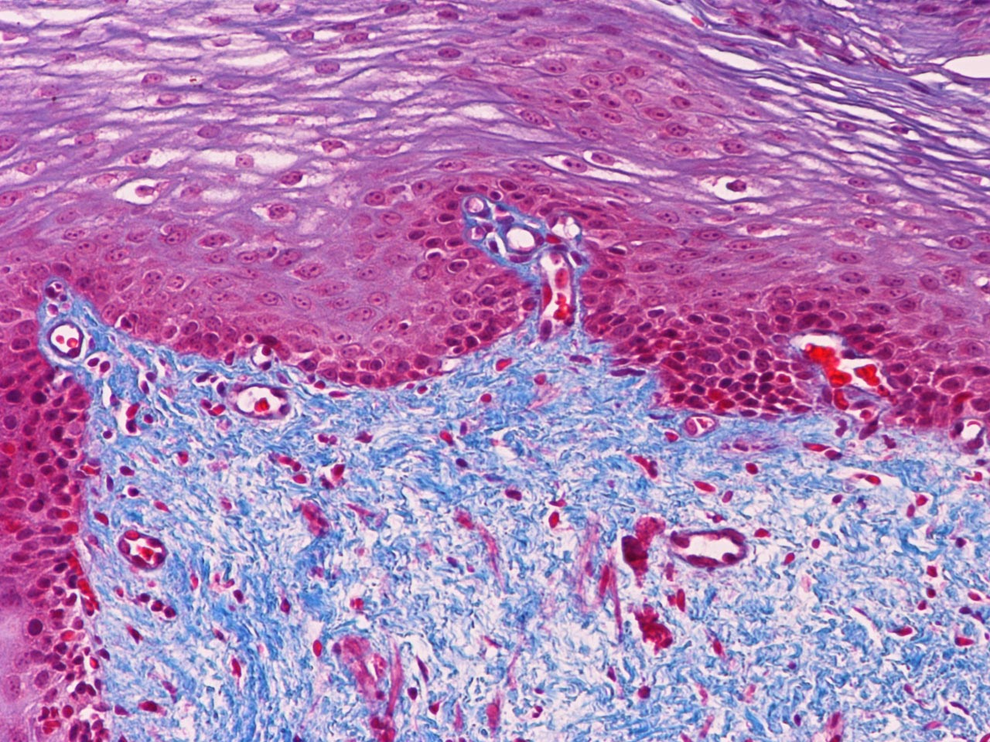
Pediatric EoE: Fibrosis can be reversed with diet or topical corticosteroids
EoE Patient
Pre-treatment
EoE Patient
Post-treatment
Trichrome stain
Lieberman…Chehade, Allergy 2012
Used by permission from John Wiley and Sons
Notes:
This emphasizes the importance of treating children with EoE, to reverse complications
Reference:
Lieberman JA, Morotti RA, Konstantinou GN, Yershov O, Chehade M. Dietary therapy can reverse esophageal subepithelial fibrosis in patients with eosinophilic esophagitis: a historical cohort. Allergy. 2012;67(10):1299-307. doi: 10.1111/j.1398-9995.2012.02881.x.

Slide 28
Conclusion: Diagnosis and Natural History of EoE
EoE diagnosis is based on clinical, endoscopic, and histological criteria.
Symptoms can be nonspecific in children with EoE.
If left untreated, EoE can lead to fibrostenotic complications.

Slide 29
Module 3
Treatment options
Dietary restriction therapies
Medications

Slide 30
EoE: Dietary Therapy

Slide 31
EoE: Dietary therapies
Histological remission rate (%)
Arias et al, Gastroenterology 2014
Notes:
3 diets have been extensively tested in patients with EoE, and have therefore become standard of care.

Slide 32
EoE: Comparative efficacy of diets
1-FED
(milk)
Remission rate (%)
Arias et al, Gastroenterology 2014
Kagalwalla…Chehade, Clin Gastroenterol Hepatol 2017
Molina-Infante et al, J Allergy Clin Immunol 2014
Molina-Infante et al, J Allergy Clin Immunol 2017

Slide 33
Diets in EoE: Which patients are ideal candidates?
Age
Diet/nutritional status
Malnutrition
Feeding difficulties
Self-restrictive behaviors toward food
Number of foods already avoided
Social and financial factors
Motivation of patient and family
Social support system
Financial support system
Acceptance of multiple endoscopies
Chehade and Brown, Expert Rev Clin Immunol 2020

Slide 34
EoE: Nutritional Management in Practice
Work Group Report of AAAAI 2017 for dietary therapy implementation:
Assess nutritional status
Eliminate dietary antigens
Individualize to meet nutritional needs
Give practical tips on substitutions
Provide monitoring
Groetch…Chehade, J Allergy Clin Immunol Pract 2017
Notes:
Reference:
Groetch M, Venter C, Skypala I, et al. Dietary Therapy and Nutrition Management of Eosinophilic Esophagitis: A Work Group Report of the American Academy of Allergy, Asthma, and Immunology. J Allergy Clin Immunol Pract. 2017;5(2):312-324.e29. doi: 10.1016/j.jaip.2016.12.026.

Slide 35
EoE: Dietary Therapy as Maintenance Therapy?
Diets can be gradually liberalized over time, through addition of foods that prove not to trigger EoE.
Challenges with food introductions:
Difficulty identifying safe foods (mostly trial and error)
Rare chance of de novo acute allergic reactivity → Skin prick test/serum food-IgE level (by an allergist) may be needed before food reintroduction
Ho and Chehade, J Allergy Clin Immunol Pract 2018
Notes:
Reference:
Ho HE, Chehade M. Development of IgE-mediated immediate hypersensitivity to a previously tolerated food following its avoidance for eosinophilic gastrointestinal diseases. J Allergy Clin Immunol Pract. 2018;6(2):649-650. doi: 10.1016/j.jaip.2017.08.014.

Slide 36
Conclusion: Dietary Therapy for EoE
Dietary therapy can be effective.
It is optimal for eligible and motivated patients.
Ongoing support is needed for its success.

Slide 37
EoE: Medical Therapy

Slide 38
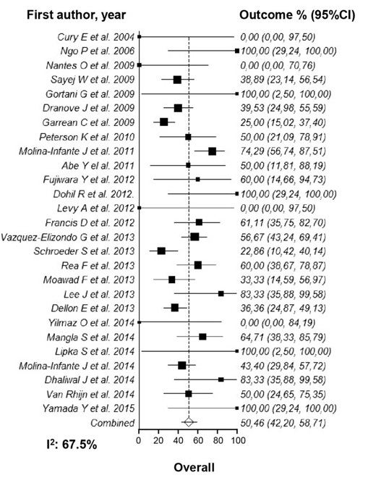
EoE: Proton pump inhibitors
Children: 54%, Adults: 50%
Lucendo et al, Clin Gastroenterol Hepatol 2016
Notes:
Reference:
Lucendo AJ, Arias Á, Molina-Infante J. Efficacy of Proton Pump Inhibitor Drugs for Inducing Clinical and Histologic Remission in Patients With Symptomatic Esophageal Eosinophilia: A Systematic Review and Meta-Analysis. Clin Gastroenterol Hepatol. 2016 ;14(1):13-22.e1. doi: 10.1016/j.cgh.2015.07.041.

Slide 39
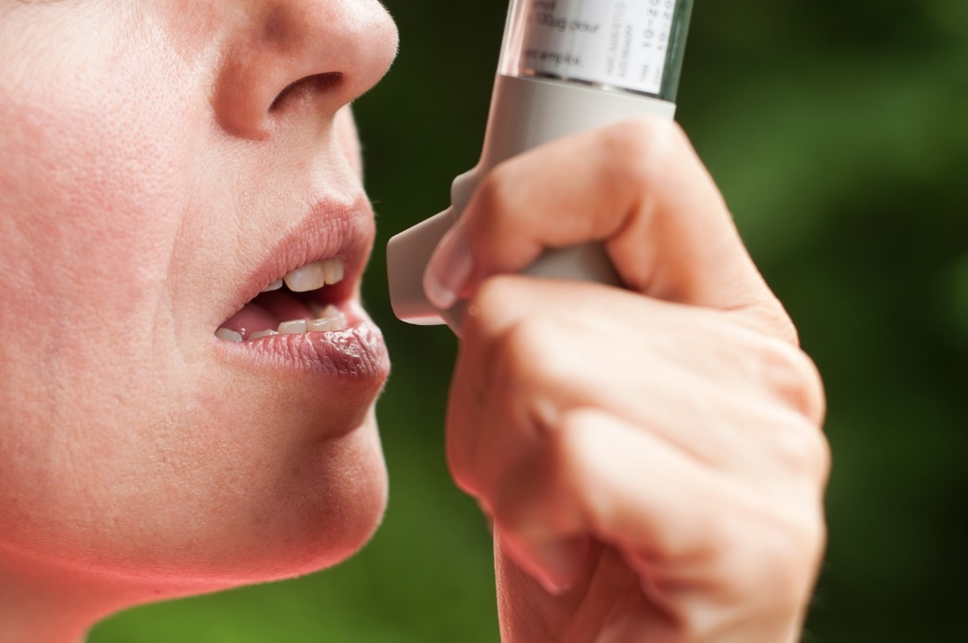
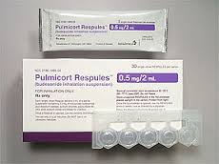
EoE: Topical corticosteroids
Commonly used ones (off-label):
Fluticasone HFA inhaler to swallow
Viscous budesonide to swallow
Efficacy rate (based on 8 RCTs) ~65%
Rank et al, Gastroenterology 2020

Slide 40
EoE: 2011 Guidelines Recommendations
Recommended doses of topical corticosteroids in children
Fluticasone
Children: 88–440 mcg 2 to 4 times daily
Budesonide
Children <10 years: 1 mg daily
Older children: 2 mg daily
Liacouras et al, J Allergy Clin Immunol 2011
Notes:
Reference:
Liacouras CA, Furuta GT, Hirano I, et al. Eosinophilic esophagitis: updated consensus recommendations for children and adults. J Allergy Clin Immunol. 2011;128(1):3-20.e6; quiz 21-2. doi: 10.1016/j.jaci.2011.02.040.

Slide 41
EoE: Budesonide oral suspension (phase 3 trial)
Phase 3 trial, results:
318 patients, 11-55 y
Randomized 2:1 to:
BOS 2 mg BID
Placebo BID
12 weeks of treatment
Clinical response (↓ DSQ by ≥30%)
Open label extension up to 52 weeks: Efficacy maintained among initial responders
Histological response (≤6 eos/HPF)
Hirano et al, Clin Gastroenterol Hepatol 2022
Dellon et al, Clin Gastroenterol Hepatol 2022

Slide 42
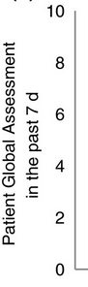
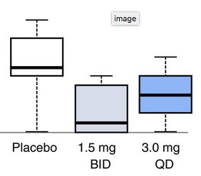
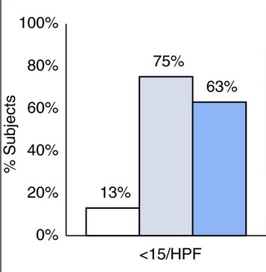
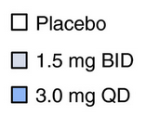
EoE: Fluticasone dissolvable tablet in adolescents and adults
Multi-center, DBPC, phase 1b/2a trial
24 EoE patients, adolescents & adults
Randomized to:
APT-1011 3 mg PO daily
APT-1011 1.5 mg PO BID
Placebo PO daily
8 weeks of treatment
Phase 3 trial currently ongoing:
APT-1011 3 mg PO daily
Placebo PO daily
Clinicaltrials.gov, NCT04281108
Hirano et al, Aliment Pharmacol Ther 2020

Slide 43
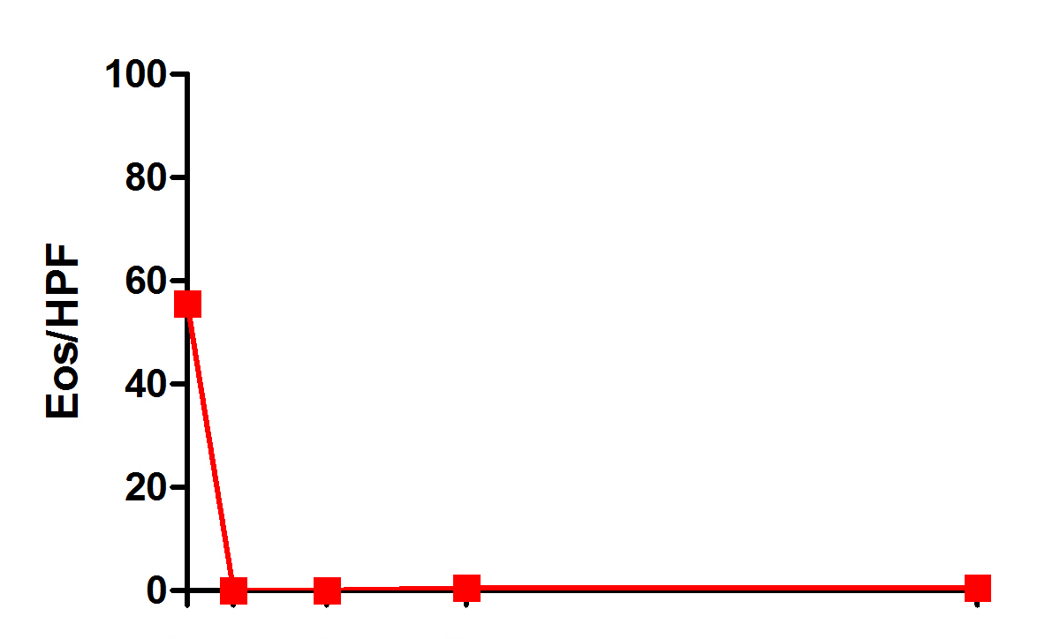
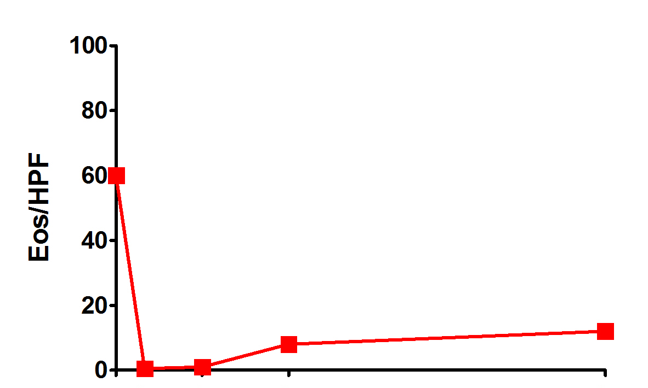
Topical Steroids as Maintenance Therapy?
EoE relapses once topical steroids are discontinued
Long-term therapy is needed
Children: effective in prospective study up to 5.5 years
Proximal Esophagus
Distal Esophagus
** P<0.01
** P<0.01
**
**
**
**
**
**
**
**
13-24 months
2-4 months
5-12 months
13-24 months
>24 months
2-4 months
5-12 months
13-24 months
>24 months
Andreae…Chehade, Am J Gastroenterol 2016
Notes:
Reference:
Andreae DA, Hanna MG, Magid MS, et al. Swallowed Fluticasone Propionate Is an Effective Long-Term Maintenance Therapy for Children With Eosinophilic Esophagitis. Am J Gastroenterol. 2016;111(8):1187-97. doi: 10.1038/ajg.2016.238.

Slide 44
EoE: Biologics
Bredenoord…Chehade…Jacob-Nara, Am J Gastroenterol 2022

Slide 45
EoE: IL-13 as target
Bredenoord…Chehade…Jacob-Nara, Am J Gastroenterol 2022

Slide 46
EoE: Cendakimab (RPC4046) (IL-13 mAb) in adults
Multi-center, DBPC, phase 2 trial
99 EoE patients, 18-65 y
Randomized to:
Cendakimab 180 mg S/C weekly
Cendakimab 360 mg S/C weekly
Placebo S/C weekly
16 weeks of treatment
Open label extension:
360 mg S/C weekly through 52 weeks
Sustained clinical and histological improvement
Multi-center, DBPC, phase 3 trial:
EoE patients, 12-75 y
Randomized to:
360 mg S/C weekly then qoweek
360 mg S/C weekly
Placebo
Clinicaltrials.gov, NCT04753697
Hirano et al, Gastroenterology 2019
Dellon et al, Clin Gastroenterol Hepatol 2021

Slide 47
EoE: IL-4 and IL-13 as targets
Bredenoord…Chehade…Jacob-Nara, Am J Gastroenterol 2022

Slide 48
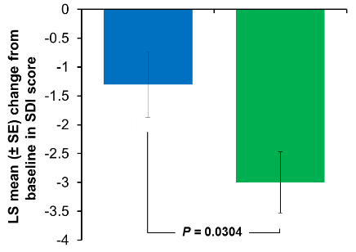
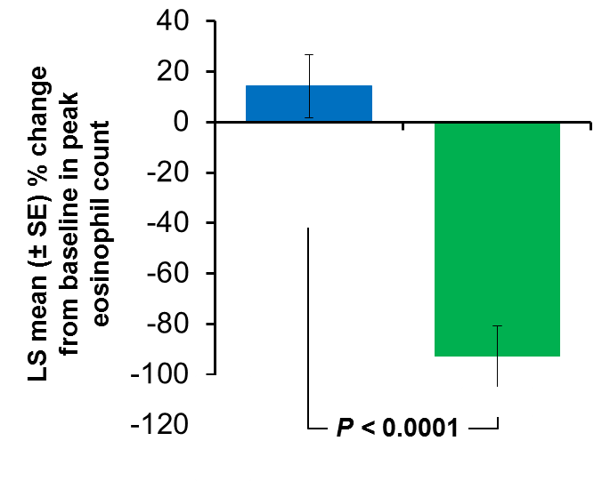
EoE: Dupilumab (anti-IL-4R⍺) in adults
Multi-center, DBPC, phase 2 trial
47 EoE patients, 18-65 y
Randomized to:
Dupilumab 300 mg S/C weekly
Placebo S/C weekly
12 weeks of treatment
Hirano…Chehade…Radin, Gastroenterology 2019

Slide 49
EoE: Dupilumab (anti-IL-4R-⍺) in adolescents and adults
Weekly dosing received
FDA approval, May 2022
Dellon… Chehade… Shabbir, N Engl J Med 2022

Slide 50
EoE: Dupilumab (anti-IL-4R-⍺) in children
***
***
Proportion of patients achieving peak esophageal eosinophil count ≤ 6 eos/hpf (%)
68%
58%
Multi-center, RDBPC trial
EoE patients, 1-11 y
Randomized to:
High dose dupilumab S/C
Low dose dupilumab S/C
Placebo S/C
16 weeks of treatment
Clinicaltrials.gov, NCT04394351
3%
Placebo
Higher-exposure regimen, SC
Lower-exposure regimen, SC
Patients, n
34
37
31
3.09
Change from baseline in body weight for age percentile (%)
0.29
Placebo
Higher-exposure regimen, SC
Patients, n
34
37
Chehade et al, DDW 2023

Slide 51
Conclusion: Medications for EoE
Proton pump inhibitors and topical corticosteroids are currently used off-label.
Dupilumab is currently FDA-approved for children ≥12 years, weighing ≥40 kg.
Chronic therapy is needed.

Slide 52
EoE: Key Takeaways
EoE is a chronic disease.
Untreated EoE can lead to fibrostenotic complications.
Early recognition and referral are important.
Diagnosis is based on clinical, endoscopic, and histological criteria.
Long-term therapy for EoE (diets or medications) is essential to prevent complications.
Ongoing involvement of pediatrician, pediatric gastroenterologist, allergist, and dietitian result in the best outcomes.

Slide 53
mirna.chehade@mssm.edu

Slide 54
Please type your question into the chat window.

Slide 55
mirna.chehade@mssm.edu

