Slide 1
How to Use Phenotyping to Guide Management of Food Allergy
David R. Stukus, MD

Slide 2
Faculty Presenter
David R. Stukus, MD
Professor of Clinical Pediatrics
Division of Allergy and Immunology
Nationwide Children’s Hospital
Columbus, Ohio

Slide 3
Faculty Disclosures
It is the policy of the Annenberg Center to ensure fair balance, independence, objectivity, and scientific rigor in all programming. All faculty participating in accredited programs are expected to identify and reference off-label product use and disclose any relationship with those supporting the activity or any others whose products or services are discussed.
David R. Stukus, MD
Consultant | ARS Pharmaceuticals
Research Support | DBV Pharmaceuticals
Faculty have documented that this presentation will involve discussion of unapproved or off-label, experimental, or investigational use.

Slide 4
Learning Objectives
By participating in this education, you will better:
Apply the latest recommendations for food allergy identification and management to create effective treatment strategies for patients with food allergies
Utilize knowledge on allergen exposure guidelines when counseling parents and caregivers to provide clear direction on managing allergen exposure during the complementary feeding period

Slide 5
Underlying:
Immunologic
Inflammatory
Metabolic
Pathophysiologic
Endotype
Ray A, et al. Physiol Rev. 2020 Jul 1;100(3):983-1017

Slide 6
Shared characteristics
Asthma
Allergic rhinitis
Atopic dermatitis
Food allergy
Unique:
Pathophysiology
Response to treatment
Prognosis
Paller AS et al. J Allergy Clin Immunol. 2019;143(1):46-55.

Slide 7
How to Use Risk Factors for Allergic Conditions
To DIAGNOSE allergy
To predict more severe and/or persistent allergy
Family history
Early onset severe eczema
Comorbid allergic conditions
*Absence of risk factors does not prevent the development of allergic conditions
Paller AS et al. J Allergy Clin Immunol. 2019;143(1):46-55.

Slide 8
Inflammation and Chronic Disease
TH1
TH2
Allergic conditions
Autoimmune conditions
Ray A, et al. Physiol Rev. 2020 Jul 1;100(3):983-1017

Slide 9
Not All Inflammation Is the Same
Autoimmune | Allergic
T_{H}1 | T_{H}2
IFN-γ | IL-4, 5, 10, 13
TNF-β | Eosinophil dominant
IL-2
Neutrophil dominant
Ray A, et al. Physiol Rev. 2020 Jul 1;100(3):983-1017

Slide 10
Allergic Inflammation
IL-4, IL-13
Skin
Lungs
Nose
IgE
Eosinophils
IL-5
Pelaia P, et al. Front Physiol. 2019 Dec 17;10:1514
Thibodeaux Q, et al. Hum Vaccin Immunother. 2019;15(9):2129-2139.

Slide 11
The Many Types of “Asthmas”
Intermittent or
Chronic
Mild
Moderate
Severe
Infrequent or frequent symptoms
Can present at any age
There is no “one size fits all” approach
Different:
Prognosis
Response to Rx

Slide 12
Which TYPE of Asthma Does Your Patient Have?
T_{H}1 inflammation:
Adult onset
Smokers
Lack of allergies
T_{H}2 inflammation:
Atopic comorbidities
Peripheral eosinophilia
Elevated FeNO
FeNO; fraction exhaled nitric oxide
Kuruvilla ME, et al. Clin Rev Allergy Immunol. 2019 Apr;56(2):219-233.

Slide 13
Type 2 Asthma
Phenotype | Treatment
Mild CS responsive Early onset allergic asthma | ICS
Early onset, moderate to severe CS treated, modestly responsive Allergic asthma | CS, Anti-IgE, anti-IL4R
Late onset, moderate to severe Eosinophilic Less CS responsive Nasal polyposis | CS, Anti-IL-4R/ Anti-IL-5/5R
Complex T2 Very severe T cell/ Type 1- dominant autoimmunity | Anti-IL-4R/ Anti-IL-5/5R With or without immunosuppressant
Type 2 inflammation
Treatment
More responsive to inhaled corticosteroids
Role for biologics
CS; corticosteroid; ICS; inhaled corticosteroid; IL; interleukin
Ray A, et al. Physiol Rev. 2020 Jul 1;100(3):983-1017

Slide 14
Type 2 Low Asthma
Phenotype | Treatment
Stable, mild asthma | Bronchodilators Low dose ICS?
Late onset Obese Airway disease (minimal obstruction and reversibility) | Weight loss Metabolic targes Anti-IL 6 ?
Early onset, long disease duration High dose CS Rx Moderate obstruction/ minimal bronchodilator response | Unclear
Late onset Infection/smoking Sputum production/ moderate obstruction | Macrolides? Anit-IL-β Mucous clearance measures
Highly variable characteristics
Lack of T2 inflammatory markers
Poor corticosteroid responsiveness
Obesity
Metabolic dysfunction
Neutrophil activation
Treatment
Bronchodilators
Muscarinic antagonists
CS, corticosteroids; ICS, inhaled corticosteroid; IL interleukin
Ray A, et al. Physiol Rev. 2020 Jul 1;100(3):983-1017.

Slide 15
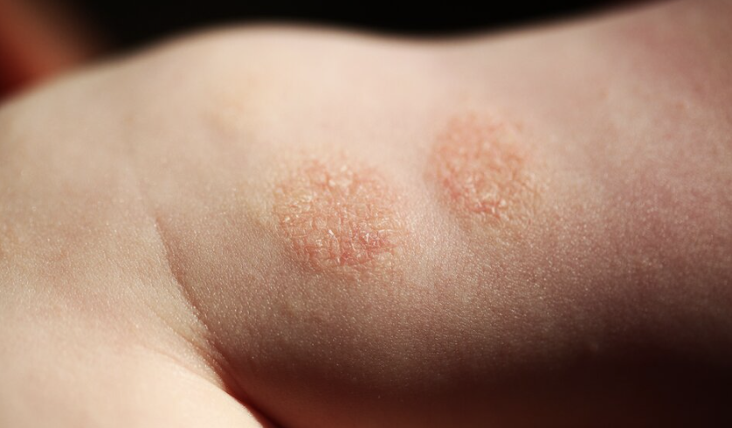
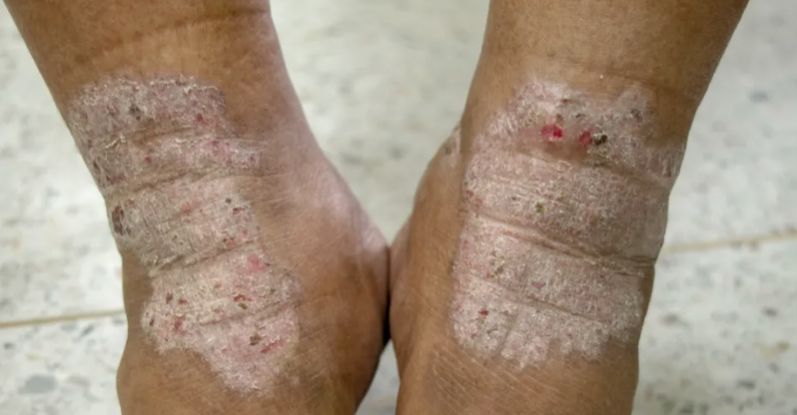
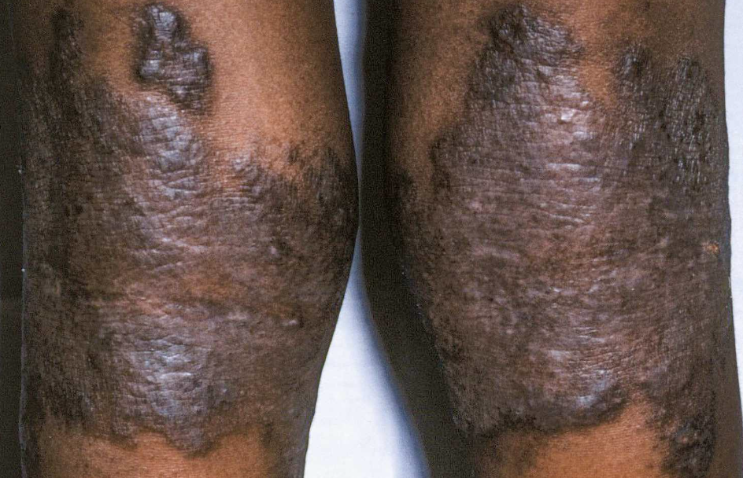
Which TYPE of Atopic Dermatitis Does Your Patient Have?

Slide 16
Atopic Dermatitis Phenotypes
Categorized by 1 of the following
Age
Topography
Morphology
Raimondo Aet al. Dermatol Pract Concept. 2021;11(4):e2021146. Published 2021 Oct 1.

Slide 17
Atopic Dermatitis Age-Related Clinical Phenotypes
Phenotype | Clinical Features | Differential Diagnosis
Infantile (0–2 years) | Eczematous lesions typically affect scalp, checks, neck, and extensor parts of the extremities with edematous papulo-vesicles, oozing, and crusting. | Seborrheic dermatitis, psoriasis, scabies, ichthyosis vulgaris, phenylketonuria Genetic syndromes: Di George syndrome, Netherton syndrome, Wiskott-Aldrich syndrome.
Childhood (2–12 years) | Eczematous lesions typically affect popliteal and antecubital fossa, hand, and foot, with edematous papulo-vesicles, oozing, crusting, and lichenification. | Impetigo, psoriasis, tinea manuum, pedis.
Adolescent/adult (12–60 years) | Eczematous lesions prevalently affect head, neck and flexural areas, with xerosis, lichenification, and depigmentation. In females they also involve periorbital and nipple areas. | ACD, psoriasis, cutaneous T-cell lymphoma, pityriasis rubra pilaris, pityriasis rosea, asteatotic eczema
Elderly (>60 years) | Extensive eczematous lesions, including flexural areas, up to erythrodermic aspect | ACD, psoriasis, cutaneous T-cell lymphoma, pityriasis rubra pilaris, pityriasis rosea, asteatotic eczema
ACD; allergic contact dermatitis
Raimondo Aet al. Dermatol Pract Concept. 2021;11(4):e2021146.

Slide 18
Atopic Dermatitis Topography-Related Clinical Phenotypes
Phenotype | Clinical Features | Differential Diagnosis
Scalp | Erythema, scaling, crusting, lichenification, excoriation, and scarring. | Psoriasis, seborrheic dermatitis, ACD, ICD, tinea capitits.
Face | Erythema, oozing, edema, xerosis, lichenification, dyspigmentation, and excoriation. | ACD, ICD, psoriasis, seborrheic dermatitis, impetigo.
Eyes | Erythema, scaling, crusting, lichenification, depigmentation, and scarring. | ACD, ICD, psoriasis, infectious conjunctivitis.
Lips | Erythema, xerosis, lichenification, fissuration, and dyspigmentation. | ACD, ICD, psoriasis, infectious cheilitis.
Flexures | Erythema, edema, excoriation, lichenification, oozing, and crusting. | Psoriasis, seborrheic dermatitis, ACD, ICD, infectious intertrigo, scabies.
Nipples | Erythema, scaling, crusting, lichenification, excoriation, and scarring. | Psoriasis, ACD, Jogger’s nipple, Paget’s disease.
Hands and Foot | Erythema, xerosis, lichenification, scaling, crusting, fissuration, and dyspigmentation. | Psoriasis, ACD, ICD, tinea manuum, tinea pedis
ACD; allergic contact dermatitis; ICD; irritant contact dermatitis
Raimondo Aet al. Dermatol Pract Concept. 2021;11(4):e2021146.

Slide 19
Atopic Dermatitis Morphology-Related Clinical Phenotypes
Phenotype | Clinical Features | Differential Diagnosis
Nummular | Circinate and ovoid plaques with central clearing and peripheral extension of papules and papulo-vesicles. | ACD, tinea corporis, psoriasis, pityriasis rosea, asteatotic eczema
Prurigo Nodularis | Excoriated hyperkeratotic and intensely itchy nodules. | Scabies, cutaneous T-cell lymphoma, psoriasis bullous pemphigoid, paraneoplastic manifestations.
Erythrodermic phenotype | Erythema on >90% of the body surface area. | Cutaneous T-cell lymphoma, psoriasis, bullous pemphigoid, Lyell syndrome, paraneoplastic manifestations.
Lichenified | Skin is thick with accentuated creases and a leathery appearance | Psoriasis, cutaneous T-cell lymphoma, ACD.
Follicular/papular | Papular-lichenoid lesions | Lichen ruber planus, psoriasis, pityriasis rubra pilaris.
ACD; allergic contact dermatitis
Raimondo Aet al. Dermatol Pract Concept. 2021;11(4):e2021146.

Slide 20
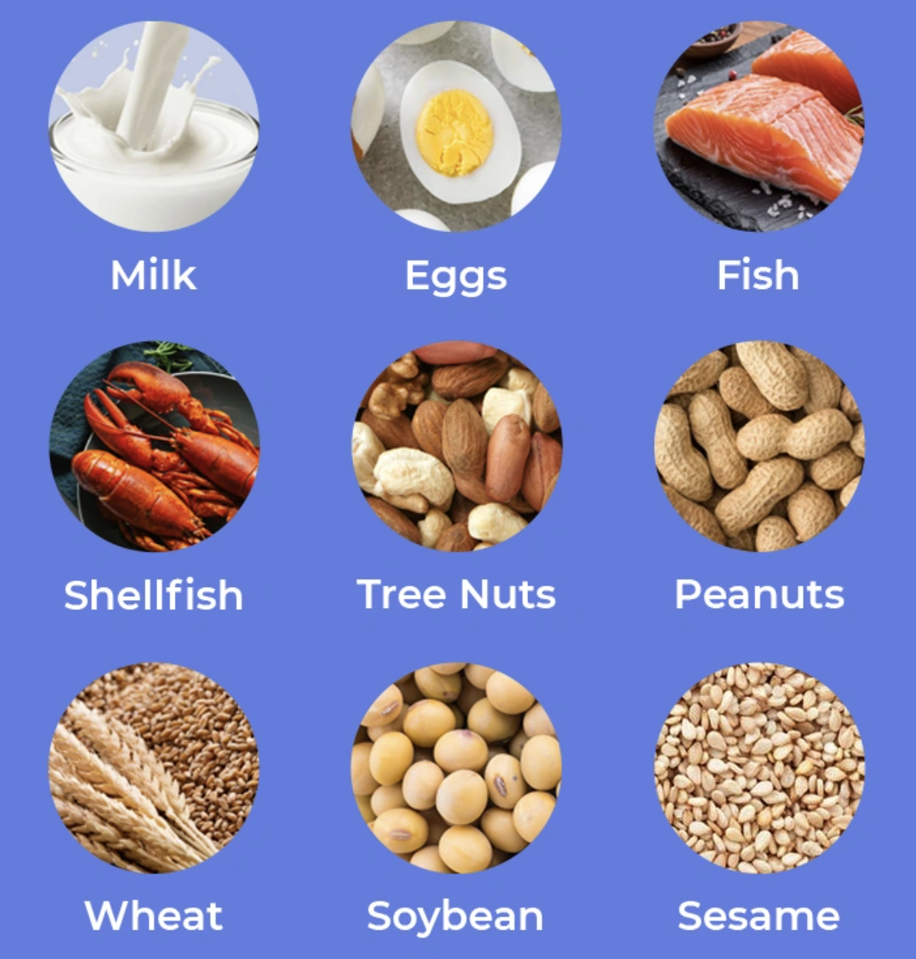
Which TYPE of Food Allergy Does Your Patient Have?
Mild
Moderate
Severe
https://www.nestlenutrition-institute.org/publications/avoiding-food-allergies-keep-mind-big-9

Slide 21
Proper Diagnosis Is Paramount
Family history
Age, comorbid conditions
Eczema severity
We should be able to risk stratify every infant into:
Low
Moderate
High
Risk for developing food allergy

Slide 22
Biologics for Moderate to Severe Persistent Asthma
+ IgE to any perennial aeroallergen
> 6 years old
No biomarkers
> 12 yrs old
TSLP
Tezepelumab
IgE
Omalizumab
IL-5
Mepolizumab*
IL-4/13
Dupilumab
Benralizumab**
Resilizumab***
“eosinophilic” phenotype
150 eos cells/mL**
> 6 yrs old*
> 12 yrs old**
> 18 yrs old***
“eosinophilic” phenotype
> 6 yrs old
Venkatesan P. Lancet Respir Med. 2023;11(7):589

Slide 23
Biologics for Moderate to Severe Atopic Dermatitis
IL-13
Tralokinumab
JAK Inhibitors
IL-4/13
Dupilumab
Upadacitinib
Abrocitinib
> 12 years old
Daily oral pill
Labs at baseline & 12 weeks
≥ 12 yr
> 6 MONTHS old
AAAAI/ACAAI JTF Atopic Dermatitis Guideline Panel, et al. Ann Allergy Asthma Immunol. 2024;132(3):274-312.

Slide 24
Atopic Dermatitis Is the Biggest Clue You’ll Ever Get
Use this to your advantage!!!
AD is associated with Th2 inflammation
AD is often 1st outward signal of an allergic individual
This can assist long term monitoring and prognosis

Slide 25
Non IgE mediated
IgE mediated
Pollen Food Allergy Syndrome
Mild
Likely to outgrow
Severe
Risk for anaphylaxis
Chong KW, et al. Ann Allergy Asthma Immunol. 2020 May;124(5):473-478.

Slide 26
We Live in the Age of Biologics
Choose the right target
Phenotyping
Biomarkers
Choose the right patient
Disease severity
Adherence
Choose the right path
Shared decision making
Revisit after starting

Slide 27
Top Takeaways for Your Practice
Phenotype every patient to provide individualized treatment options
There are clues EVERYWHERE if you know how to look for them

