Slide 1
Food Allergy Tests Are Not Screening Tests
David R. Stukus, MD

Slide 2
Faculty Presenter
David R. Stukus, MD
Professor of Clinical Pediatrics
Division of Allergy and Immunology
Nationwide Children’s Hospital
Columbus, Ohio

Slide 3
Faculty Disclosures
It is the policy of the Annenberg Center to ensure fair balance, independence, objectivity, and scientific rigor in all programming. All faculty participating in accredited programs are expected to identify and reference off-label product use and disclose any relationship with those supporting the activity or any others whose products or services are discussed.
David R. Stukus, MD
Consultant | ARS Pharmaceuticals
Research Support | DBV Pharmaceuticals
Faculty have documented that this presentation will involve discussion of unapproved or off-label, experimental, or investigational use.

Slide 4
Learning Objectives
By participating in this education, you will better:
Apply the latest recommendations for food allergy identification and management to create effective treatment strategies for patients with food allergies
Utilize knowledge on allergen exposure guidelines when counseling parents and caregivers to provide clear direction on managing allergen exposure during the complementary feeding period

Slide 5
Definitions
Allergy: An immunologic response to an allergen that results in reproducible symptoms with every exposure
Intolerance: A nonimmunologic response to a substance (food) that causes gastrointestinal symptoms with exposure
Sensitivity: No agreed upon definition. Not an immune response. Often applied to a variety of symptoms without evidence to support use.
American Academy of Allergy, Asthma& Immunology. April 7, 2024. https://www.aaaai.org/tools-for-the-public/allergy,-asthma-immunology-glossary

Slide 6
A Growing Epidemic
PREVALENCE OF FOOD ALLERGY IN THE UNITED STATES*
5-8%
of US children
have a food allergy
All races and income groups are affected
*Children <18 years of age; N=3339.
Gupta RS, et al. Pediatrics. 2011;128(1):e9-e17.

Slide 7
IgE Mediated Food Allergy: The History IS the Test
Reactions are:
Objective
Rapid onset
Reproducible with every exposure to the offending food, no matter what form
Typical symptoms:
Hives
Swelling
Vomiting
Runny nose/congestion
Wheezing
Hypotension
Anaphylaxis
Ingestion is almost always required
Reber LL, et al. J Allergy Clin Immunol. 2017;140(2):335-348.

Slide 8
Before we go any further…
Allergy tests are NOT pregnancy tests
Results are not “positive” or “negative”
They are designed to detect allergen specific IgE, NOT diagnose allergy

Slide 9
When Should Allergy Tests Be Obtained?
To Clarify Diagnosis
To Assist Avoidance
To Determine Resolution
NIAID-Sponsored Expert Panel, et al. J Allergy Clin Immunol. 2010;126(6 Suppl):S1-S58.

Slide 10
An Ideal Food Allergy Test
Accessible
Readily available
Reliable
High positive predictive value
Low false positives
Easy to use and interpret
Threshold dose
Severity of reaction
Noninvasive
Clinically Applicable

Slide 11
An Ideal Food Allergy Test
Accessible
Readily available
Reliable
High positive predictive value
Low false positives
Easy to use and interpret
Threshold dose
Severity of reaction
Noninvasive
Clinically Applicable

Slide 12
Pearls of Wisdom
Both skin and blood testing have high FALSE POSITIVE rates
The best test is what happens upon exposure
You cannot predict who will develop allergy
“Shotgun” testing, or testing of patients without symptoms is not recommended for ANY reason
A negative skin test with a high pretest probability warrants serum IgE and/or oral food challenge
NIAID-Sponsored Expert Panel, et al. J Allergy Clin Immunol. 2010;126(6 Suppl):S1-S58.

Slide 13
Specific IgE Cutoff Points
Allergen | Decision Point (kU/L) | PPV | NPV
Egg | 7 | 98 | 38
Milk | 15 | 95 | 53
Peanut | 14 | 100 | 36
Fish | 3 | 56 | 93
Soybean | 30 | 73 | 82
Wheat | 26 | 74 | 87
PPV: positive predictive value; NPV: negative predictive value
NIAID-Sponsored Expert Panel, et al. J Allergy Clin Immunol. 2010;126(6 Suppl):S1-S58.

Slide 14
Cross-Reactivity: Clinical vs Testing
Foods | Clinical Reactions | Testing
Peanut + Tree nuts | Low/none | Moderate
Tree nuts + Other tree nuts | Pecan + walnut Cashew + pistachio | High
Fish + Shellfish | Low/none | Low/none
Fish + Other fish | High | High
Shellfish + Other shellfish | High | High
Peanut + soy | Low/none | High
Wheat + grains | Low/none | High
Cow’s milk + goat/sheep’s milk | High | High
NIAID-Sponsored Expert Panel, et al. J Allergy Clin Immunol. 2010;126(6 Suppl):S1-S58.

Slide 15
Aeroallergen Cross Reactivity
Aeroallergen | Food
Dust mite Cockroach | Shellfish
Birch tree pollen | Peanut Tree nuts Fruits Soy
Grass pollen | Wheat
Tree pollen | Tree nuts
NIAID-Sponsored Expert Panel, et al. J Allergy Clin Immunol. 2010;126(6 Suppl):S1-S58.

Slide 16
Peanut/Tree Nut Component Testing
Interpretation varies according to population background
Nut | Antigens Associated with Clinical Allergy
Peanut | Ara h 1, 2, 3, 6
Hazelnut | Cor a 9, Cor a 14
Cashew | Ana o 3
Walnut | Jug r 1
Pecan | Car I 1, Car I 2
Pistachio | Pis v 1, Pis v 2
Predictive values have NOT been established
These only indicate likelihood of clinical reactivity, NOT severity
Stiefel G, et al. Clin Exp Allergy. 2017;47(6):719-739.

Slide 17
Oral Food Challenges
Gold Standard
Benefits
Threshold
Severity
Challenges
Time-consuming
Requires expertise
Clarification
Potential reactions
Upton JEM, et al. Ann Allergy Asthma Immunol. 2020;124(5):451-458.

Slide 18
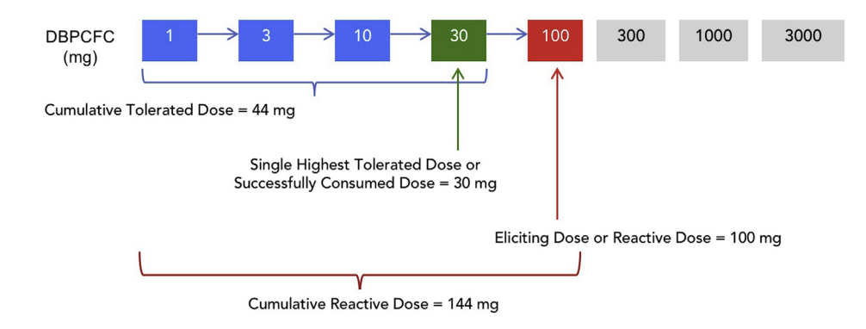
Oral Food Challenge Terminology
J Allergy Clin Immunol Pract. 2020 Jan;8(1):75-90.e17.

Slide 19
Benefits of Unsuccessful Challenge
Quality of life improves after a challenge
P= 0.02
FAQL-PB; Food Allergy Quality of Life-Parental Burden
Franxman TJ, et al . J Allergy Clin Immunol Pract. 2015;3(1):50-56.

Slide 20
Benefits of a Successful Challenge
Life altering
Improved quality of life
Positive impacts to self-identity

Slide 21
Pitfalls on ”Screening” Infants Before Introduction
Caregiver | Clinician | Systemic Issues
Undue anxiety regarding safety of feeding without testing first | Improper interpretation of results | Delayed introduction while waiting for testing or referral
May think they “need” testing before introduction | Inaccurate diagnosis | Not cost effective
Distrust in changing and contradictory guidelines | Time constraints for counseling during clinical encounters | Disparities in timely access to specialists
Abrams EM, Shaker M, Stukus D, Mack DP, Greenhawt M. Pediatrics. 2023 Nov 1;152(5):e2023062836.

Slide 22
Identifying Level of Risk
Family history
Age, comorbid conditions
Eczema severity
We should be able to risk stratify every infant into:
Low
Moderate
High
Risk for developing food allergy

Slide 23
The Art of Testing
Borrow Dave’s spiel:
“There is no medical indication to test before introducing any food to your baby.
However, I meet enough parents to know that some need to see a negative result to give them confidence.
I’m happy to test for select foods if a negative result will help you go home and introduce today.
If we see an elevated result, I’m not going to diagnose allergy, but we can easily have you introduce that food in my office, if that’s ok.”
Identify anxiety
Discuss risks & benefits of testing
BEFORE testing, ask if & how it will change things

Slide 24
Summary
Current allergy tests are not predictive and not an effective screening tool
History is the best way to diagnose food allergies
IgE levels do not predict severity of reaction and can cross-react with other aeroallergens
Oral food challenges can be used to confirm allergic response and improve quality of life

