Slide 1
Social Media For Clinicians Who Care For Infants and
Myths and Facts About Allergy
David R. Stukus, MD
Mimi Tang, PhD

Slide 2
Faculty Presenters
David R. Stukus, MD
Professor Mimi Tang
Professor of Clinical Pediatrics
Division of Allergy and Immunology
Nationwide Children’s Hospital
Columbus, Ohio
Director of Allergy Translation, Murdoch Children’s Research Institute
Allergy Immunology, The Royal Children’s Hospital Melbourne
Department of Paediatrics, The University of Melbourne

Slide 3
Faculty Disclosures
It is the policy of the Annenberg Center to ensure fair balance, independence, objectivity, and scientific rigor in all programming. All faculty participating in accredited programs are expected to identify and reference off-label product use and disclose any relationship with those supporting the activity or any others whose products or services are discussed.
David R. Stukus, MD
Consultant | ARS Pharmaceuticals
Research Support | DBV Pharmaceuticals
Mimi Tang, PhD
No relevant financial disclosures
Faculty have documented that this presentation will involve discussion of unapproved or off-label, experimental, or investigational use.

Slide 4
Social Media For Clinicians Who Care For Infants
David R. Stukus, MD

Slide 5
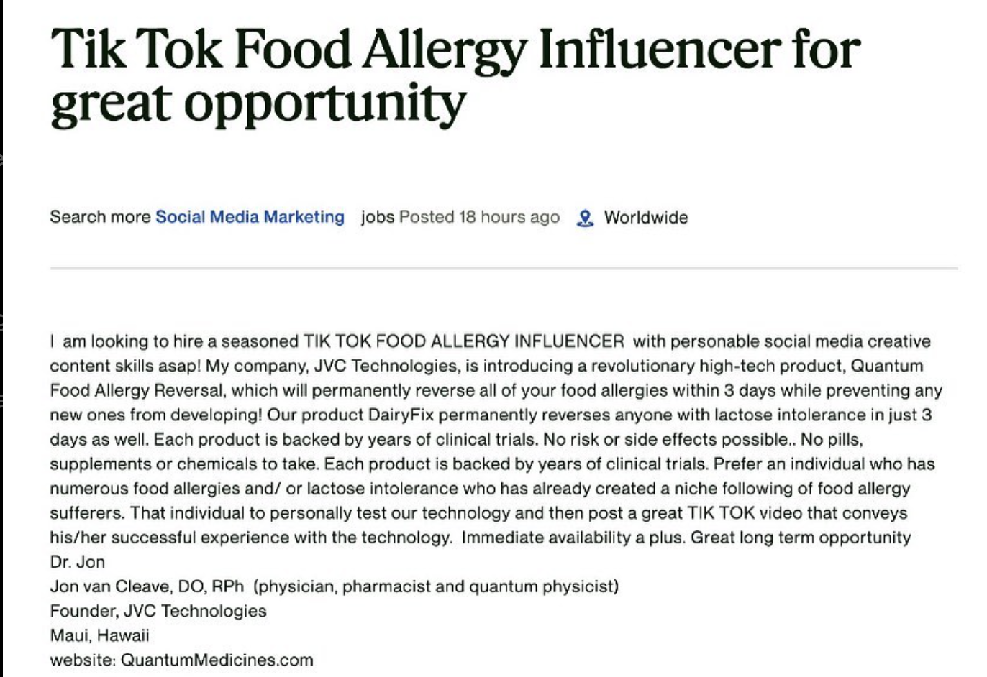
Credible Information?
Stukus D. @allergykidsdoc. November 9, 2022. Accessed May 2, 2024. https://www.instagram.com/p/CkxC3EaOTmI/

Slide 6
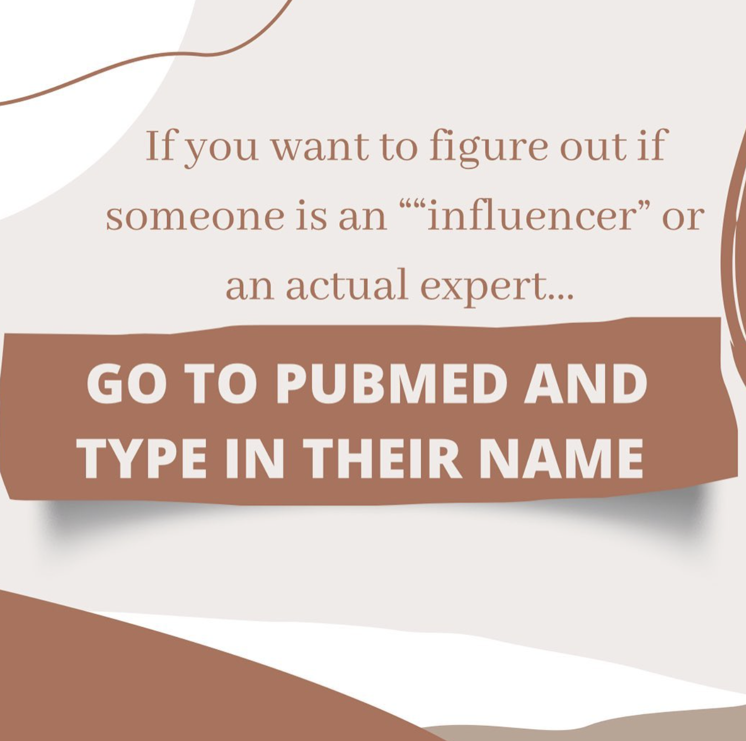
Consider The Source
Stukus D. @allergykidsdoc. September 13, 2023. Accessed May 2, 2023. https://www.instagram.com/p/CxNjHXXu_QT/

Slide 7
Cognitive Biases Are “Mental Shortcuts”
Brain needs a way to speed up ability to make judgements
Limited Attention
Mental Shortcuts
Cognitive Bias
Hofmann B.. BMC Med Ethics. 2023;24(1):17.
Notes:
Attention is a limited resource!

Slide 8
Examples of Cognitive Bias
⚠️Recency bias^{1,2,3}
  We tend to overvalue the most recent examples and neglect prior cumulative experiences.
⚠️Bandwagon effect^{1,3}
  If a story is being circulated or shared in your groups, it artificially inflates its importance in our minds.
  See also: groupthink.
⚠️Anecdotes are not evidence¹
  They are 1 person’s story
  They are ALWAYS missing important details to know
Stukus D. @allergykidsdoc. May 13, 2023. Access May 2, 2024. https://www.instagram.com/p/Cpu8wjVu3p6/?img_index=4
Tversky A et al. Science. 1974;185(4157):1124-1131.
H ofmann B.. BMC Med Ethics. 2023;24(1):17.

Slide 9
Examples of Mental Shortcuts
Anchoring^{1,2,3}
  Accepting the first explanation for an event as most likely when comparing any subsequent explanations to the initial explanation
Confirmation Bias²
  Tendency to focus on information in a way that confirms one's preconceptions
Negativity Bias³
  More trust is given to negative information than positive information
1. Tversky A et al. Science. 1974;185(4157):1124-1131.
2. Hofmann B.. BMC Med Ethics. 2023;24(1):17.
3. Raj A, et al. Vaccines (Basel). 2023;11(12):1837.

Slide 10
Flawed Logic Examples
Pseudoscientific Information
Anecdotal
False Cause and False Attribution
Incomplete comparison
Irrelevant Conclusion
Fallacy of Composition and Division
Retrospective Determinism
  Marketing
  Appeal to Authority
  Appeal to Nature
  Appeal to Tradition
  Bandwagon
Logical Fallacies. Accessed April 7, 2024. https://www.logicalfallacies.org

Slide 11
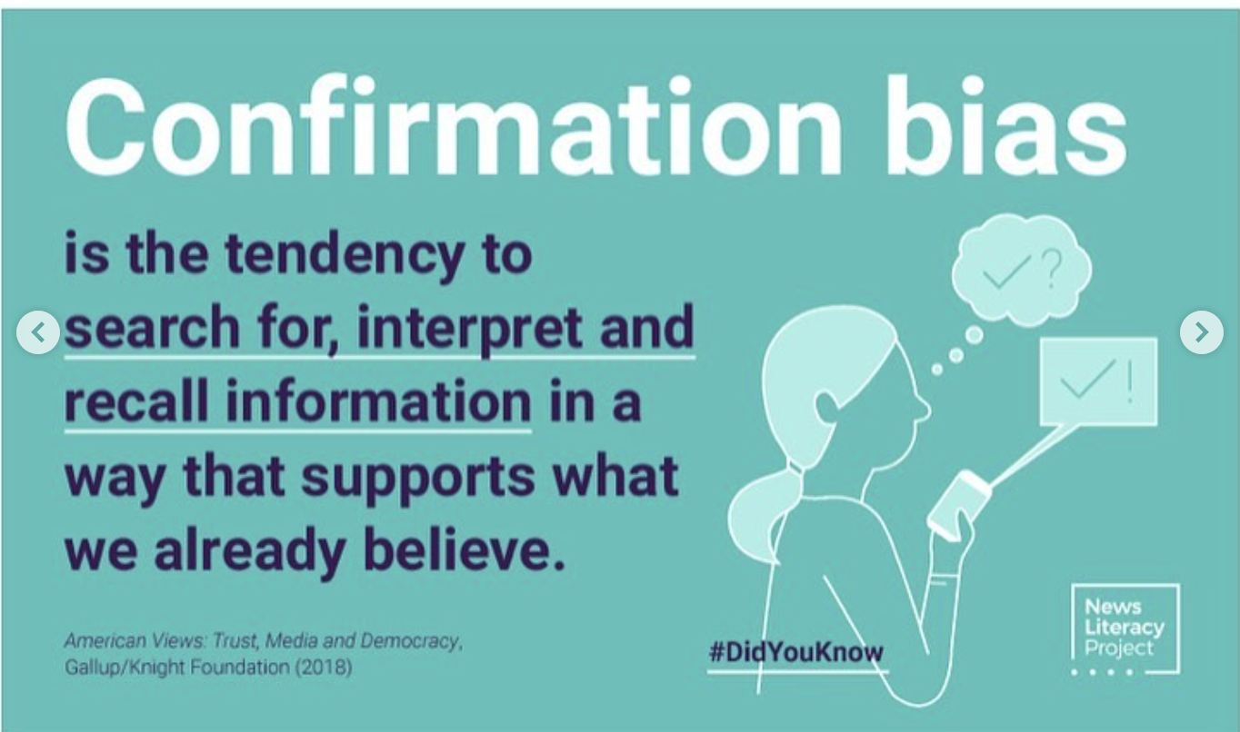
Consider How Information Compares to Values
Stukus D. @allergykidsdoc. October 28, 2022. Accessed May 2, 2024. https://www.instagram.com/p/CkRW9vjvvEX/?img_index=3

Slide 12
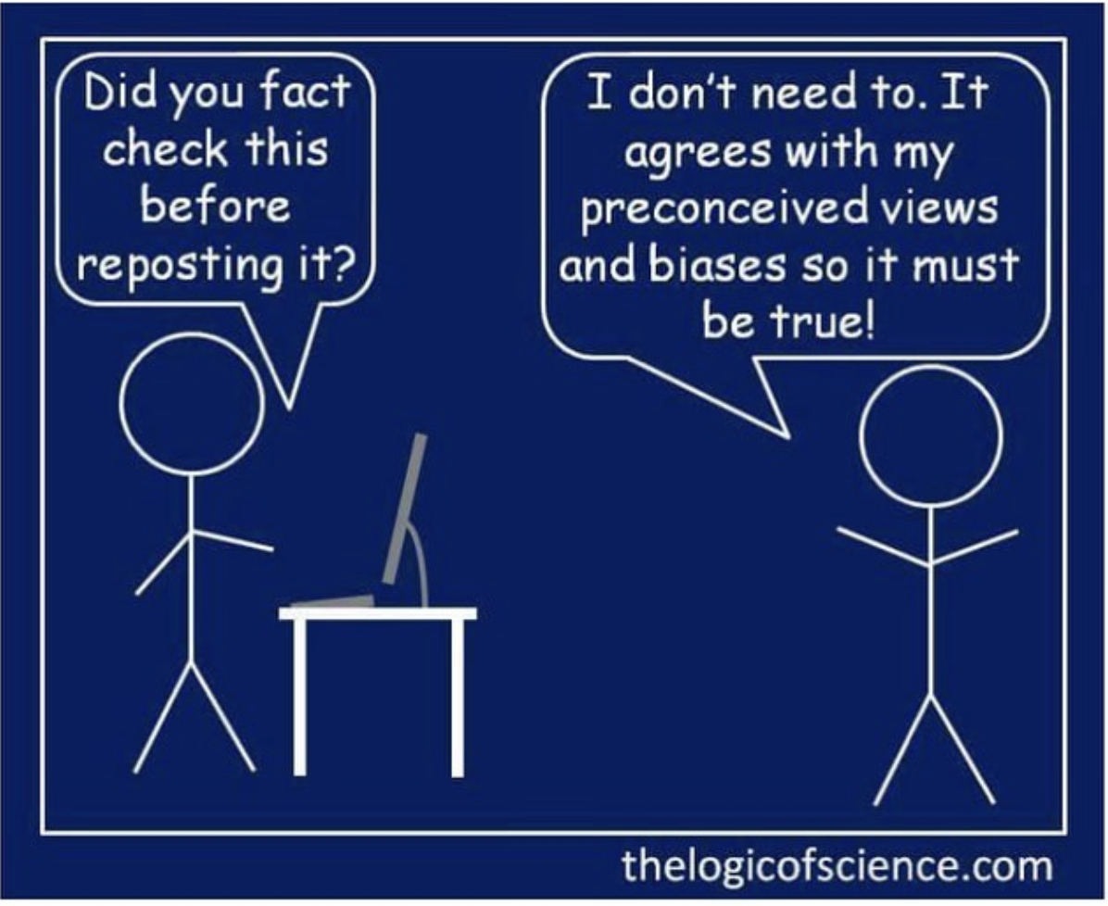
Illustrating Cognitive Bias
Stukus D. @allergykidsdoc. October 28, 2022. Accessed May 2, 2024. https://www.instagram.com/p/CkRW9vjvvEX/?img_index=4

Slide 13
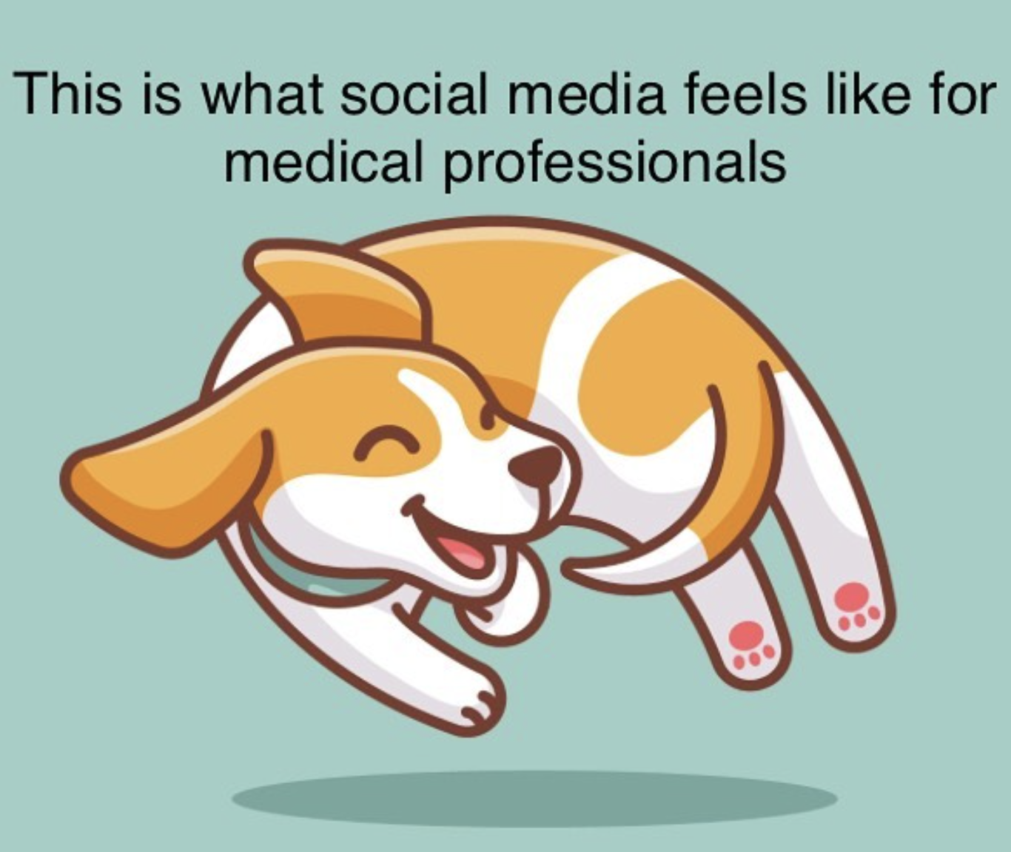
Trying to Keep Up
Stukus D. @allergykidsdoc.. December 12, 2022. Accessed May 2, 2024 https://www.instagram.com/p/CmGFRsVu1AJ/

Slide 14
Engage in Dialogue
Listen
Seek to understand
Empathize
Correct Misinformation
Educate on how to identify misinformation
Provide Information
Share on social media
Provide reputable sources
A Community Toolkit for Addressing Health Misinformation. Office of the U.S. Surgeon General. Accessed April 6, 2024. https://www.hhs.gov/surgeongeneral/reports-and-publications/health-misinformation/index.html:
Confronting Health Misinformation. The U.S. Surgeon General’s Advisory on Building a Healthy Information Environment. July 15, 2021.Accessed April 6, 2024 https://www.hhs.gov/surgeongeneral/reports-and-publications/health-misinformation/index.html

Slide 15
Think Before You Share
Does the original author/creator have the appropriate expertise to share the content?
Is it consistent with available literature?
Any risk for cognitive bias based on how the content is presented?
Does the creator have any potential bias? If so, was it disclosed?
  Are they sponsored by the product ?
  Who funded the research?
Is the headline misleading?
  Does it match the content of the information?
Is the information timely?
What is your motivation in sharing ?
  Do you have any potential bias that you need to keep in check?
A Community Toolkit for Addressing Health Misinformation. Office of the U.S. Surgeon General.
Accessed April 6, 2024. https://www.hhs.gov/surgeongeneral/reports-and-publications/health-misinformation/index.html

Slide 16
Think Sheep Before You Share
Remember these checks when browsing social media
Source Look at what lies beneath. Check the about page of a website or account, look at any account info and search for names or usernames.
History Does this source have an agenda? Find out what subject it regularly covers or if it promotes only 1 perspective.
Evidence Explore the details of a claim or meme and find out if it is backed up by reliable evidence from elsewhere.
Emotion Does the source rely on emotion to make a point? Check for sensational, inflammatory and divisive language.
Pictures Pictures paint a thousand words. Identify what message an image is portraying and whether the source is using images to get attention.
Stukus D. @allergykidsdoc. ” October 28, 2022. Accessed May 2, 2024. https://www.instagram.com/p/CkRW9vjvvEX/?img_index=2

Slide 17
Key Takeaways
Social media is changing the way people access health and nutrition information
Cognitive shortcuts make it easy for misinformation to spread
It’s our responsibility to ensure that we help patients access accurate information

Slide 18
Myths and Facts About Allergy
Mimi Tang, PhD

Slide 19
Understanding allergy vs intolerance

Slide 20
Food Allergy vs Food Intolerance
Host-independent
Toxic
Pharmacologic
Nonimmunologic
Host-dependent
Enzymatic/Metabolic
Adverse reactions to food
IgE-mediated
Irritative
Immunologic
Mixed IgE/
non-IgE-mediated
Undefined
Non-IgE-mediated
Gargano D, et al. Nutrients. 2021;13(5):1638.

Slide 21
Food Allergy vs Food Intolerance
Food Allergy
Reproducible adverse health effect from an immune response on exposure to a food¹
  IgE-mediated vs non-IgE-mediated and mixed IgE/non-IgE-mediated
  Most common food allergies: Peanut, tree nut, cow’s milk, egg, wheat, soy, fish, shellfish, sesame²
Food Intolerance
Nonimmune reactions that include metabolic, toxic, pharmacologic, and undefined mechanisms³
NIAID-Sponsored Expert Panel, et al. J Allergy Clin Immunol. 2010;126(6 Suppl):S1-S58
Allergy & Asthma Network. Accessed May 5, 2024. https://allergyasthmanetwork.org/health-a-z/allergic-march/
Gargano D, et al. Nutrients. 2021;13(5):1638.

Slide 22
IgE-Mediated vs.
Mixed IgE/Non-IgE and Non‑IgE-Mediated Allergies ^{1,2}
 | IgE-mediated | Mixed IgE/Non-IgE and Non-IgE-mediated | Intolerance
Mechanism of disease | Allergic hypersensitivity mediated by IgE | Allergic hypersensitivity mediated by immune cells | Nonallergic hypersensitivity
Organ system specificity | Skin: Hives, swelling Gut: pain, vomiting, diarrhea Airway: hoarse voice, wheeze, difficulty breathing Circulation: collapse | Gut: pain, vomiting, diarrhea (Occasionally CVS - loss of fluid with excessive vomiting, e.g. food protein-induced enterocolitis syndrome [FPIES]) | Variable: depending on cause / trigger
Timing of symptoms | Rapid: < 1 hr, often minutes | Delayed: 2hrs or more | Variable: depending on cause / trigger
Examples | Mild reaction: hives, swelling Severe reaction: anaphylaxis | Food protein-induced allergic proctocolitis (FPIAP), FPIES, food protein-induced enteropathy (FPIE) | Lactose intolerance Reactions to MSG
Jensen SA et al. World Allergy Organ J. 2022;15(9):100668.
Fiocchi A et al. World Allergy Organ J. 2022;15(1):100609.

Slide 23

Examples from Cow’s Milk Allergy
The World Allergy Organization (WAO) uses the following definitions for cow’s milk hypersensitivities:
Cow’s milk protein allergy (CMPA) is a hypersensitivity reaction caused by immune signaling
IgE-mediated CMPA is a hypersensitivity reaction to cow’s milk protein (CMP) mediated by IgE binding to Fcε receptors on mast cells and basophils, leading to the rapid release of histamine and other inflammatory mediators
Non-IgE-mediated CMPA is a hypersensitivity reaction to proteins in cow’s milk that is caused by cell-mediated and other non-IgE mechanisms, leading to delayed-onset reactions
Cow’s milk intolerance is a nonallergic hypersensitivity
Fiocchi A et al. World Allergy Organ J. 2022;15(1):100609.

Slide 24
Is food allergy increasing?

Slide 25
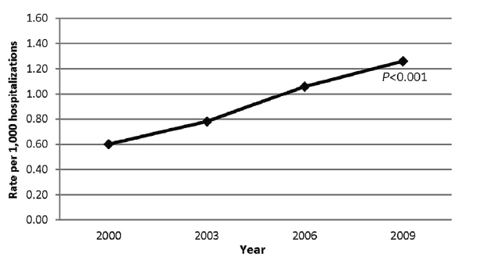
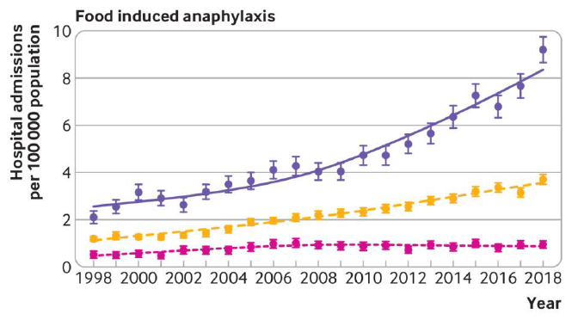
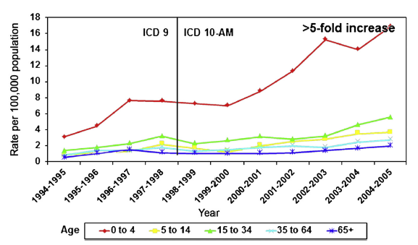

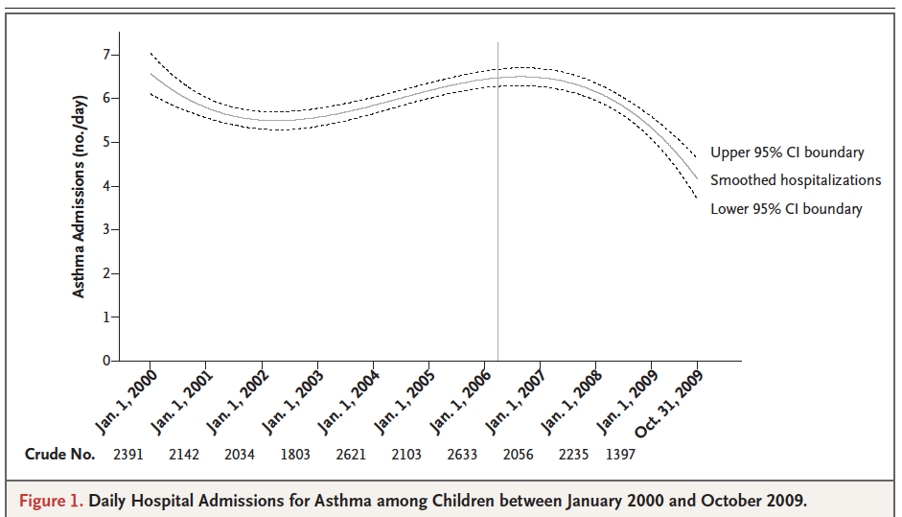
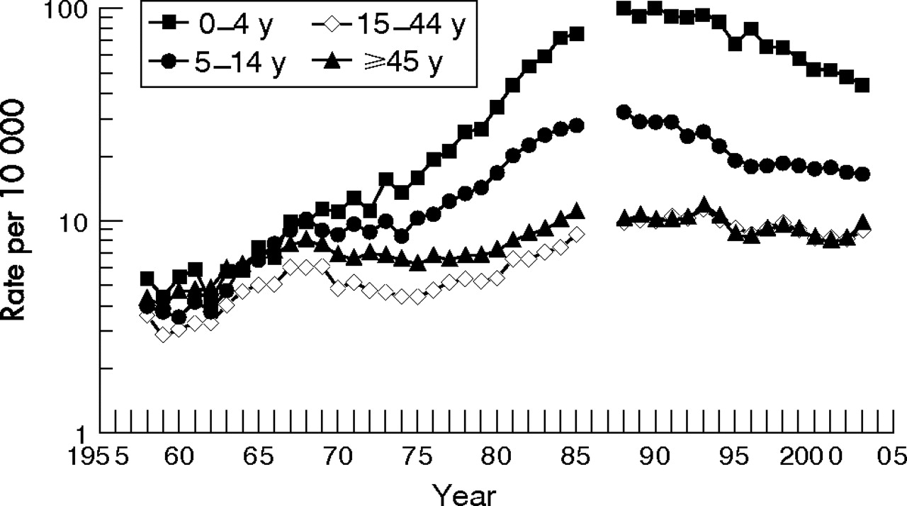
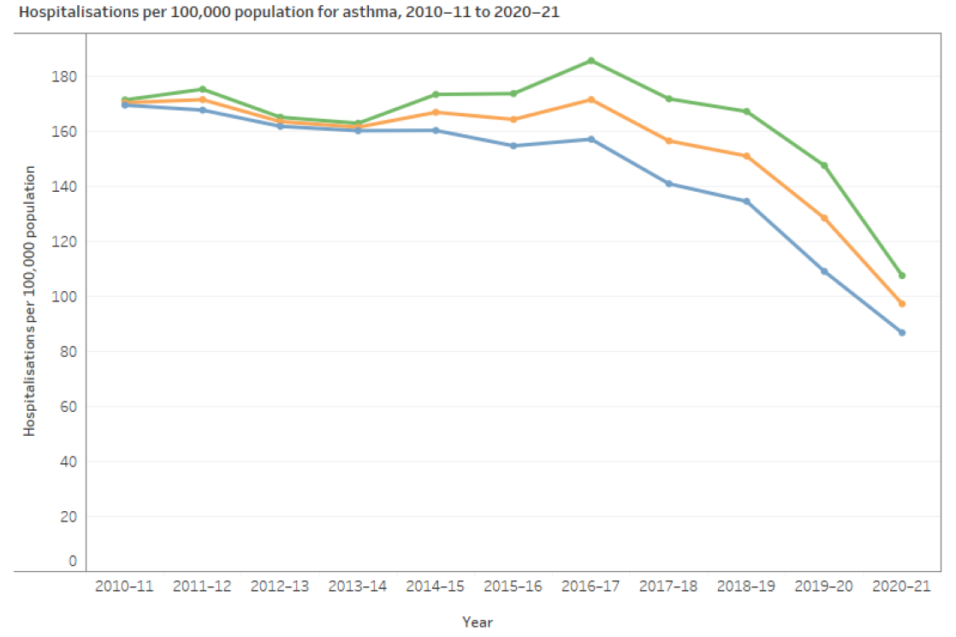

Rising Rates Of Food Allergy Across The Globe
United States¹
United Kingdom³
Australia⁵
Children <18 years
Food anaphylaxis admissions
United States²
United Kingdom⁴
Australia⁶
Asthma admissions
[1] Rudders SA, et al. J Allergy Clin Immunol. 2014;134(4):960-2.e3. [2] Mackay D, et al. N Engl J Med. 2010;363(12):1139-1145. [3] Baseggio Conrado A, et al. BMJ. 2021;372:n251. [4] Anderson HR, et al. Thorax. 2007;62(1):85-90 [5]Liew WK, et al. J Allergy Clin Immunol. 2009;123(2):434-442.
[ 6] Australian Institute of Health and Welfare. Accessed May 5, 2024. https://www.aihw.gov.au/reports/chronic-respiratory-conditions/asthma

Slide 26
Why is food allergy increasing?

Slide 27
Factors For Increasing Food Allergy
Genes
^{Environment}
Why have allergy problems increased so dramatically in such a short time frame?
Altered immune tolerance
This increase has happened much too quickly to be due to changes in our genes….
Changes in the environment must be responsible
The Western Lifestyle
Allergic Disease
Islam N, Chu DK. Front Allergy. 2022;3:1037596.

Slide 28
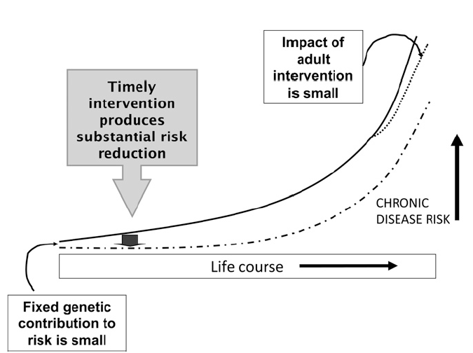
Risk For Chronic Disease Is Set In Early Life
-9 mos to 2-3yrs
Hanson M, et al. Am J Clin Nutr. 2011;94(6 Suppl):1754S-1758S.

Slide 29
The Intestinal Microbiota Plays A Critical Role In Immune Development
A healthy gut microbiota supports healthy immune responsiveness
Healthy microbiome
TOLERANCE
IMMUNE
DYSREGULATION
Dysbiosis
Benedé S, et al. EBioMedicine. 2016;7:27-34.
Chung HJ, et al. Front Microbiol. 2018;9:1510

Slide 30
Early Life Factors Modifying Microbial Exposures And Immune Programming
Aitoro R, et al. Nutrients. 2017;9(7):672

Slide 31
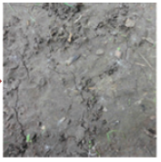

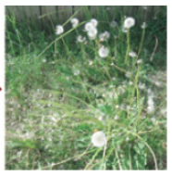
Probiotics, Prebiotics And Synbiotics As An Approach To Support Tolerance
Probiotics
Live microorganisms that when administered in adequate amounts confer a health benefit on the host
Prebiotics
Substrates that are selectively used by host microorganisms, conferring a health benefit
Immune Dysregulation
Tolerogenic Environment
Synbiotics
Probiotic + Prebiotic
Sestito S, et al. Front Pediatr. 2020;8:583946.

Slide 32

Addressing Myths and Misperceptions Among Parents
It is important to dispel myths and promote facts when discussing allergies
Key counseling points:
  Food allergies are not the same as food intolerances
    Food allergy is an immune mediated condition that develops when the immune system incorrectly recognizes a food allergen as harmful
  Food allergies are increasing in prevalence across the globe
    Data from the US, UK and Australia have consistently shown rising rates of food allergy
  Rising rate of food allergy likely relate to changes in the gut microbiota
    Reduced microbial exposures, diet, Vitamin D / UV exposure

