Slide 1
Let the Babies Eat: Instilling Confidence Surrounding Early Introduction of Allergenic Foods
Mimi Tang, PhD

Slide 2
Faculty Presenter
Professor Mimi Tang
Director of Allergy Translation, Murdoch Children’s Research Institute
Allergy Immunology, The Royal Children’s Hospital Melbourne
Department of Paediatrics, The University of Melbourne

Slide 3
Faculty Disclosures
It is the policy of the Annenberg Center to ensure fair balance, independence, objectivity, and scientific rigor in all programming. All faculty participating in accredited programs are expected to identify and reference off-label product use and disclose any relationship with those supporting the activity or any others whose products or services are discussed.
Mimi Tang, PhD
No relevant financial disclosures
Faculty have documented that this presentation will involve discussion of unapproved or off-label, experimental, or investigational use.

Slide 4
Presentation Objectives
Appreciate why current evidence-based guidelines changed regarding prior advice surrounding introduction of allergenic foods
Discuss common concerns with parents regarding risk for allergic reactions in infants
Implement proactive discussions into clinical encounters at infant well child visits

Slide 5
AAP Allergy Prevention Advice – 2000
AAP recommendations published in 2000… delayed introduction of the highly allergenic foods in infants at high risk for allergic disease to prevent the development of future allergy:
cow’s milk until age 1 year;
egg until age 2 years;
peanuts, tree nuts, and fish until age 3 years
AAP, American Academy of Pediatrics
Greer Fret al. Pediatrics. 2008;121(1):183-191.

Slide 6
AAP Allergy Prevention Advice – 2008
AAP Committee on Nutrition and Section on Allergy and Immunology Clinical Report 2008¹… no convincing evidence for delaying the introduction of specific highly allergenic food
AAAAI Adverse Reactions to Foods Committee 2012²… recommendations on when and how to introduce the highly allergenic foods
Introducing complementary foods between 4 and 6 months of age, at a rate not faster than one new food every 3 to 5 days.
Highly allergenic foods may be introduced as complementary foods once a few typical complementary foods are tolerated
Offer an initial taste at home, rather than at day care or at a restaurant
If no apparent reaction, introduce in gradually increasing amounts
AAP, American Academy of Pediatrics; AAAAI,, American Academy of Allergy, Asthma, and Immunology
1 Greer Fret al. Pediatrics. 2008;121(1):183-191
2. Fleischer et al. J Allergy Clin Immunol: In Practice 2013;1:29-36)

Slide 7
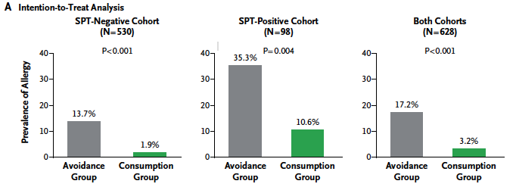
Pivoting Guidance Based on Reducing Allergy Prevalence
SPT, skin prick test
Du Toit G et al. N Engl J Med. 2015;372(9):803-813.

Slide 8
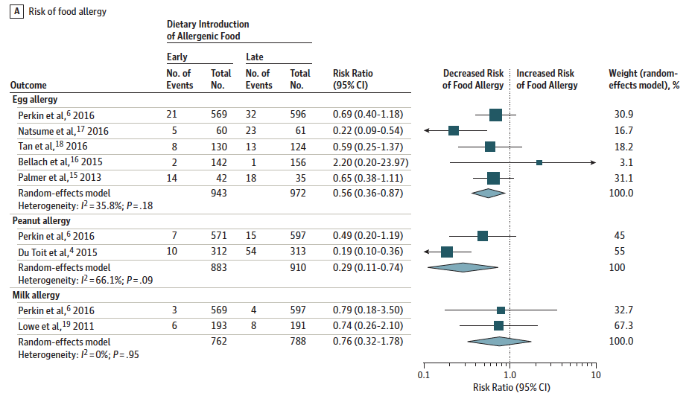
Timing of Allergenic Food Introduction to the Infant Diet and Risk of Allergic or Autoimmune Disease: A Systematic Review and Meta-analysis
Ierodiakonou et al. JAMA. 2016;316(11):1181-1192

Slide 9
Timing of Allergenic Food Introduction to the Infant Diet and Risk of Allergic or Autoimmune Disease: A Systematic Review and Meta-analysis
Moderate-certainty evidence from 5 trials (1915 participants)
Early egg introduction at 4 to 6 months associated with reduced egg allergy (RR 0.56; 95%CI, 0.36-0.87; I2 = 36%; P = .009).
Absolute risk reduction for a population with 5.4% incidence of egg allergy was 24 cases (95%CI, 7-35 cases) per 1000 population.
Moderate-certainty evidence from 2 trials (1550 participants)
Early peanut introduction at 4 to 11 months associated with reduced peanut allergy (RR 0.29; 95%CI 0.11-0.74; I2 = 66%; P = .009).
Absolute risk reduction for a population with 2.5% incidence of peanut allergy was 18 cases (95%CI, 6-22 cases) per 1000 population.
Ierodiakonou et al. JAMA. 2016;316(11):1181-1192

Slide 10
Current USDA Recommendations - 2015
Potentially allergenic foods
Peanuts
Egg
Cow milk products
Tree nuts
Wheat
Crustacean shellfish
Fish
Soy
Should be introduced when other complementary foods are introduced to an infant’s diet around 4-6 months
USDA, United States Department of Agriculture
Fleischer DM et al. Allergy, Asthma & Clinical Immunology (2015) 11:23
USDA. https://www.dietaryguidelines.gov/sites/default/files/2020-12/Dietary_Guidelines_for_Americans_2020-2025.pdf

Slide 11
Prevention of Peanut Allergy
"If an infant has severe eczema, egg allergy, or both (conditions that increase the risk of peanut allergy), age-appropriate, peanut containing foods should be introduced into the diet as early as age 4 to 6 months.”
“This will reduce the risk of developing peanut allergy."
Consult provider
USDA. https://www.dietaryguidelines.gov/sites/default/files/2020-12/Dietary_Guidelines_for_Americans_2020-2025.pdf

Slide 12
How To Introduce Peanut
Prepare a full portion (4 recipe options, for 2 g peanut protein)
Offer a small amount with the tip of a spoon
Wait 10 min
If no reaction feed the remainder
If doing in office observe 30 min
Make sure a caregiver can observe for at least 2 H
Togias A, et all. J Acad Nutr Diet. 2017;117(5):788-793.

Slide 13
Severe Eczema and/or egg allergy
Consider peanut IgE or SPT
Moderate reactivity
Low low reactivity
Home introduction
Supervised in office
Supervised feed
OFC
HIgh
Likely allergy, refer
High-risk infants
None
By family preference
Introduce at ~6 months
Mild to moderate Eczema
SPT, skin prick test: OFC, oral food challenge
Togias A, et all. J Acad Nutr Diet. 2017;117(5):788-793.

Slide 14
Improving The Implementation Of Guidelines
Barriers to implementation
Healthcare providers
Education of health professionals
Health professional support of guidelines
Community
Parental awareness of guidelines
Parental hesitancy to adopt the advice to introduce allergenic solids
Alignment
Existing infant feeding resources not aligned with ASCIA guidance
ASCIA, Australian Society for Clinical Immunology and Allergy

Slide 15
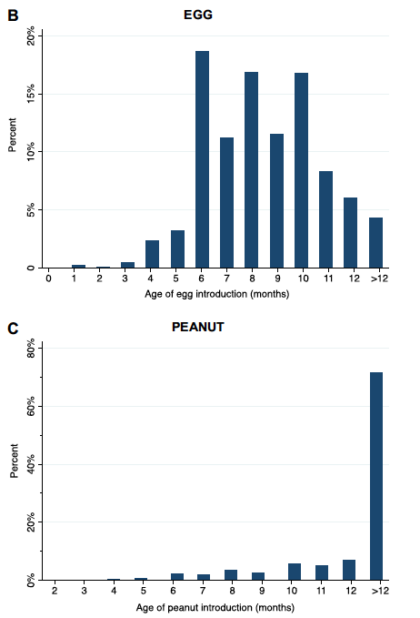
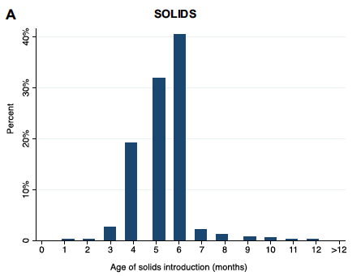
Infant Feeding Practices in Australia 2007-2011
Almost all infants (91.7%) introduced solids between 4 and 6 months of age
Egg mostly introduced 7 to 12 mos (70.6%)
Peanut mostly introduced >12 mos (71.6%)
Tey D et al. J Allergy Clin Immunol 2014;133:476-84

Slide 16
Increased Early Introduction Of Peanut
83% of infants with early eczema introduced peanut by 12m
2007-2009, n = 2,268
2009-2011, n = 3,008
2017-2018, n = 860
Soriano et al. J Allergy Clin Immunol. 2019 Nov;144(5):1327-1335

Slide 17
Families Also Introduced Egg And Cashew Earlier
CASHEW
HealthNuts: 5% introduced cashew by 12m
Soriano et al. J Allergy Clin Immunol. 2019 Nov;144(5):1327-1335; Brettig et al, EAACI conference 2023

Slide 18
Improving Guideline Implementation
Challenges
Existing infant feeding resources not aligned with guidance
Key Components
Optimise eczema management to prevent sensitisation to foods through the skin
Health professional education to increase support of guidelines
Parental awareness of guidelines
Parental hesitancy to adopt the advice to introduce allergenic solids
Food allergy prevention project
Introduce common allergy causing foods in first year of life
Public health approach to actively promote the guidelines to parents and health professionals
Next Steps

Slide 19
Food Allergy Prevention Project
Initiative of the National Allergy Council – ASCIA and Allergy & Anaphylaxis Australia
Funding from Australian Federal Government
Implementation process guided by key stakeholder organisations - Infant Feeding Implementation Meeting (Mar 2017)
Program components:
Nip Allergies in the Bub (NAITB) website - Evidence-based information for parents and health professionals
SmartStartAllergy app - smartphone SMS service that sends parents reminders about introducing allergenic solids, link to a questionnaire, and directs parents to NAITB website
Support line - answer questions from parents and health professionals
Pilot phase (Western Australia) rolled out in Aug 2018; National launch in Sept 2019.

Slide 20
SmartStartAllergy
Smartphone app based on SmartVax infrastructure designed to monitor reactions to vaccines
Integrates with General Practice (primary healthcare) management software to send SMS texts
Allergy module runs automatically alongside vaccination monitoring and reminders module
Voluntary participation - parents/families recruited through the SmartVax app.
SMS messages sent to parents of infants at age 6m, 9m and 12m asking if they have introduced solid foods including peanut. Subsequent SMS asks if there has been an allergic reaction to foods.
2 data collection components
Text messages – information on timing of peanut introduction
Online questionnaire - information on introduction of common food allergens, parent-reported food reactions, eczema, family history of allergy, country of birth
Data collected locally by general practice
Identifiable data only available to local practice
Caring clinician alerted by the SmartStartAllergy program if parent reports a reaction

Slide 21
Evaluation of SmartStartAllergy Service
Objective: Did SmartStartAllergy influence the rate of peanut introduction in the first 12m?
Methods:
Participants recruited via GP practices that were using SmartVax
Intervention group: Parents of children under 12m of age – parents received text messages when child was 6m, 9m, 12m, asking about timing of peanut introduction.
Control group: Parents of children aged 12m – parents received text message asking about timing of peanut introduction
All parents invited to complete an online questionnaire (link sent by text message) at 6m, 9m, and 12m (intervention group) or at 12m (controls). Information was collected on:
Introduction of other common food allergens
Parent-reported food reactions
Eczema, Famly history of allergy, Country of birth.
Vale et al. J Allergy Clin Immunol Global 2023;2:100102

Slide 22
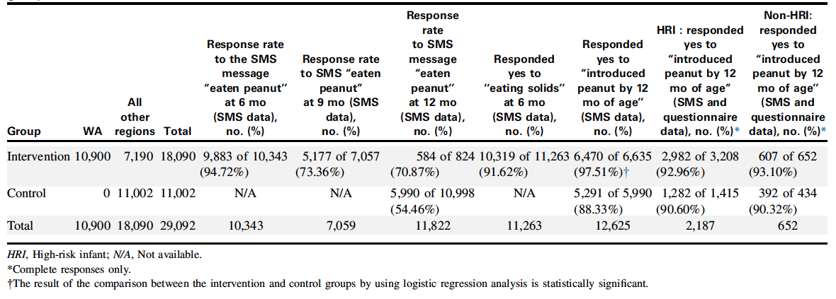
Evaluation of SmartStartAllergy service
Participants recruited from 21st Sept 2018 to 26th April 2022
Peanut introduced by 12m in 97.51% intervention vs 88.33% control group
Crude odds ratio 5.18 (95% CI 4.35 – 6.16; p<0.0001)
Similar rates amongst high-risk and non-high-risk groups
Vale et al. J Allergy Clin Immunol Global 2023;2:100102

Slide 23
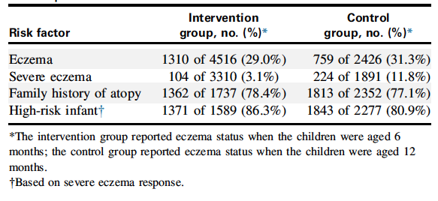
Evaluation of SmartStart Allergy service
Logistic regression analysis adjusting for high-risk infant status showed similar results
High risk of food allergy = severe eczema and/or first degree relative with history of atopy
Adjustment for high-risk infant status OR 5.33 (95% CI 4.48-6.35; p<0.01)
Adjustment for high-risk infant status and family history of food allergy OR 5.34 (95%CI 4.48-6.37; p<0.01)
Vale et al. J Allergy Clin Immunol Global 2023;2:100102

Slide 24
Evaluation of SmartStart Allergy Service
Summary
SmartStartAllergy service promoted introduction of peanut by 12m even amongst high-risk
Control group peanut introduction (88.3%) was comparable to EarlyNuts study (88.6%)
Possible factors contributing to positive results (vs other studies / programs that use SMS)
When parent responds that they have not introduced peanut, SmartStartAllergy sends a text message advising there is evidence to support the effectiveness of peanut introduction in preventing peanut allergy and a link to NAITB website
Information on a website with an ASCIA logo is considered credible by parents; web-based information is a preferred method for sourcing information
NAITB website is specifically developed for parents and is free
NAITB, Nip Allergies in the Bub, ASCIA, Australian Society for Clinical Immunology and Allergy
Vale et al. J Allergy Clin Immunol Global 2023;2:100102

Slide 25
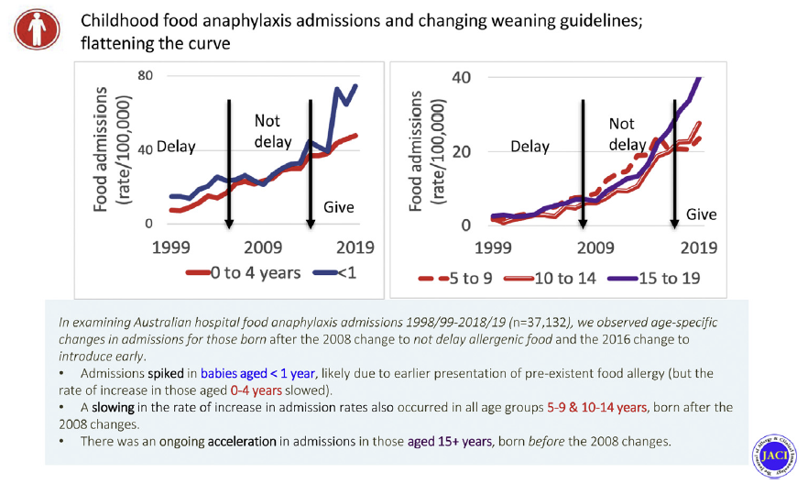
Updated Guidelines → Slowing Rates Of Food Anaphylaxis
Mullins RJ, et al. J Allergy Clin Immunol. 2022;150(1):140-145.e1.

Slide 26
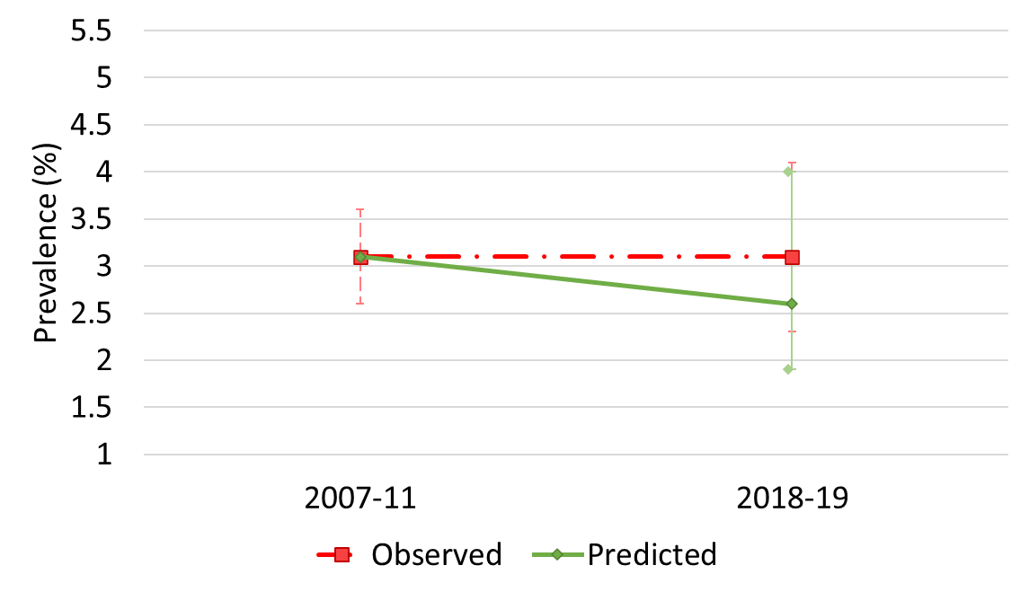
Modest Decrease In Population Prevalence Of Peanut Allergy
ª Standardised to HealthNuts population characteristics: infant ancestry, family history of food allergy, family history of hay fever, dog ownership, number of siblings, and interactions between family history of food allergy.
Soriano V et al. JAMA. 2022 Jul 5;328(1):48-56.

Slide 27
Why Was Early Introduction Of Peanut Less Effective vs LEAP study?
Applying the findings of LEAP to the HealthNuts population:
Early peanut introduction should prevent up to 44% of peanut allergy cases in high-risk infants, and (assuming same magnitude of risk reduction could be achieved in low-risk infants), up to 58% of peanut allergy cases in the community might be prevented
Possible explanations for the limited impact of peanut introduction on prevention of peanut allergy:
Early peanut introduction is less effective in low-risk infants
Dose and frequency of real-world ingestion was insufficient
Peanut allergy was measured earlier (12m vs 5 yr)

Slide 28
Early Peanut Introduction Is More Effective In High-Risk Infants
LEAP excluded infants with SPT >4 mm (9% of those screened) because they were likely to be peanut allergic
EarlyNuts = 1.8% of the population would be excluded, of which 60% would be allergic, accounting for half of total peanut allergy burden
Decrease in peanut allergy may be limited to those infants with early onset eczema
Eczema* | HealthNuts (2007-2011) |  |  | Unadjusted EarlyNuts |  | Adjusted EarlyNuts ª | P value
 | n/N | % (95% CI) |  | n/N | % (95% CI) | % (95% CI)
No | 67/4140 | 1.6 (1.3-2.1) |  | 22/1090 | 2.0 (1.3-3.0) | 1.8 (1.1-2.6) | 0.643
Yes | 73/516 | 14.1 (11.4-17.4) |  | 20/165 | 12.1 (7.9-18.1) | 9.3 (5.2-13.9) | 0.062
Standardised to baseline study, HealthNuts, distribution: infant ancestry, family history of food allergy, family history of hay fever, dog ownership, number of siblings, and interactions between family history of food allergy and study.
*Early onset, moderately-severe eczema, defined as a diagnosis of eczema in the first 6 months of life, treated with topical steroids
Soriano V et al. JAMA. 2022 Jul 5;328(1):48-56.

Slide 29
Key Learnings From The Australian Experience
In Australia, peanut introduction by 12m appears to be effective at preventing peanut allergy.
Parents are more likely to follow advice if it is backed by expert recommendation, readily available (eg website, free), and supported by guidance on ‘how to introduce’.
In Australia, a smart-phone app reminding parents to introduce peanut was effective at promoting timely introduction of peanut
Reminders to introduce allergenic solids could be offered opportunistically at well baby checks or physician visits during infancy.
National admissions data in Australia showed that introducing peanut and egg in the first year of life was not associated with an increased rate of anaphylaxis admissions, although there was a shift towards earlier presentation of anaphylaxis.

Slide 30
Key Takeaways For Your Practice
Early introduction of allergenic foods can reduce the risk of developing food allergy
Consistency of messaging is key
Technology with reminders can be leveraged to improve introduction of allergic foods
Opportunistic reminders at routine health visits may improve introduction of allergic foods

