Slide 1
Food Oral Immunotherapy: Risks, Benefits, Expected Outcomes
Mimi Tang, PhD

Slide 2
Faculty Presenter
Professor Mimi Tang
Director of Allergy Translation, Murdoch Children’s Research Institute
Allergy Immunology, The Royal Children’s Hospital Melbourne
Department of Paediatrics, The University of Melbourne

Slide 3
Faculty Disclosures
It is the policy of the Annenberg Center to ensure fair balance, independence, objectivity, and scientific rigor in all programming. All faculty participating in accredited programs are expected to identify and reference off-label product use and disclose any relationship with those supporting the activity or any others whose products or services are discussed.
Mimi Tang, Phd
No relevant financial disclosures
Faculty have documented that this presentation will involve discussion of unapproved or off-label, experimental, or investigational use.

Slide 4
Presentation Objectives
Understand the principles of oral immunotherapy – dosing regimens and clinical outcomes
Discuss the daily regimen and risks associated with food oral immunotherapy
Participate in shared decision making with caregivers of children with food allergies to help them understand the potential outcomes that may be achieved with oral immunotherapy

Slide 5
Presentation Overview
OIT outcomes
Challenge-defined outcomes (Desensitization, Remission)
Patient-centered outcomes (Quality of Life, Safety)
Aligning patient needs and expectations with treatment outcomes

Slide 6
Challenge-defined outcomes

Slide 7
Typical Oral Immunotherapy Regimen
DDPCFC, Doble-blind placebo-controlled food challenge
Barni S, et al. . Medicina (Kaunas). 2020;56(3):111.
Figure f rom Medicina (cropped from original) licensed under MPDI open access

Slide 8
Challenge-Defined Efficacy Outcomes
Eat allergen freely
Off treatment
No avoidance
No allergen intake
Protection against accidental reactions BUT….
Indefinite treatment
Must continue avoidance
Frequent reactions
Off treatment
No avoidance
Eat allergen freely
Some allergen intake
Desensitisation
Remission
(Sustained Unresponsiveness)
Persistent Remission
? Possible tolerance
Limited BENEFIT TO PATIENT
Large
.
Burks et al. J Allergy Clin Immunol 2018;141:1-9

Slide 9
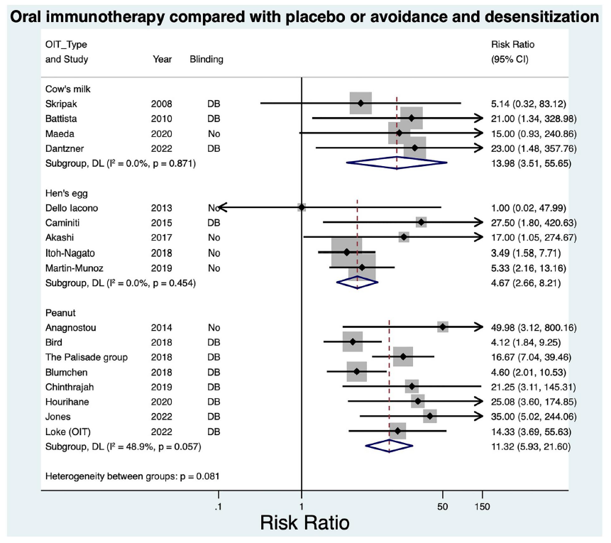
Systematic review: OIT Efficacy At Inducing Desensitization
RCT evaluating OFC-proven outcomes
Egg, milk, peanut OIT
Comparison with placebo or avoidance
OFC on all participants before treatment and at study completion
NNT for Desensitisation:
Peanut = 1.88
Egg = 3.21
Milk – not calculable
RCT, Randomized controlled trial; OFC, oral food challenge
Lodge CJ et al. Clin Transl Allergy. 2023;13(7):e12268
Figure from Clinical and Translational Allergy (cropped from original) is licensed under CC BY 4.0

Slide 10
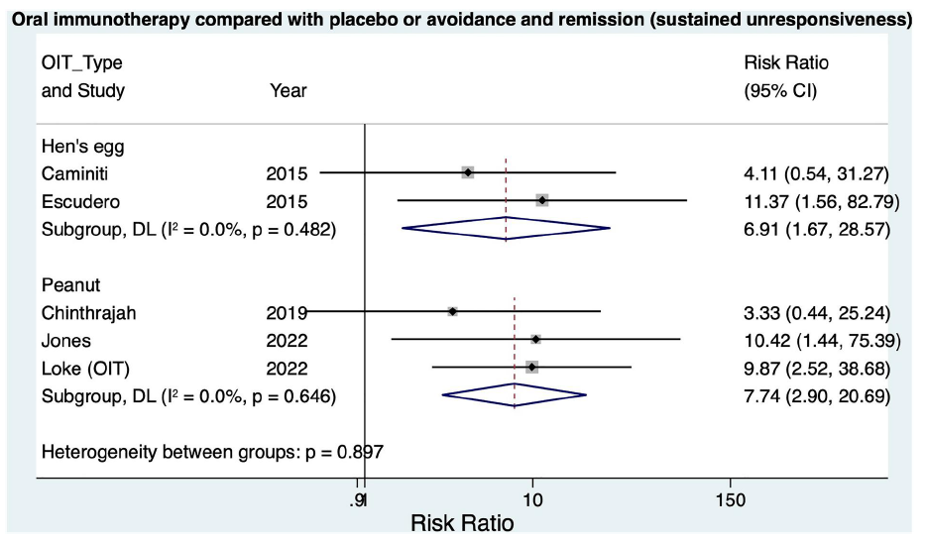
Systematic review: OIT Efficacy At Inducing Remission (SU)
NNT for SU/Remission:
Peanut = 3.38
Egg = 3.29
Lodge CJ et al. Clin Transl Allergy. 2023;13(7):e12268
Figure from Clinical and Translational Allergy (cropped from original) is licensed under CC BY 4.0

Slide 11
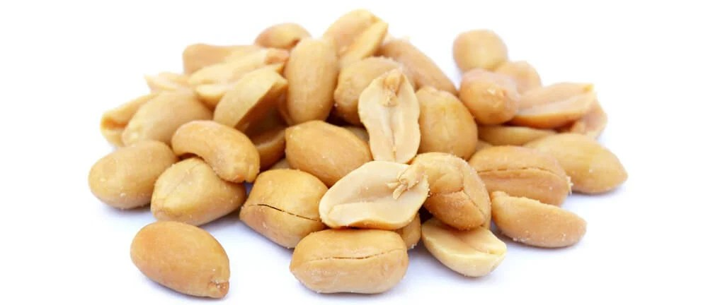
Different Levels of Protection
Standard of Care
Desensitization
Remission
Peanut avoidance
Peanut avoidance
Free intake
Indefinite daily treatment
18 months treatment
Low dose OIT
High dose OIT
High dose,
rapid escalation OIT

Slide 12
Why We Must Test For Desensitization vs Remission After OIT
Distinguishing between desensitisation and remission is essential
Need for ongoing immunotherapy
Need for continued dietary avoidance
Level of protection that is achieved ie trace amounts in packaged foods vs standard serve
Different challenge-defined outcomes have different effects on patient-centered outcomes
Allergic reactions
Quality of life
Achieving efficacy in terms of challenge-defined outcomes may not provide meaningful benefit to patients in terms of patient-centered outcomes
Lazizi Set al. Front Allergy. 2022;3:974250.

Slide 13
How Do We Test for ‘Remission’ (SU)?
Variability in the how remission is assessed
Duration of allergen elimination prior to allergen challenge
Trials have applied wide range of elimination periods – 2 weeks to 26 weeks
Long enough to clear desensitisation effect
Longer periods can lead to some children losing their remission
Cumulative dose in the remission challenge
Absence of clinical reactivity – diagnostic challenge
Confusion with sustained desensitisation
Lazizi Set al. . Front Allergy. 2022;3:974250.

Slide 14
Patient-centered outcomes

Slide 15
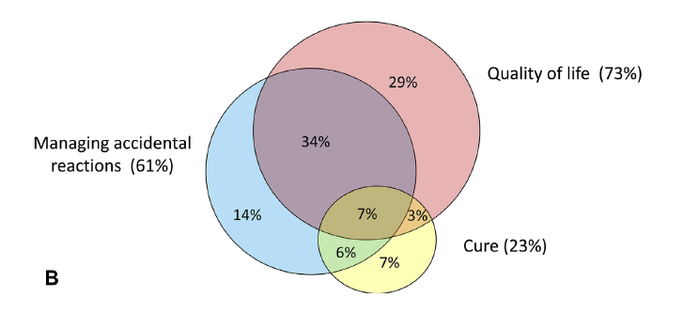
Patients Want a Treatment That Can Improve Quality of Life
Study examining patient expectations from OIT
1024 patients referred for OIT at a single academic center from 2017 to 2019
Le Blanc V, et al. J Allergy Clin Immunol Pract. 2021;9(5):2087-2089.

Slide 16
Patients Want Freedom From The Burden of Living With Allergy
Survey of parent attitudes to oral immunotherapy – July to August 2021
220 members of Allergy and Anaphylaxis Australia
Allergy and Anaphylaxis Australia Membership Survey (unpublished data, 2021)

Slide 17
Aligning challenge-defined outcomes with patient-centered outcomes: Quality of Life

Slide 18
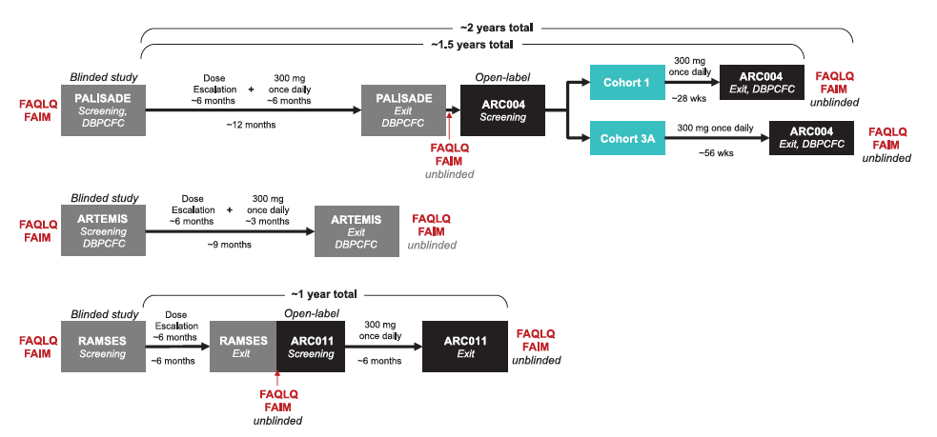
Meta-analysis of Child Quality of Life With Desensitization
Study endpoint was Desensitisation
(600mg or 1000mg peanut protein)
Galvin AD, et al. Clin Transl Allergy. 2022;12(12):e12213
Figure from Clinical and Translational Allergy modified is licensed under CC BY 4.0

Slide 19
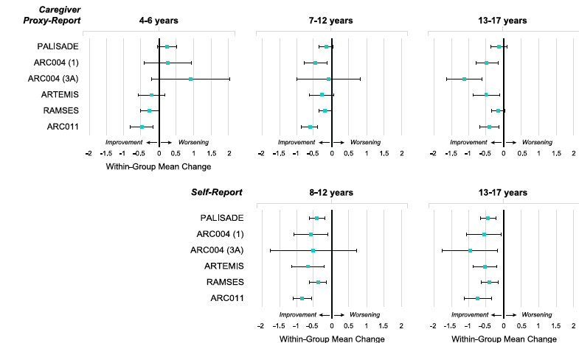
Desensitization Does Not Improve Quality of Life Compared With Placebo
Improvement in HRQL from baseline suggests potential benefit from treatment
Galvin AD, et al. Clin Transl Allergy. 2022;12(12):e12213
Figure from Clinical and Translational Allergy modified is licensed under CC BY 4.0

Slide 20
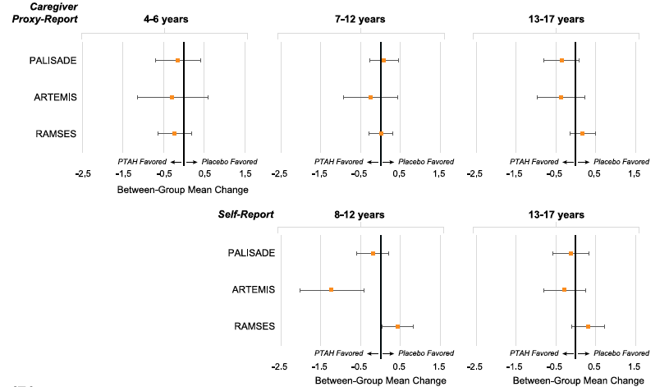
Desensitization Does Not Improve Quality Of Life Compared with Placebo
No HRQL benefit from treatment when compared with placebo
Galvin AD, et al. Clin Transl Allergy. 2022;12(12):e12213
Figure from Clinical and Translational Allergy modified is licensed under CC BY 4.0

Slide 21
Remission Leads to Better Quality of Life vs Desensitization and vs Allergy
Improvement
Change in FAQLQ Score
Minimal Clinically Important Difference
Greatest improvement was in Social and Dietary Limitation
* #
* p=0.01 SU/remission vs Allergic
# p=0.05 SU/remission vs Desensitized
Loke P, et al. Lancet Child Adolesc Health. 2022;6(3):171-184.

Slide 22
Continued Improvement In Quality Of Life Over Time
Study entry
End-of-treatment
3m post-Rx
12m post-Rx
4y post-Rx
Remission leads to lasting improvement in quality of life that increases over time
Greatest improvement in children
eating large amounts of peanut.
Dunn Galvin et al J Allergy Clin Immunol Prac 2022

Slide 23
Aligning challenge-defined outcomes with patient-centered outcomes: Allergic Reactions

Slide 24
Meta-Analysis Of Desensitization Peanut OIT Studies
Desensitization with OIT → more reactions than avoidance or placebo treatment
Event | Risk Ratio (95% Confidence Interval)
Anaphylaxis risk | 3.12 (1.76 – 5.55)
Anaphylaxis frequency (incidence rate ratio; IRR) | 2.71 (1.57 – 4.72)
Epinephrine use | 2.21 (1.27 – 3.83)
Serious adverse events | 1.92 (1.00 – 3.66)
Vomiting (incidence rate ratio; IRR) | 2.11 (1.54 – 2.89)
Angioedema (IRR) | 2.51 (1.79 – 3.52)
Upper respiratory (IRR | 1.48 (1.04 – 2.10)
Lower respiratory (wheeze, asthma) (IRR) | 1.55 (0.96 – 2.50)
Chu DK et al. Lancet. 2019;393(10187):2222-2232.

Slide 25
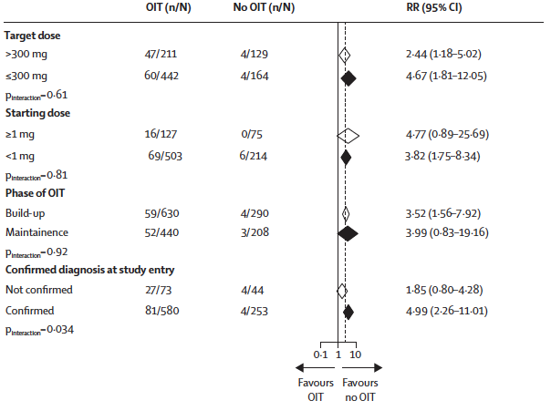
Increased Anaphylaxis Risk - Irrespective Of OIT Regimen And Treatment Phase
Increased anaphylaxis risk was irrespective of:
Entry challenge eliciting dose
Starting dose
Maintenance dose
Phase of immunotherapy
Duration of OIT
Age
Proprietary vs food OIT
Chu Dk et al. Lancet. 2019;393(10187):2222-2232. ​

Slide 26
Reactions Over Time on OIT
Safety (4-17 yr) | Daily treatment
 | First 12m PALISADE (n=374) | Second 12m ARCOO4 (n=31)
Withdrawals | 21.4% (80) | 16.1% (5)
Subjects with reactions to treatment | 98.7% (167) | 48.4% (15)
Subjects with systemic reactions | 14.2% (53) | 16.1% (5)
Subjects receiving Epinephrine | 14.0% (52) | 12.9% (4)
Longer duration of desensitization with OIT does not reduce systemic reactions or rescue epinephrine use
* Eligibility for ARC004 – Completed PALISADE with desensitization $≥$300mg
Vickery BP et al. J Allergy Clin Immunol Pract. 2021;9(5):1879-1889.e13.

Slide 27
Remission: Half The Number Of Reactions vs Sensitization
 | Allergic (n=46) | Desensitized (without remission) (n=44) | Remission (n=80)
Subjects with any reaction | 10.9% (5) | 54.3% (24) | 26.3% (21)
Subjects needing EpiPen to treat reactions | 0% (0) | 6.8% (3) | 3.75% (3)
Compared to desensitised children, children with Remission/SU were
Half as likely to have a reaction (p<0.01)
Half as likely to use rescue epinephrine
Loke P, et al. Lancet Child Adolesc Health. 2022;6(3):171-184.

Slide 28
Measuring safety

Slide 29
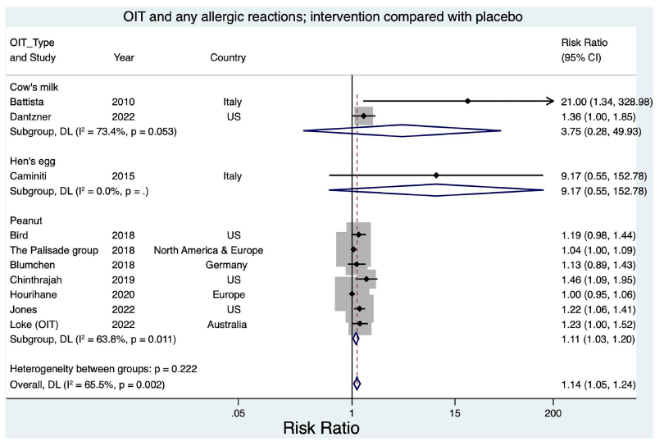
Any Allergic Reactions: OIT vs Placebo or Avoidance
Lodge CJ et al. Clin Transl Allergy. 2023;13(7):e12268.
Figure from Clinical and Translational Allergy cropped from original is licensed under CC BY 4.0

Slide 30
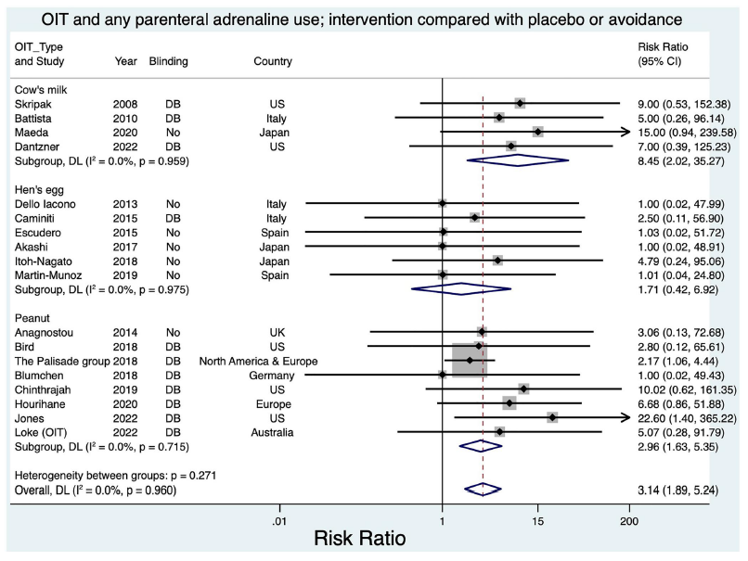
Any Allergic Reactions: OIT vs Placebo or Avoidance
Lodge CJ et al. Clin Transl Allergy. 2023;13(7):e12268.
Figure from Clinical and Translational Allergy cropped from original is licensed under CC BY 4.0

Slide 31
Exposure Adjusted Incidence Rate Of Adverse Events With Desensitisation OIT
Standardized measure of the ‘burden’ of side effects
 | PALISADE trial
 | Palforzia (n=372) | Placebo (n=124)
OVERALL | 40.7 | 5.7
Rush | 256.9 | 93.2
Buildup | 59.7 | 9.3
Maintenance | 18.0 | 1.5
Number of adverse events per year on treatment
Number of treatment-related adverse events
Days on treatment
X 365
Vickery BP et al. J Allergy Clin Immunol Pract. 2021;9(5):1879-1889.e13.

Slide 32
Experts and Regulatory Bodies Have Questioned Whether Desensitization OIT Regimens Provide Benefit To Patients
Chu et al - 2018 metaanalysis of peanut oral immunotherapy¹
“Desensitization with available OIT regimens considerably increases allergic and anaphylactic reactions over avoidance or placebo and doesn’t improve quality of life”
“Safer peanut allergy treatment approaches and rigorous randomised controlled trials that evaluate patient-important outcomes are needed.”
Institute of Clinical and Economic Review (ICER) - 2019 Report on peanut immunotherapies²
“Treatment does not provide greater benefit than avoidance”
Uncertainty around:
Long-term safety; and adherence during adolescence and young adulthood
No evidence of improvement in quality of life outcomes not available
Tolerated dose level that represents a clinically meaningful outcome for desensitization
Chu Dk et al. Lancet. 2019;393(10187):2222-2232. ​
Tice JA, et al. . J Manag Care Spec Pharm. 2020;26(5):620-623.

Slide 33
Which patient groups can benefit from the individual challenge-defined efficacy outcomes?

Slide 34
Understanding Risks & Benefits Of Individual Clinical Outcomes
Population eliciting doses in peanut allergy ¹
Around half the peanut allergy population will react to <300mg peanut protein¹
Quantitative risk assessment ²
Eliciting dose ≥300mg peanut protein → negligible risk (less than 0.08%) of reaction to peanut in packaged foods
Desensitisation therapies mainly benefit ‘more sensitive’ patients... protect against peanut contamination
Remission therapies can benefit all patients, including ‘less sensitive’ patients.
Houben et al. Food and Chemical Toxicology 146 (2020) 111831;
Baumert et al. J Allergy Clin Immunol Pract 2018;6:457-65

Slide 35
Majority Of Remission Patients Are Eating Peanut Often
Most children in remission were eating moderate or large amounts of peanut
Most children in remission were eating peanut once a week or more
Loke P, et al. Lancet Child Adolesc Health. 2022;6(3):171-184.

Slide 36
Around Half of Patients With Remission “Enjoy Eating Peanut”
Two thirds of children with SU/remission enjoy eating peanut or are eating peanut often
Only ~11% of patients prefer not to eat peanut at all
Loke P, et al. Lancet Child Adolesc Health. 2022;6(3):171-184.

Slide 37
Key Points
OIT describes the approach of allergen immunotherapy administered orally
Many different regimens that lead to different outcomes
The different clinal outcome goals have different benefits and risks
Desensitization → protection against accidental exposure (small or larger amounts) but continuing allergen avoidance and maintenance dosing required
Remission → the option to eat allergen freely, no regimented maintenance dosing, no allergen avoidance
Challenge-defined outcomes do not always align with patient-centred outcome
Remission is the only outcome that has been shown to provide improved quality of life
Understanding the patient’s allergy phenotype (sensitivity level / reaction threshold) and treatment goals will help guide the selection of suitable treatment approach tailored to the individual patient

Slide 38
Clinical Care Must Provide Outcomes That Are Meaningful To Patients
Socrates…
“We should set the highest value, not on living, but on living well"
Reduced quality of life is the most significant impact for people living with food allergy…. Remission offers substantial improvement in quality of life

Slide 39
Key Takeaways For Your Practice
Remission has been shown to improve quality of life compared with placebo
Desensitization requires continued maintenance dosing
Patients who continue on OIT or allergen exposure to maintain their desensitization must have access to rescue medication as serious reactions do not reduce over time

