Slide 2
Faculty Presenters
Julie Khlevner, MD
Rachel Lee Rosen, MD, MPH
Associate Professor of Pediatrics at Columbia University Medical Center
Pediatric Gastroenterology
Director, Neurogastroenterology and Motility Center
New York, New York
Professor of Pediatrics Director, Aerodigestive Center Harvard Medical School Boston Children's Hospital Boston, Massachusetts
Cover image credit: xijian via iStock by Getty Images

Slide 3
Faculty Disclosures
It is the policy of the Annenberg Center to ensure fair balance, independence, objectivity, and scientific rigor in all programming. All faculty participating in accredited programs are expected to identify and reference off-label product use and disclose any relationship with those supporting the activity or any others whose products or services are discussed.
Julie Khlevner, MD
Consultant: Abbvie/Ironwood; Speakers Bureau: Abbott Pediatric Nutrition, QOL Medical
Rachel Lee Rosen, MD, MPH
No financial relationships to disclose.
Faculty have documented that this presentation will involve discussion of unapproved or off-label, experimental, or investigational use.

Slide 4
Learning Objectives
By participating in this education, you will better:
Differentiate the clinical criteria and management strategies for Gastroesophageal Reflux (GER) vs Gastroesophageal Reflux Disease (GERD)
Summarize the guidelines for the clinical management of GER
Explain how Proton Pump Inhibitors (PPIs) and H2 Receptor Antagonists (H2RAs) work in an infant’s body and their potential short- and long-term risks
Devise a clinical management plan for an infant diagnosed with GERD

Slide 5
Overview of GER and GERD
Julie Khlevner, MD
Notes:
Kh

Slide 6
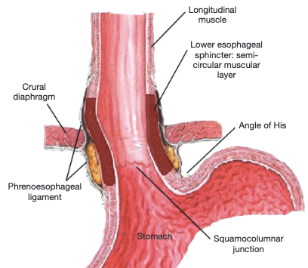
Physiology of the Anti-Reflux Barrier
The Gastroesophageal Junction^{[1]}
The anti-reflux barrier is an anatomic zone that protects against esophageal reflux exposure^{[2]}
Includes lower esophageal sphincter (LES), crural diaphragm, and structures supporting the gastroesophageal flap valve
Overlap of the LES and diaphragm creates an effective barrier
Airway protective mechanisms (e.g., coughing and swallowing) facilitate esophageal clearance
Transient LES relaxation and impaired esophageal clearance can lead to reflux
Image used under a Creative Commons license (CC BY). © The Authors (2021).
[1]. Andrews WG, Louie BE. Ann Laparosc Endosc Surg. 2021;6:41. [2]. Tack J, Pandolfino JE. Gastroenterology. 2018;154(2):277-288. doi:10.1053/j.gastro.2017.09.047

Slide 7
Defining Gastroesophageal Reflux and Gastroesophageal Reflux Disease
Terminology | NASPGHAN/ESPGHAN definitions for pediatric populations
Gastroesophageal reflux (GER) | The passage of gastric contents into the esophagus with or without regurgitation and vomiting
Gastroesophageal reflux disease (GERD) | When GER leads to troublesome symptoms that affect daily functioning and/or result in complications (eg, esophagitis, strictures)
Refractory GERD | GERD that does not respond to optimal treatment after 8 weeks
ESPGHAN, European Society for Pediatric Gastroenterology, Hepatology, and Nutrition; NASPGHAN, North American Society for Pediatric Gastroenterology, Hepatology, and Nutrition.
Rosen R et al. J Pediatr Gastroenterol Nutr. 2018;66(3):516-554.

Slide 8
Prevalence and Natural History of GER and GERD
Curien-Chotard M, Jantchou P. BMC Pediatr. 2020;20(1):152.

Slide 9
Risk Factors for GERD in Infants
Several risk factors for GERD in infants have been identified, including:
Preterm birth
Cystic fibrosis and other chronic lung conditions
Congenital diaphragmatic hernia
Esophageal atresia
Cerebral palsy and other neurological conditions
National Institute of Diabetes and Digestive and Kidney Diseases. November 2020. https://www.niddk.nih.gov/health-information/digestive-diseases/acid-reflux-ger-gerd-infants/symptoms-causes.

Slide 10
Clinical Presentation of GERD in Infants
GERD signs and symptoms are nonspecific and vary considerably by patient age. Some of the common signs of GERD in infants include:
Discomfort/irritability
Failure to thrive
Feeding refusal
Dystonic neck posturing
Anemia
Regurgitation with/without vomiting
Hematemesis
Dysphagia
Esophagitis
Esophageal stricture
Barrett’s esophagus
Wheezing, cough, or hoarseness
Stridor
Apnea spells
Recurrent pneumonia
Recurrent otitis media
General
GI tract
Airway
GI, gastrointestinal
Rosen R et al. J Pediatr Gastroenterol Nutr. 2018;66(3):516-554.

Slide 11
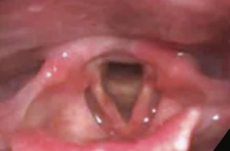
ENT Evaluation, Airway Inflammation, and GERD
Airway examination is not recommended for the diagnosis of GERD due to a lack of correlation between airway inflammation and reflux findings.^{[1]}
Prospective, cohort study of 77 children with chronic cough undergoing airway examination by blinded ENTs and multichannel intraluminal impedance testing with pH (pH-MII)^{[1]}
No correlation between pH-MII results and airway inflammation scores
Low concordance among ENTs for airway inflammation scoring
No difference in airway inflammation scores between patients with or without esophagitis
Diffuse Laryngeal Erythema^{[2]}
ENT, ear, nose, and throat specialist
Image used under a Creative Commons license (CC BY). © The Authors (2022).
[1]. Rosen R et al. J Pediatr. 2017;183:127-131. [2]. Joshi AA, Chiplunkar B. Int J Head Neck Surg. 2022;13(1):8-17.

Slide 12
Diagnosing GERD in Infants: Challenges and Considerations
In the absence of universal diagnostic criteria, definitive diagnosis of GERD in infants remains challenging^{[1]}
Heterogeneous and nonspecific symptoms
Difficult to correlate symptoms with reflux events
High prevalence of common symptoms (e.g., irritability) in infants with and without GERD
Because infants cannot verbalize when symptoms are “troublesome,” the extent of caregiver concern is usually the factor that determines the need for a diagnosis^{[2]}
[1]. Bingham SM, Muniyappa P. Curr Probl Pediatr Adolesc Health Care. 2020;50(5):100784. [2]. Rosen R et al. J Pediatr Gastroenterol Nutr. 2018;66(3):516-554.

Slide 13
Evaluating the Infant With Frequent Regurgitation or Vomiting
A thorough clinical history and physical examination are usually sufficient for the diagnosis of uncomplicated GERD.
Age at onset?
Pattern of regurgitation (e.g., nocturnal, postprandial)?
Digested vs undigested?
Duration of feedings?
Volume of feeds?
Breastfed or formula?
Type and methods of formula mixing?
Feed additives?
Interval between feeds?
Family medical history?
Possible triggers (e.g., secondhand smoke exposure)?
Past interventions?
Growth trajectory?
Warning signs?
Symptoms
Feeding/diet
Other
Rosen R et al. J Pediatr Gastroenterol Nutr. 2018;66(3):516-554.

Slide 14
Differential Diagnosis: Red Flag Signs and Symptoms
Category | Signs and symptoms | Potential differential diagnoses
General | Weight loss, lethargy, fever, excess irritability | Various conditions (e.g., infectious diseases)
 | Dysuria | Urinary tract infection
 | Regurgitation onset >6 months of age or worsening/persisting beyond 12-18 months of age | May be indicative of alternative to GERD
Neurologic | Bulging fontanel, rapid increase in head circumference, seizures, macro- or microcephaly | Raised intracranial pressure (e.g., meningitis, brain tumor, hydrocephalus)
GI | Persistent forceful vomiting | Hypertrophic pyloric stenosis
 | Nocturnal vomiting | Increased intracranial pressure
 | Bilious vomiting | Intestinal obstruction (e.g., Hirschsprung disease)
 | Hematemesis | GI bleed (may still be GERD associated)
 | Chronic diarrhea | Food protein-induced gastroenteropathy
 | Rectal bleeding | Various conditions (e.g., proctocolitis)
 | Abdominal distension | Obstruction, dysmotility, or anatomic abnormalities
Rosen R et al. J Pediatr Gastroenterol Nutr. 2018;66(3):516-554.

Slide 15
Differential Diagnosis: Selected GERD Mimickers
Gastrointestinal
GI obstruction (eg, pyloric stenosis, Hirschsprung disease) Achalasia Gastroparesis Gastroenteritis Peptic ulcer Eosinophilic esophagitis Food allergy/intolerance Inflammatory bowel disease Pancreatitis Appendicitis
Metabolic
Galactosemia Hereditary fructose intolerance Urea cycle defects Amino and organic acidemias Fatty acid oxidation disorders Metabolic acidosis Congenital adrenal hyperplasia/adrenal crisis
Neurologic
Hydrocephalus Subdural hematoma Intracranial hemorrhage Intracranial mass
Cardiovascular
Heart failure Vascular ring Autonomic dysfunction
Infectious
Sepsis/meningitis Urinary tract infection Upper/lower airway infection Otitis media Hepatitis
Others
Pediatric condition falsification Child neglect or abuse Self-induced vomiting Cyclic vomiting syndrome Rumination syndrome
Renal
Obstructive uropathy Renal insufficiency
Rosen R et al. J Pediatr Gastroenterol Nutr. 2018;66(3):516-554.

Slide 16
Diagnosing GERD in Infants: Additional Evaluations
Most cases of pediatric GERD can be diagnosed clinically and without additional diagnostic testing.
Additional testing may be considered in infants with red flags or effects on feeding, growth, and development:
Barium contrast imaging or ultrasonography—to exclude anatomical abnormalities
Esophagogastroduodenoscopy with biopsy—to assess GERD complications, underlying mucosal disease (i.e., eosinophilic esophagitis), or before treatment intensification
High-resolution manometry—when a motility disorder is suspected)
pH-MII—for troublesome or persistent GERD
Rosen R et al. J Pediatr Gastroenterol Nutr. 2018;66(3):516-554.

Slide 17
GERD Management: Nonpharmacologic Treatment
Rachel Rosen, MD, MPH

Slide 18
Nonpharmacologic Treatment Strategies: the Cornerstones of GER and GERD Management
Caregiver reassurance^{[1]}
Regurgitation as normal in infants
Nutritional interventions^{[1],[2]}
Thickening of human milk or formula
Modification of feeding volumes or intervals
Counseling on proper feeding practices^{[1]}
Signs and symptoms warranting medical evaluation (e.g., refusal to feed)
As the digestive system matures, regurgitation usually improves by age 12 months
Upright positioning during feeding
Burping during and after feeds
Identifying satiety cues and avoiding overfeeding
Ensuring appropriate feeding frequency, volume, composition, and bottle and nipple
Trial of extensively hydrolyzed formula (only for those who have not responded to conventional GERD therapies)
[1]. Haiden N et al. J Pediatr Gastroenterol Nutr. 2024;79(1):168-180. [2]. Rosen R et al. J Pediatr Gastroenterol Nutr. 2018;66(3):516-554.

Slide 19
Infant Positioning to Reduce GER/GERD Symptoms
Head elevation and left lateral positioning may improve GER symptoms, especially in the first hour after meals.^{[1]}
Flat prone and left-side–down positioning only recommended in awake, observed infants^{[1]}
No evidence for benefit of inclined positions from 10° to 28° for the treatment of GER symptoms^{[2]}
Note: Left lateral positioning and head elevation have not been shown to improve GER symptoms in preterm infants^{[3]}
Remind parents to always lay infants flat on their backs for sleeping to reduce the risk of sudden infant death syndrome (SIDS).
[1]. Rosen R et al. J Pediatr Gastroenterol Nutr. 2018;66(3):516-554. [2]. Paul IM et al. JPGN Rep. 2023;4(2):e312. [3]. Eichenwald EC et al. Pediatrics. 2018;142(1):e20181061.

Slide 20
Thickened or “Anti-Reflux” Formulas for the Formula-fed Infant With Visible Reflux
Thickened feeds have been associated with^{[1],[2]}:
Reduced visible regurgitation and vomiting
Increased regurgitation-free days
Increased weight gain
Thickened feeds have not been shown to improve non-regurgitation signs and symptoms of GERD^{[1]}
[1]. Rosen R et al. J Pediatr Gastroenterol Nutr. 2018;66(3):516-554. [2]. Haiden N et al. J Pediatr Gastroenterol Nutr. 2024;79(1):168-180.

Slide 21
Stepped Care Approach: Nonpharmacologic Interventions for Formula-Fed Infants
Stepped Care Approach for Formula-Fed Infants With GER and Significant Distress^{[1]}
Clinical Considerations and Counseling Points for Thickened Formulas^{[2]}
Recommend achieving slightly or mildly thick feeds (IDDSI Flow Test), depending on severity
Discuss use of different nipple sizes to achieve flow rate
Account for altered nutritional profile of feeds (increased calorie content) and, if possible, work with dietitian
Schedule follow-up to evaluate tolerability of thickener and degree of thickening
Review feeding history and, if feeds excessive for infant weight, reduce feed volumes
Trial smaller, more frequent feeds while maintaining appropriate total daily intake volume
Trial thickened formulas
IDDSI, International Dysphagia Diet Standardisation Initiative
[1]. NICE. Updated October 9, 2019. https://www.nice.org.uk/guidance/ng1. [2]. Duncan DR et al. Curr Gastroenterol Rep. 2019;21(7):30.

Slide 22
Nutritional Interventions for Breastmilk-Fed Infants
GERD is not an indication for switching to formula in most breastfed infants; caregivers of breastfed infants with GERD should be encouraged to continue breastfeeding.
For infants with frequent regurgitation, human milk thickeners added to pumped breastmilk may be considered.
Recommended for infants:
Carob bean gum thickeners (>42 weeks’ gestation)
Food-based thickeners
Recommended for older children:
Xanthan gum thickeners (>1 year of age due to risk of NEC)
Food-based thickeners
[1]. Haiden N et al. J Pediatr Gastroenterol Nutr. 2024;79(1):168-180. [2]. Rosen R et al. J Pediatr Gastroenterol Nutr. 2018;66(3):516-554.

Slide 23
Contraindications for Thickeners
Motility disorders
Disorders associated with poor intestinal perfusion (eg, congenital heart disease)
Heme-positive stools
History of NEC or NEC watches
Duncan DR et al. Curr Gastroenterol Rep. 2019;21(7):30.

Slide 24
Thickener Types and Characteristics
Thickener type | Calories (kcal/teaspoon) | Can thicken breastmilk? | Age/weight restrictions | Notes
Cereals
Rice | 5 kcal per teaspoon of cereal | No | None | Change in bowel movements Consider arsenic exposure
Oatmeal | 5 kcal per teaspoon of cereal | No | None | Increased risk of nipple clogs Consider arsenic exposure
Other grains | Varies depending on grain | No | None | Nutritional considerations and consistencies vary by grain Consider arsenic exposure
Carob bean gum | +5 kcal per ounce for nectar consistency | Yes | >42 weeks’ CA, weight >6 lbs | Heating required for thickening
Xanthan gum | +5 kcal per ounce for nectar consistency | Yes | >1-3 years CA, depending on institution | Case reports of NEC Includes soluble fiber
Corn starch | +4 kcal per ounce for nectar consistency | No | >12 months CA | Grainy texture reported GI upset May benefit history of hypoglycemia
Tara gum | +2 kcal per ounce for nectar consistency | Yes | >12 months CA | Thickens both hot and cold liquids
Food purees (e.g., fruit, yogurt, etc) | Varies | Yes | Typically >4 months of age | Important to work with dietitian and feeding specialist to ensure appropriate nutritional content and consistency Consider arsenic exposure
CA, corrected age.
Duncan DR et al. Curr Gastroenterol Rep. 2019;21(7):30.

Slide 25
Troubleshooting Caregiver Issues and Concerns Related to Thickening
Concern | Troubleshooting
Clumping/inconsistent thickening | Consider finer-grain cereal May try pulverizing grain with food processor before adding to the bottle May mix or blend solution with handheld immersion blender or whisk
Viscosity increasing over time | Consider changing thickeners or mixing one bottle at a time, immediately prior to consumption Consult with speech-language pathologist to discuss temperature of formula and its effect of increasing viscosity
Nipple clogging despite following recipe | Re-check viscosity with International Dysphagia Diet Standardization Initiative testing Consult with team to adjust recipe and/or nipple size, if safe Advise against manually opening nipple hole
Decreased liquid intake | Consider viscosity relative to nipple size Consider switch to more palatable thickener
Stooling changes | Consider change in thickening agent or rotation of different thickening agents in collaboration with team
Duncan DR et al. J Pediatr. 2023;260:113510.

Slide 26
GERD Management: Pharmacologic Treatment
Rachel Rosen, MD, MPH

Slide 27
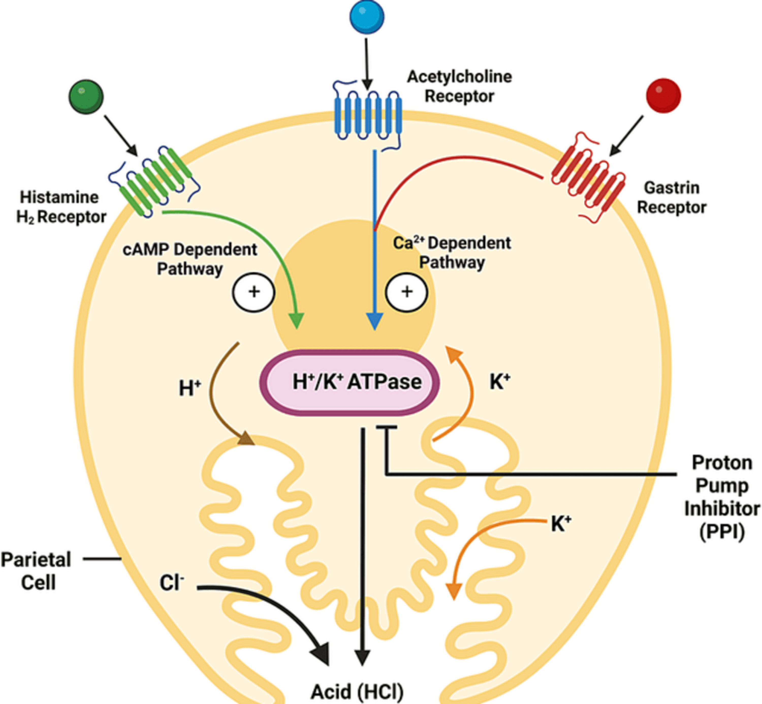
Pharmacologic Treatment Options for GERD
Antacids and alginates neutralize gastric acid^{[2]}
Acid-suppressive agents decrease gastric acid secretion^{[3],[4]}
Proton pump inhibitors (PPIs) irreversibly inhibit the H⁺/K⁺ ATPase of parietal cells
Histamine H₂ receptor antagonists (H2RAs) are competitive inhibitors of the H2 receptor, preventing downstream signaling that leads to gastric acid release
Potassium-competitive acid blockers (P-CABs) reversibly inhibit binding of K⁺ to the H⁺/K⁺ ATPase
Pharmacologic Inhibition of Gastric Acid Suppression^{[1]}
H₂RAs
Acetylcholine receptor
Gastrin receptor
Histamine H2 receptor
PPIs
Parietal cell
P-CABs
Acid (HCl)
Image used under a Creative Commons license (CC BY). © The Authors (2022).
[1]. Meyer JC et al. Cureus. 2022;14(11):e31918. [2]. Gonzalez Ayerbe JI et al. Pediatr Gastroenterol Hepatol Nutr. 2019;22(2):107-121. [3]. Wilks A et al. In: Chai J (ed). Gastroesophageal Reflux Disease – A Growing Concern. 2022; InTech Open. [4]. Katzka DA et al. Gastroenterology. 2023;164(1):14-15.

Slide 28
Risk-Benefit Profile of Acid-Suppressive Medications for the Management of Infant GERD
Large systematic reviews and meta-analyses have shown that acid suppressants do not improve symptoms relative to placebo in infants with GERD.^{[1],[2]}
Acid suppressants have been associated with adverse events in infants and children:
Dysbiosis^{[3]} | Serious infections^{[4]} |  | Fractures^{[5]}
~5- to 13-fold higher prevalence of potentially pathogenic gastric bacteria | ~8-fold higher risk of Clostridioides difficile infection |  | 23%-31% increased risk of fracture in first year of life (PPIs)
Allergic diseases^{[6]} |  | Obesity^{[7]}
~16% increased risk of asthma and ~28% increased risk of food allergy |  | Duration-associated increased risk for obesity
[1]. Rosen R et al. J Pediatr Gastroenterol Nutr. 2018;66(3):516-554. [2]. Fernández-González SM et al. Children (Basel). 2024;11(3):296. [3]. Rosen R et al. JAMA Pediatr. 2014;168(10):932-937. [4]. Freedberg DE et al. Clin Infect Dis. 2015;61(6):912-917. [5]. Malchodi L et al. Pediatrics. 2019;144(1):e20182625. [6]. Noh Y et al. JAMA Pediatr. 2023;177(3):267-277. [7]. Stark CM et al. Gut. 2019;68(1):62-69.

Slide 29
Risks of Acid-Suppressive Medications in Preterm Infants
Pharmacotherapies for GERD—particularly acid suppressants—are associated with substantial risks in preterm infants with no evidence for symptomatic benefits
Preterm infants who receive acid-suppressive medications are at increased risk for:
Necrotizing enterocolitis (NEC)
Late-onset sepsis
Mortality
Eichenwald EC et al. Pediatrics. 2018;142(1):e20181061.

Slide 30
NASPGHAN/ESPGHAN Recommendations for Medical Management of Infant GERD
Acid suppressants not recommended for the treatment of:
Regurgitation in otherwise healthy infants
Crying or distress in otherwise healthy infants
Extraesophageal symptoms
Acid suppressants recommended for the treatment of GER-associated erosive esophagitis:
First-line PPIs
H2RAs if PPIs not available or contraindicated
Additional recommendations:
Evaluate treatment effectiveness after 4-8 weeks of acid suppression
In those not responding after 4-8 weeks, exclude alternative causes of symptoms
Regularly re-assess the need for ongoing treatment with acid suppressants
Rosen R et al. J Pediatr Gastroenterol Nutr. 2018;66(3):516-554.

Slide 31
Management of Uncomplicated GER in Clinical Practice: a Case Study
Julie Khlevner, MD

Slide 32
Case #1: Breastfed Infant With Regurgitation
5-week-old, exclusively breastfed term infant
Brought in by parents with concerns about constant irritability, fussing, and regurgitation
Clinical interview reveals:
Regurgitation of curdled milk occurring 4-5 times per day, usually within 10-15 minutes of feeds
Frequent, seemingly inconsolable crying or fussing episodes lasting 30-60 minutes intermittently throughout the day

Slide 33
Case #1: Breastfed Infant With Regurgitation
Vital signs: unremarkable
Current weight: 4.5 kg
Weight at 2-week visit: 3.6 kg
Physical examination reveals:
Fussiness when laid supine; improved when held upright or prone
Otherwise unremarkable
You suspect the infant is experiencing episodes of GER. The infant’s parents have asked you whether you would recommend medications to reduce regurgitation.
How should you counsel these parents?

Slide 34
Case #1: Breastfed Infant With Regurgitation
You provide the parents with counseling on:
GER as a common occurrence among infants
Lifestyle modifications that may reduce symptoms
You explain that medications aren’t recommended for their infant due to the lack of benefits and risks associated
You remind parents to return for care if any red flags develop

Slide 35
Pediatric GERD Treatment Algorithm in Infants^{[1]}
eHF, extensively hydrolyzed formula.
Image used under a Creative Commons license (CC BY). © The Authors (2019).^{[2]}
[1]. Rosen R et al. J Pediatr Gastroenterol Nutr. 2018;66(3):516-554. [2]. Gonzalez Ayerbe JI et al. Pediatr Gastroenterol Hepatol Nutr. 2019;22(2):107-121.

Slide 36
Use of Acid Suppressants in Real-World Clinical Practice
Despite evidence for risks and guideline recommendations against use for most infants with GER, acid suppressants are commonly prescribed in real-world clinical practice.^{[1]-[3]}
~7% of all infants are prescribed acid-suppressive therapies.^{[1]}
~1 in 4 hospitalized preterm and term infants receive acid-suppressive therapies.^{[4]}
~56% of hospitalized infants who were prescribed acid suppressants remained on treatment at discharge.^{[4]}
[1]. Wolf ER et al. Pediatrics. 2023;151(3):e2022058330. [2]. Tracy MS et al. Acta Paediatr. 2022;111(2):440-441. [3]. Levy EI et al. Eur J Pediatr. 2020;179(12):1957-1961. [4]. Slaughter JL et al. J Pediatr. 2016;174:63-70.e3.

Slide 37
Key Components of Reassurance for Caregivers of Infants With GER
When discussing GER with caregivers, provide counseling on the basics of effortless regurgitation in infants, including that GER…^{[1],[2]}
Is common, affecting more than one-half of infants younger than 6 months
Typically begins prior to 8 weeks of age and becomes less frequent as infants get older (about 90% of cases resolve by 1 year of age)
Can occur frequently (about 1 in 20 infants have ≥6 episodes per day)
Does not typically require additional evaluation or treatment
[1]. National Institute for Health and Care Excellence (NICE). Updated October 9, 2019. https://www.nice.org.uk/guidance/ng1. [2]. Curien-Chotard M, Jantchou P. BMC Pediatr. 2020;20(1):152.

Slide 38
Providing Guidance on Red Flags
Discussing red flags and warning signs to look for may help ease caregiver anxiety about GER symptoms
Advise caregivers to return for medical evaluation for any of the following changes:
Persistent, projectile vomiting
Green or green-yellow vomiting (bile stained)
Blood in vomit
New signs of marked distress, feeding difficulties, or growth faltering
Persistent, frequent regurgitation past 1 year of age
NICE. Updated October 9, 2019. https://www.nice.org.uk/guidance/ng1.

Slide 39
Differential Diagnostic Approach to GER Red Flags: a Case Study
Rachel Rosen, MD, MPH

Slide 40
Case #2: Infant With Feeding Difficulties
7-month-old former preterm infant (corrected age, 6 months)
Brought in by parents with reports of feeding difficulties, reflux, crying, and wheezing
Birth history:
Delivery at 36 weeks’ gestation via emergency Cesarean
Discharged from NICU at 40 weeks’ postmenstrual age

Slide 41
Case #2: Infant With Feeding Difficulties
Medical history:
Multiple recent upper respiratory tract infections
Infrequent otitis media
Clinical interview:
Gagging and coughing during feedings beginning about 2-3 weeks prior
Frequent regurgitation and occasional vomiting during episodes
Occasional audible wheezing
No reports of cyanosis or apnea

Slide 42
Case #2: Infant With Feeding Difficulties
Vital signs: unremarkable
Growth trends:
Birth weight: 3.4 kg
50%ile weight-for-age
Current weight: 6.8 kg
10%ile weight-for-age
Physical examination: transmitted upper airway sounds, otherwise unremarkable

Slide 43
Case #2: Infant With Feeding Difficulties
Based on your initial evaluation, you note several characteristics that may be suggestive of a more complex diagnosis, requiring further work-up:
Symptom onset after age 6 months
Wheezing and frequent respiratory infections—potentially indicative of aspiration
Coughing and gagging during feeds, suggesting potential swallowing difficulties
Slowing growth trend
What is the most appropriate next step for this infant?

Slide 44
Case #2: Infant With Feeding Difficulties
You discuss the potential causes of the infant’s symptoms with her parents, which may include GERD, as well as oropharyngeal dysphagia
You refer the infant for clinical evaluation by a speech-language pathologist and a pediatric gastroenterologist
The infant is diagnosed with oropharyngeal dysphagia and managed with thickened formula and feeding therapy

Slide 45
Collaborative Care for Infants With GER/GERD
Most cases of GER can be successfully managed in the primary care setting
Multidisciplinary care teams can help optimize GER/GERD management
Caregiver support
Evaluation of infants with red flags or GERD not responsive to optimized medical management
Nutritional evaluation and counseling when using thickeners
Primary care
Gastroenterology
Speech-language pathology
Otolaryngology
Pulmonology
Multidisciplinary Care Team for Infant With GERD
Duncan DR et al. J Pediatr. 2023;260:113510.

Slide 46
Key Takeaways
Julie Khlevner, MD

Slide 47
Key Takeaways: GER/GERD Evaluation and Diagnosis
Because infants cannot verbalize when symptoms are “troublesome,” the extent of caregiver concern is usually the factor that determines the need for a diagnosis
A thorough clinical history and physical examination are usually sufficient for the diagnosis of uncomplicated GERD
Infants should be evaluated for potential red flag symptoms, including persistent, forceful vomiting; dysuria; and onset in infants older than 6 months or worsening/persistence beyond 12-18 months.

Slide 48
Key Takeaways: GER/GERD Management
Caregiver reassurance, counseling on proper feeding practices, and nutritional interventions are the cornerstones of GERD management
Head elevation and left lateral positioning may improve GER symptoms, especially in the first hour after meals
Infants with persistent GER and significant distress may benefit from thickened feeds
Pharmacologic interventions, including acid suppressants, are not routinely recommended for otherwise healthy infants with reflux

Slide 49
Audience Questions

Slide 50
GER and GERD and Infants: What Are Your Treatment Strategies?
What is the earliest age you recommend thickening formula or human milk? Do you have any concerns regarding changing the macronutrient profile, since thickeners increase carbs, and thereby decrease protein and fat concentration?

Slide 51
GER and GERD and Infants: What Are Your Treatment Strategies?
What would you suggest to use to thicken regular infant formulas if specialized thickened formulas are unavailable?

Slide 52
GER and GERD and Infants: What Are Your Treatment Strategies?
Will thickening formula help a leaking G-tube for an older child?

Slide 53
GER and GERD and Infants: What Are Your Treatment Strategies?
When babies in the NICU have some desaturation and bradycardia events while an NG tube is infusing, suggesting the spells are attributed to reflux, are there data that show that positioning with the head of the bed up during the feeding helps decrease these spells?

Slide 54
GER and GERD and Infants: What Are Your Treatment Strategies?
Is the presence of bradycardias and desaturations with feeds always associated with reflux?

Slide 55
GER and GERD and Infants: What Are Your Treatment Strategies?
What thickeners would you recommend for a preterm infant?

Slide 56
GER and GERD and Infants: What Are Your Treatment Strategies?
Can we expect new guidelines on the management of GERD from NASPGHAN?

