Slide 1
Updates on nutritional assessment of very preterm infants
Mandy Brown Belfort, MD MPH
Associate Professor of Pediatrics, Harvard Medical School
Attending Neonatologist, Brigham and Women’s Hospital
Miami Neonatology / November 19, 2024

Slide 2
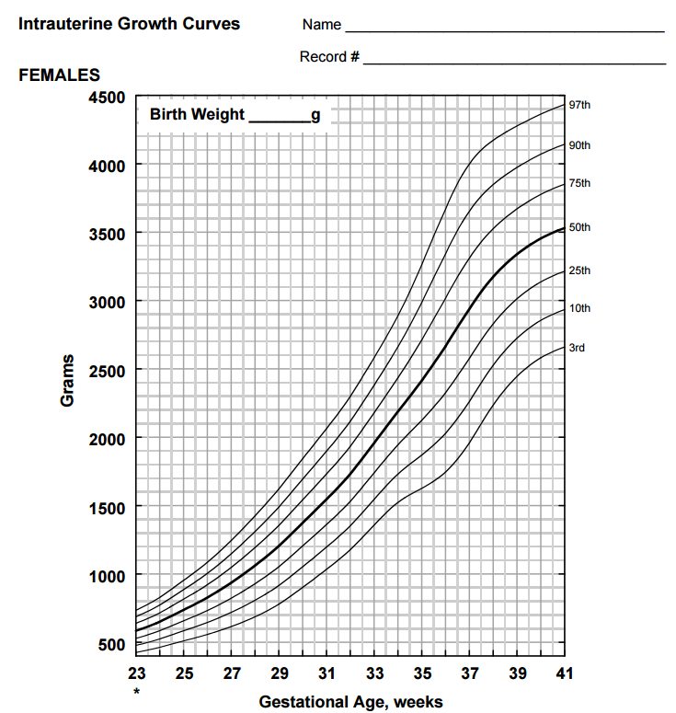
Agenda
Nutritional care in the NICU sets the stage for lifelong health of preterm infants.
An optimal NICU diet supports brain development while minimizing cardiometabolic risks.
Accurate and specific indicators of nutritional status are needed to guide decision-making.
Anthropometry
Body composition
Notes:
Reason I find this topic so interesting is that there is so much amazing work being done on all levels from basic science to epi to clinical trials to QI/implementation to advocacy
My own work draws on my training in epidemiology and you will see that I love a big dataset
I will also highlight the work of others in the field to illustrate all the different ways in which I see the science of human milk being leveraged to improve the health of our very preterm patients

Slide 3
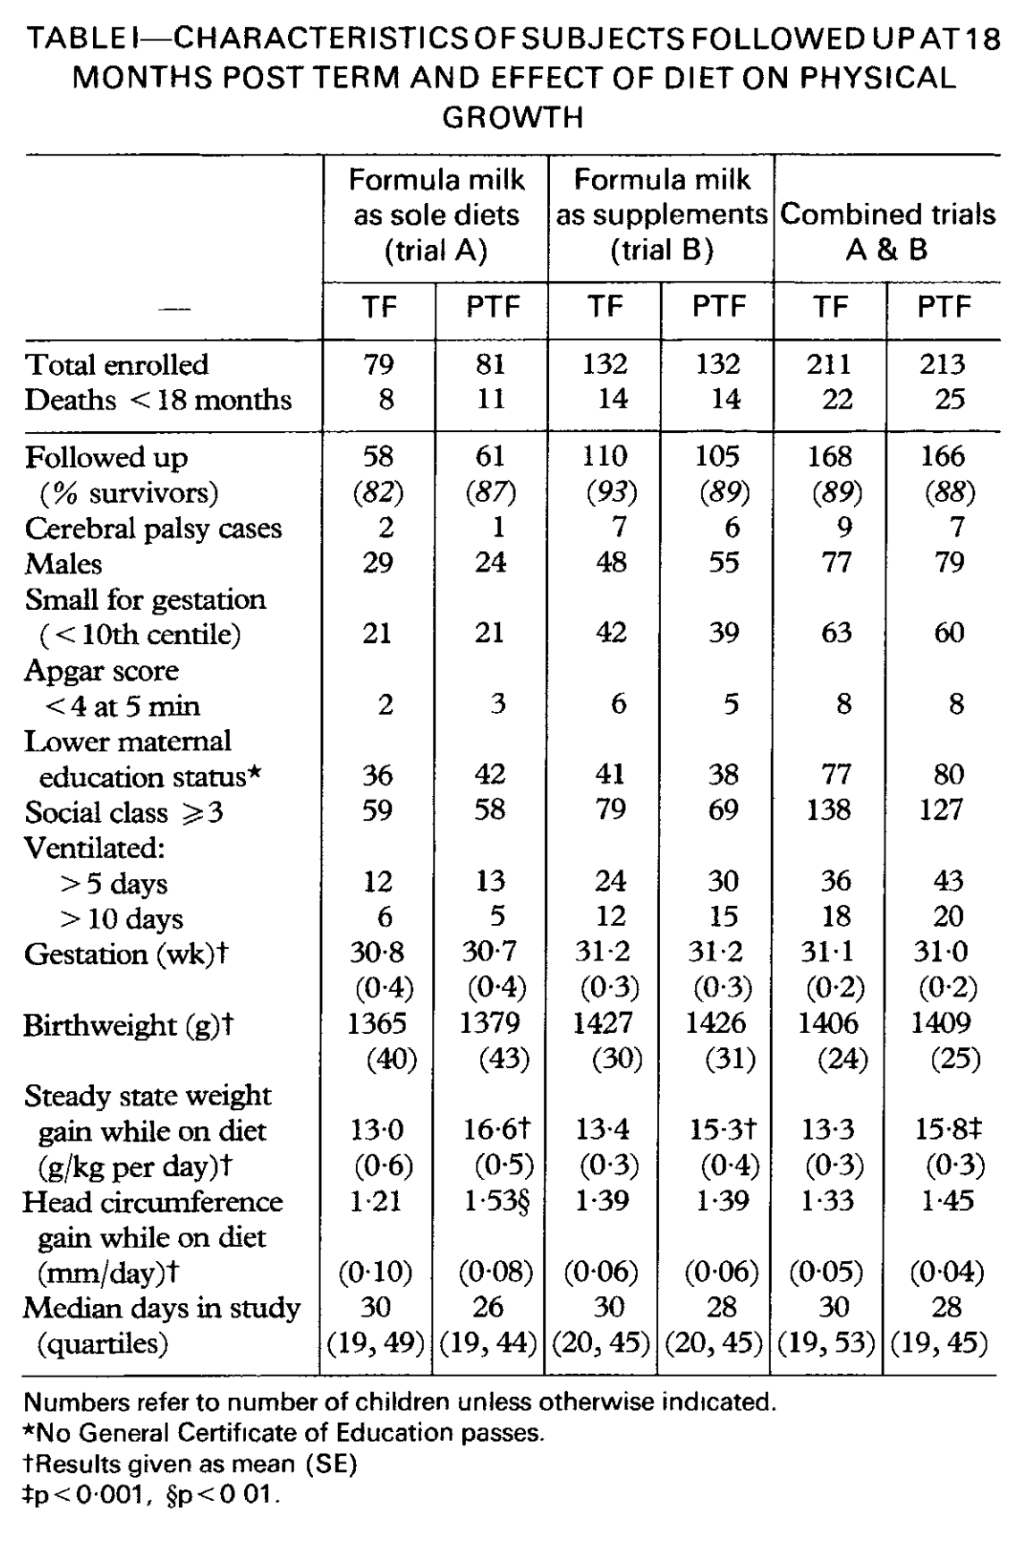
Nutritional care in the NICU sets the stage for lifelong health.
NICU hospitalization coincides with a critical period in development when adverse exposures program chronic disease risk
Lucas et al., Lancet 1990
NICU diet interventions improve neurodevelopmental outcomes

Slide 4
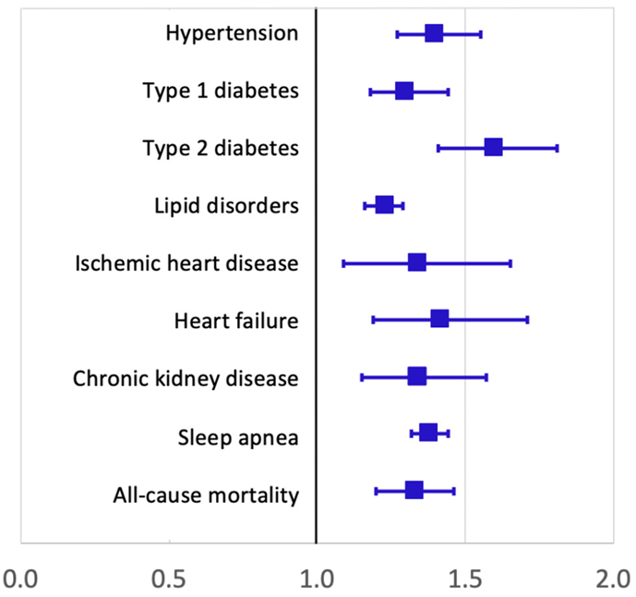
Preterm birth increases cardiovascular disease risk.
Early-life diet may influence these risks.
Adjusted hazard ratios (95% CIs), associations of preterm birth with outcomes @18-45 years vs. full term birth
Sweden, 1973-2014
Crump C. Early Hum Dev. 2020
Notes:
But what about cardiovascular disease? Here is a figure from an excellent review article that synthesizes a large and growing body of work led by Casey Crump using population based data from Sweden.
I am specifically focusing on these disease outcomes of ischemic heart disease, heart failure, and chronic kidney disease, which are at least in part preventable by taking early action on risk factors such as hypertension and diabetes.
Not shown here, but a recent paper reported an increase in stroke as well.

Slide 5
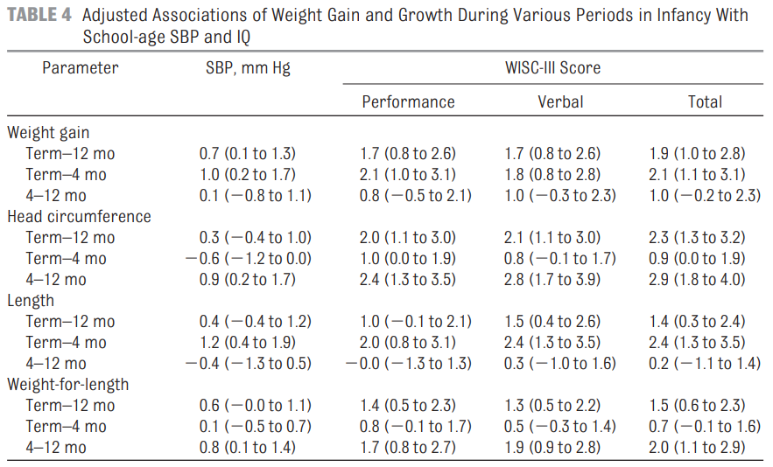
Tradeoffs exist between optimizing neurodevelopment and cardiometabolic health.
More rapid weight gain & linear growth after NICU discharge were associated with higher IQ @school age…..
…..and with higher systolic blood pressure
Belfort et al. Pediatrics 2010
Notes:
Goal is to maximize neurodevelopmental potential while minimizing excess adiposity and cardiometabolic risk

Slide 6
These tradeoffs factor into every-day clinical decisions in the NICU.
This baby is gaining a lot of weight, should we back off on calories?
This baby’s weight gain is falling off, but linear and head growth look ok, should we change anything?
This baby is heavy but short, do we need to add more protein? Reduce calories?

Slide 7
The goal is to promote brain development and minimize cardiometabolic risk.

Slide 8
American Academy of Pediatrics:
“Current recommendations are … to approximate the rate of growth and composition of weight gain for a normal fetus of the same post-conceptual age”
Notes:
So how do clinicians now how much to feed babies in the NICU? Well currently the available guidelines for both macronutrients such as protein and micronutrients such as iron and zinc are based on a concept known as the “reference” fetus. And essentially this concept says that the preterm infant should grow and accrete nutrients just like a fetus. Now this makes intuitive sense, and it is also practical, because it is possible to model fetal nutrient accretion rates and thereby provide recommendations for all macronutrients and micronutrients. But this approach also gives a false sense that we actually know what is optimal for a preterm baby who is not in the womb but instead is in the NICU, faced with environmental stressors, physical demands, and illnesses that are not experienced in-utero. And there are more challenges such as the immature digestive, absorptive, and metabolic functions of the preterm infant. So the reference fetus concept is a starting point, a hypothesis, but we need to test it in order to create truly evidence-based dietary recommendations for preterm infants. And for these babies who are born at a vulnerable developmental stage and experience such a different environment from the fetus, it may not just be a matter of maintaining sufficiency or repleting deficits that were incurred in-utero.

Slide 9
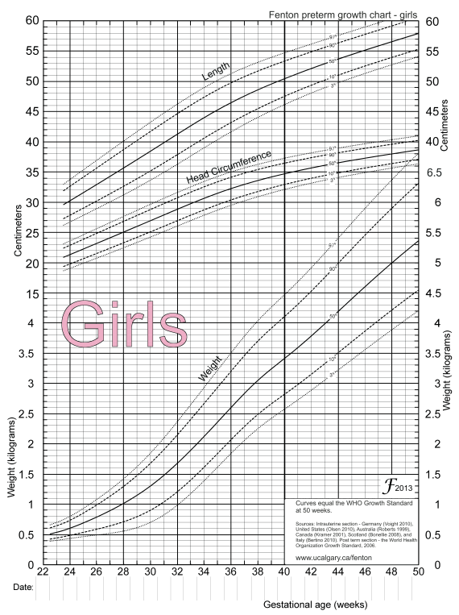
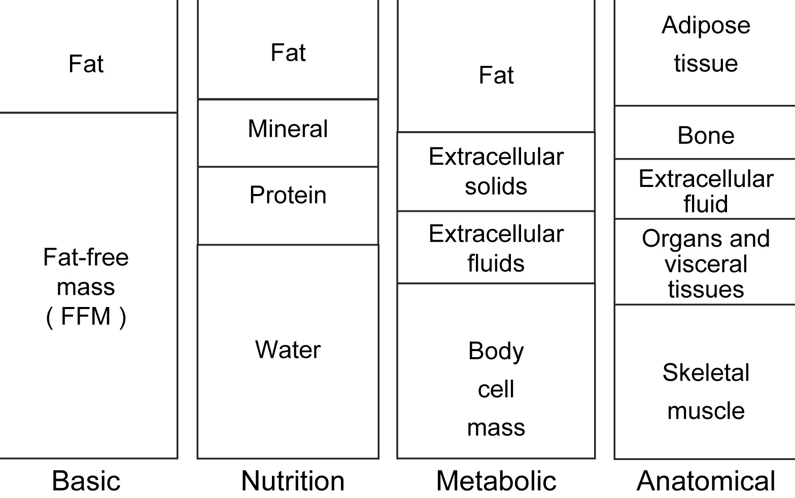
Optimal decision-making requires accurate, specific assessment of current nutritional status and response to intervention over time.
ferritin
Hct
retic
Ca
Phos
Fatty acid profile
Vit D
BUN
Serial anthropometry is the primary approach to nutritional assessment in the NICU.
Body composition assessment provides more specific information about the type of weight gain.
Biochemical markers provide complementary information.
Ellis. Semin Fetal Neonatal Med 2007

Slide 10
Optimal decision-making requires accurate, specific assessment of current nutritional status and response to intervention over time.
ferritin
Hct
retic
Ca
Phos
Fatty acid profile
Vit D
BUN
Serial anthropometry is the primary approach to nutritional assessment in the NICU.
Body composition assessment provides more specific information about the type of weight gain.
Biochemical markers provide complementary information.
Ellis. Semin Fetal Neonatal Med 2007

Slide 11
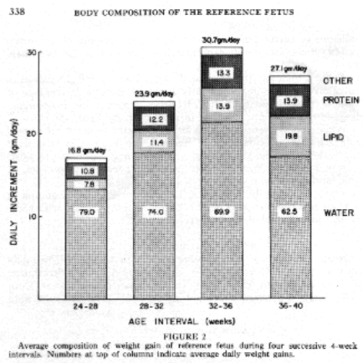
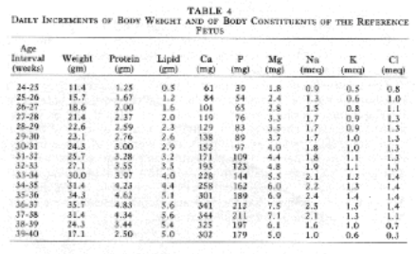
Preterm infants “should” grow like a healthy fetus
Dogma
Ziegler et. al. Growth 1976
Compare growth with “reference fetus” defined by size at birth across GA range
e.g., Fenton 2013
Nutrient accretion based on chemical analysis → dietary intake

Slide 12
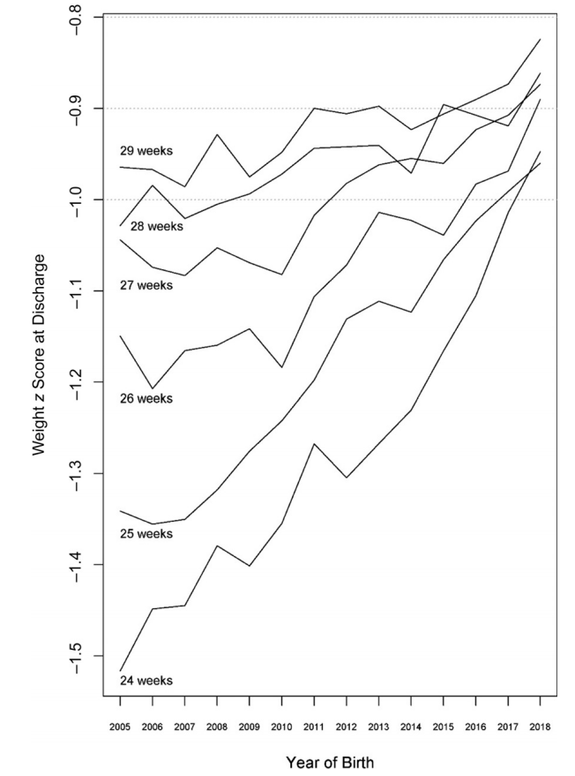
Preterm infants don’t grow like a healthy fetus.
Marked improvement over time
Still well below fetal standard
Wrong standard?
Edwards et. al. Pediatrics 2021

Slide 13
Challenging the dogma
“The idea that the growth of preterm infants should match the growth of healthy fetuses is not substantiated by data and…is seldom attained.”
“A preterm infant is not, in any nutritional, metabolic, or physiologic sense, a fetus and should not be managed as such in clinical practice.”
“Throughout the literature, it is stated that standards cannot be produced for preterm infants because infants born preterm are neither normal nor healthy.”
Villar et. al. Pediatrics 2018

Slide 14
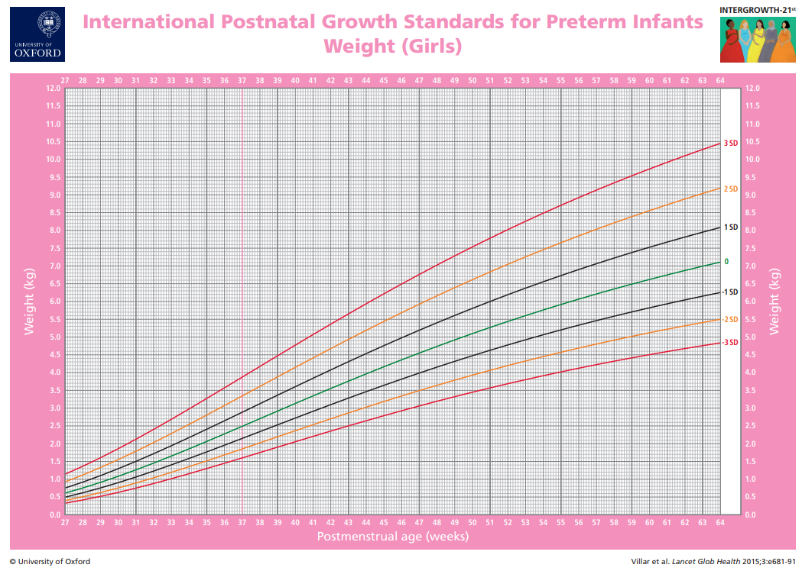
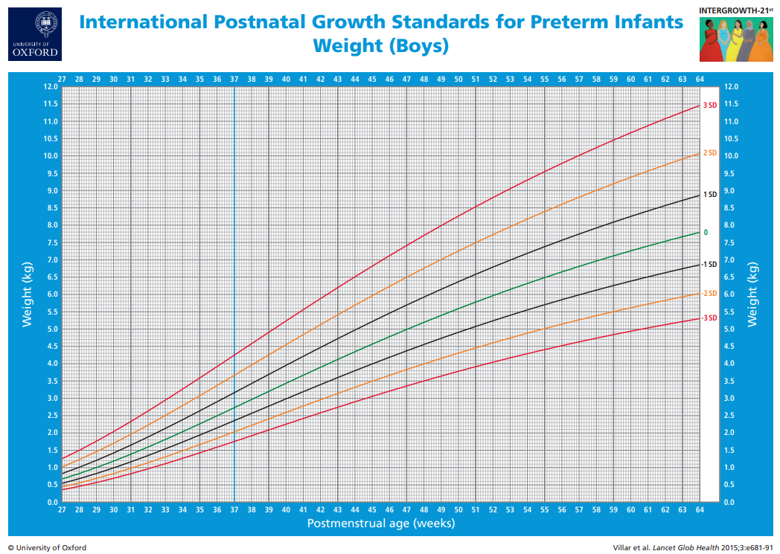
INTERGROWTH-21ST preterm postnatal standards
“We believe it is possible to produce standards based on…preterm infants”
Fetal Growth Longitudinal Study (n=4321)
Accurate gestational age
Healthy mother, uncomplicated pregnancy
No congenital abnormalities
No fetal growth restriction (ultrasound)
224 preterm infants
Preterm Postnatal Follow-up Study (n=201)
86% late preterm (≥34 weeks )
14% early preterm (<34 weeks)
41% NICU/SCN admission >1 day
22% tube feeding or parenteral nutrition
10% RDS
1 infant with BPD
2 infants with feedings held >3 days
Villar et. al. Pediatrics 2018
Notes:
Halfway

Slide 15
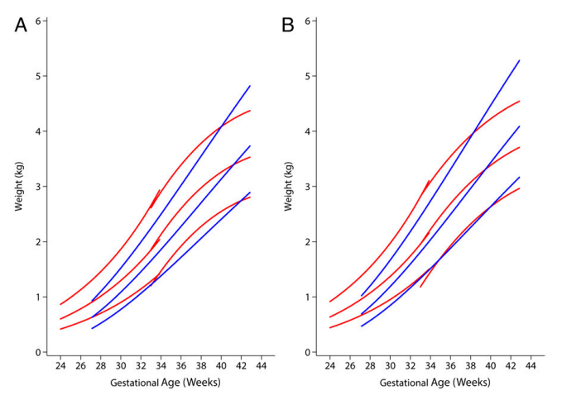
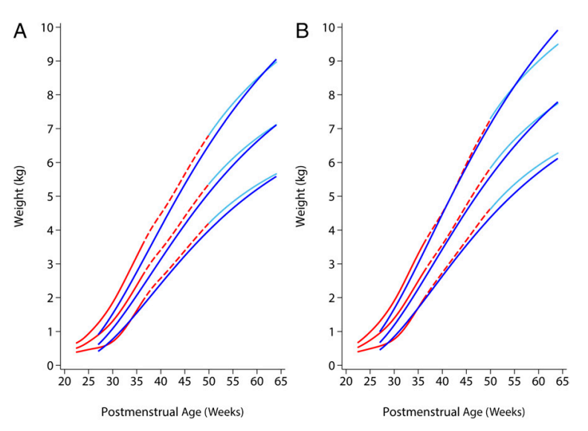
Preterm postnatal standard vs. reference fetal standard
Fenton/Kim→ WHO
Preterm postnatal
Estimated fetal weight
Preterm postnatal
Fetal ultrasound
Size at birth
Preterm postnatal vs. fetus
Weight < fetus during preterm period
Meets WHO standard by ~65 weeks’ PMA
Villar et. al. Pediatrics 2018

Slide 16
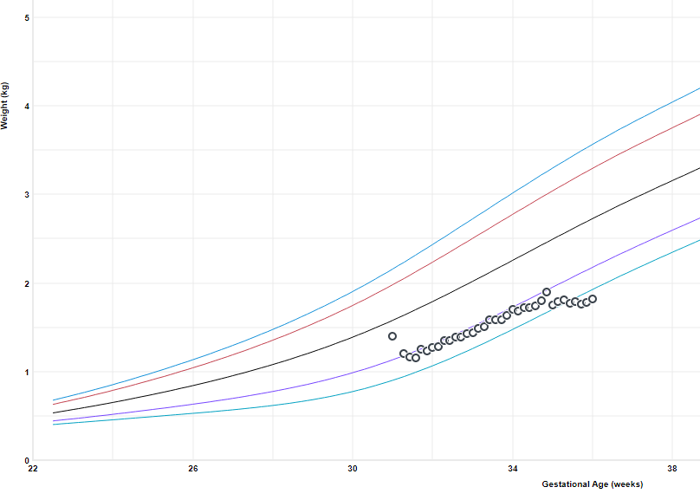
Another problem: the fetal standard does not consider postnatal adaptation = one-time fluid shift

Slide 17
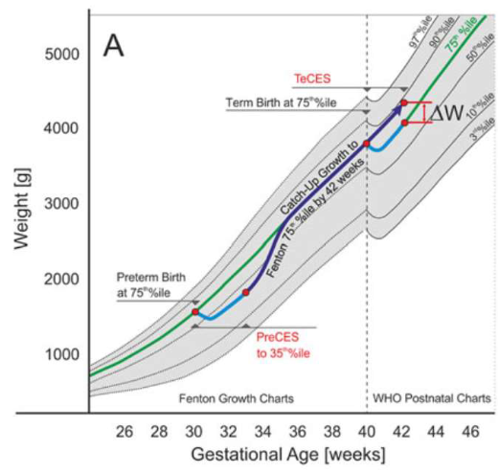
Replacing fluid loss with catch-up growth would result in excess body weight by 42 weeks.
Possible harm of excess tissue accretion during critical period
Landau-Crangle et al. JPEN 2018

Slide 18
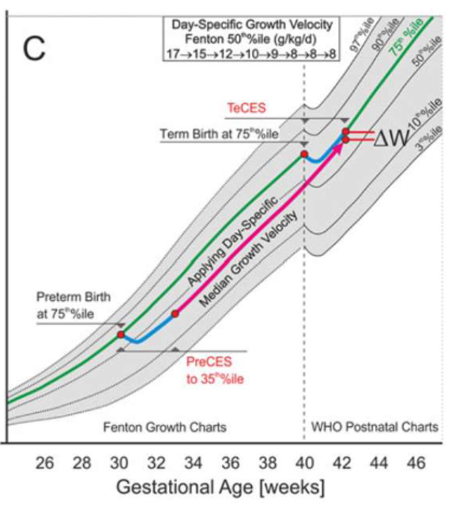
Alternative approach allows for preterm or full-term postnatal adaptation.
One-time contraction of extracellular space after preterm birth followed by weight gain at rate of reference fetus
Curve converges with full-term infant at 42 weeks, accounting for extracellular space contraction after full term birth
Landau-Crangle et al. JPEN 2018

Slide 19
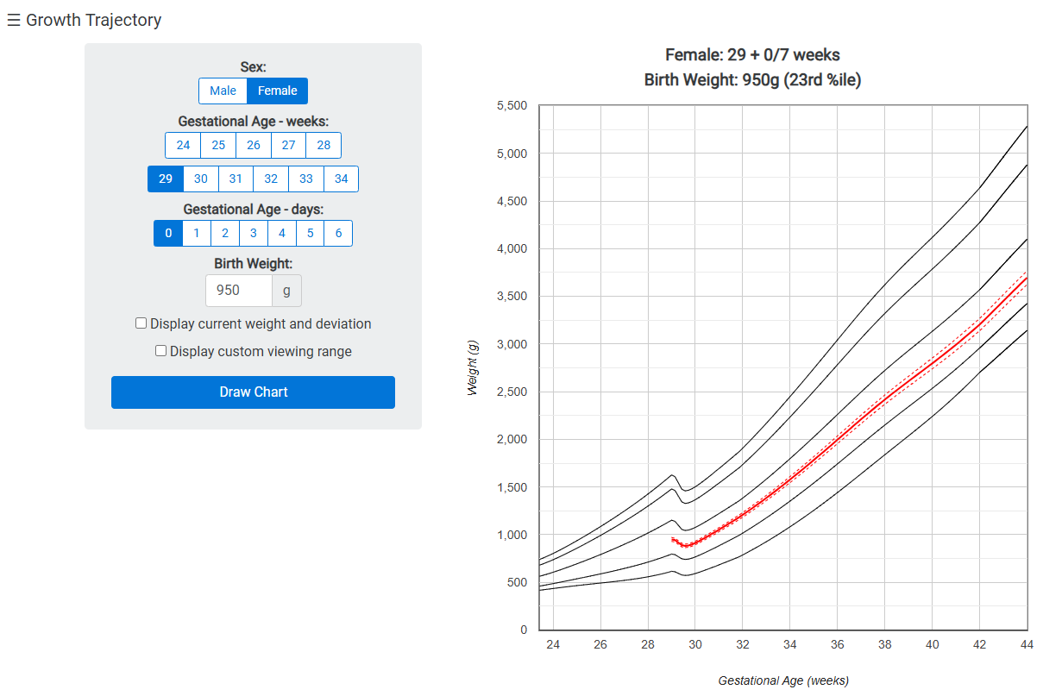
Online individualized growth trajectory calculator supports clinical decision-making.
www.growthcalculator.org

Slide 20
Very preterm infants at term equivalent age have a deficit in fat-free mass and excess of body fat.
~50% are below 10th percentile
~85% are above 90th percentile
Bell et al. PAS 2022

Slide 21
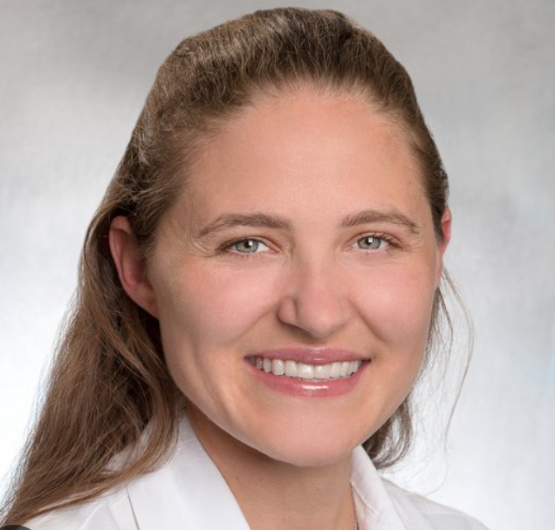
Fat-free mass is more brain-specific than fat mass.

Slide 22
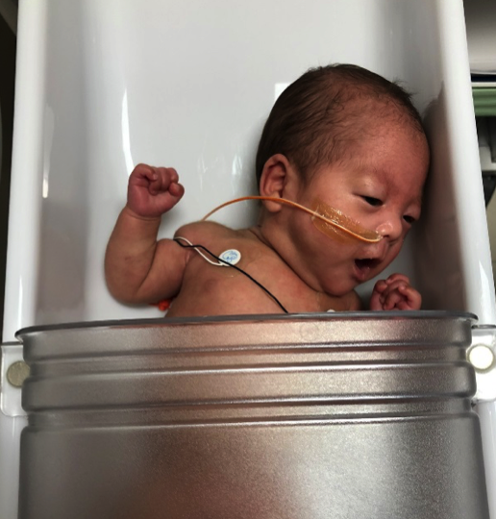
Air displacement plethysmography (ADP) differentiates body weight into fat-free mass and fat mass.
Body volume determined by displacement of air
Estimates fat-free mass, fat mass, body fat percent
Whole body density
Known density of fat, accounting for water loss after birth
Age- and sex-specific density constants
Technically accurate
Preterm reference data available >34 weeks
Not sensitive to infant movement
Expensive, non-portable equipment
Stable infants only

Slide 23
ADP is now being used in clinical trials.
HMF at feeding day 2 vs. standard of care = wait until full volume ~14 days
Primary outcome = fat-free mass z-score at 36 weeks or discharge
150 randomized, 128 completed diet
Salas et al. Pediatrics 2023

Slide 24
Use in recent clinical trial highlights limitations.
No difference in FFM z-score between groups
22 (18%) missing primary outcome
Intervention group had lower BW (by chance)
No baseline ADP, unable to evaluate change
FFM z-score
Time

Slide 25
Important benefits of early fortification emerge with longitudinal growth data.
Changes in weight, length, head circumference all favored intervention
Baseline and outcome time points assessed in virtually all participants

Slide 26
NEED: inexpensive, portable, accurate method to measure infant body composition longitudinally in the NICU setting

Slide 27
Bioelectrical impedance analysis (BIA)
Measures opposition of body’s tissues to harmless electrical current
Resistance related to volume of total body water
Fat-free mass contains most of body’s water, fat anhydrous
Predication equations estimate total body water, fat-free mass from resistance, hydration constants, weight & length
Inexpensive, portable, can be used at bedside
Technical accuracy less certain
No reference data

Slide 28
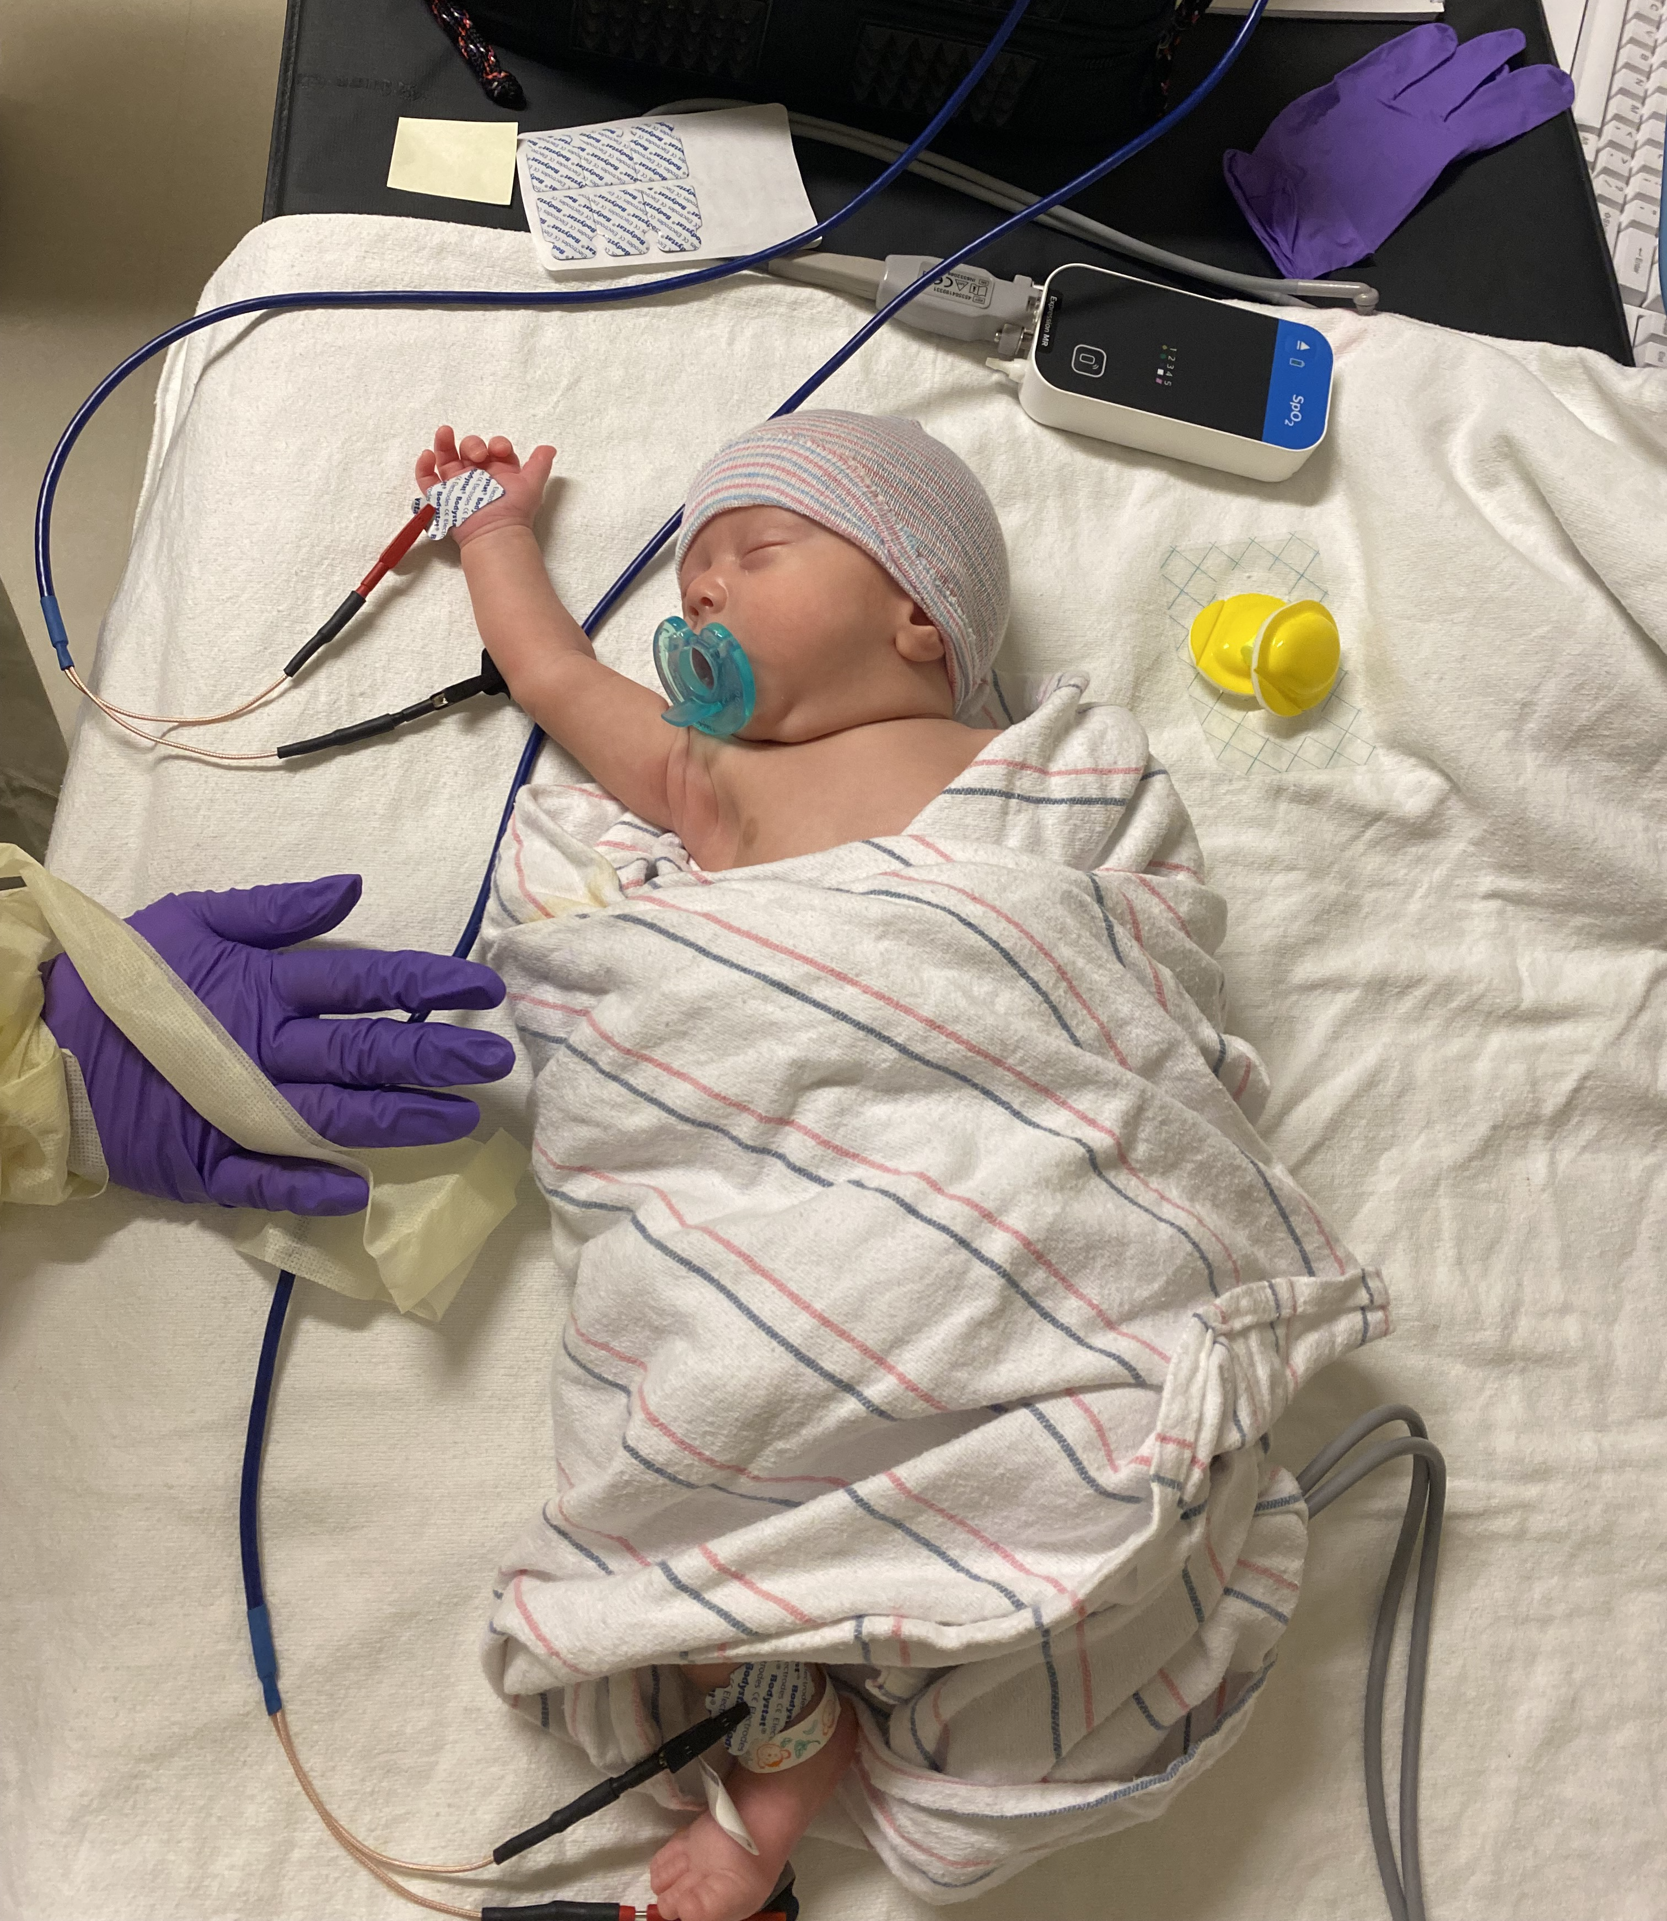
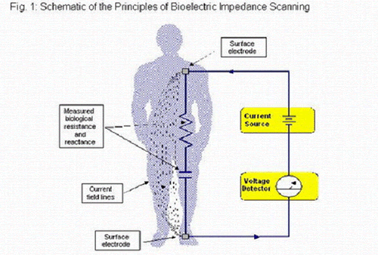
BIA offers an alternative approach with advantages over ADP.
Theory: Electrical current passes easily through hydrated tissue (fat-free mass) but meets resistance passing through fat
Practice:
Inexpensive, portable device
Feasible to assess longitudinally
Notes:
SARA

Slide 29
Our preliminary data supports technical accuracy in NICU setting.
 | Equation used to calculate fat-free and fat mass from BIA data
 | Equation (1st author)
 | Kushner | Raghavan | Lingwood | Tint | Wibaek
Fat-free mass | 0.44 | 0.66 | 0.83 | 0.80 | 0.74
Fat mass | -0.04 ^{NS} | -0.60 | 0.82 | 0.64 | 0.73
Pearson correlations of ADP vs. BIA derived FFM.
High correlation of FFM by ADP vs. BIA
Equation matters
Bell et al. manuscript in preparation
Notes:
MANDY

Slide 30
Introducing…
The Baby BEAN Project:
A study of how NICU babies grow
Bioimpedance
EEG
Anthropometrics
Neurodevelopment
R01 HD111016 // Multiple PI Belfort & Ramel
Notes:
SARA → transition to MANDY

Slide 31
We will establish gestational age-based reference curves for body composition.
Aim 1) Derive valid prediction equations for fat-free mass using bioimpedance with ADP as the gold standard
Aim 2) Create size-at-birth reference curves for fat-free mass from 24 to 35 weeks of gestation using bioimpedance
Overcome key barriers to applying this approach in the NICU setting
Notes:
SARA

Slide 32
We will explore fat-free mass accretion over time in relation to brain health.
Aim 3) Use bioimpedance data to examine fat-free mass accretion over time in NICU as predictor of brain structure and function (MRI & EEG at term, Bayley-4 at 12 months)
Apply new tools to further understanding of fat-free mass as a “brain specific” nutritional status indicator.
Notes:
SARA

Slide 33
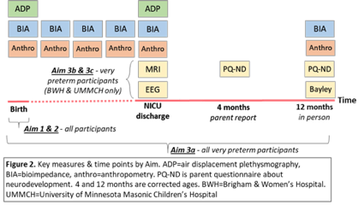
Total n=390 participants from 4 NICUs
Singletons born 23-35 completed weeks’ GA
Exclude BW<3rd percentile, anomalies
Aim 1 (equation)
All GA, concurrent BIA+ADP
Aim 2 (size at birth reference)
All GA, BIA within 72 hours
Aim 3 (longitudinal BIA, brain health)
GA 23-31 weeks
4 & 12 month follow-up at all sites
MRI & EEG at BWH, UMMCH only
Notes:
SARA

Slide 34
Take home points
Nutritional care in the NICU sets the stage for lifelong health of preterm infants.
Both neurodevelopment and cardiometabolic health have early origins.
An optimal NICU diet supports brain development while minimizing cardiometabolic risks.
Balancing lean tissue growth with fat accumulation may be important.
Accurate and specific indicators of nutritional status are needed to guide decision-making.
Anthropometry – time to question the dogma of the reference fetus?
Body composition – need better methods before we decide about utility.
Notes:
Reason I find this topic so interesting is that there is so much amazing work being done on all levels from basic science to epi to clinical trials to QI/implementation to advocacy
My own work draws on my training in epidemiology and you will see that I love a big dataset
I will also highlight the work of others in the field to illustrate all the different ways in which I see the science of human milk being leveraged to improve the health of our very preterm patients

