Slide 1
Human milk and preterm infant brain development
Mandy Brown Belfort, MD MPH
Associate Professor of Pediatrics
Harvard Medical School
Attending Neonatologist
Brigham and Women’s Hospital
Miami Neonatology / November 19, 2024

Slide 2
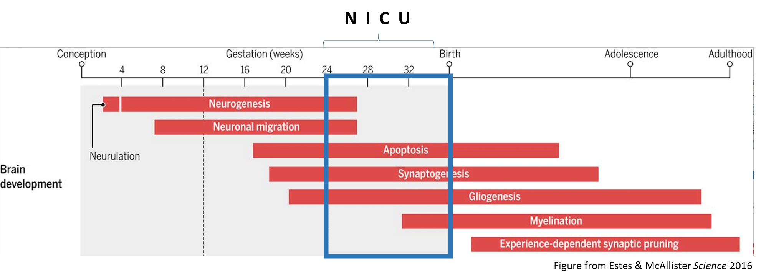
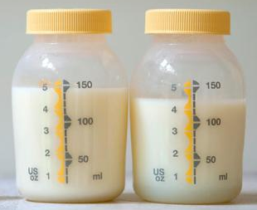
Agenda
1) The NICU hospitalization coincides with a critical period in brain development for preterm infants.
2) A fortified maternal milk-based diet promotes better neurodevelopment, particularly among those most vulnerable to impairments.
3) Brain MRI is emerging as a useful tool to establish timing and investigate potential mechanisms underlying effects of maternal milk on preterm infant brain development.
Notes:
Reason I find this topic so interesting is that there is so much amazing work being done on all levels from basic science to epi to clinical trials to QI/implementation to advocacy
My own work draws on my training in epidemiology and you will see that I love a big dataset
I will also highlight the work of others in the field to illustrate all the different ways in which I see the science of human milk being leveraged to improve the health of our very preterm patients

Slide 3
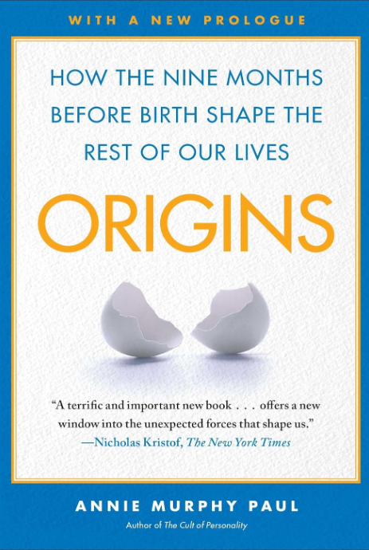
Critical period: specific window of time during development when an organism is particularly sensitive to environmental stimuli or experiences

Slide 4
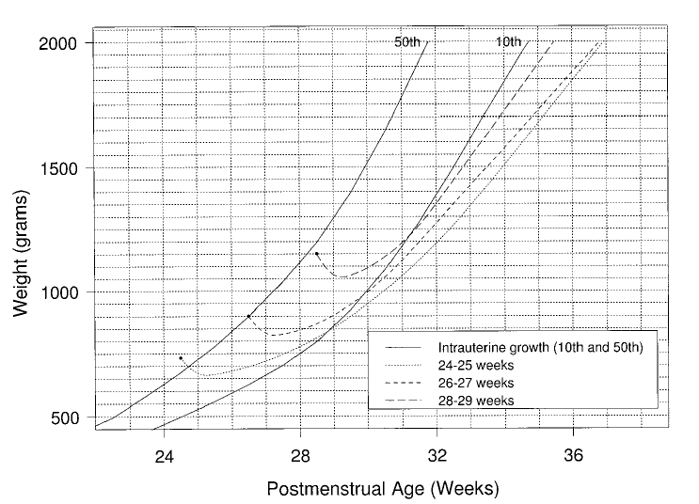
Hospitalized very preterm infants experience undernutrition during a critical period.
Postnatal growth faltering
Size at birth
Ehrenkranz et al. Pediatrics 1999

Slide 5
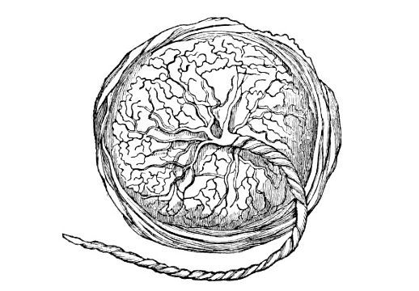
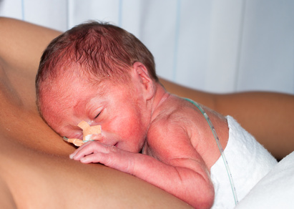
Preterm infants are nutritionally vulnerable.
Miss in utero nutrient transfer during 3rd trimester
Accumulate deficits from placental insufficiency manifesting as IUGR
Immature feeding, motility, digestion, absorption, metabolism
Critical illness and inflammation impair accretion

Slide 6
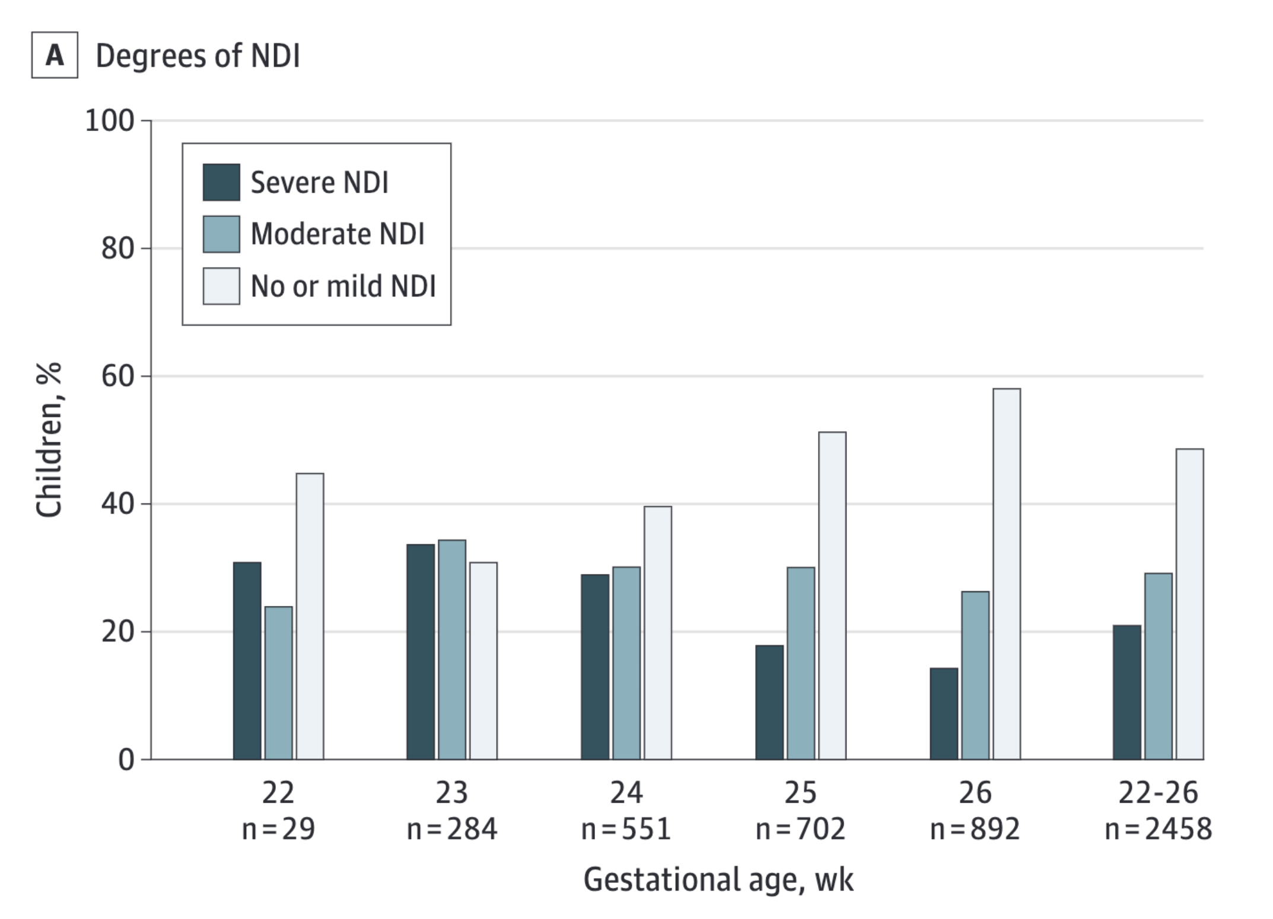
Extremely preterm infants are vulnerable to neurodevelopmental impairments.
N=2458 U.S. children evaluated at 22-26 months of corrected age
Bell et al. JAMA 2022

Slide 7
Nutrients are required for brain development during the NICU critical period.
N I C U
Figure from Estes & McAllister Science 2016
Nutrients
Dobbing Am J Clin Nutr 1985; Levitsky & Strupp, J Nutr 1995

Slide 8
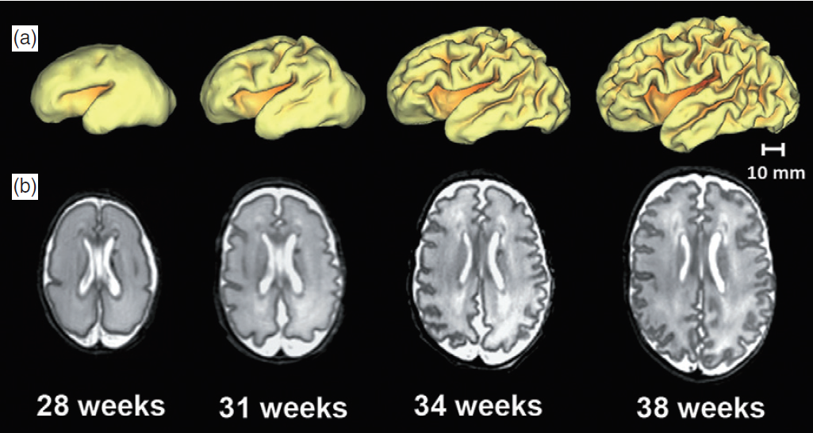
Rapid brain growth and structural development occur during NICU hospitalization.
Smyser J Paediatr Child Health 2012

Slide 9
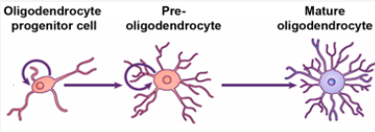
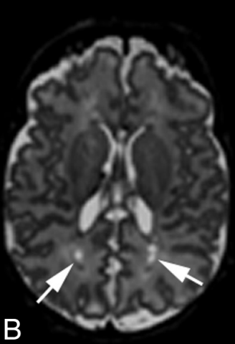
Nutrients may be neurorestorative after early brain injury, to which very preterm infants are prone.
Injury to pre-OL
Dysmaturation & hypomyelination
Image from Traiffort et al J Dev Biol 2016
Nutrients
Image from Kidokoro et al Am J Neuroradiol 2013
Volpe Pediatr Neurol 2019; Volpe J Neonatal-Perinatal Med 2019

Slide 10
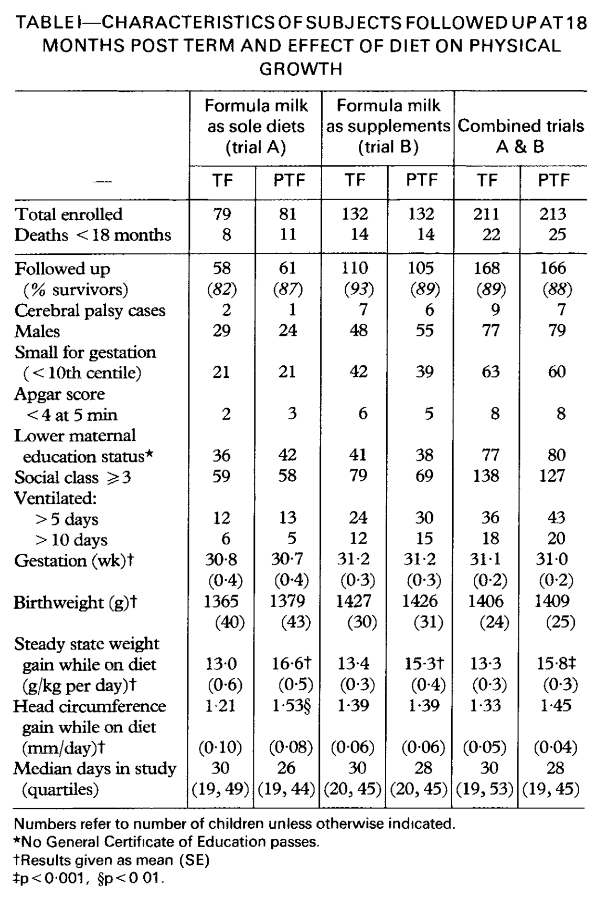
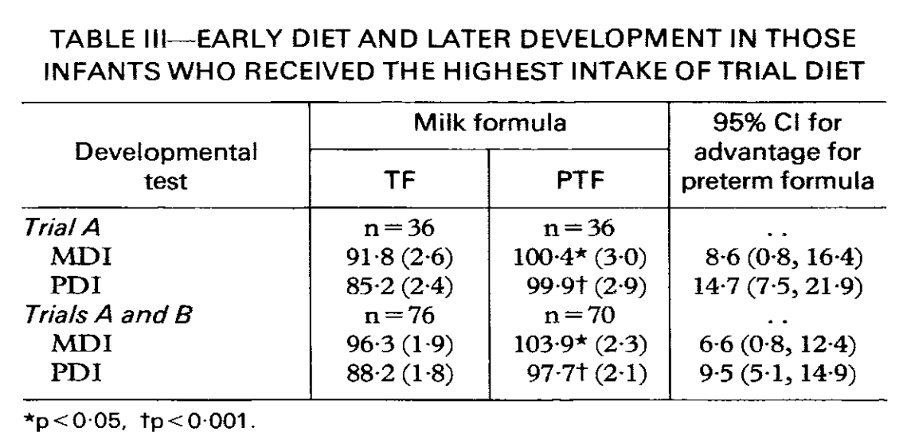
Classic RCTs established a causal role of NICU diet on brain development during the critical NICU period.
RCT of preterm vs. term formula in NICU
Increased weight gain, head growth
Higher Bayley scores 18 months
Lucas et al. Lancet 1990

Slide 11
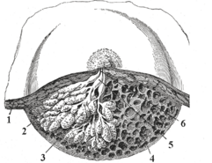
After birth, the mammary gland assumes many functions of placenta.
Term birth
A m n i o t i c f l u i d
M o t h e r ‘ s m i l k
A m n i o t i c f l u i d
M o t h e r ‘ s m i l k
Preterm birth
Potential to compensate for early separation from placenta

Slide 12
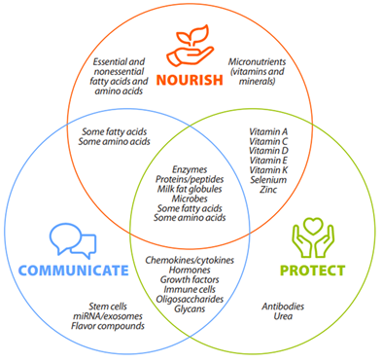
Smilowitz et al, Am J Clin Nutr 2023 (NIH BEGIN Project)

Slide 13
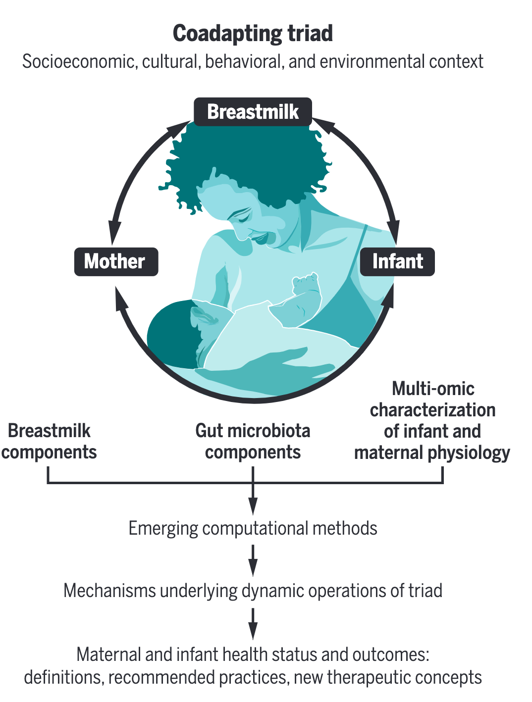
Example = altered milk composition after preterm vs. term birth
Bode et al. Science 2020

Slide 14
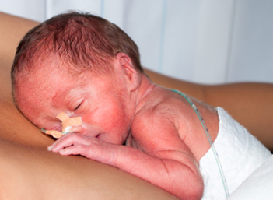
Clinical translation lies in unique health benefits of human milk for very preterm infants
Photo from kellymom.com

Slide 15
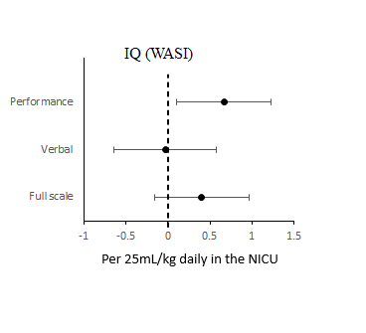
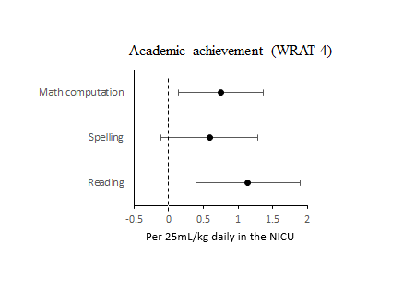
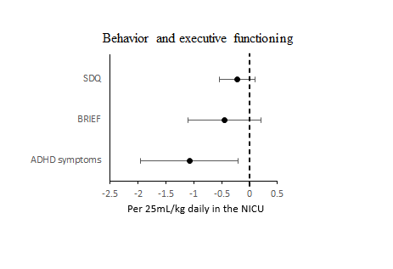
Maternal milk is associated with better long-term neurodevelopmental outcomes.
Belfort et al. JAMA Network Open 2022

Slide 16
Beneficial associations of maternal milk were most pronounced in infants born <30 weeks of gestation.
Belfort et al. JAMA Network Open 2022

Slide 17
Similar associations in different cohort.
 | Points per day >50% human milk
 | β | 95% CI
IQ | 0.5 | 0.2, 0.8
Reading | 0.5 | -0.03, 1.0
Math | 0.5 | 0.1, 0.9
Attention | 0.02 | -0.1, 0.1
Working memory | 0.5 | 0.1, 0.9
Language | 0.4 | -0.1, 1.0
Visual perception | -0.03 | -0.1, 0.09
Motor function | 0.1 | 0.02, 0.2
Adjusted for age, sex, gestational age, NICU illness, social risk
VIBeS cohort
Melbourne, Australia
<30 weeks’ GA
2001-2003
N=180 (80% of original cohort) evaluated at 7 years
Belfort et al J Pediatr 2016

Slide 18
Caveat: data reflect routine HMF use to support nutrient delivery and growth
Estimates adjusted for potential confounders (sex, GA, BW-z, PMA at discharge, multiple gestation, NICU diagnoses, hospital)
N=4062 VPT/VLBW infants from 12 Brazilian NICUs
Weight and HC z-scores at discharge lower in “exclusive HM” vs. “mixed” diets
Suggests lower nutrient delivery / accretion in HM only diet
Soldateli et al. J Pediatr (Rio J) 2024

Slide 19
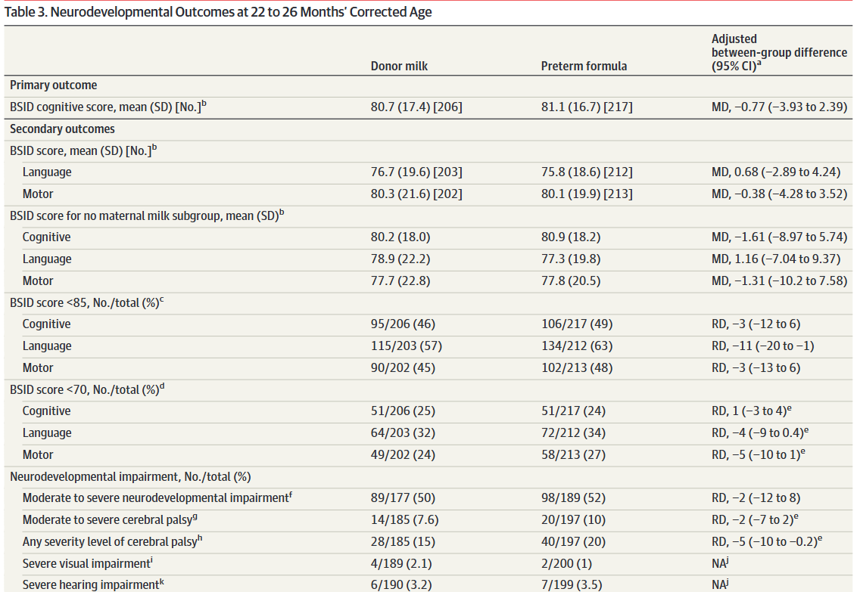
Neurodevelopmental benefits not seen with donor milk.
NICHD MILK Study
<29 weeks or <1000 grams
Little or no maternal milk
Fortified donor milk or formula until discharge or death or 120 days
Colaizy et al. JAMA 2024

Slide 20
Slower growth hints that relative deficit in nutrient delivery may have offset benefits
Colaizy et al. JAMA 2024

Slide 21
Brain differences associated with maternal milk diet are detectable before NICU discharge
Deep nuclear gray matter:
Thalamus, basal ganglia = major relay stations in the brain
Larger volumes at term, less functional impairment
Hippocampus:
Important for memory, learning
Perhaps related to finding of better working memory
VIBeS cohort
Melbourne, Australia
<30 weeks’ GA
2001-2003
N=180
Total and regional brain volumes at term equivalent age, before influence of post-discharge environment
Belfort J Pediatr 2016

Slide 22
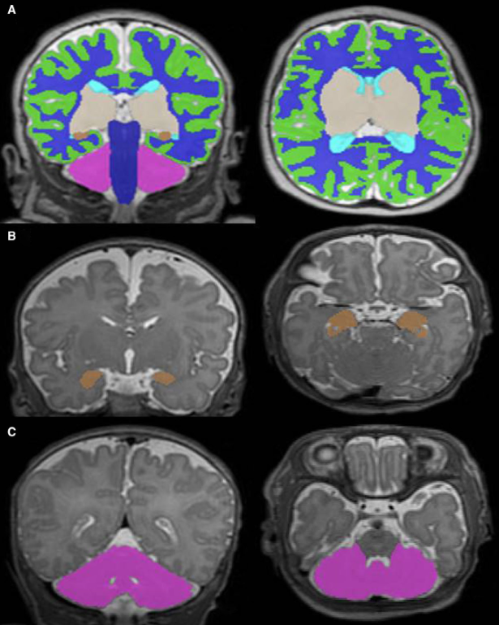
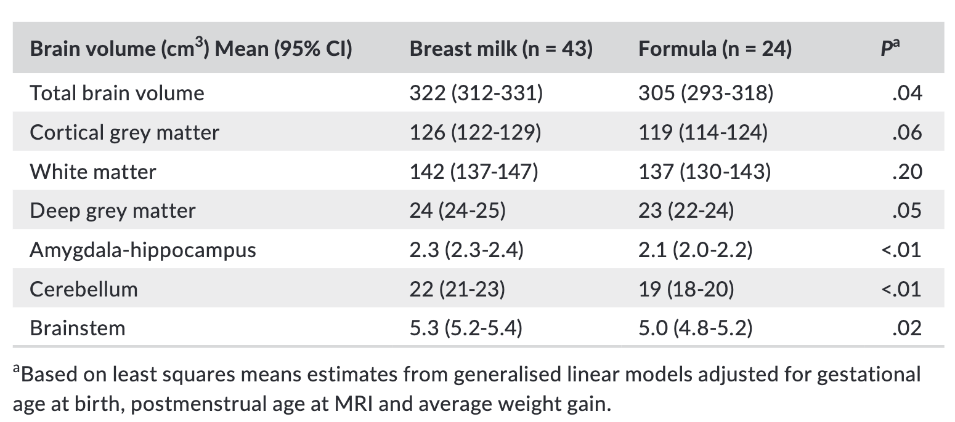
Human milk diet associated with larger total and regional brain volumes.
Human milk defined as >50% of total enteral feeding volume in NICU
Ottolini et al. Acta Paediatr 2020

Slide 23
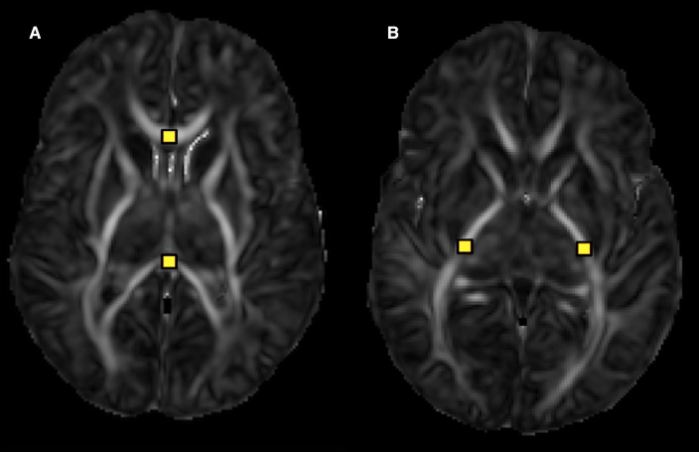
Human milk diet associated with more mature microstructure in early-myelinating white matter tracts.
Posterior limb of internal capsule
Corpus collosum
Lower mean diffusivity implies improved white matter development
Ottolini et al. Acta Paediatr 2020

Slide 24
Human milk diet associated with cortical development more similar to full-term infant.
Sullivan et al. Ann Neurol 2023

Slide 25
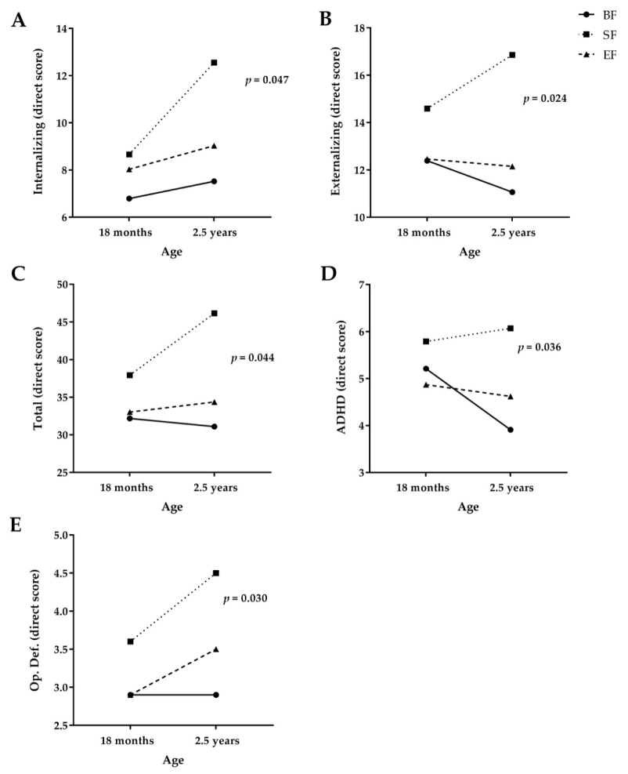
Plausible mechanisms include nutrients and non-nutrient bioactive factors.
COGNIS Study
MFGM
Synbiotics (FOS, inulin)
B. infantis & L. rhamnosus
LCPUFAs
Gangliosides
Nucleotides
Sialic acid
Added to experimental
formula
Experimental formula → fewer behavioral problems at 18 months, 2.5 years; higher language score at 4 years
(Breastfed reference performed better at all ages)
Nieto-Ruiz et al. Nutrients 2019 & 2020

Slide 26
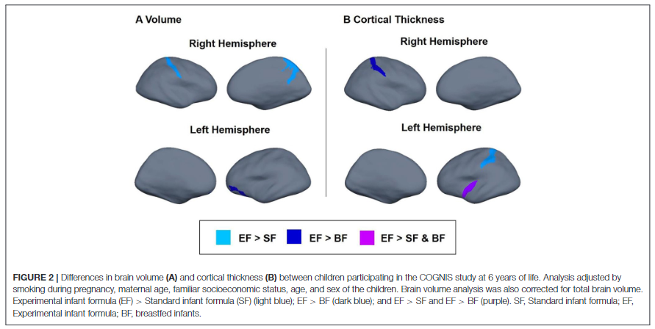
Follow-up at 6 years revealed higher IQ, larger brain volumes, greater cortical thickness in EF vs. SF
Nieto-Ruiz et al. Front Nutr 2022

Slide 27
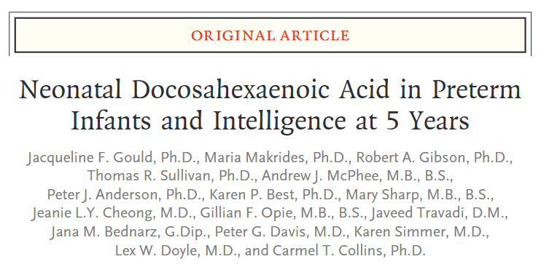
Nutrients in maternal milk contribute to neurodevelopmental benefits.
N3RO trial of enteral DHA
Hospitalized infants born <29 weeks
Supplement of 60 mg/kg/day vs. placebo in addition to DHA in maternal milk or formula
Gould et al. New Engl J Med 2022

Slide 28
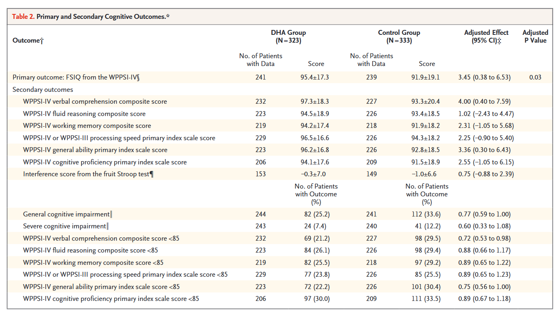
Gould et al. New Engl J Med 2022

Slide 29
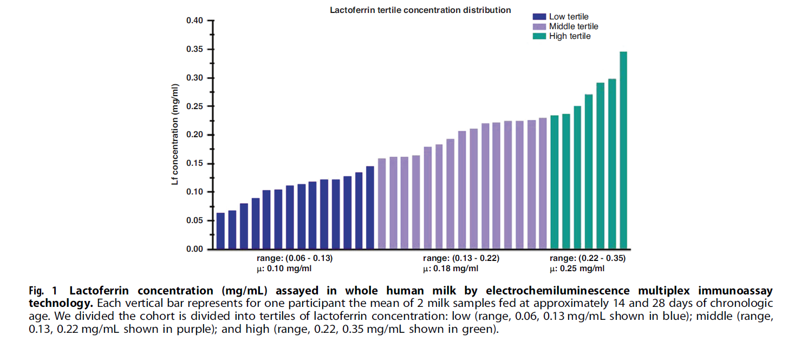
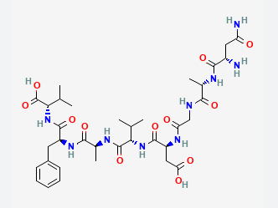
Lactoferrin intake varies among maternal milk fed very preterm infants.
Lf = antimicrobial, anti-inflammatory, immunomodulatory protein found abundantly in milk
Atayde et al. Pediatr Res 2024

Slide 30
Lactoferrin may contribute to increased brain growth during the NICU critical period.
High (vs. low) Lf exposure associated with larger total brain, cortical gray matter, deep gray matter, white matter
Associations robust to adjustment for GA, BW z-score, PMA at scan, sex
Atayde et al. Pediatr Res 2024

Slide 31
Research on brain development affirms AAP recommendation for human milk diet.
American Academy of Pediatrics (2021)
Promoting human milk and breastfeeding for the very low birth weight infant
Mother’s own milk, appropriately fortified, is the optimal nutrition source for VLBW infants

Slide 32
Take home points
1) The NICU hospitalization coincides with a critical period in brain development for preterm infants.
NICU-based diet interventions improve long-term outcomes and are highly feasible to implement.
2) A fortified maternal milk-based diet promotes neurodevelopment, particularly among those most vulnerable to impairments.
Maternal milk has a myriad of effects on brain development in the NICU, which may be mediated by nutrients & bioactives, underlying long-term neurodevelopmental benefits.
3) Brain MRI is emerging as a useful tool to establish timing and investigate potential mechanisms underlying effects of maternal milk on preterm infant brain development.
Human milk nutrients (e.g., DHA) and bioactives (e.g., Lf) may play an important role.
Notes:
Reason I find this topic so interesting is that there is so much amazing work being done on all levels from basic science to epi to clinical trials to QI/implementation to advocacy
My own work draws on my training in epidemiology and you will see that I love a big dataset
I will also highlight the work of others in the field to illustrate all the different ways in which I see the science of human milk being leveraged to improve the health of our very preterm patients

Slide 33
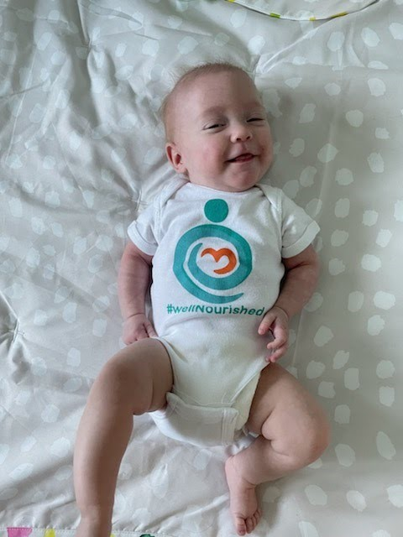
Ultimate goal:
Very preterm infants who leave the NICU well-nourished, because this is a foundation for their lifelong health and well-being

