Slide 1


Biomarkers and the Prediction of Risk for NEC
Misty Good, MD, MS
Division Chief, Neonatal-Perinatal Medicine
Co-Program Director, Pediatric Physician Scientist Training Program
University of North Carolina at Chapel Hill

Slide 2
Disclosures
Current Funding Sources:
NIH R01DK124614, R01HD105301, R44HD110306, DP1DK140012
Chan Zuckerberg Initiative
AAP SONPM Strategic Initiatives Grant for Physician-Scientist Development
Department of Pediatrics, UNC
Patent: PCT/US2017/027806
Previous Funding Sources:
NIH R01DK118568, R03DK111473, K08DK101608, March of Dimes Basil O’Connor Award
NIH Loan Repayment Program
Sponsored Research Agreements – Takeda Pharmaceuticals, Inc., Astarte Medical, Evive Biotech, Inc.
NEC Society
NEC Biorepository pilot award
Washington University and University of Pittsburgh Departments of Pediatrics
Children's Discovery Institute
I do not intend to discuss an unapproved/investigative use of a commercial product/device in my presentation.

Slide 3
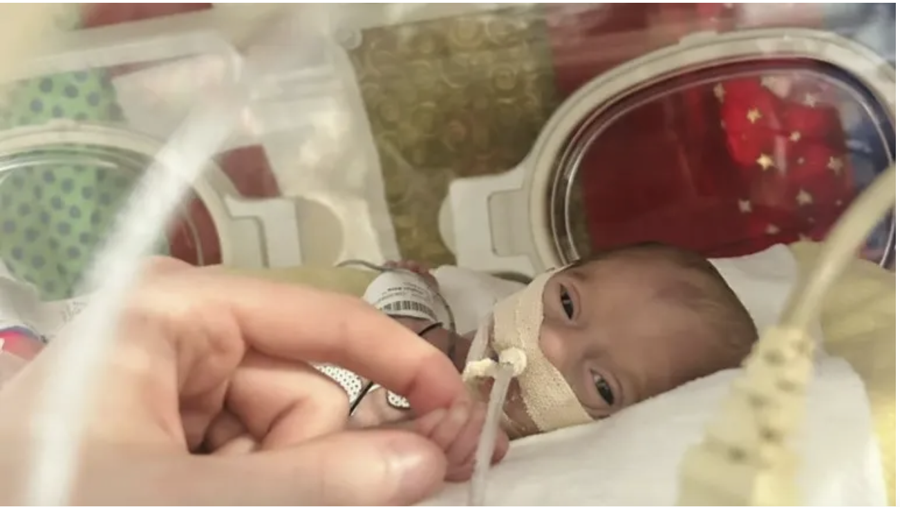
This presentation is dedicated to Titus and the Titus Strong Foundation

Slide 4
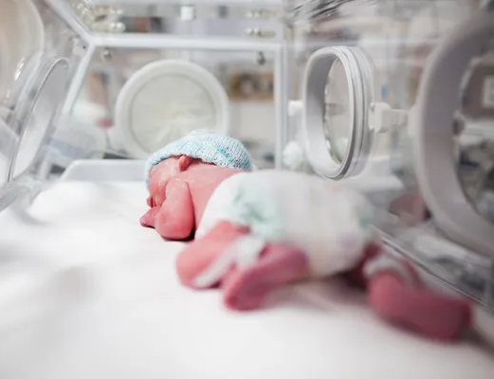
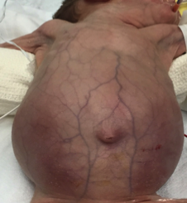
Clinical Overview
Necrotizing Enterocolitis (NEC)
Affects ~ 7% of all premature infants
Leading cause of death from GI disease in premature infants
High mortality rate
For NEC survivors, significant morbidities
Pathophysiology: Exaggerated inflammation, gut immaturity, microbial dysbiosis
Career Goal: Save the babies from NEC!
Human Small Intestine
Human NEC
Image credit to photodictionary.com

Slide 5
Diagnostic Challenges in NEC Research
The pathogenesis of NEC is highly complex, with numerous factors involved, many of which remain unknown.
The underlying etiology varies between patients.
NEC impacts a relatively small number of patients at individual centers.
Collaboration between institutions with highly skilled and committed teams of investigators is required to obtain adequate numbers of samples for quality research.

Slide 6
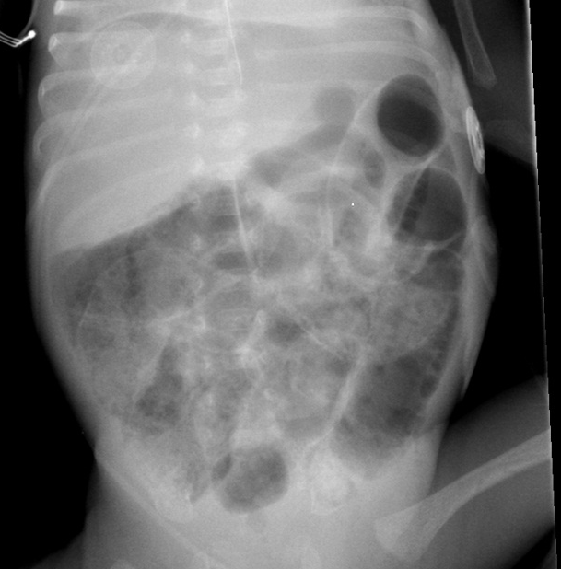
Diagnostic Challenges in NEC Research
Early detection can reduce mortality and morbidity but remains challenging.
C-reactive protein, white blood cell count, and radiographic findings lack sensitivity and specificity.
Ultrasound findings of pneumatosis can be more sensitive and useful in certain settings.
Used with permission

Slide 7
Types of Biomarkers for NEC
Inflammatory Markers: Cytokines, chemokines
Microbial and Metabolite Markers: Gut microbiome, metabolites
Proteomic and Metabolomic Markers: Specific peptides, amino acids
Genetic and Epigenetic Markers: Host genetic susceptibility and epigenetic modifications

Slide 8
Inflammatory and Microbial Biomarkers for NEC
Cytokines and Chemokines: TNF-α, IL-6, IL-8 are associated with NEC severity.
Microbial Patterns: Shifts in microbial composition, including decreased Bifidobacterium and increased Enterobacteriaceae, correlate with NEC.
Microbiome Predictive Models: Use of microbiome profiling to predict NEC onset.

Slide 9
Stool Biomarkers
Microbiome – Dysbiosis precedes NEC
Calprotectin – Inflammatory marker, not specific for NEC
Volatile Organic Compounds – Early predictor NEC vs. sepsis
Intestinal Alkaline Phosphatase – Heath et al., Jama Netw Open, 2019
    Elevated protein, low enzyme activity

Slide 10
Urine Biomarkers
Urine Intestinal Fatty Acid Binding Protein – Marker of mucosal damage. Higher 3-7 days prior to NEC. Gregory et al., J Peds, 2014.
Urine Serum Amyloid A – Higher in complicated NEC. Reisinger et al., PLoS One, 2014.
Prostaglandin E2 Major Urinary Metabolite
    Associated with length of necrotic intestine Konishi et al., JPS, 2019

Slide 11

Why don’t we have a biomarker for NEC yet?

Slide 12
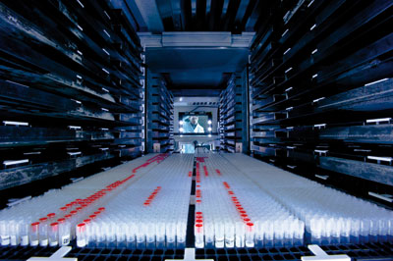
Biobanking and Biomarker Discovery
Develop a Biorepository with a lot of samples from a lot of babies.
Definition: A biorepository collects, processes, stores and distributes biospecimens to support investigation.
Purpose: To maintain specimens and clinical info for research.
Biorepository assures the quality and manages the accessibility and distribution of the samples.
Image source: L. Rubenstein/Broad Institute

Slide 13

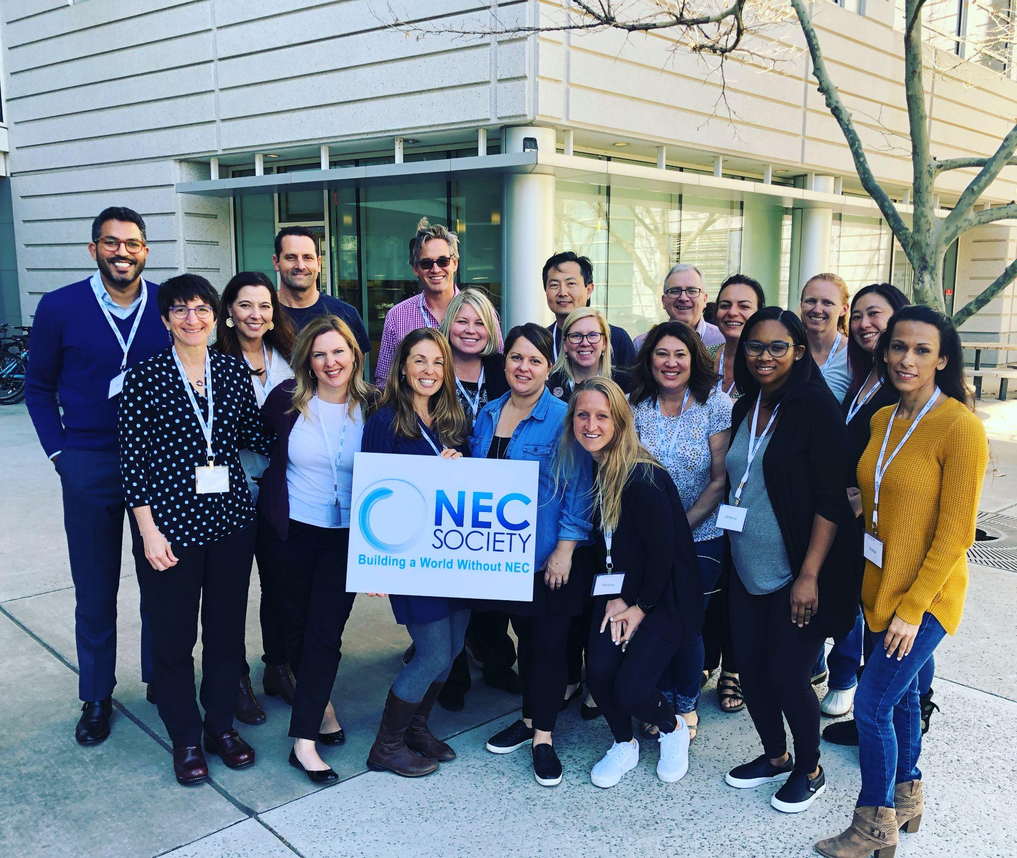
Advocacy: Patient Organization Research Collaborators
Jenn Canvasser, Founder/Executive Director
Erin Pryor, Research Coordinator

Slide 14
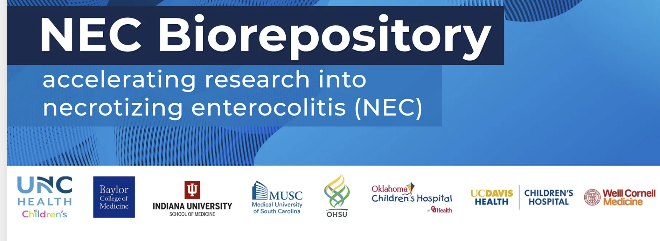


Slide 15
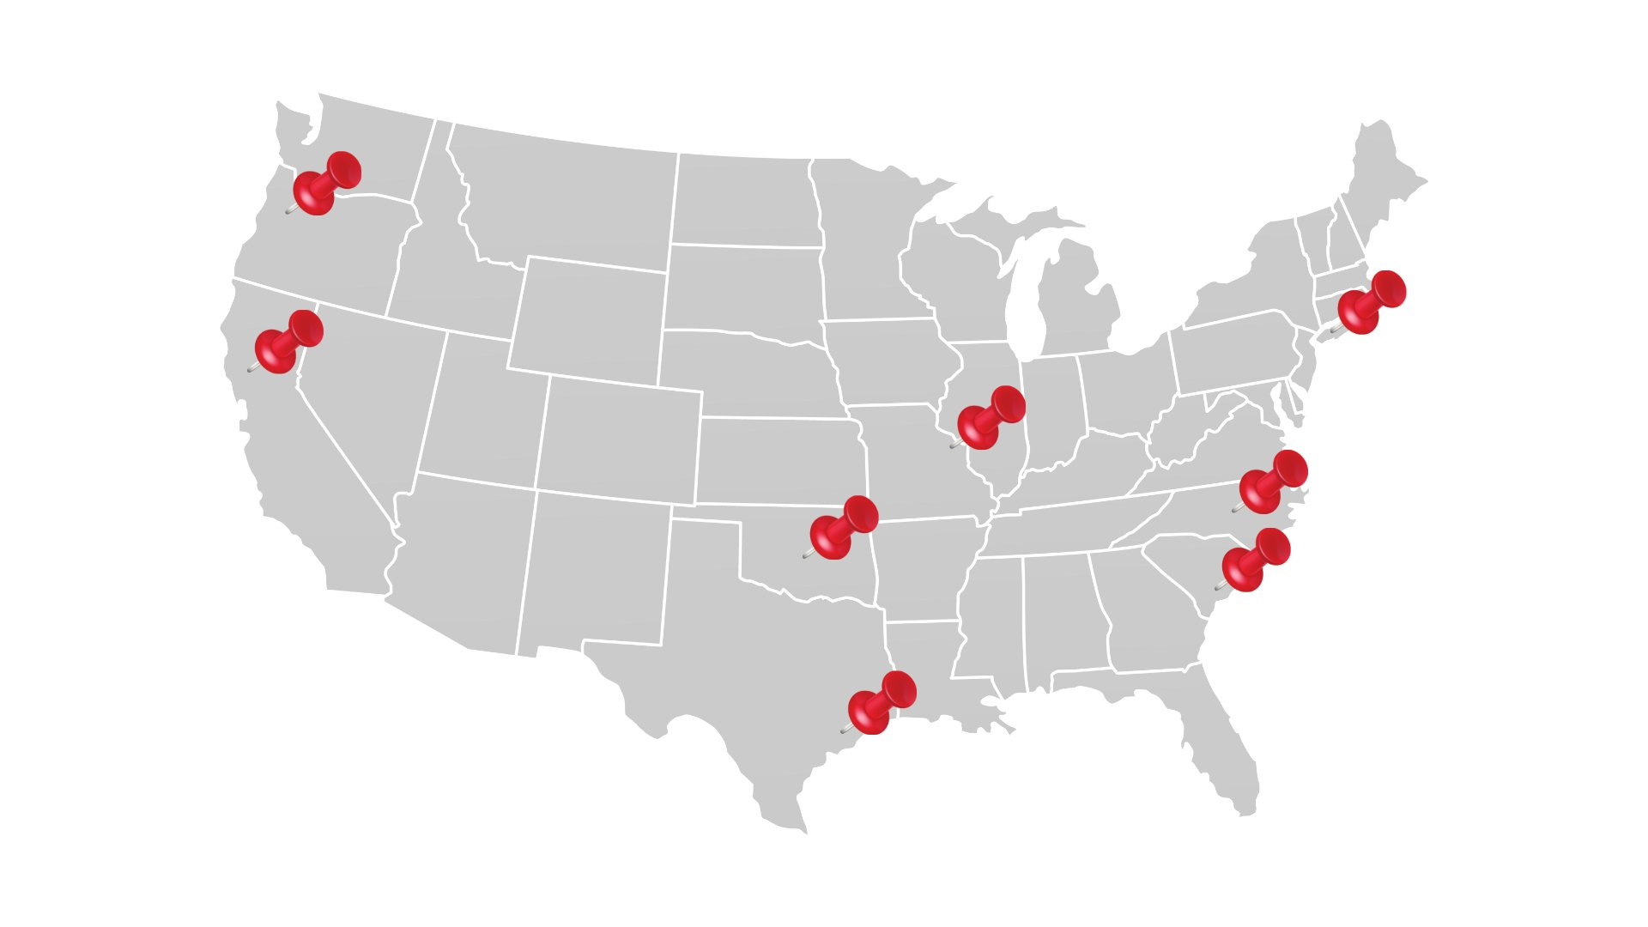








NEC Biorepository Sites

Slide 16
NEC Biorepository Administrative Structure
Single IRB for all member sites overseen by the UNC IRB
IRB protocols and consents shared between sites with approval by the UNC IRB and site IRBs
Consent training and support for research staff at each site
MTAs/DUAs between each site and UNC to facilitate sharing of data and samples

Slide 17
NEC Biorepository Research Infrastructure
Oversight and training provided by UNC team at onboarding
Standard Operating Procedures, Manual of Operations, REDCap database shared between sites
Consistency in sample processing, storage, and reagents
Troubleshooting and support provided by UNC team

Slide 18
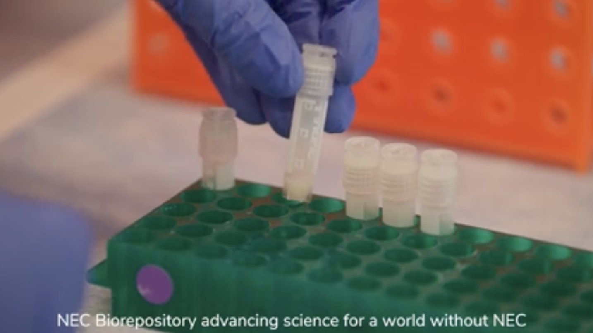
What samples are collected ?
  Blood at enrollment, at NEC, discarded
  Urine
  Stool
  Gastric aspirate
  Saliva
  Maternal breast milk
  Resected intestinal tissue

Slide 19
Tissue Procurement
Intestinal resections for NEC and “Non-NEC” from stoma closures, atresias, SIPs, strictures.
Detailed procedures for 24/7/365 tissue procurement, processing, and storage.

Slide 20

Biorepository Maintenance
Funding
  Generous support provided by the NEC Society
  Funds obtained through collaborative grant writing between biorepository sites
  Each center also to obtain their own funding Internal, NIH, Foundation, Industry

Slide 21

Chan Zuckerberg Initiative Award
Overview of Chan Zuckerberg Initiative Award
2nd Round awarded!
    $1.6M for Science
    $400K for NEC Society
NEC phenotypes using multi-omics approaches
This research is possible because of the NEC Biorepository.
Image courtesy of NEC Society

Slide 22


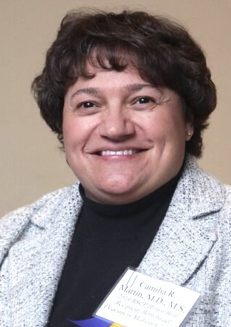

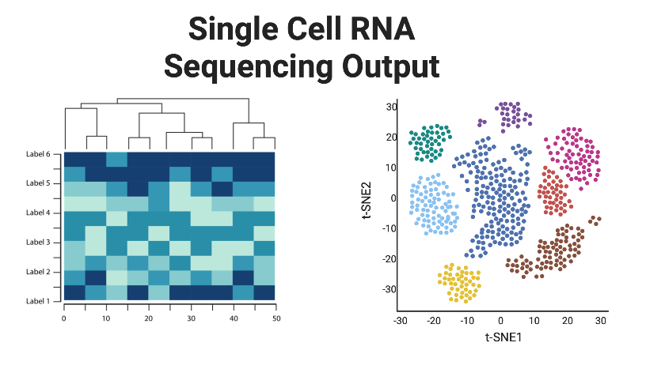
CZI Research Team
Scott Magness, PhD – UNC Chapel Hill (co-PI)
Amy Hair, MD - Baylor/Texas Children’s (site PI)
Cami Martin, MD, MS - Weill Cornell Medicine (site PI)
Troy Markel, MD - Indiana University (site PI)
Notes:
Research team presents

Slide 23
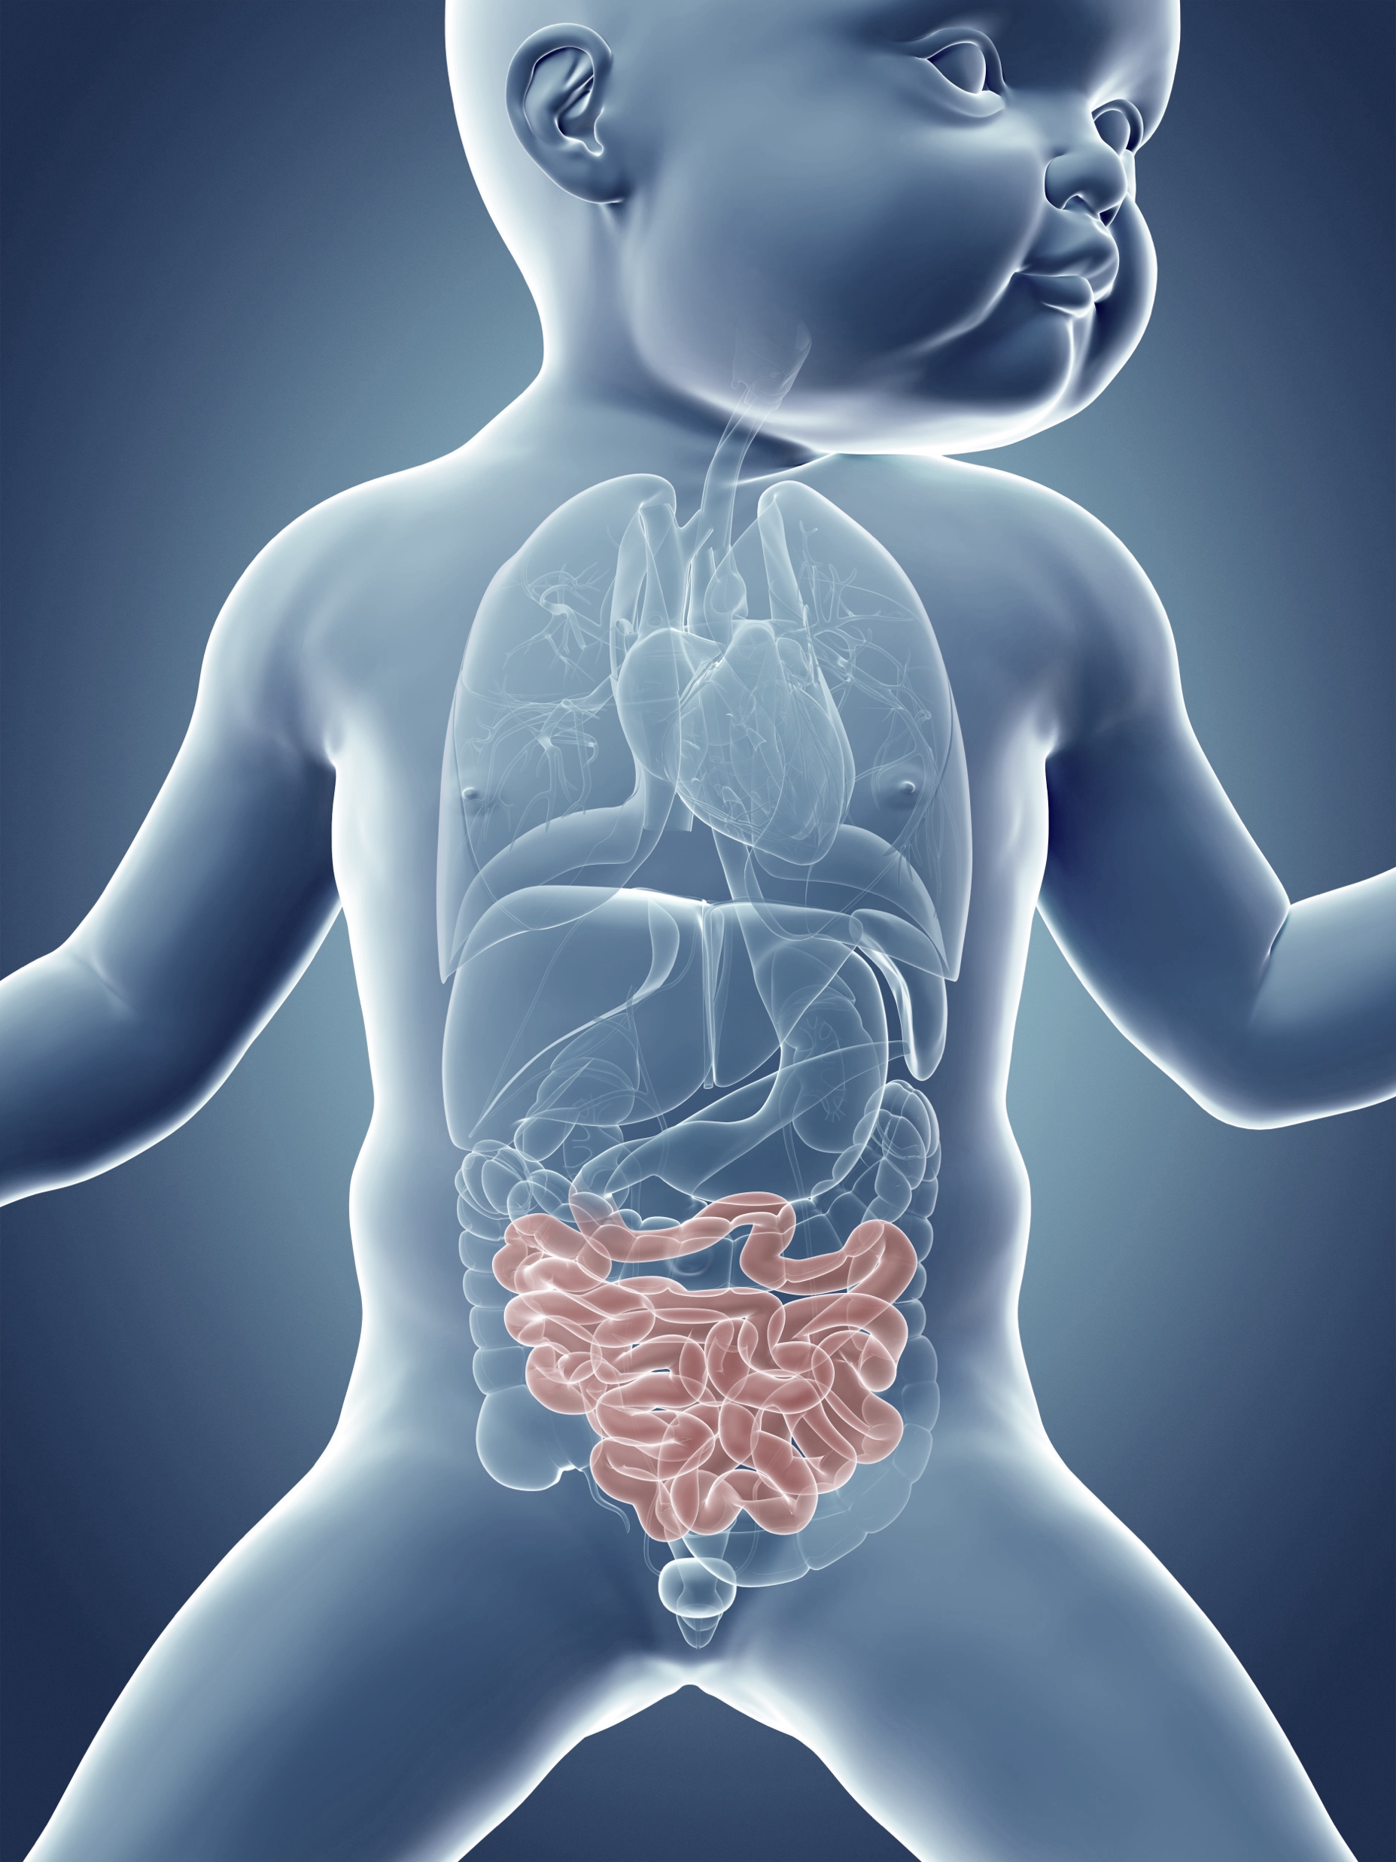
Biomarker phenotypes – Multi-omic approaches
Image source: Shutterstock

Slide 24
Global DNA hypermethylation in NEC colon and ileum
Good et al., Clin Epigenetics, 2020

Slide 25
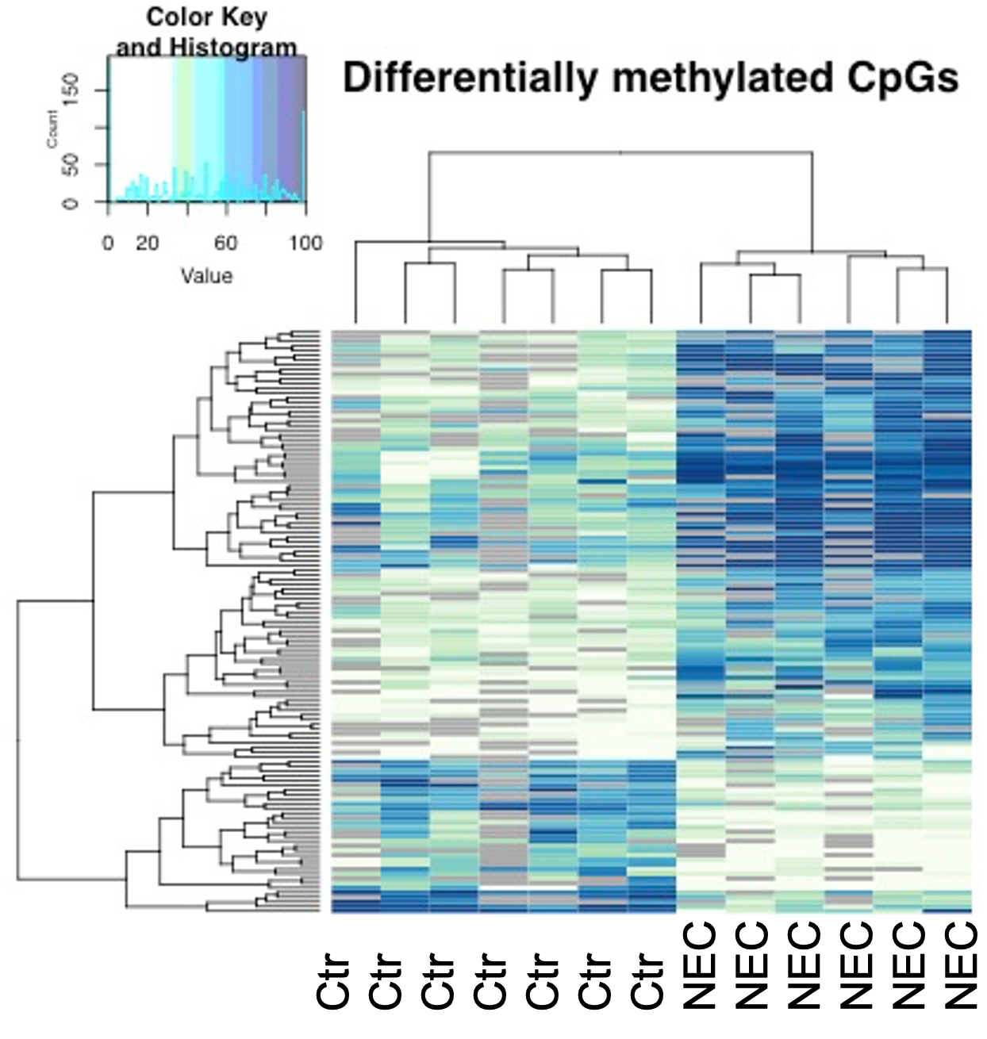
Stool DNA hypermethylation in infants with NEC
Good et al., Clin Epigenetics, 2022

Slide 26
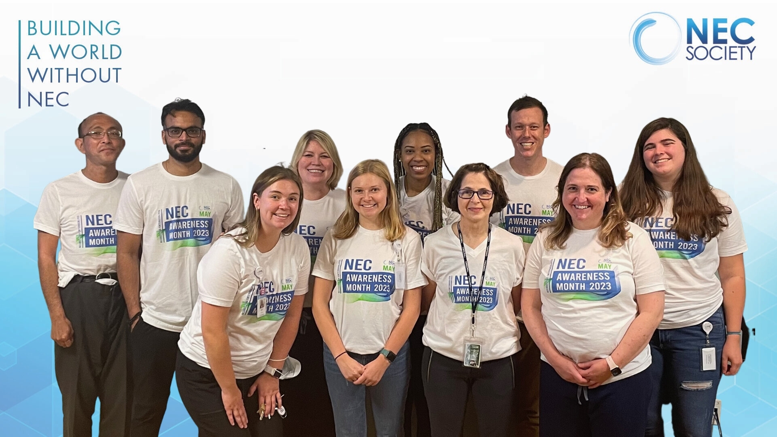
Serum Proteomics for Biomarker Discovery
11 serum proteins are were significantly different between infants with NEC and controls
Mackay et al., Front Pediatr, 2023

Slide 27
Serum Proteomics for Biomarker Discovery
Patterns of serum protein abundance differ between infants with and without NEC
Mackay et al., Front Pediatr, 2023

Slide 28
Urine Proteomics for Biomarker Discovery
Fold Change
-
+
A
+
Fold Change
-
Mackay et al., MedRxiv, 2024

Slide 29
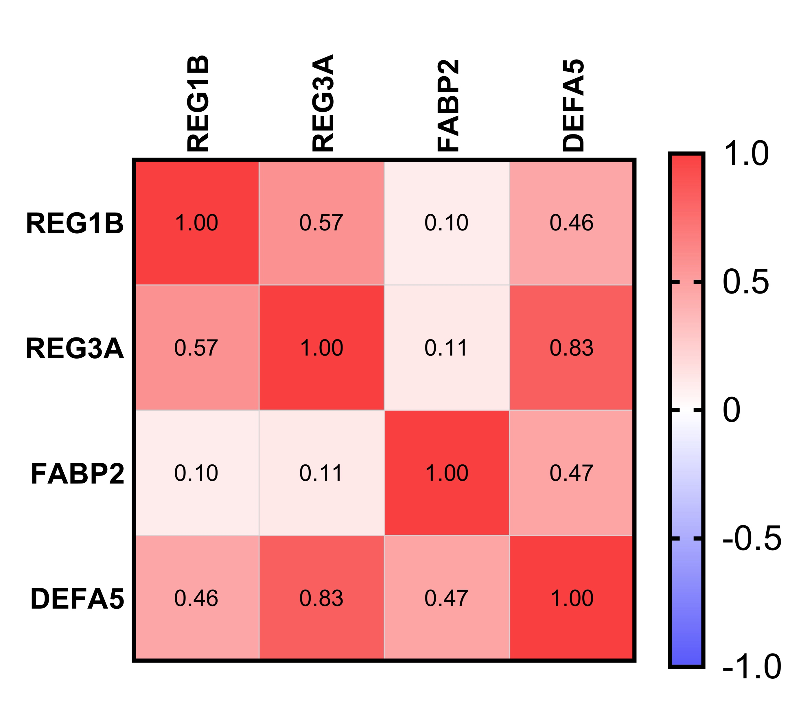
Urine Proteomics for Biomarker Discovery
Protein Panel 1
Protein Panel 2
2 Urine Protein Panels of interest
AUC 0.9;
95% CI 0.8-1.0
AUC 0.98;
95% CI 0.95-1.0
Mackay et al., MedRxiv, 2024

Slide 30
Want to be a NEC Biorepository Center?
Email me to setup an initial meeting with our team.
Discuss how the biorepository works and infrastructure in more detail.
We will give you information on everything you need to get started.
Sites are added to the single IRB, shared database, and sharing of samples/information between centers with MTAs/DUAs.

Slide 31
Conclusions
The complexity of the underlying pathophysiology of NEC has impeded progress in improving outcomes for decades.
Discovering biomarkers, preventative approaches, and effective therapies for NEC requires a collaborative multi-center approach.
We all need to work together to Build a World Without NEC!

Slide 32

Save the Date!

Slide 33
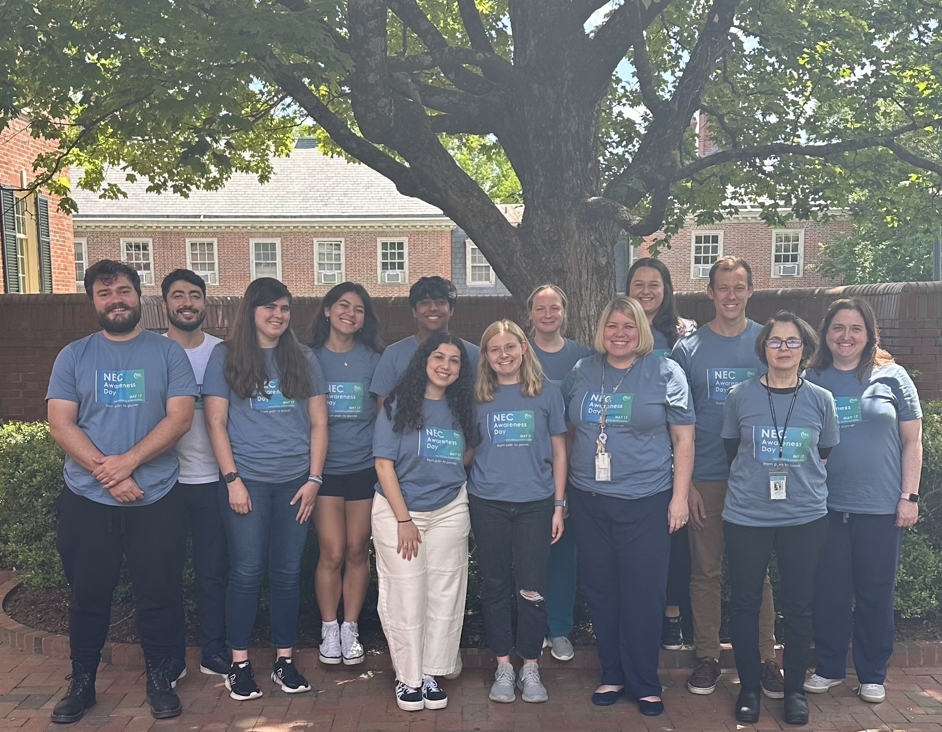
Acknowledgements
Good Lab
Funding Sources
Natalia Akopyants, PhD
Corey Jania
Lauren Frazer, MD, PhD
Yuki Yamaguchi, PhD
Olivia Cassidy
Kelly Orgel, MD, PhD
Ahmad Sami, MD
Greg Mozes
Sofia Domenech
Adelle Levi
Dhairya Patel
Vikram Puri
Ethan Brown
Lauren Bolzan
Catherine Rizzuto
Grace Bailey
Laney Clodfelter
Stephen Mackay, PhD
Dhirend Singh, PhD
Claire Miller
Wyatt Lanik
NIH R01DK118568
R01DK124614
R01HD105301
R44HD110306
DP1DK140012
Chan Zuckerberg
UNC Dept. of Peds
Titus Strong Foundation
Collaborators & NEC Biorepository sites
NEC Society
Dave Peters, PhD, Pitt
Steve McElroy, MD, UC Davis
Brian Scottoline, MD, PhD, OHSU
Amy Hair, MD, Baylor
Jay Kolls Lab, Tulane
Scott Magness Lab, UNC
Sun Kim, PhD, LSU
Katie Chetta, MD, MUSC
Troy Markel, MD, Indiana
Cami Martin, MD, MS, Cornell
Hala Chaaban, MD, OK

Slide 34

Thank you!
Interested in collaborating?
Email: mistygood@unc.edu
Follow us: @mistygoodlab
Good Lab logo designed by Claire Miller

